Slide 1
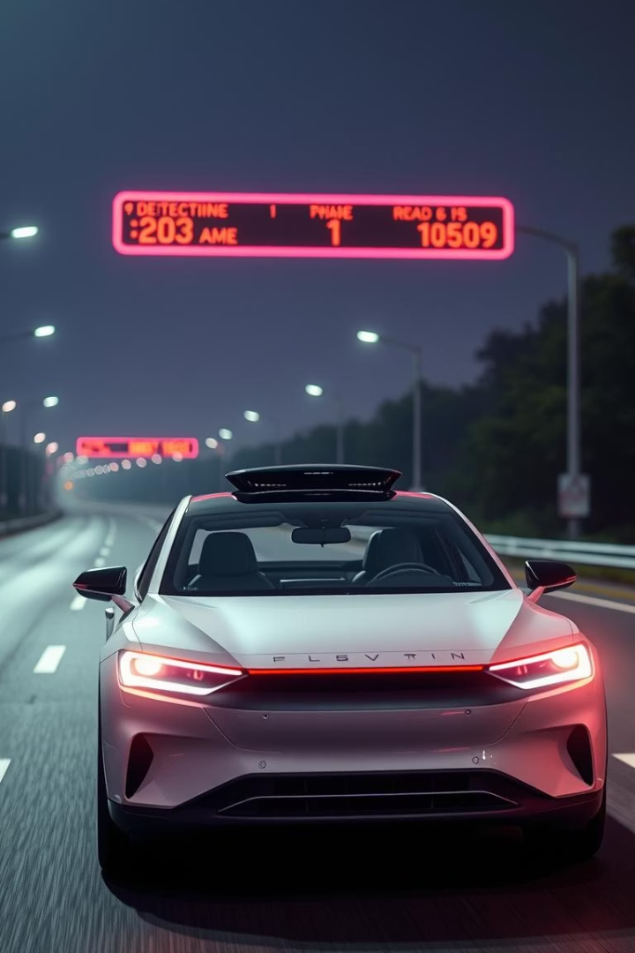
Road Sign Classification Using CNN
By: Yashwanth K
Date: 02-06-2025

Slide 2



Introduction
Project Objective
Key Use Case
Automatically classify road sign images using Convolutional Neural Networks (CNNs).
Real-time recognition for autonomous vehicles and driver assistance systems.

Slide 3
Dataset Overview
Structure
Details
Images organized in class folders - DATA and TEST
Size: Approximately 40MB.
Separate directories for training, validation, and testing.
Labels: Mapped via labels CSV file.
DATA – 743 Images – Training – 631 | Validation – 112
TEST – 285 Images

Slide 4
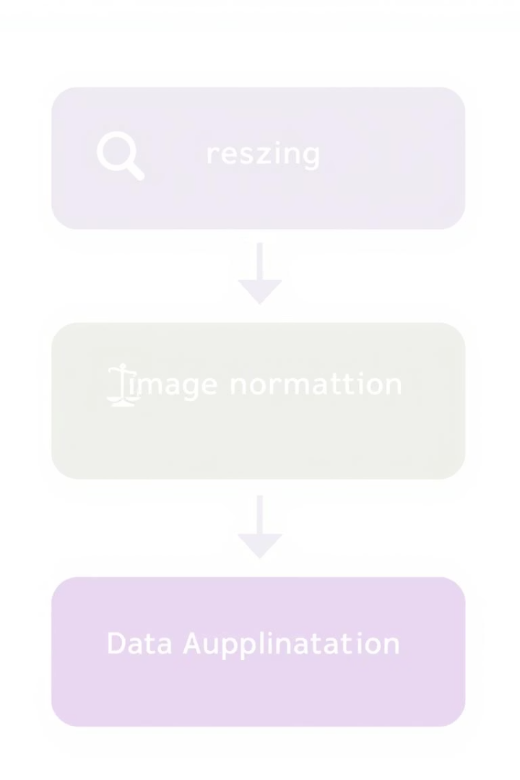




Data Preprocessing
Resize Images
All images are uniformly resized to 64x64 pixels.
Normalize Pixels
Pixel values are normalized to a 0-1 range.
Data Augmentation
Applied ImageGenerator to increase dataset diversity.
Tools Used
Leveraged TensorFlow, OpenCV, and Pandas for processing.

Slide 5
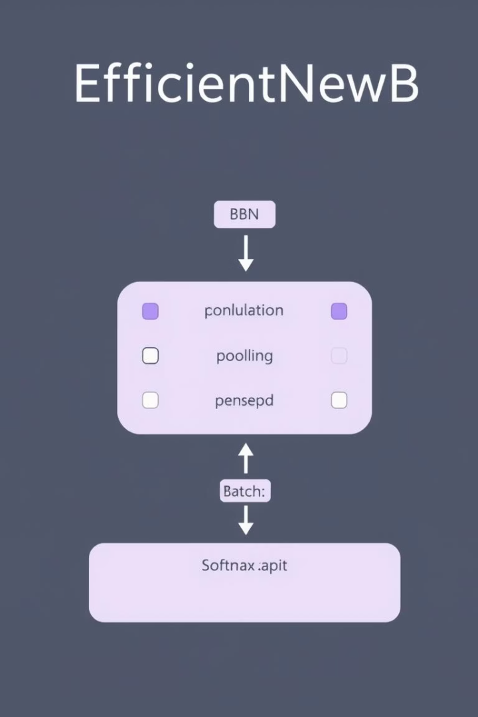
Model Architecture
Base Model: EfficientNetB
Selected for its balance of accuracy and efficiency.
Additional Layers
Includes GlobalAveragePooling2D, BatchNormalization, Dense (ReLU), and Dropout.
Output Layer
A Softmax activation for multi-class classification.
Optimization
Utilizes EarlyStopping and ReduceLROnPlateau callbacks.

Slide 6
Training Configuration
20
Loss Function
Epochs
Sparse_categorical_crossentropy for integer-encoded labels.
Initial and post-tuning epochs.
Optimizer
Adam optimizer for efficient gradient descent.
32
Batch Size
Epochs
20 epochs before and after hyperparameter tuning.
Optimal batch size for training.
Batch Size
Processed in batches of 32 samples per update.

Slide 7






Hyperparameter Tuning
Model Tuned
EfficientNetB3 model was optimized.
Tuning Method
Utilized RandomSearch for efficient exploration.
Performance Gains
Improved model accuracy and generalization.

Slide 8
90%
95%
Model Evaluation
Val Accuracy
Val Accuracy
Before tuning achieved high test accuracy across all classes.
After tuning achieved high test accuracy across all classes.
Accuracy assesses overall correctness.
Confusion Matrix visualizes misclassifications.
Classification Report provides detailed per-class metrics.
62%
60%
The model achieved high test accuracy. It demonstrated robust performance across all road sign classes.
Test Accuracy
Test Accuracy
Before tuning achieved high test accuracy across all classes.
After tuning achieved high test accuracy across all classes.

Slide 9
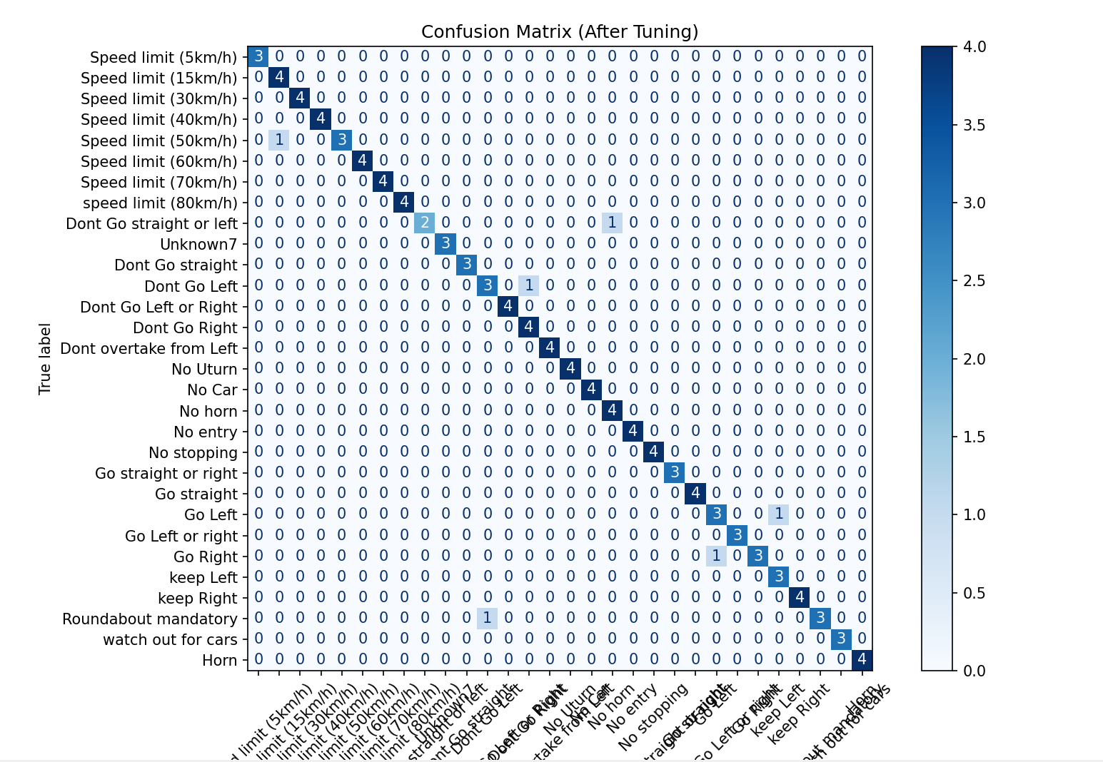
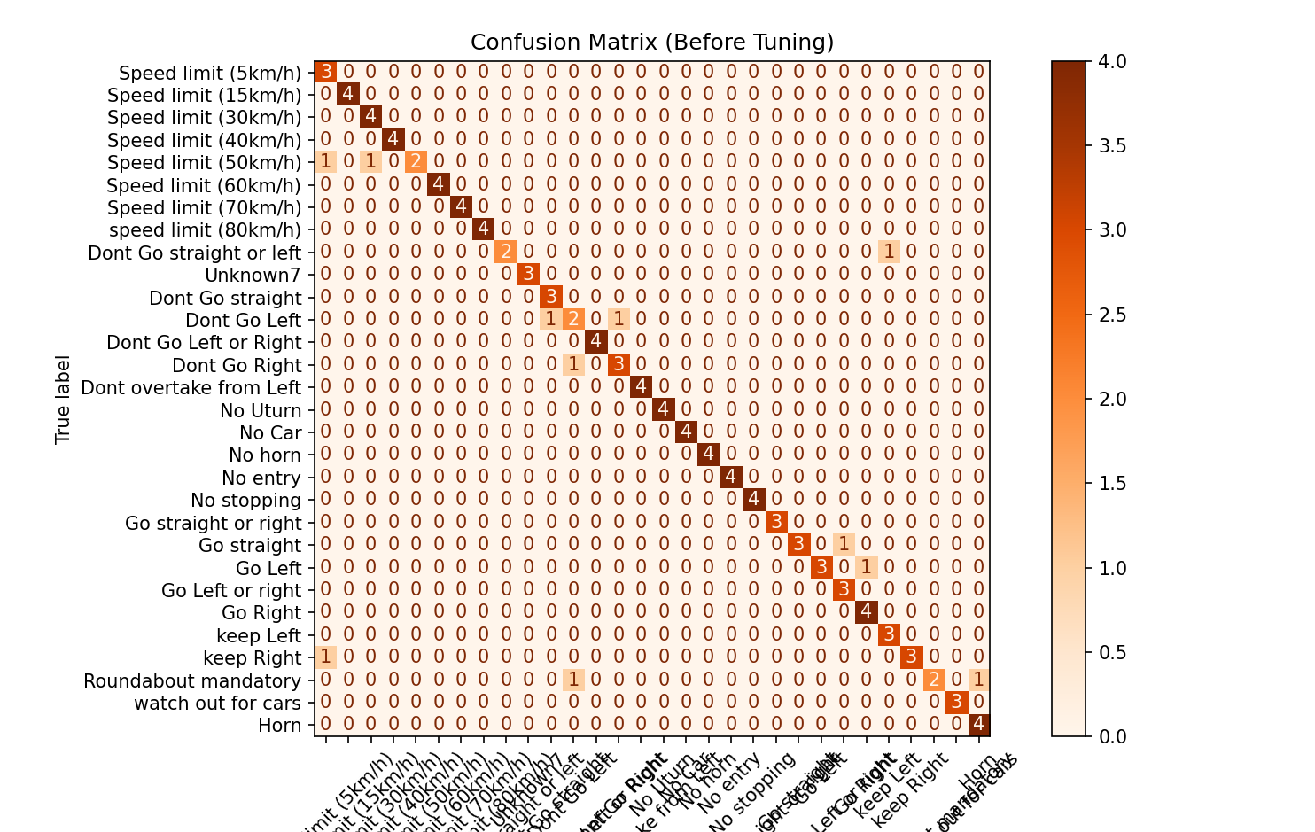
Confusion Matrix & Results

Slide 10
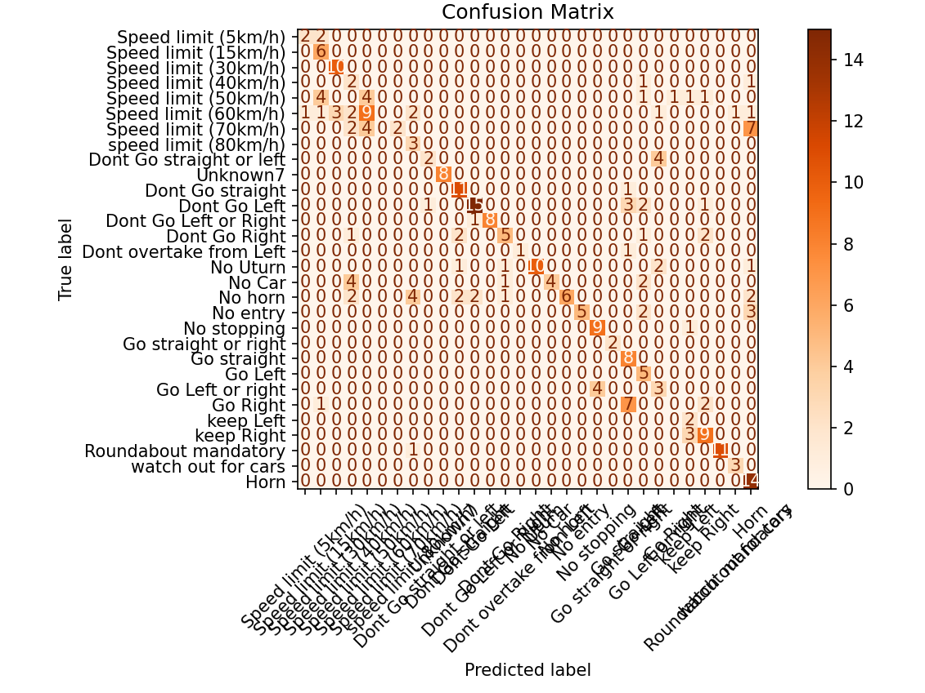
Confusion Matrix & Results - Testing

Slide 11
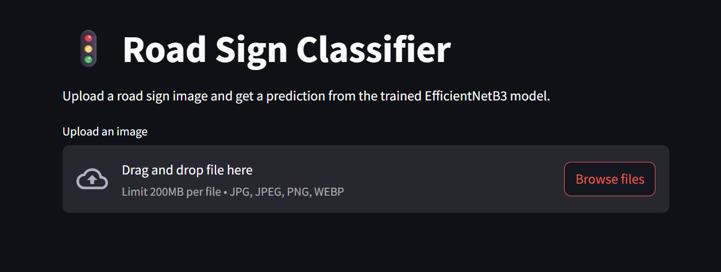
Streamlit Web App
Upload Image
Real-time Prediction
Users can easily upload road sign images.
The app provides immediate classification output.
Tech Stack
Built with Python, Streamlit, and TensorFlow.

Slide 12




Conclusion & Future Scope
Achievements
Future Work
Deployment
Developed an accurate, lightweight model with a user-friendly interface.
Retrain with real-world data and integrate with simulations.
Quantization for optimized mobile deployment.

Slide 13

Thank You
“Drive safe, one sign at a time!”

