Slide 1
Servlets in Java – Full Topic
Complete explanation with architecture, lifecycle, and example programs

Slide 2
What is a Servlet?
A Servlet is a Java program that runs on a web server and handles client requests and responses to generate dynamic web content.

Slide 3
Servlet Containers
Common servlet containers include Apache Tomcat, Jetty, and GlassFish.

Slide 4
Why Servlets are Used
Process client requests
Generate dynamic web pages
Connect Java with web technologies
Interact with databases

Slide 5
Servlet Architecture
Client Browser → Web Server → Servlet Container → Servlet → Response to Client

Slide 6
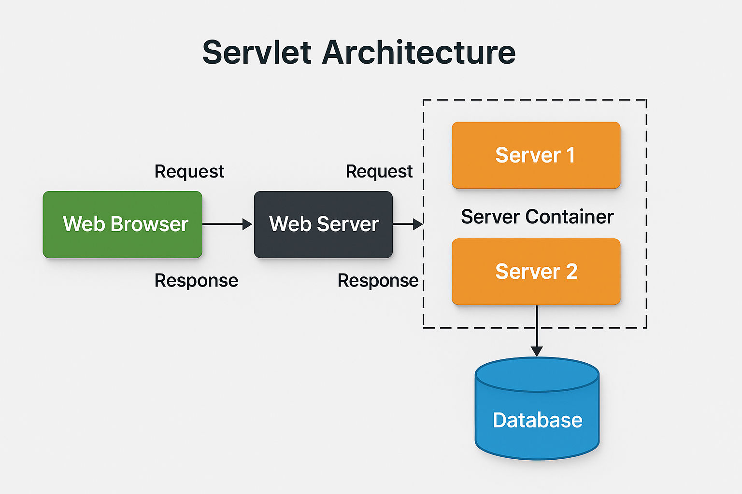

Slide 7
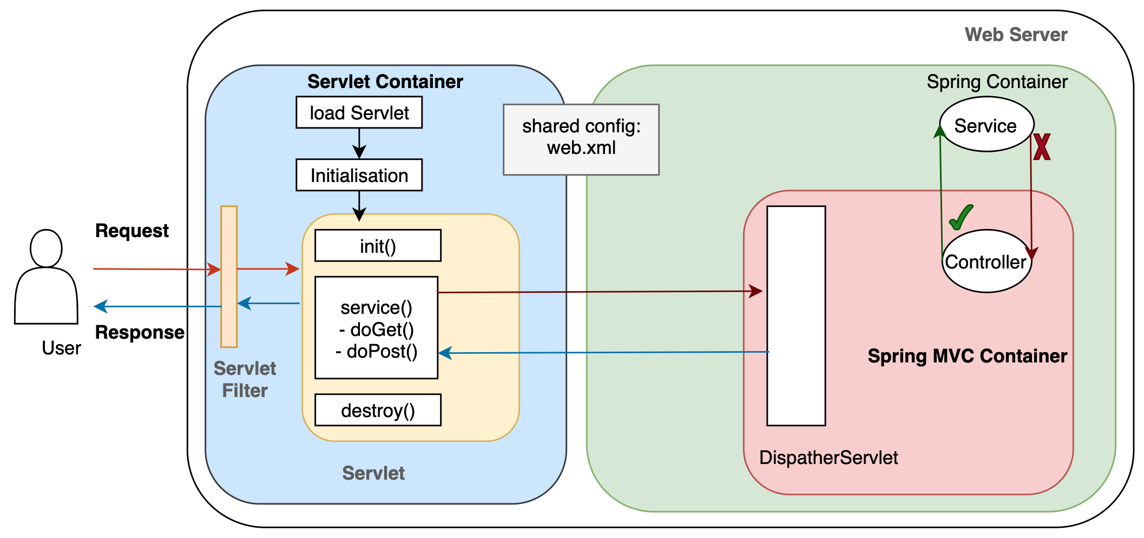

Slide 8
Servlet API Packages
Servlets use packages from Jakarta Servlet API.
jakarta.servlet.*
jakarta.servlet.http.*

Slide 9
Important Interfaces
Servlet
ServletRequest
ServletResponse
HttpServletRequest
HttpServletResponse

Slide 10
Important Classes & Interfaces
Type | Name
Interface | Servlet
Interface | ServletRequest
Interface | ServletResponse
Class | GenericServlet
Class | HttpServlet
Interface | HttpServletRequest
Interface | HttpServletResponse

Slide 11
Types of Servlets
1. Generic Servlet
2. HTTP Servlet

Slide 12
Generic Servlet
Protocol independent
Extends GenericServlet class

Slide 13
HTTP Servlet
Used for web applications
Works with HTTP protocol

Slide 14
Servlet Life Cycle
init() → service() → destroy()
Servlet lifecycle is managed by the Servlet Container.

Slide 15
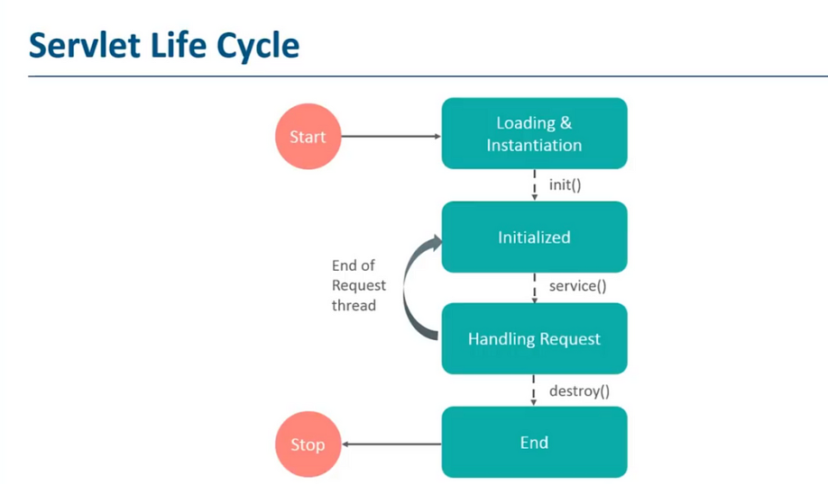

Slide 16
init() Method
Called once when servlet is loaded.
Used for initialization tasks like database connection.

Slide 17
service() Method
Handles every client request and generates response.

Slide 18
destroy() Method
Called when servlet is removed from memory.
Used for cleanup tasks.

Slide 19
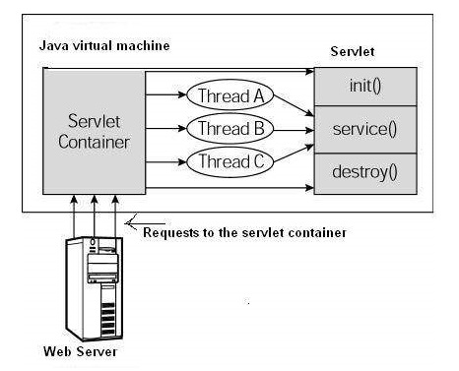

Slide 20
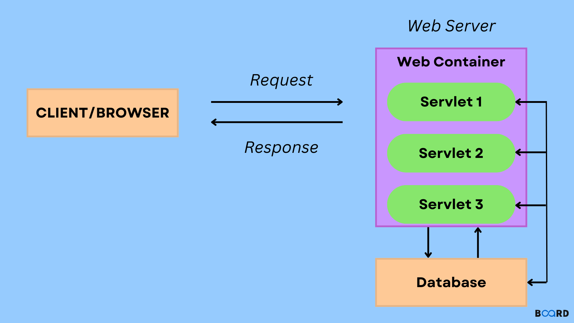

Slide 21
First Servlet Program
Example using HttpServlet to return HTML response.

Slide 22
HelloServlet Example
import java.io.*;
import jakarta.servlet.*;
import jakarta.servlet.http.*;
public class HelloServlet extends HttpServlet {
public void doGet(HttpServletRequest request,
HttpServletResponse response)
throws IOException {
response.setContentType("text/html");
PrintWriter out = response.getWriter();
out.println("<h1>Hello Welcome to Servlets</h1>");
}
}

Slide 23
web.xml Configuration
<web-app>
<servlet>
<servlet-name>HelloServlet</servlet-name>
<servlet-class>HelloServlet</servlet-class>
</servlet>
<servlet-mapping>
<servlet-name>HelloServlet</servlet-name>
<url-pattern>/hello</url-pattern>
</servlet-mapping>
</web-app>

Slide 24
Servlet URL Example
http://localhost:8080/projectname/hello

Slide 25
Servlet Annotation Method
Using @WebServlet instead of web.xml configuration.

Slide 26
Annotation Example
@WebServlet("/hello")
public class HelloServlet extends HttpServlet {
protected void doGet(HttpServletRequest request,
HttpServletResponse response)
throws IOException {
PrintWriter out = response.getWriter();
out.println("<h1>Hello Servlet using Annotation</h1>");
}
}

Slide 27
GET Request
GET is used to retrieve data from server.

Slide 28
GET Example
String name = request.getParameter("name");
PrintWriter out = response.getWriter();
out.println("Hello " + name);

Slide 29
POST Request
POST is used to send form data to server.
<form action="postExample" method="post">
Name:
<input type="text" name="name">
<input type="submit">
</form>

Slide 30
POST Example
@WebServlet("/postExample")
public class PostExample extends HttpServlet {
protected void doPost(HttpServletRequest req,
HttpServletResponse res)
throws IOException {
String name = req.getParameter("name");
PrintWriter out = res.getWriter();
out.println("Welcome " + name);
}
}

Slide 31
Servlet Config
Used to get initialization parameters for a specific servlet.
<init-param>
<param-name>username</param-name>
<param-value>admin</param-value>
</init-param>
public void init(ServletConfig config)
{
String user = config.getInitParameter("username");
}

Slide 32
Servlet Context
Used to share data across multiple servlets in an application.

Slide 33
Request Dispatcher
Used to forward or include another resource.
Methods: forward(), include()

Slide 34
Session Tracking
HTTP is stateless so session tracking is required.
Methods: Cookies, URL rewriting, Hidden fields, HttpSession

Slide 35
HttpSession Example
HttpSession session = request.getSession();
session.setAttribute("user","John");
String name = (String) session.getAttribute("user");

Slide 36
Cookies in Servlet
Cookies store client data on the browser.

Slide 37
Cookie Example
Cookie c = new Cookie("username","John");
response.addCookie(c);

Slide 38
Reading Cookies
Cookie[] cookies = request.getCookies();

Slide 39
Servlet vs JSP
Servlet: Java code based
JSP: HTML based
Servlet handles logic, JSP handles presentation

Slide 40
Advantages of Servlets
Platform independent
Fast compared to CGI
Secure
Powerful APIs
Supports MVC architecture

Slide 41
Disadvantages of Servlets
UI development is difficult
Requires server configuration
HTML generation becomes lengthy

Slide 42
Real World Flow
Browser → Servlet Controller → Business Logic → Database → Response

Slide 43
Servlet Methods
doGet()
doPost()
doPut()
doDelete()
doHead()
doOptions()

Slide 44
Summary
Servlets are the foundation of Java web development and used to build dynamic web applications and backend services.

