Slide 1
Collections Framework in Java – Full Topic
Complete, Exam‑Ready & Interview‑Ready Explanation

Slide 2
What is Collections Framework?
The Collections Framework in Java is a set of classes and interfaces that provide a standardized way to store, manipulate, and process groups of objects.
• Introduced in Java 1.2
• Located in java.util package

Slide 3
Why Collections Framework?
Before Collections:
• Arrays had fixed size
• No built‑in sorting/searching
• No uniform architecture
Collections Framework Solves:
✔ Dynamic size
✔ Ready‑made data structures
✔ Standard APIs
✔ High performance
✔ Easy maintenance

Slide 4
Core Components of Collections Framework
1. Interfaces
2. Implementing Classes
3. Algorithms (Utility Methods)

Slide 5
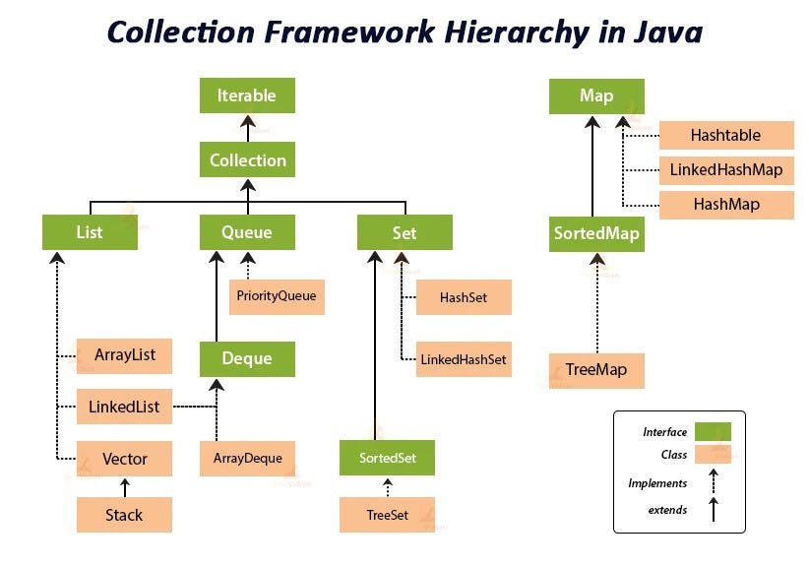

Slide 6
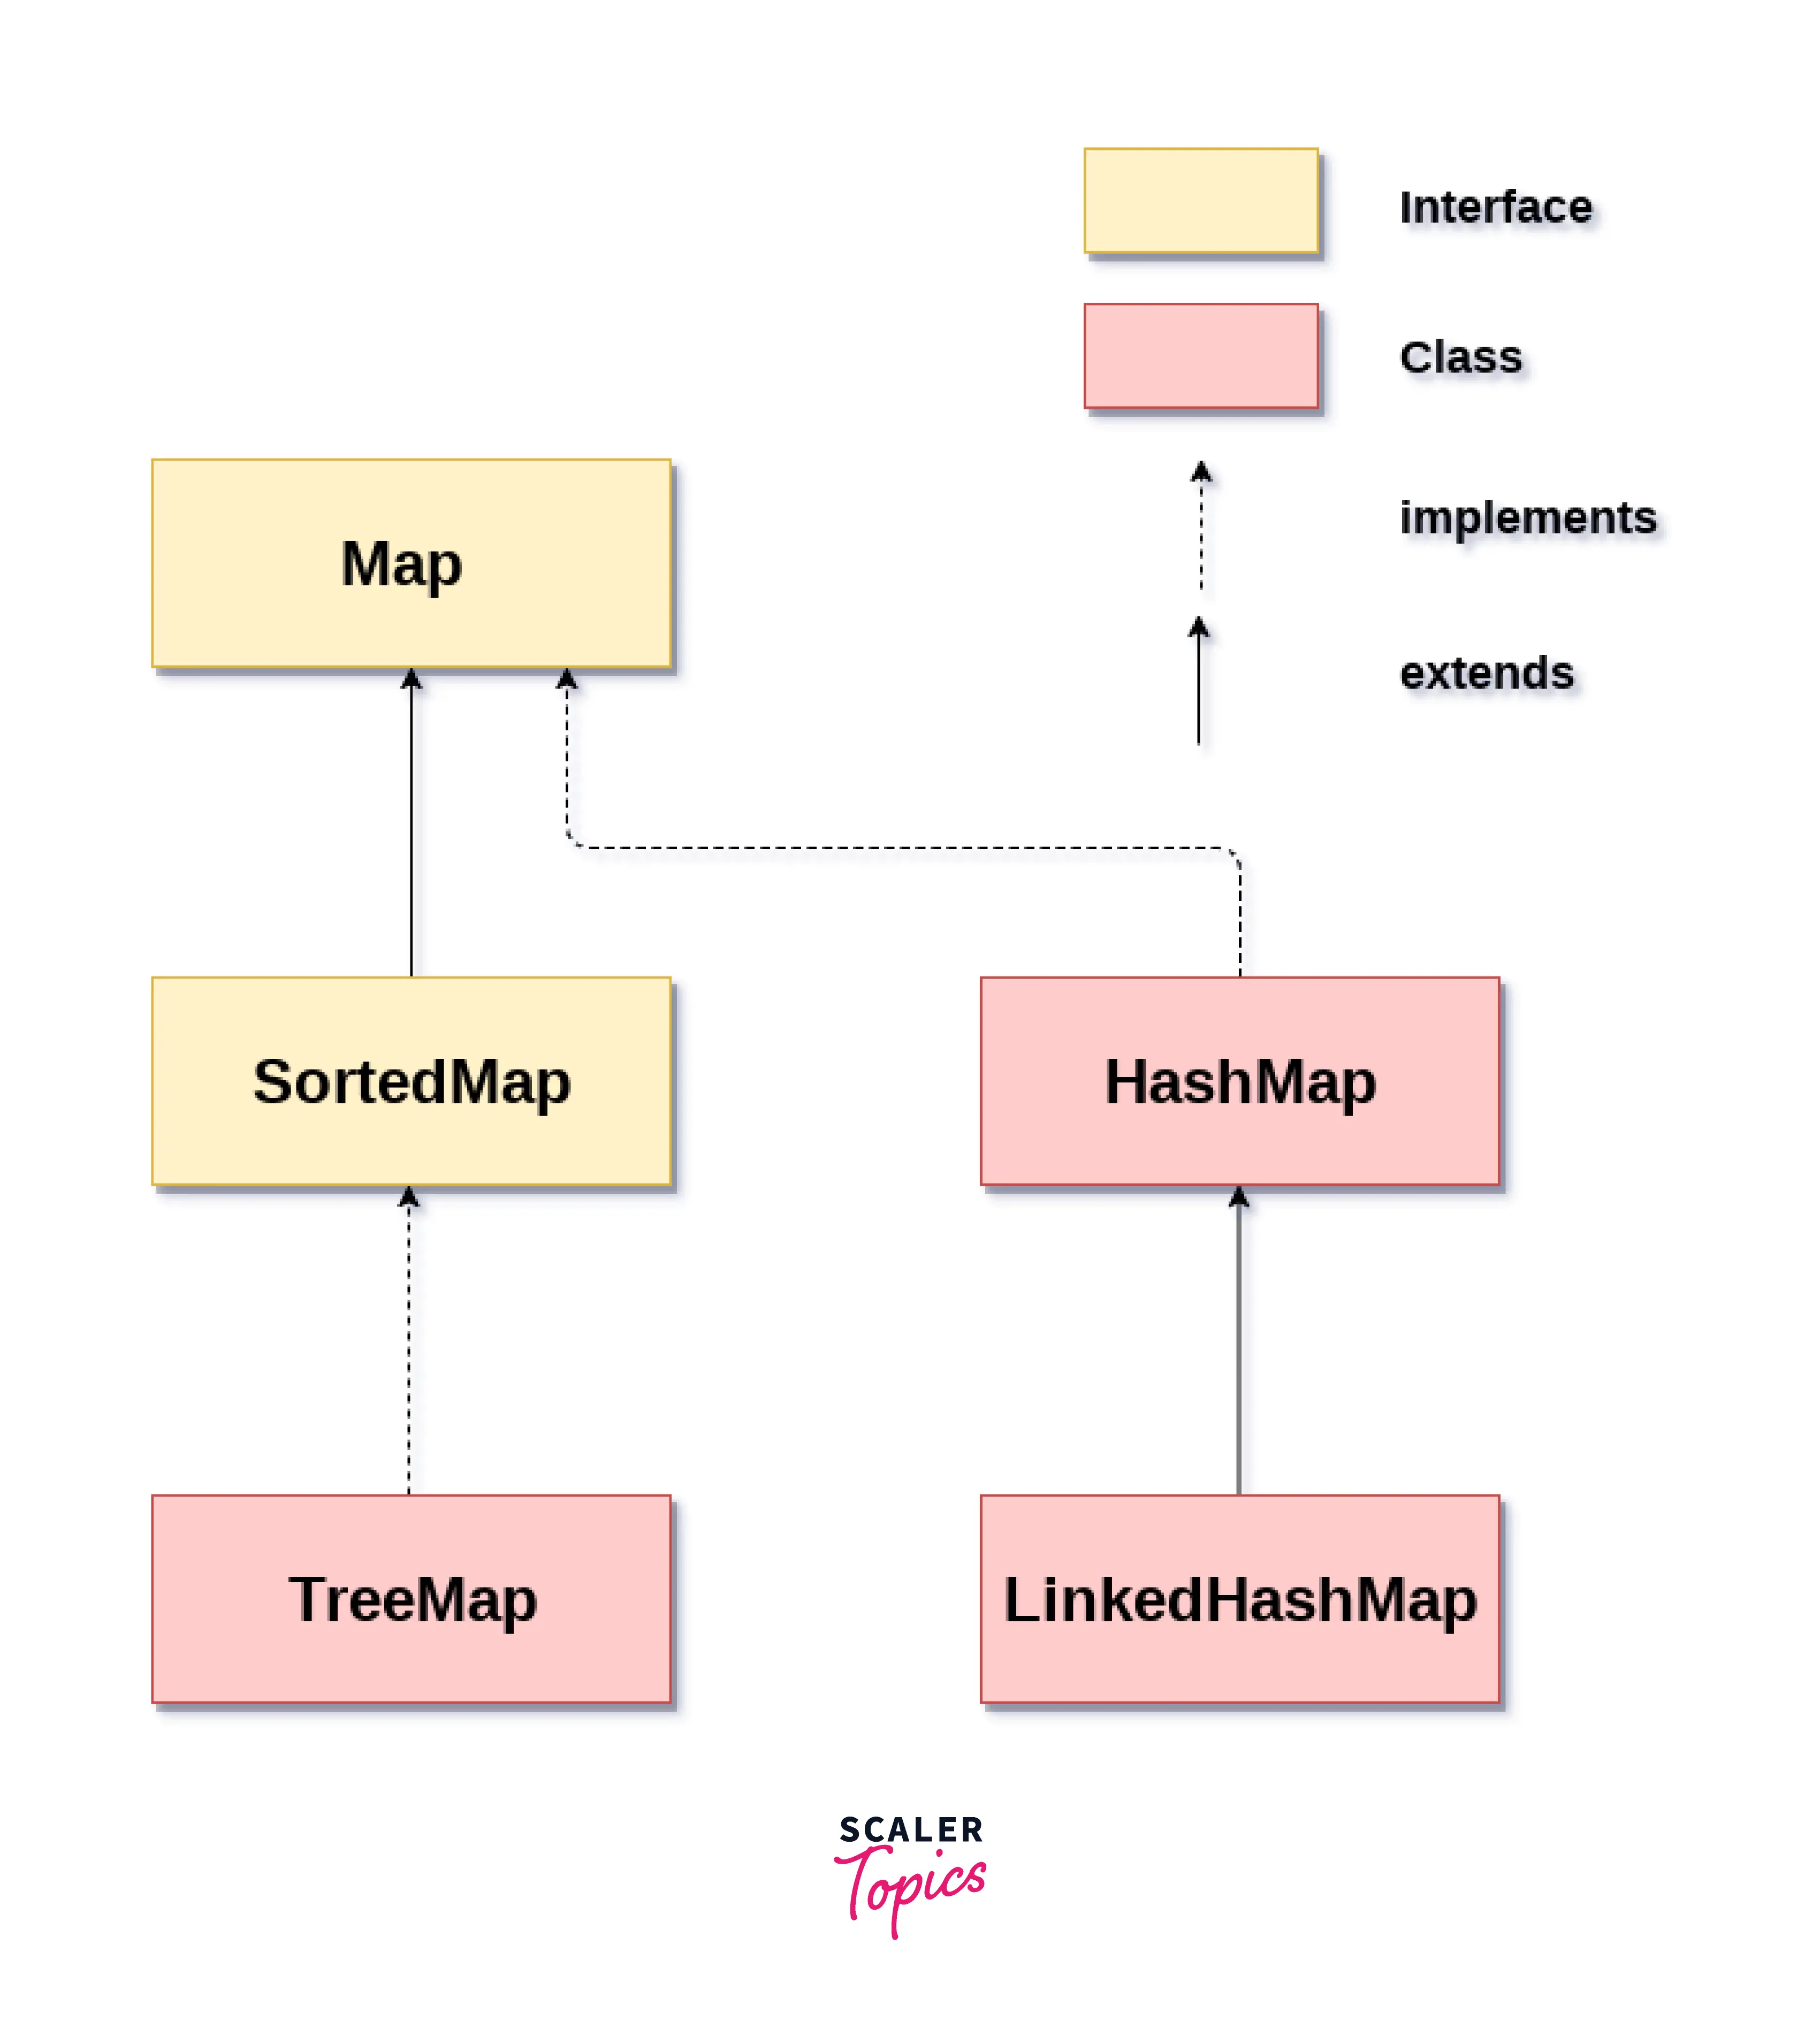

Slide 7
Collection Hierarchy (Overview)
Iterable
|
Collection
|
-----------------------------------
| | | |
List Set Queue Deque
⚠ Map is NOT part of Collection interface

Slide 8
Collection Interface
• Root interface of Collections Framework
• Represents a group of objects
• Does NOT store key‑value pairs
Common Methods:
add(), remove(), size(), isEmpty(), contains(), clear()

Slide 9
List Interface
• Allows duplicate elements
• Maintains insertion order
• Index‑based access
Implementations:
• ArrayList
• LinkedList
• Vector
• Stack

Slide 10
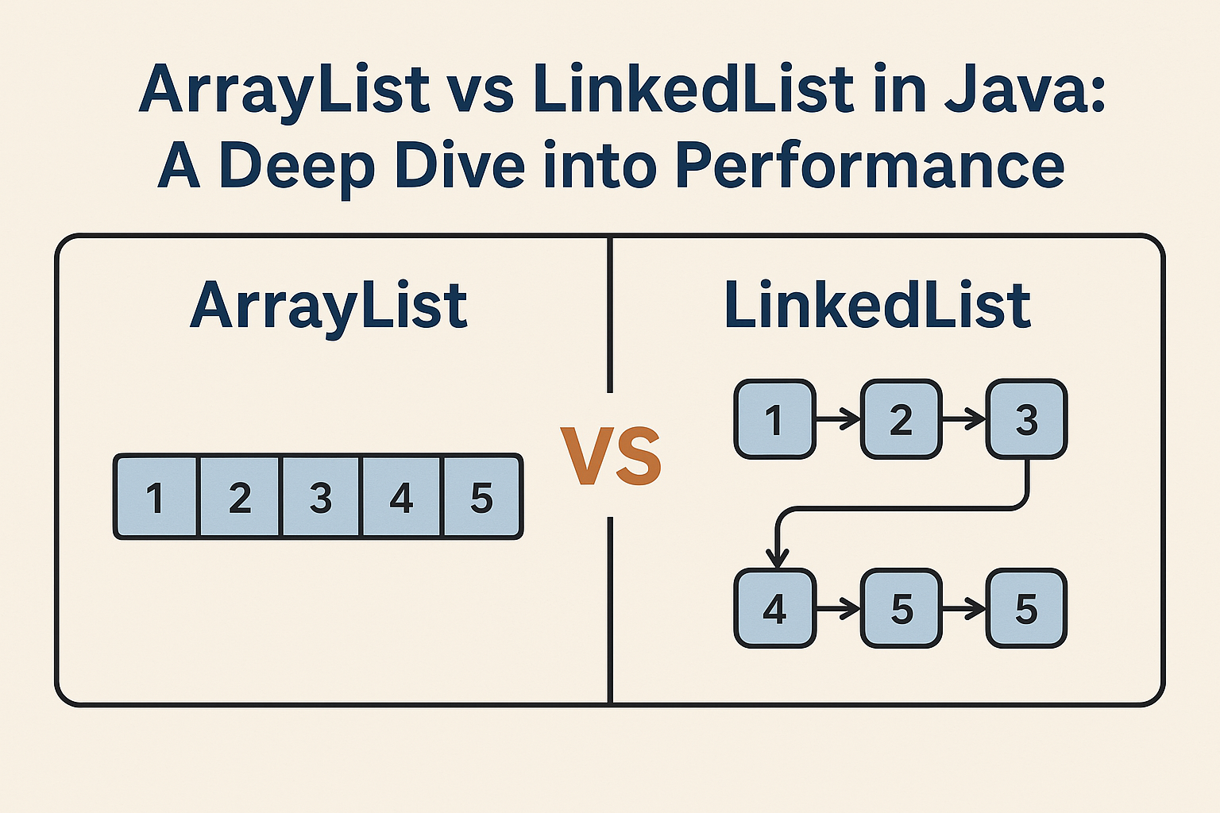

Slide 11
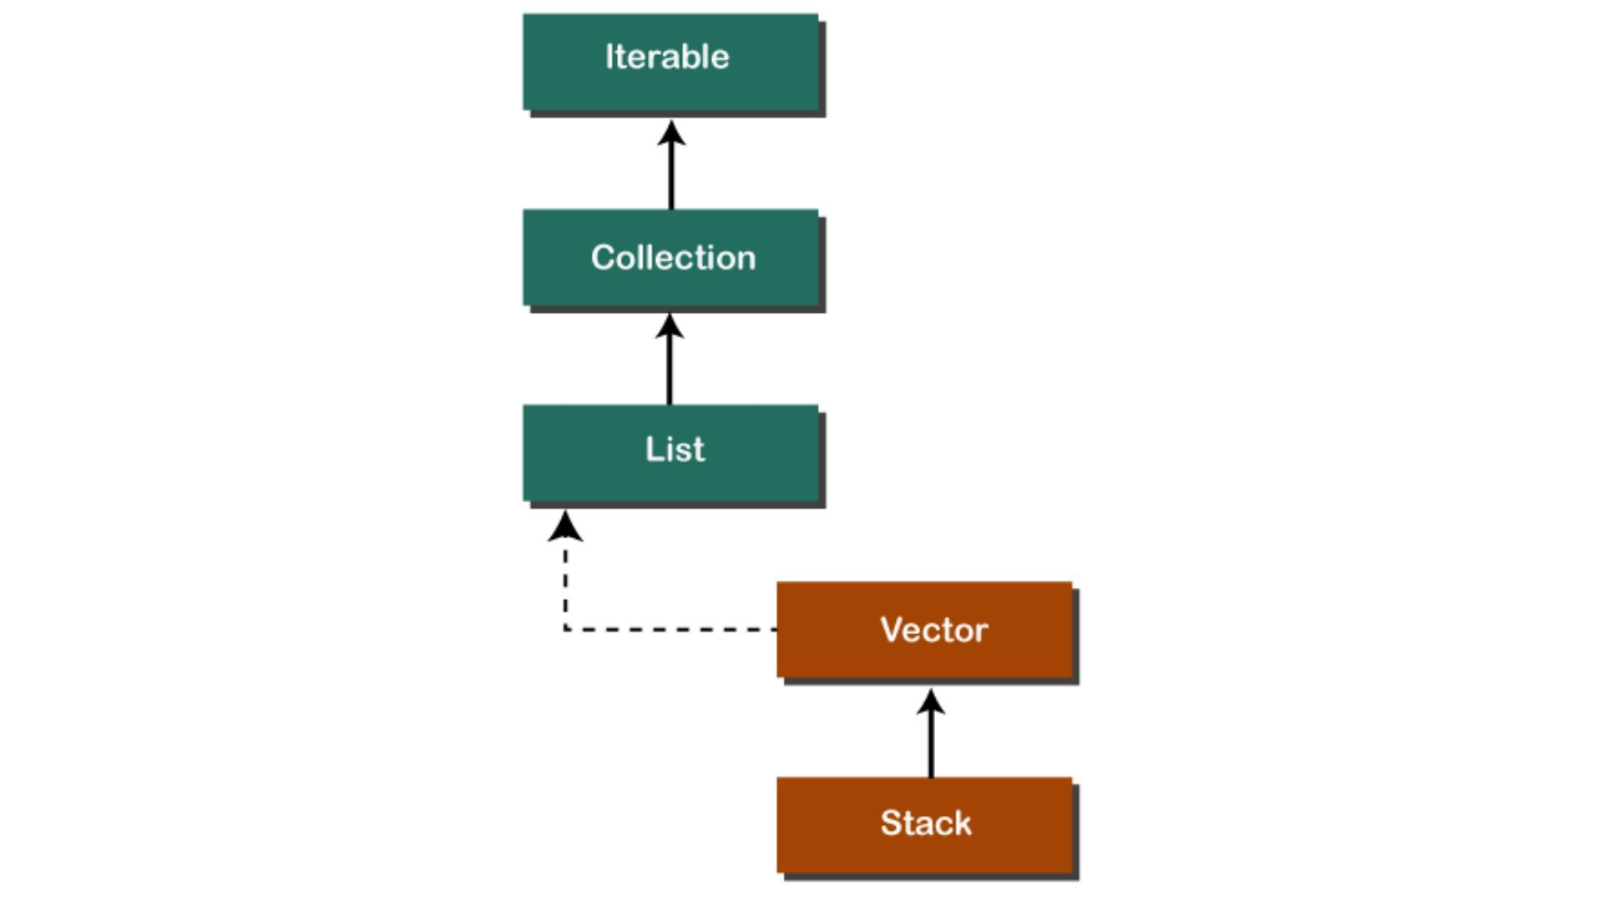

Slide 12
ArrayList
• Uses dynamic array
• Fast random access
• Slow insertion/deletion in middle
Example:
List<String> list = new ArrayList<>();
list.add("Java");
list.add("Python");

Slide 13
LinkedList
• Uses doubly linked list
• Faster insertion/deletion
• Slower access
List<Integer> list = new LinkedList<>();
list.add(10);
list.add(20);

Slide 14
Vector (Legacy)
• Thread‑safe
• Synchronized
• Slower than ArrayList

Slide 15
Stack (LIFO)
Stack<Integer> stack = new Stack<>();
stack.push(10);
stack.pop();

Slide 16
Set Interface
• No duplicates
• No guaranteed order
Implementations:
• HashSet
• LinkedHashSet
• TreeSet

Slide 17
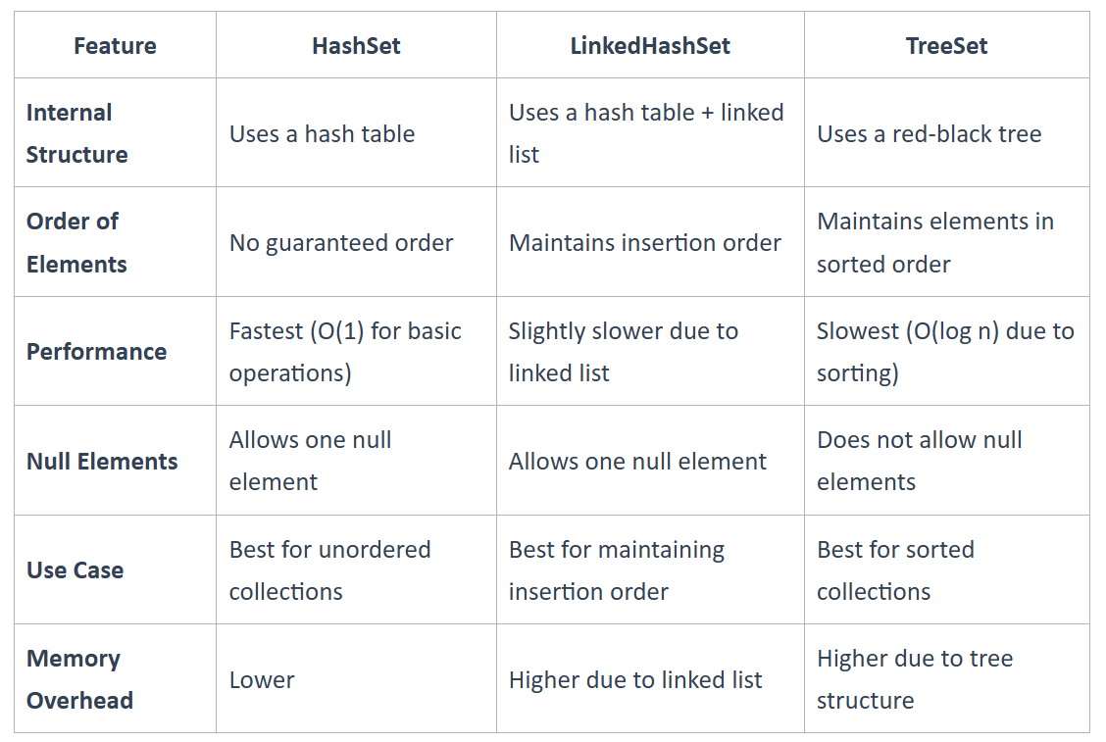

Slide 18
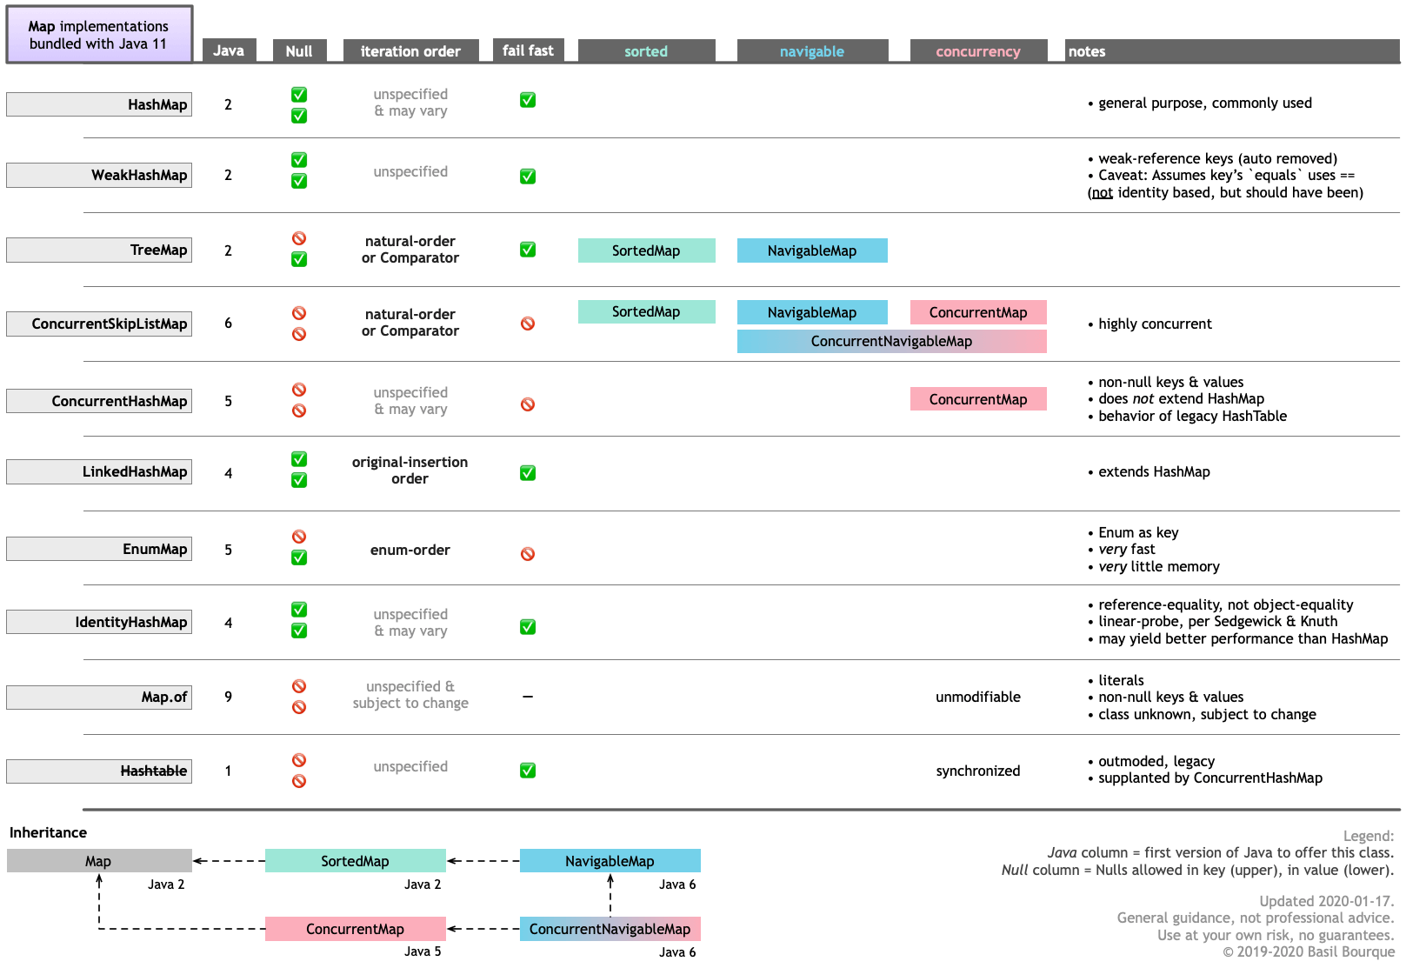

Slide 19
HashSet
• Uses hashing
• No order
• Fast performance
Set<String> set = new HashSet<>();
set.add("A");
set.add("B");
set.add("A"); // ignored

Slide 20
LinkedHashSet
• Maintains insertion order

Slide 21
TreeSet
• Sorted order
• Uses Red‑Black Tree
• Slower than HashSet
Example:
Set<Integer> set = new TreeSet<>();
set.add(30);
set.add(10);
set.add(20);
System.out.println(set); // [10, 20, 30]

Slide 22
Queue Interface
• Follows FIFO
• Used for processing elements
Implementations:
• PriorityQueue
• LinkedList
• ArrayDeque

Slide 23
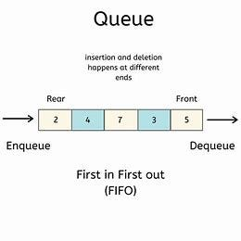

Slide 24
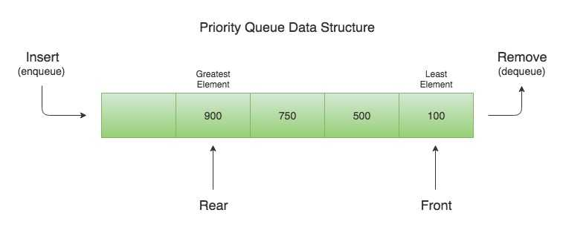

Slide 25
PriorityQueue
• Elements processed based on priority
• Default: Min Heap
Queue<Integer> pq = new PriorityQueue<>();
pq.add(30);
pq.add(10);
pq.add(20);
System.out.println(pq.poll()); // 10

Slide 26
Deque Interface
• Double Ended Queue
• Insert/remove from both ends
Deque<Integer> dq = new ArrayDeque<>();
dq.addFirst(10);
dq.addLast(20);

Slide 27
Map Interface (Not a Collection)
• Stores key‑value pairs
• Keys are unique
• Values can be duplicated
Implementations:
• HashMap
• LinkedHashMap
• TreeMap
• Hashtable

Slide 28
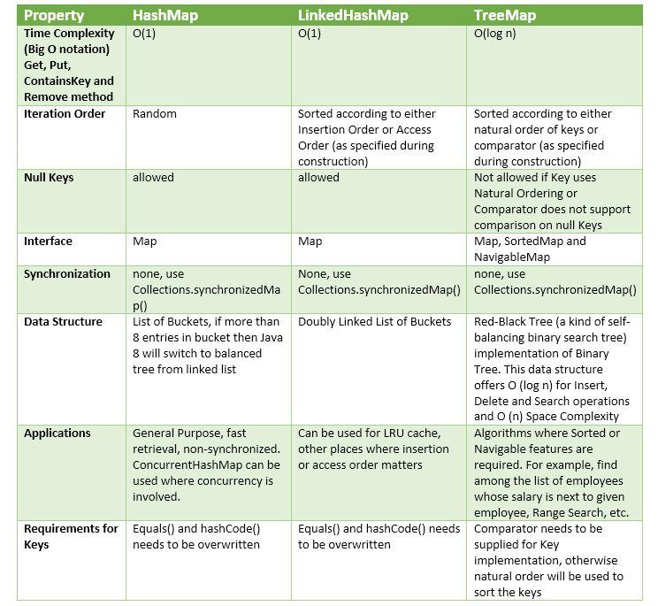

Slide 30
HashMap
• No order
• Allows one null key
• Not synchronized
Example :
Map<Integer, String> map = new HashMap<>();
map.put(101, "Ravi");
map.put(102, "Kumar");

Slide 31
LinkedHashMap
• Maintains insertion order

Slide 32
TreeMap
• Sorted by key
• No null key

Slide 33
Hashtable (Legacy)
• Synchronized
• No null key/value

Slide 34
Iterator & ListIterator
Iterator:
• Forward direction only
Example :
Iterator<String> itr = list.iterator();
while(itr.hasNext()) {
System.out.println(itr.next());
}
ListIterator:
• Forward + backward
• Only for List

Slide 35
Collections Utility Class
java.util.Collections
Methods:
sort(), reverse(), shuffle(), max(), min(), binarySearch()

Slide 36
Comparable vs Comparator
Comparable:
• compareTo()
• Natural ordering
• Inside class
Comparator:
• compare()
• Custom ordering
• Outside class

Slide 37
Thread Safety in Collections
Thread Safe:
• Vector
• Hashtable
Not Thread Safe:
• ArrayList
• HashMap

Slide 38
Fail‑Fast vs Fail‑Safe
Fail‑Fast:
• ConcurrentModificationException
• ArrayList, HashMap
Fail‑Safe:
• ConcurrentHashMap
• CopyOnWriteArrayList

Slide 39
Summary (Interview Gold)
✔ Collection is root interface
✔ List → duplicates + order
✔ Set → unique elements
✔ Queue → FIFO
✔ Map → key‑value pairs
✔ HashMap fastest
✔ TreeSet & TreeMap sorted
✔ Vector & Hashtable are legacy

