Slide 1
File Handling in Java
Detailed Explanation with Examples By - M. Yashwanth Babu

Slide 2
What is File Handling?
File Handling in Java is the process of creating, reading, writing, updating, and deleting files.
It allows Java programs to store data permanently on secondary storage.

Slide 3
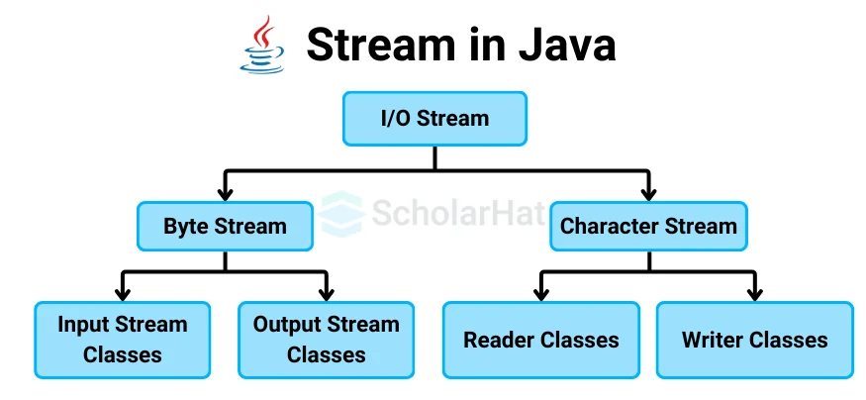

Slide 4
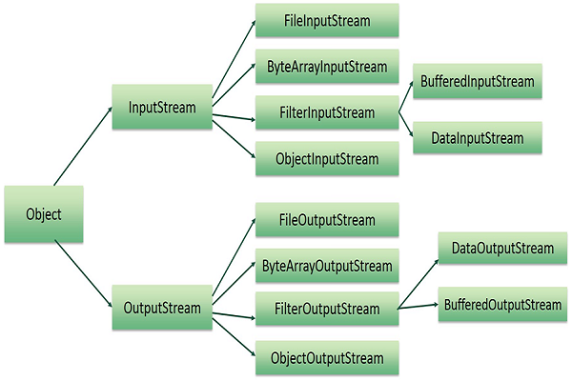

Slide 5
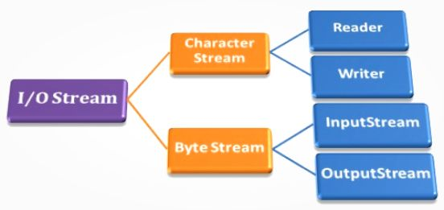

Slide 6
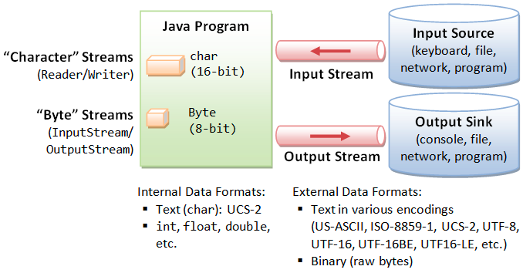

Slide 7
Why File Handling is Required?
- Permanent data storage
- Logging application data
- Configuration files
- Handling large data
- Data recovery after program termination

Slide 8
Java IO Package
Java provides the java.io package for file handling.
It contains classes for input and output operations.

Slide 9
Types of File Handling
1. Byte Stream (Binary Data)
- Images, audio, video
- InputStream, OutputStream
2. Character Stream (Text Data)
- Text files
- Reader, Writer

Slide 10
File Class
Represents file or directory path
Important Methods:
- createNewFile()
- exists()
- delete()
- getName()
- getAbsolutePath()

Slide 11
Creating a File
File file = new File("demo.txt");
file.createNewFile();

Slide 12
Writing Data to File
FileWriter fw = new FileWriter("data.txt");
fw.write("Hello File Handling");
fw.close();

Slide 13
Reading Data from File
FileReader fr = new FileReader("data.txt");
int ch;
while((ch = fr.read()) != -1) {
System.out.print((char)ch);
}
fr.close();

Slide 14
BufferedWriter
Used for fast writing
BufferedWriter bw = new BufferedWriter(new FileWriter("buffer.txt"));
bw.write("Buffered Writing");
bw.close();

Slide 15
BufferedReader
Used for fast reading
BufferedReader br = new BufferedReader(new FileReader("buffer.txt"));
String line;
while((line = br.readLine()) != null) {
System.out.println(line);
}

Slide 16
Byte Stream Example
Used to copy binary files
FileInputStream fis = new FileInputStream("source.jpg");
FileOutputStream fos = new FileOutputStream("target.jpg");

Slide 17
Append Data to File
FileWriter fw = new FileWriter("data.txt", true);
fw.write("Appended Data");

Slide 18
Try With Resources
Automatically closes resources
try(FileWriter fw = new FileWriter("auto.txt")) {
fw.write("Auto Close");
}

Slide 19
Serialization
Used to convert object into file
Requires Serializable interface

Slide 20
Advantages of File Handling
- Permanent storage
- Easy retrieval
- Handles large data
- Secure storage

Slide 21
Interview Questions
- Difference between FileReader and BufferedReader?
- Difference between Byte Stream and Character Stream?
- Why should streams be closed?

Slide 22
Summary
- Java supports file handling via java.io
- Byte & Character streams
- Buffered classes improve performance
- Try-with-resources is best practice

