Slide 1
JDBC (Java Database Connectivity)
JDBC Full Topic Explanation
Exam Ready + Interview Ready

Slide 2
What is JDBC?
JDBC (Java Database Connectivity) is a standard Java API that allows Java applications to connect to databases, execute SQL queries, and process results.
JDBC acts as a bridge between Java programs and databases.

Slide 3
Why JDBC is Needed?
Without JDBC:
• Java programs cannot communicate with databases
• Database operations are not possible
With JDBC:
• Java can interact with databases like MySQL, Oracle, PostgreSQL
• Used in web, enterprise, and desktop applications

Slide 4
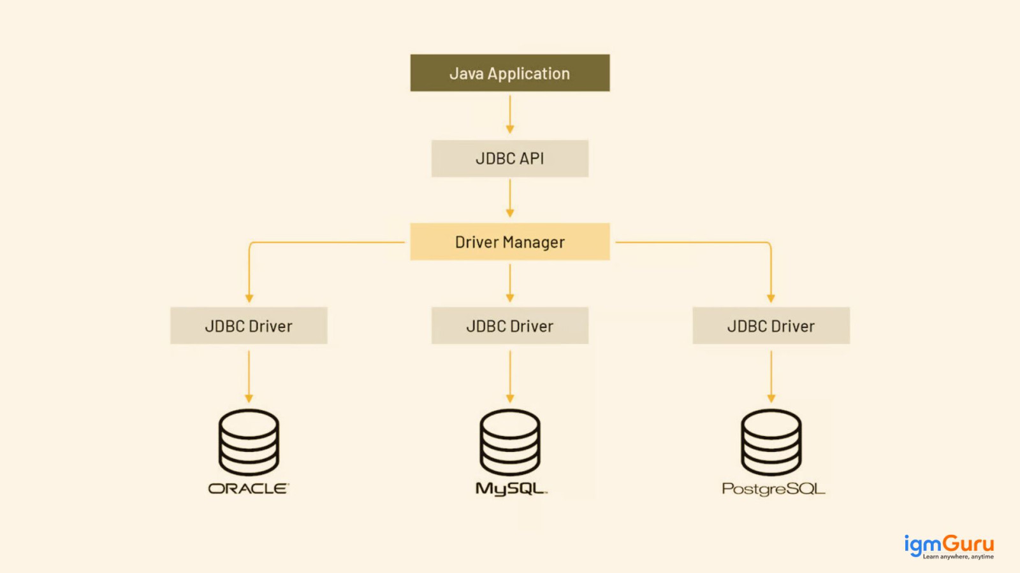

Slide 5
JDBC Architecture
Java Application
JDBC API
DriverManager
JDBC Driver
Database

Slide 6
JDBC Drivers
Type 1: JDBC-ODBC Bridge
Type 2: Native API Driver
Type 3: Network Protocol Driver
Type 4: Thin Driver (Most Used)
✅ Type 4 driver is recommended (fast, portable)

Slide 7
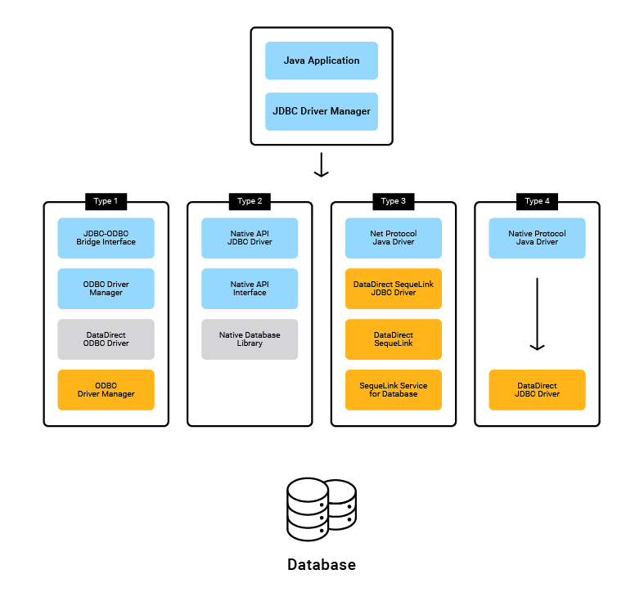

Slide 8
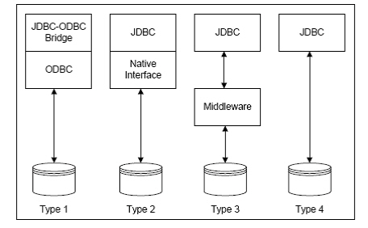

Slide 9
Package | Description
java.sql | Core JDBC interfaces
javax.sql | Advanced features (Connection Pooling, RowSet)

Slide 10
Core JDBC Interfaces
DriverManager
Connection
Statement
PreparedStatement
CallableStatement
ResultSet
SQLException

Slide 11
Interface / Class | Purpose
DriverManager | Manages JDBC drivers
Driver | Database-specific driver
Connection | Establishes DB connection
Statement | Executes SQL
PreparedStatement | Precompiled SQL
CallableStatement | Calls stored procedures
ResultSet | Holds query results
SQLException | Handles DB errors

Slide 12
Steps in JDBC
1. Load Driver
2. Establish Connection
3. Create Statement
4. Execute SQL
5. Process ResultSet
6. Close Connection

Slide 13
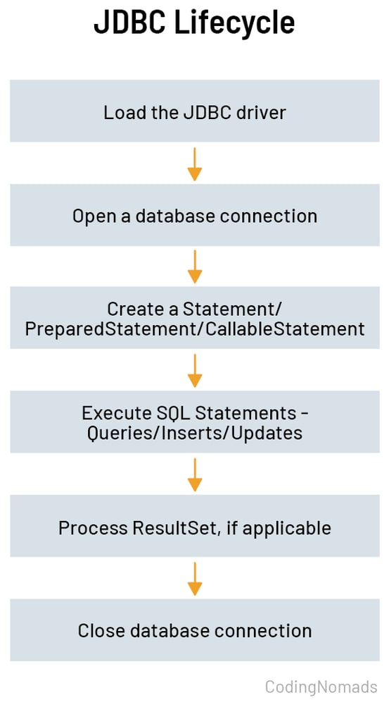

Slide 14
Statement vs PreparedStatement
Statement:
• Dynamic SQL
• Slower
• SQL Injection risk
PreparedStatement:
• Precompiled
• Faster
• Secure

Slide 15
🔹 PreparedStatement Example
String sql = "INSERT INTO student(name, marks) VALUES (?, ?)";
PreparedStatement ps = con.prepareStatement(sql);
ps.setString(1, "Ravi");
ps.setInt(2, 85);
ps.executeUpdate();

Slide 16
📞 CallableStatement (Stored Procedures)
Used to call stored procedures.
CallableStatement cs =
con.prepareCall("{call getStudent(?)}");
cs.setInt(1, 1);
ResultSet rs = cs.executeQuery();

Slide 17
Advantages of JDBC
• Platform Independent
• Standard API
• Supports multiple databases
• Fine-grained control

Slide 18
Disadvantages of JDBC
• Boilerplate code
• Manual resource handling
• SQL dependent

Slide 19
Thank You
JDBC Full Topic Completed

