Slide 1
JSP Introduction
JSP (Java Server Pages) is a server-side technology
Used to create dynamic web pages using Java
Built on top of Servlets
Part of Java Web Development (Servlet + JSP + JDBC + MVC)

Slide 2
JSP Example Program
<html>
<body>
<%
out.println("Hello Yashwanth");
%>
</body>
</html>

Slide 3
Why JSP
Hard to write HTML inside Servlets
Hard to maintain
Not readable
JSP allows clean HTML with embedded Java

Slide 4
Servlet HTML Writing Problem
PrintWriter out=response.getWriter();
out.println("<html>");
out.println("<body>");
out.println("<h1>Hello</h1>");
out.println("</body>");
out.println("</html>");

Slide 5
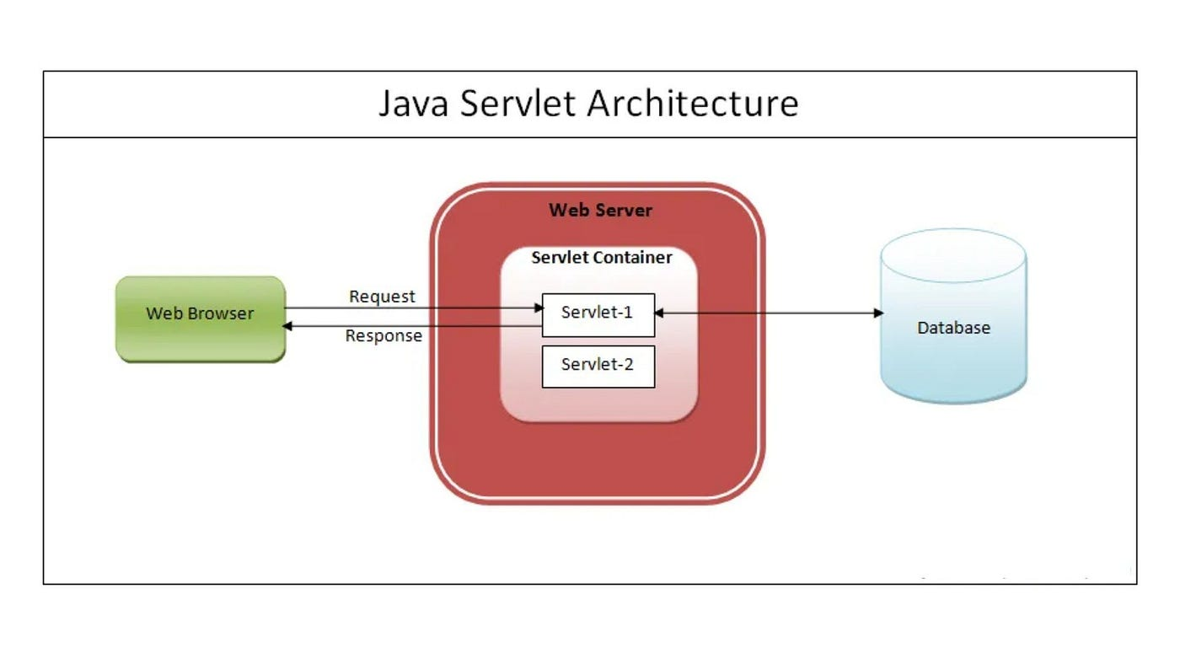

Slide 6
JSP Architecture
Browser sends request
JSP translated into Servlet
Servlet compiled
Servlet executed
Response returned

Slide 7
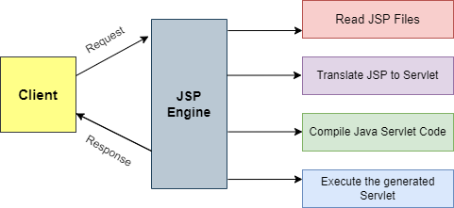

Slide 8
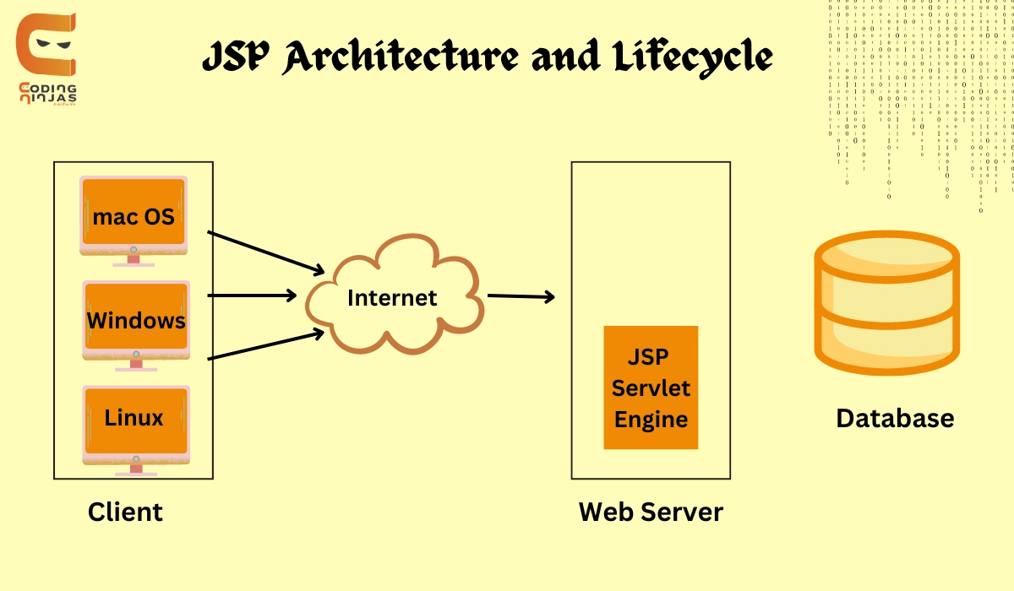

Slide 9
JSP Lifecycle Methods
jspInit()
_jspService()
jspDestroy()

Slide 10
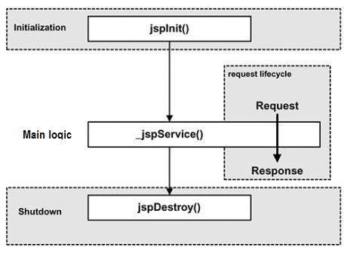

Slide 11
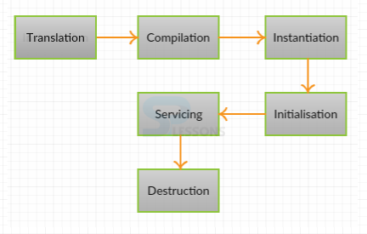

Slide 12
JSP Elements
Directive tags
Scripting elements
Implicit objects
Action tags
Expression Language
JSTL

Slide 13
Page Directive Example
<%@ page import="java.util.Date" %>
<html>
<body>
Current date:
<%
Date d=new Date();
out.println(d);
%>
</body>
</html>

Slide 14
Scriptlet Example
<html>
<body>
<%
int a=10;
int b=20;
out.println(a+b);
%>
</body>
</html>

Slide 15
Expression Example
<html>
<body>
Sum:
<%= 10+20 %>
</body>
</html>

Slide 16
Declaration Example
<%!
int square(int n)
{
return n*n;
}
%>
<html>
<body>
Square:
<%= square(5) %>
</body>
</html>

Slide 17
JSP Implicit Objects
Object | Type
request | HttpServletRequest
response | HttpServletResponse
out | JspWriter
session | HttpSession
application | ServletContext
config | ServletConfig
pageContext | PageContext
page | Object
exception | Throwable

Slide 18
Implicit Object Example
<html>
<body>
Request method:
<%= request.getMethod() %>
Session id:
<%= session.getId() %>
</body>
</html>

Slide 19
JSP Action Tags
jsp:include
jsp:forward
jsp:useBean
jsp:setProperty
jsp:getProperty

Slide 20
jsp:include Example
header.jsp:
<h2>Header</h2>
main.jsp:
<html>
<body>
<jsp:include page="header.jsp"/>
Content here
</body>
</html>

Slide 21
JSP vs Servlet
JSP | Servlet
HTML centric | Java centric
Easy UI | Hard UI
Presentation | Logic
Converted to servlet | Already servlet

Slide 22
MVC Pattern
JSP – View
Servlet – Controller
Java class – Model

Slide 23
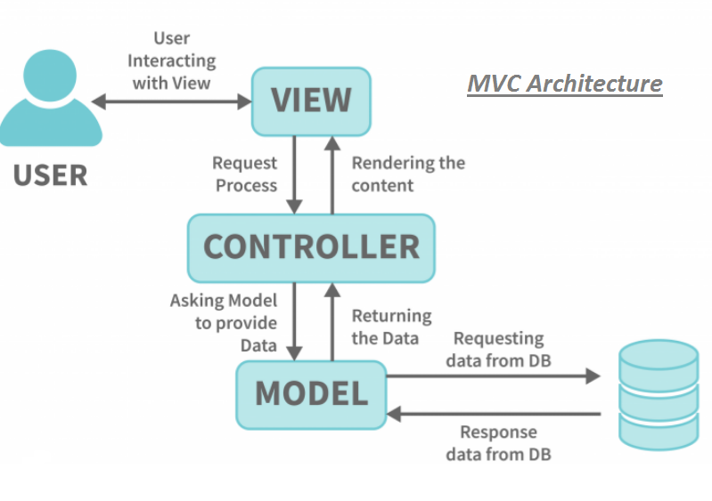

Slide 24
Model Class Employee.java
public class Employee
{
String name="Yashwanth";
public String getName()
{
return name;
}
}

Slide 25
Servlet Controller Example
Employee emp=new Employee();
req.setAttribute("emp",emp);
RequestDispatcher rd=
req.getRequestDispatcher("employee.jsp");
rd.forward(req,res);

Slide 26
JSP View Example
Employee e=(Employee)
request.getAttribute("emp");
Employee name:
<%= e.getName() %>

Slide 27
Advantages
Easy to write HTML
Fast development
Automatic servlet conversion
Reusable components
MVC support

Slide 28
Disadvantages
Mixing Java + HTML bad practice
Hard debugging
Legacy technology
Replaced by Thymeleaf/React

Slide 29
JSP Interview Questions
What happens when JSP executes?
JSP converts into servlet
Include vs jsp include
Forward vs sendRedirect
Scriptlet vs Expression

Slide 30
Login JSP Example
<html>
<body>
<form action="LoginServlet">
Username:
<input type="text" name="user">
Password:
<input type="password" name="pass">
<input type="submit">
</form>
</body>
</html>

Slide 31
Login Servlet Example
String u=req.getParameter("user");
String p=req.getParameter("pass");
if(u.equals("admin") && p.equals("123"))
{
forward success.jsp;
}
else
{
forward error.jsp;
}

Slide 32
success.jsp
<h1>Login success</h1>

Slide 33
error.jsp
<h1>Login failed</h1>

Slide 34
Modern JSP Best Practices
Avoid Scriptlets <% %>
Use EL(Expression Language)
Instead of:
<%= employee.getName() %>
We write:
${employee.name}
Use JSTL(JSP Standard Tag Library)
Instead of Java:
<% if(a>b) out.println("Greater"); %>
We use JSTL:
<c:if test="${a>b}"> Greater </c:if>
Follow MVC pattern

