Slide 1

DATA DRIVEN ANALYSIS OF POULTRY FARM OPERATIONS AND LIVE CHICKEN SUPPLY
PULLURI YASHWANTH KRISHNA
23f1002174
IITM Online BS Degree Program

Slide 2
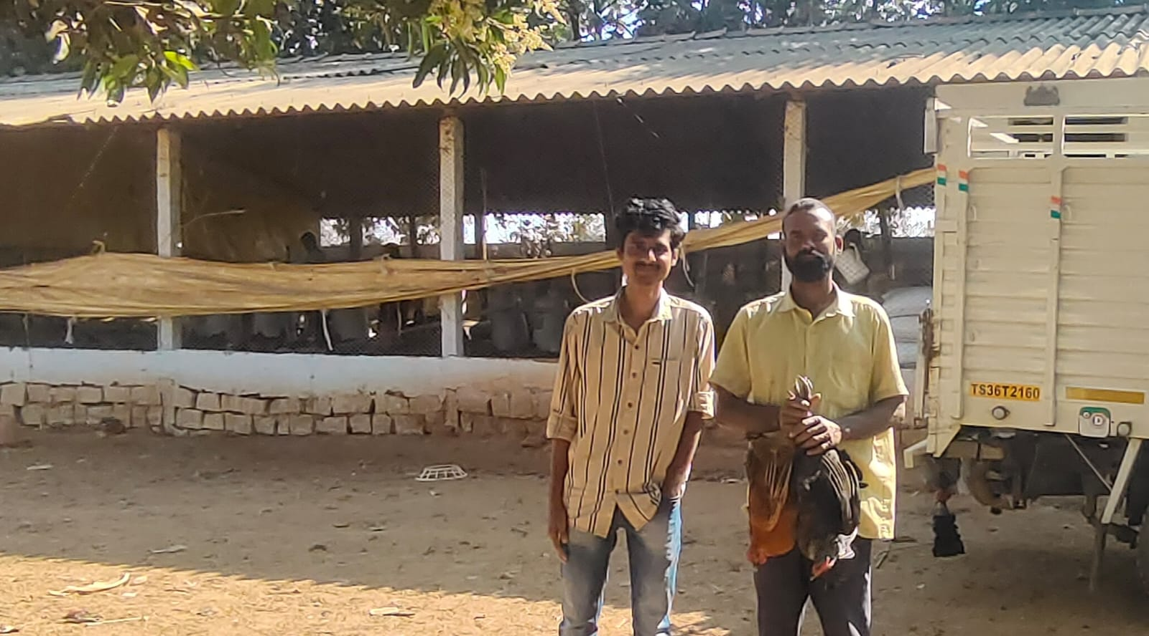
ABOUT THE BUSINESS:
Karthik Reddy Poultry Farm, Chinna Masanpally Village, Rayapole Mandal, Telangana.
Small-scale B2B poultry farm.
Supplies to meat shops, hotels and Restaurants.
10-12 employees, daily operations.
Facing issues in mortality, sales, inventory
Uses manual record keeping system and unorganized business.

Slide 3
CHALLENGES:
Problem 1: High Chick Mortality
High deaths in poultry batches
Temperature and Hygiene issues
Irregular Vaccination Practices
Leads to Production and Revenue Losses
Problem 2: Sales Fluctuations
Demand inconsistencies
Seasonal Variation in sales
Irregular supply to buyers
Revenue instability.
Problem 3: Inventory Issues
Overstock and wastage of feed
Poor stock planning
Medicines and vaccines mismanaged
Increased operational Cost

Slide 4
DATA
COLLECTION
Primary data collected from poultry farm
Sources: farm records, WhatsApp, owner interaction
Duration: July- September (92 days)
Real Time operational Data is used.
Mortality Data
Date
Chick died
Mortality Rate
Temperature
Humidity
Sales Data
Date
Birds Sold
Selling Price
Total Sales amount
Buyer Type
Inventory Data
Item Name
Quantity Used
Stock levels
Unit cost
Total Consumption Value

Slide 5


Methodology and Tools
Methods Used
Descriptive Statistics – summarize sales and mortality data
Regression Analysis – identify mortality factors
Time-Series Analysis- analyze sales trends
ABC Analysis – classify inventory items
Tools Used
Excel / Google Sheets – Data cleaning
Python – data analysis and Visualization
Libraries: Pandas, Matplotlib

Slide 6
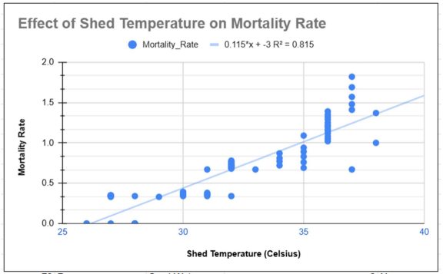
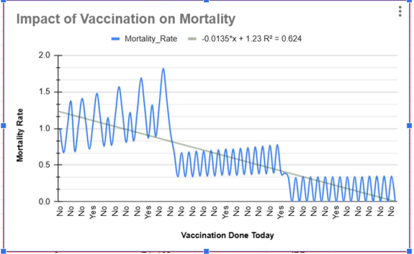
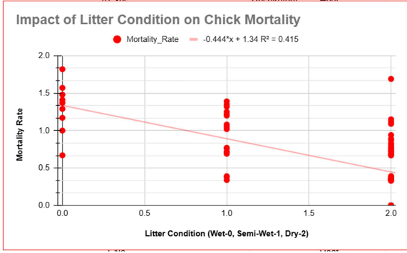
RESULTS: FINANCIAL OVERVIEW(CHICK MORTALITY)
Mortality increases with temperature
Poor hygiene increases chick deaths
Ventilation reduces mortality
R2 = 0.815(strong)
Vaccination reduces mortality
No vaccination increased deaths
Regular Vaccination Schedules risk.
Strong impact on Chick Survival
Vaccination support regression analysis study.
Dry Litter reduces mortality
Wet litter increases disease prone
Poor hygiene increases infections
This leads chick mortality.

Slide 7
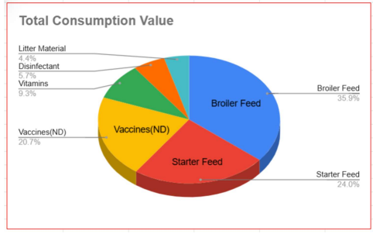
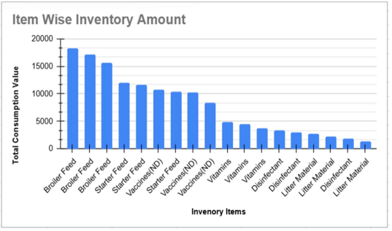
RESULTS: INVENTORY (ABC ANALYSIS)
ABC Analysis:
Class A items: Broiler feed, Starter feed
Class B Items: Vaccines(ND)
Class C Items: Litter items, disinfectants
Feed items used most frequently
High-value items drive total cost
Low-value items have less impact
Inventory is highly concentrated.

Slide 8
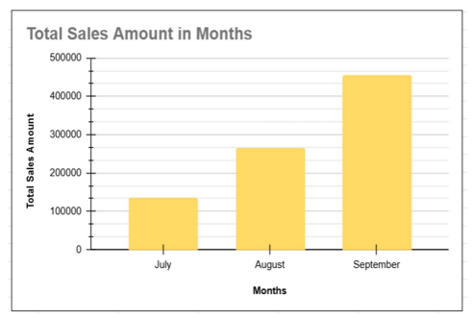
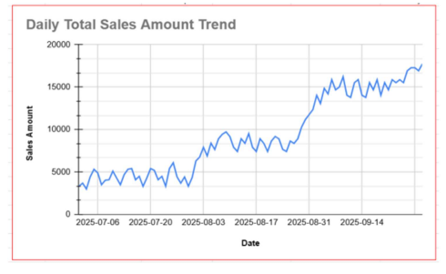
RESULTS: SALES RESULTS
Sales increased from July to September
September shows highest sales
August higher than July
Growth trend clearly Visible
Sales show upward trend
Gradual increase over time
Short-term fluctuations observed
Demand improving steadily

Slide 9
INTERPRETATION OF RESULTS
Problem 1: Chick Mortality
Mortality affected by temperature and hygiene.
Vaccination and ventilation reduce chick deaths.
Environmental factors are main cause of chick mortality.
Problem 2: Sales and Demand
Demand increases over time.
Seasonal factors influence sales.
Revenue improving but fluctuating.
Problem 3: Inventory Cost
Feed items contribute highest cost.
Few items dominate inventory value.
Vaccines have moderate cost impact.
Poor planning increases expenses.

Slide 10
RECOMMENDATIONS (Data-Driven & Actionable)
For Chick Mortality
Maintain optimal Shed temperature daily.
Record temperatures at peak time like 2pm for better ventilation and heat stress management.
Ensure proper vaccination and hygiene practices which can reduce 8-10% chick mortality rate.
For Sales
Track weekly Sales. And monthly sales trends.
Plan production based on demand
Maintain stock during peak seasons and ensure good relations with buyers.
For Inventory
Avoid overstocking of feed items and maintain optimal stock levels.
Monitor expiry of vaccines and reduce feed wastage.

Slide 11



