Slide 1
DATA DRIVEN ANALYSIS FOR OPERATIONAL IMPROVEMENT: TELANGANA BELLAM CHAI
Kamera Rajaramesh
23f1003064

Slide 2
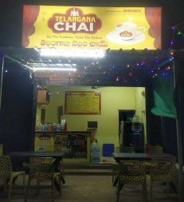
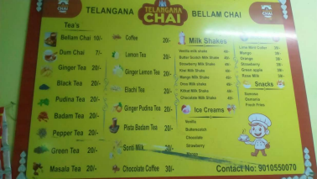
ABOUT THE BUSINESS:
Small, owner-managed tea outlet
Location: Kadem, Nirmal District, Telangana
Operating since 2024 with stable local demand
It is a B2C business
Key products:
* Bellam Chai
* Coffee
* Leamon Tea
* Ginger Tea
Records maintained manually by owner

Slide 3
CHALLENGES:
Problem 1: Inventory Planning Inefficiency
Frequent stockouts of milk and jaggery
Unplanned bulk purchases increase daily costs
Direct impact on Bellam Chai sales and profit
Problem 2: Informal Credit Management
Credit given without limits or repayment rules
Few customers hold large outstanding amounts
Causes cash-flow stress during procurement
Problem 3: Peak-Hour Workload Pressure
High customer rush during 7–10 AM and 4–7 PM
Owner manages all tasks alone
Leads to slow service and missed sales

Slide 4
DATA
OVERVIEW
The data collected was a primary data
To tackle these challenges following data was collected from the period 1st June to 30th September.
Inventory Data
Date
Item Name
Quantity
Cost
Sales Data
Date
Item Name
Price/unit
Quantity Sold
Total Price
Credit Data
Transaction Date
Customer Name
Credit Amount
Repayment
Outstanding Balance

Slide 5


Methodology and Tools
Methods Used
Descriptive Statistics – sales, cost and Credit Analysis
ABC Analysis – inventory prioritization
RFM Analysis – credit customer segmentation
Profit & Margin Analysis – financial performance of the business
Tools Used
Excel / Google Sheets – cleaning, summaries
Python – visualization and statistical analysis

Slide 6
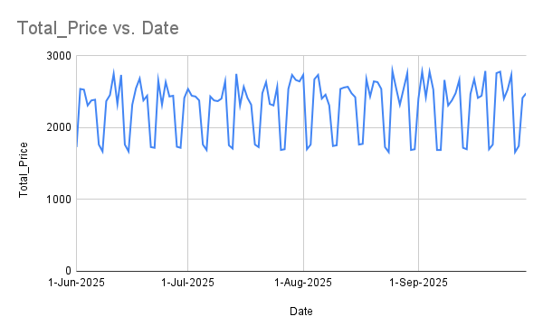
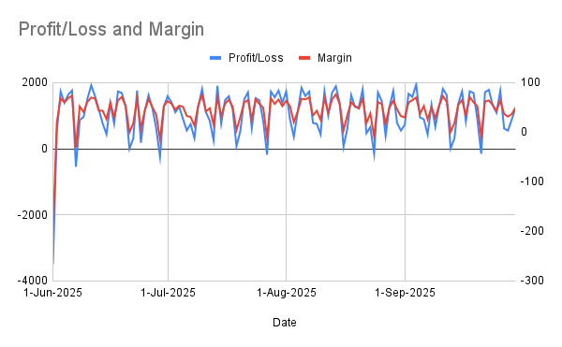
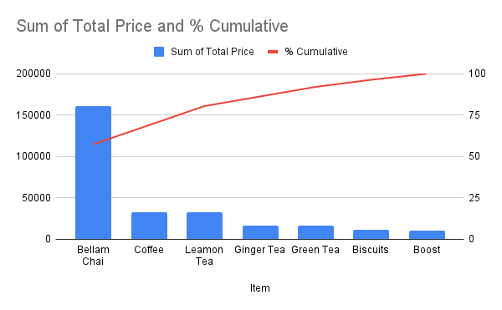
RESULTS: FINANCIAL OVERVIEW
Average Sales: 2293.07 Rs
Median: 2415.00 Rs
Range of Sales: 1660 Rs -2790 Rs
Range of Profits: -3492 Rs to 1941 Rs.
Average Margin: 43.75
Median Profits: 1247.21 Rs
Average Profits : 1066 Rs
Highest Sales – Bellam Chai
Medium Sales – Coffee, Leamon Tea
Lowest Sales – Boost
Correlation: -0.22

Slide 7
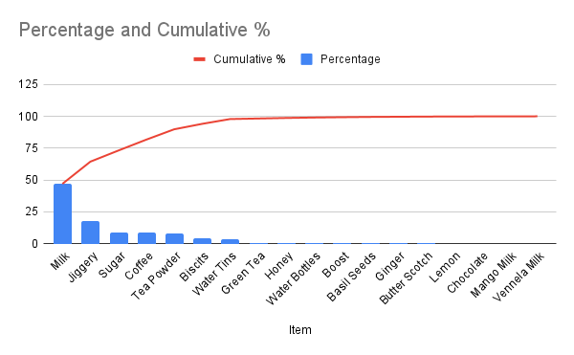
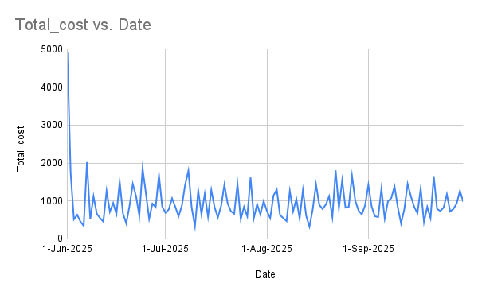
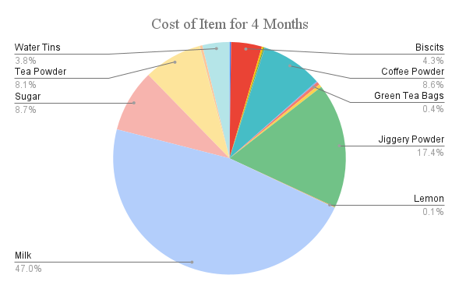
RESULTS: INVENTORY (ABC ANALYSIS)
ABC Analysis:
Class A items: Milk, Jaggery Powder, Sugar
Class B Items: Coffee Powder & Tea Powder
Class C Items: Remaining all Items.
Inventory Cost of all Items:
Average Inventory Cost: 957.42 Rs
Median Cost: 844 Rs
The day have highest Inventory Cost: 1st June
Lowest Cost Day: 14th Aug and 5th Sep.
Cost of each Item for 4 months:
Highest Purchase Item: Milk
Lowest Purchase Items: Milk Shake Flavours.

Slide 8
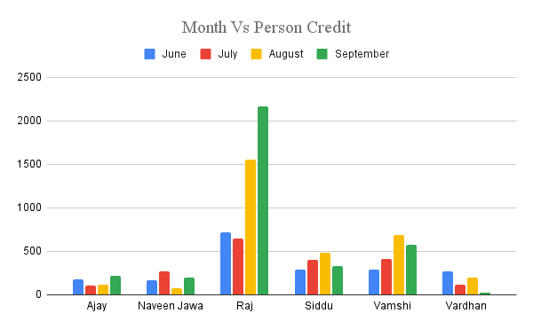
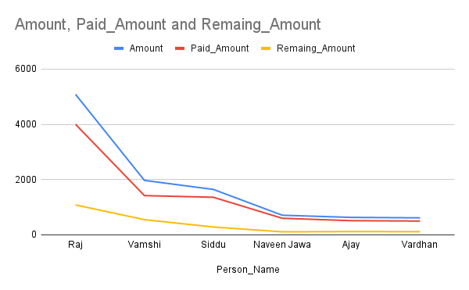
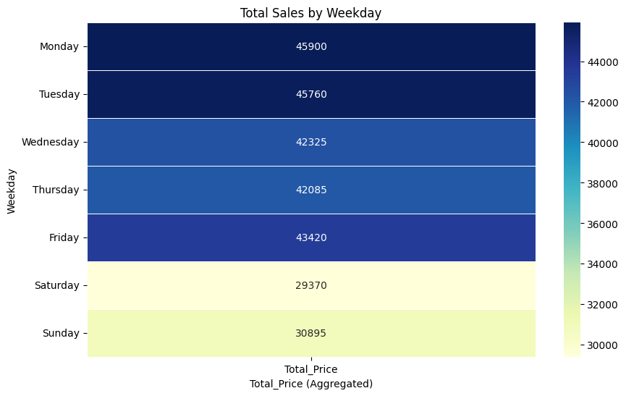
RESULTS: CREDIT & PEAK TIME
Raj and Vamshi account for the highest credit amounts
credit risk is driven by a small number of high-value borrowers rather than the entire customer base.
Day Wise Sales
Highest sales were in the week days
Peak Hours
Morning: 7–10 AM
Evening: 4–7 PM
Single-person operations cause delays
Credit Findings (RFM Analysis)
Few customers hold most outstanding dues
High-frequency, high-value credit customers identified
Credit impacts working capital availability

Slide 9
INTERPRETATION OF RESULTS
Problem 1: Inventory Planning Inefficiency
Sales are stable, but profit drops occur only on days with bulk inventory purchases.
ABC analysis shows Milk, Jaggery, and Sugar contribute ~70% of inventory cost, making them critical items.
Unplanned procurement of these Class-A items causes cost spikes and margin reduction.
Problem 2: Informal Credit Management
Credit outstanding is highly concentrated among a few customers (e.g., Raj, Vamshi).
RFM analysis indicates high-frequency, high-monetary customers pose cash-flow risk.
Delayed repayments reduce available cash for daily inventory purchases.
Problem 3: Peak-Hour Workload Pressure
Major sales occur during 7–10 AM and 4–7 PM, creating operational bottlenecks.
Single-person operations lead to slow service and missed sales, despite high demand.
Revenue loss is due to capacity constraints, not lack of customers.

Slide 10
RECOMMENDATIONS (Data-Driven & Actionable)
For Inventory Management
Implement ABC-based reorder planning for Milk, Jaggery, and Sugar. ( Day Wise consumption of milk is 7.5 liters, Jaggery Powder 2 kgs, Sugar 4 kgs)
Avoid bulk purchases; follow small, frequent procurement based on daily usage trends.
For Credit Management
Set credit limits using RFM segmentation (stricter limits for high-risk customers).
Enforce weekly or short-cycle repayment for customers with large outstanding amounts.
For Peak-Hour Operations
Deploy a part-time helper during peak hours (7–10 AM, 4–7 PM).
Pre-prepare key ingredients before rush periods to increase service speed.

Slide 11
CONCLUSION & NEXT STEPS
Business is profitable but operationally inefficient
Data-driven insights highlight internal issues
Inventory, credit, and workload are key levers
Next Steps:
Adopt structured inventory planning
Improve credit discipline
Scale operations gradually
Additional Information: BDM_Project

Slide 12


