Slide 1
AWS

Slide 2
What is Cloud Computing?
Cloud computing is an umbrella term used to refer to Internet based development and services.
A number of characteristics define cloud data, applications services and infrastructure:
A. Services or data are hosted on remote infrastructure.
B. Services or data are available from anywhere.
C. The result is a utility computing model similar to traditional that of traditional utilities, like gas and electricity - you pay for what you would want!

Slide 3
What is Cloud Computing?
Example:
Many companies are delivering services from the cloud.
Some notable examples include the following:
' Google — Has a private cloud that it uses for delivering Google Docs and many other services to its users, including email access, document applications, text translations, maps, web analytics, and much more. '
Microsoft — Has Microsoft@ Office 365 online service that allows for content and business intelligence tools to be moved into the cloud, and Microsoft currently makes its office applications available in a cloud. '
Salesforce.com — Runs its application set for its customers in a cloud, and its Force.com and Vmforce.com products provide developers with platforms to build customized cloud services.

Slide 4
Deployment Models
The Public Cloud allows systems and services to be easily accessible to the general public.
Public cloud may be less secure because of its openness
e.g., e-mail.
PRIVATE CLOUD : The Private Cloud allows systems and services to be accessible within an organization.
It offers increased security because of its private nature.
COMMUNITY CLOUD : The Community Cloud allows systems and services to be accessible by group of organizations.
HYBRID CLOUD : The Hybrid Cloud is mixture of public and private cloud.
However, the critical activities are performed using private cloud while the non- critical activities are performed using public cloud.

Slide 5
Service Models
Service Models are the reference models on which the Cloud Computing is based.
These can be categorized into three basic service models as listed below:
1. Infrastructure as a Service (laaS)
2. Platform as a Service (PaaS)
3. Software as a Service (SaaS)

Slide 6
Amazon Web Service(AWS)
Amazon Web Services (AWS) is a comprehensive, evolving cloud computing platform provided by Amazon.
It provides a mix of infrastructure as a service (IaaS), platform as a service (PaaS) and packaged software as a service (SaaS) offerings.

Slide 7
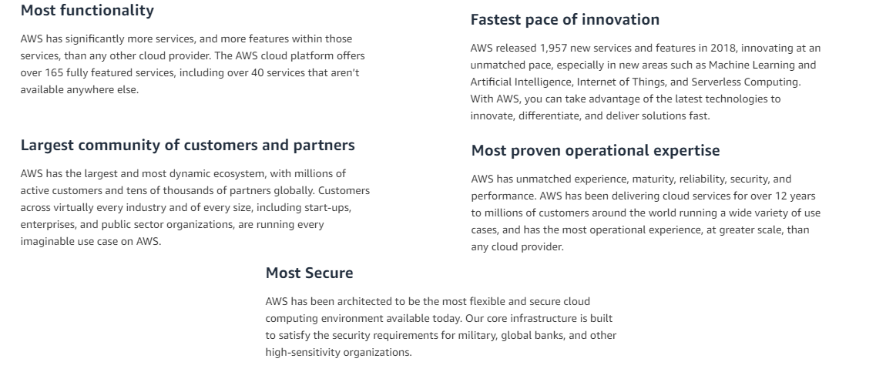
Amazon Web Service(AWS)

Slide 8
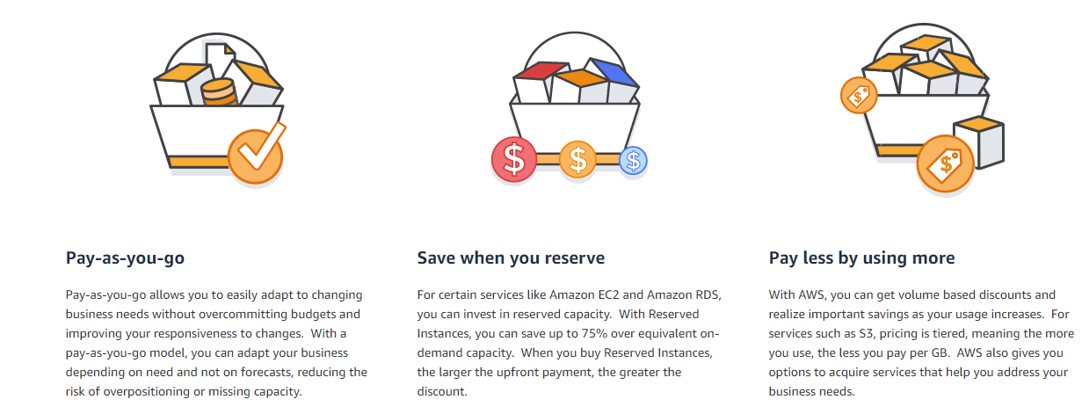
AWS Pricing

Slide 9
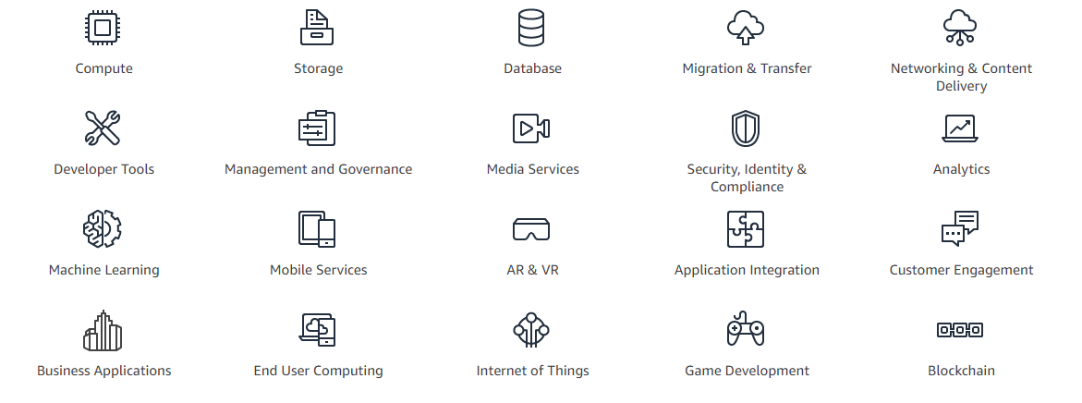
Important Amazon Services

Slide 10
Amazon Elastic Cloud Computing (Amazon EC2)

Slide 11
Amazon Elastic Compute Cloud (Amazon EC2)
Amazon Elastic Compute Cloud (Amazon EC2) provides scalable computing capacity in the Amazon Web Services (AWS) cloud.
You can use Amazon EC2 to launch as many or as few virtual servers as you need, configure security and networking, and manage storage.
Amazon EC2 enables you to scale up or down to handle changes in requirements or spikes in popularity, reducing your need to forecast traffic.

Slide 12
Features of Amazon EC2
Virtual computing environments, known as instances
Preconfigured templates for your instances, known as Amazon Machine Images (AMIs), that package the bits you need for your server (including the operating system and additional software)
Various configurations of CPU, memory, storage, and networking capacity for your instances, known as instance types
Secure login information for your instances using key pairs (AWS stores the public key, and you store the private key in a secure place)

Slide 13
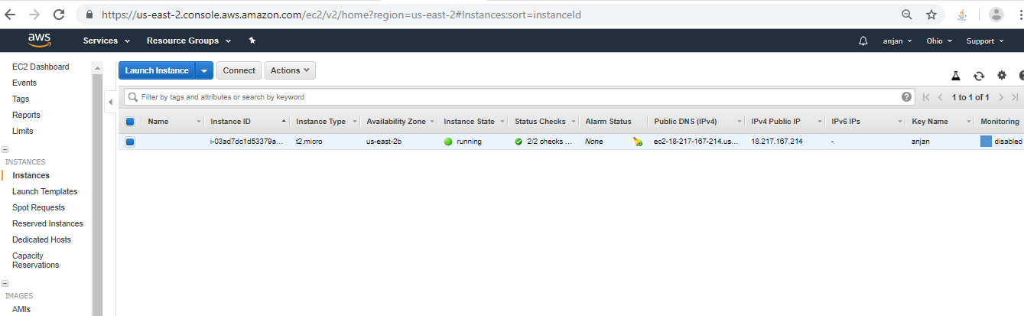
EC2 Instance

Slide 15
Amazon S3

Slide 16
What is Amazon S3?
Amazon Simple Storage Service is storage for the Internet. It is designed to make web-scale computing easier for developers.
Amazon S3 has a simple web services interface that you can use to store and retrieve any amount of data, at any time, from anywhere on the web.
It gives any developer access to the same highly scalable, reliable, fast, inexpensive data storage infrastructure that Amazon uses to run its own global network of web sites.
The service aims to maximize benefits of scale and to pass those benefits on to developers.

Slide 17

AWS Free Usage Tier As S3
As part of the AWS Free Usage Tier, you can get started with Amazon S3 for free.
Upon sign-up, new AWS customers receive 5GB of Amazon S3 storage in the S3 Standard storage class; 20,000 GET Requests; 2,000 PUT, COPY, POST, or LIST Requests; and 15GB of Data Transfer Out each month for one year.

Slide 18
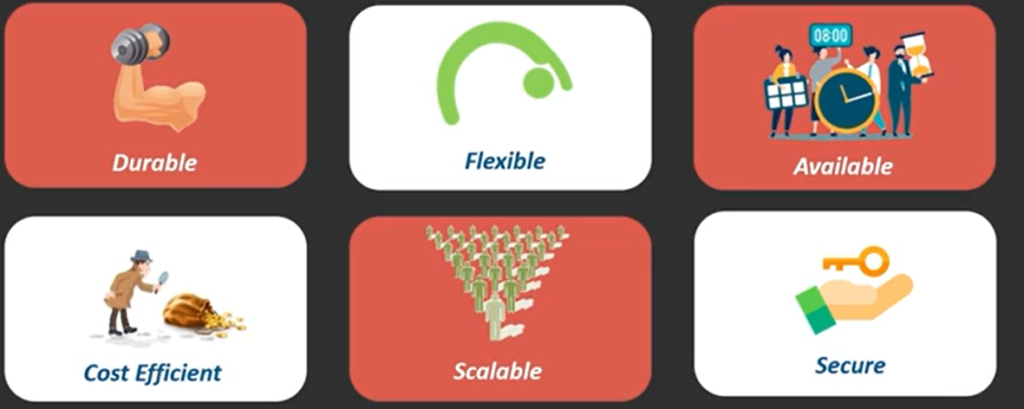
S3 - Property

Slide 19
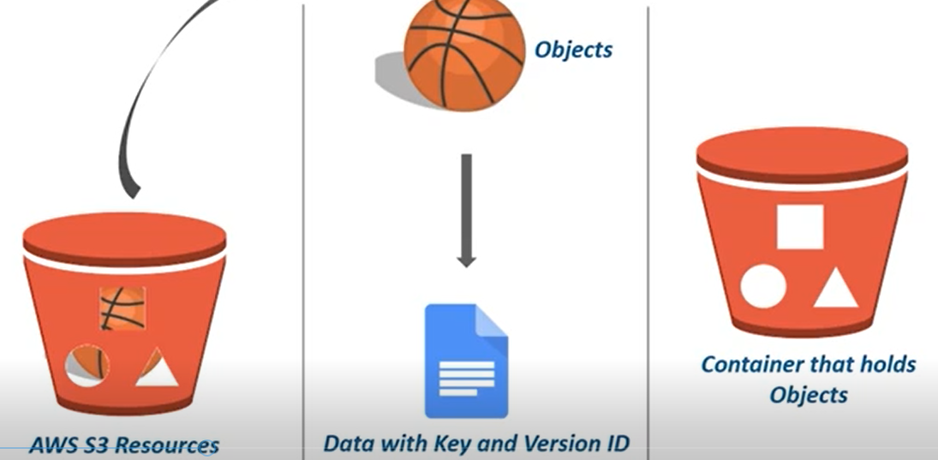
S3- Architecture

Slide 20
Lab For Uploading File to S3 Bucket
To give permission on bucket
click on bucket -- permissions -- block public access -- edit -- uncheck the check box -- type confirm - confirm to save
click on bucket -- permissions -- bucket policy
Now click on file and check.....
Its working fine....
{
"Version": "2012-10-17",
"Statement": [
{
"Sid": "PublicReadGetObject",
"Effect": "Allow",
"Principal": "*",
"Action": [
"s3:GetObject"
],
"Resource": [
"arn:aws:s3:::mybucket/*"
]
}
]
}

Slide 22


Slide 23
AWS Elastic Beanstalk
The AWS Elastic Beanstalk is a cloud deployment service by which you can easily set up your application on the Amazon Web Services infrastructure simply by just uploading it.
All the other necessary operations like autoscaling, provisioning, load balancing, and application health monitoring will be handled automatically by using it.

Slide 24
AWS Elastic Beanstalk
Elastic Beanstalk is blessed with an open architecture, which means that even the applications not written for the web can be deployed on it.
Amazon doesn’t charge additionally for the Elastic Beanstalk, consumers will just have to pay for the resources used to run and store their apps.

Slide 26
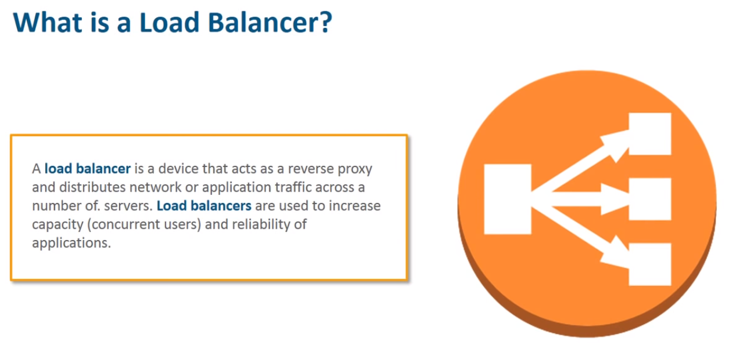

Slide 27
Features of Classic Load Balancer
A load balancer distributes incoming application traffic across multiple EC2 instances in multiple Availability Zones. This increases the fault tolerance of your applications. Elastic Load Balancing detects unhealthy instances and routes traffic only to healthy instances.
Your load balancer serves as a single point of contact for clients. This increases the availability of your application. You can add and remove instances from your load balancer as your needs change, without disrupting the overall flow of requests to your application.
Elastic Load Balancing scales your load balancer as traffic to your application changes over time. Elastic Load Balancing can scale to the vast majority of workloads automatically.

Slide 28
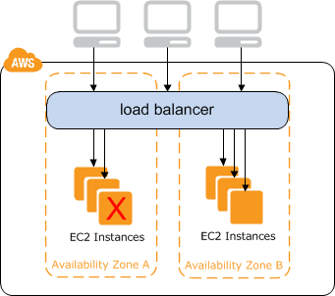
Classic Load Balancer

Slide 30
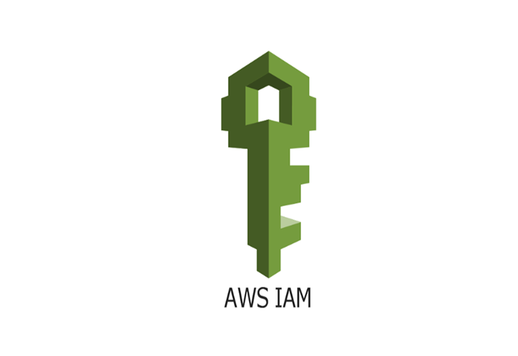
AWS Identity and Access Management (IAM)

Slide 31
AWS Identity and Access Management (IAM)
AWS Identity and Access Management (IAM) enables you to manage access to AWS services and resources securely.
Using IAM, you can create and manage AWS users and groups, and use permissions to allow and deny their access to AWS resources.
IAM is a feature of your AWS account offered at no additional charge.
You will be charged only for use of other AWS services by your users.

Slide 32
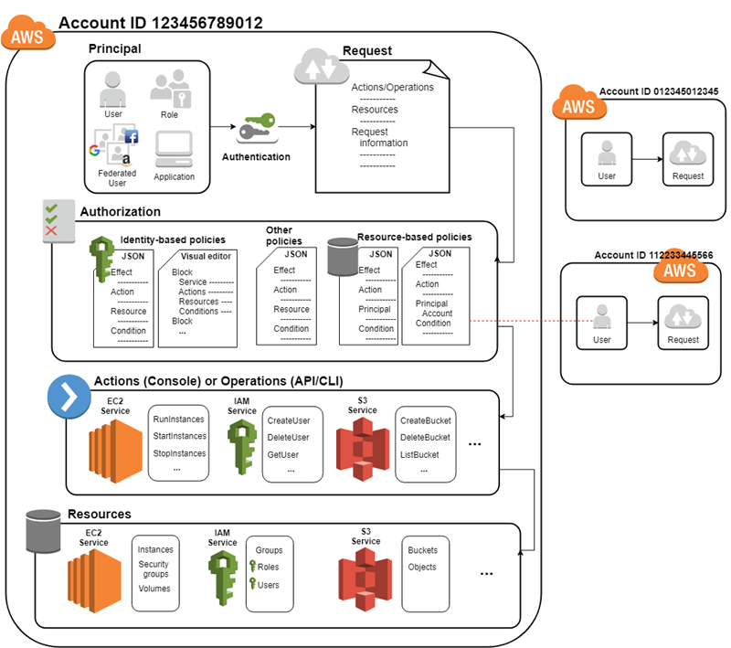
AWS Identity and Access Management (IAM)

Slide 33
AWS Identity and Access Management (IAM)
AWS Identity and Access Management (IAM) is a web service that helps you securely control access to AWS resources.
You use IAM to control who is authenticated (signed in) and authorized (has permissions) to use resources.
When you first create an AWS account, you begin with a single sign-in identity that has complete access to all AWS services and resources in the account.
This identity is called the AWS account root user and is accessed by signing in with the email address and password that you used to create the account.
We strongly recommend that you do not use the root user for your everyday tasks, even the administrative ones.

Slide 35
Amazon DynamoDB

Slide 36
Amazon DynamoDB
Amazon DynamoDB is a key-value and document database that delivers single-digit millisecond performance at any scale.
It's a fully managed, multi-region, multi-active, durable database with built-in security, backup and restore, and in-memory caching for internet-scale applications.
DynamoDB can handle more than 10 trillion requests per day and can support peaks of more than 20 million requests per second.

Slide 37
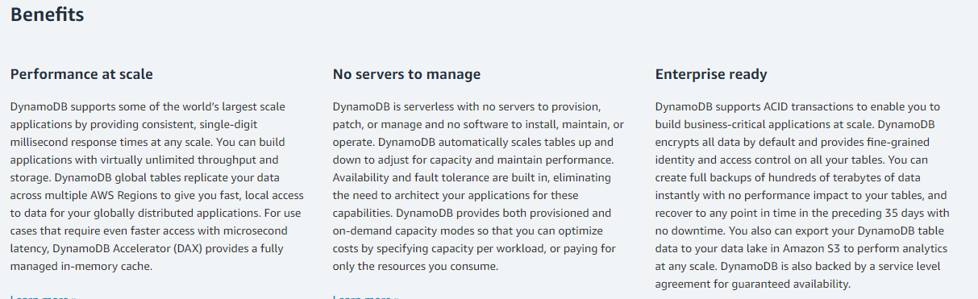

Slide 38
Anatomy of an Item
An item is the core unit of data in DynamoDB.
It is comparable to a row in a relational database, a document in MongoDB, or a simple object in a programming language.
Each item is uniquely identifiable by a primary key that is set on a table level.
An item is composed of attributes, which are bits of data on the item. This could be the "Name" for a User, or the "Year" for a Car.
Attributes have types -- e.g., strings, numbers, lists, sets, etc -- which must be provided when writing and querying Items.

Slide 39
Keys
When creating a new table, you will need to specify the primary key of that table.
Every item in a table is uniquely identified by its primary key.
Accordingly, the primary key must be included with every item that is written to a DynamoDB table.
There are two types of primary keys.
A simple primary key uses a single attribute to identify an item, such as a Username or an OrderId.
Using a DynamoDB table with a simple primary key is similar to using most simple key-value stores, such as Memcached.
A composite primary key uses a combination of two attributes to identify a particular item.
The first attribute is a partition key (also known as a "hash key") which is used to segment and distribute items across shards.

Slide 40
Attributes
An item is made up of attributes, which are different elements of data on a particular item.
For example, an item in the User table might have a Name attribute, an Age attribute, an Address attribute, and more.
They are comparable to columns in a relational database.

Slide 41
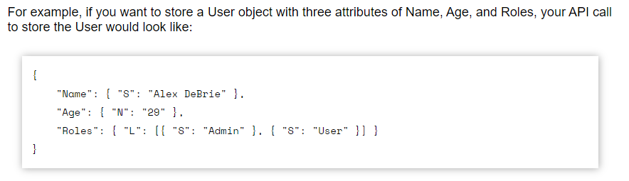
Attribute types
When setting an attribute for a DynamoDB item, you must specify the type of the attribute.
Available types include simple types like strings and numbers as well as composite types like lists, maps, or sets.

Slide 43
Amazon Virtual Private Cloud (VPC)
Amazon Virtual Private Cloud is a commercial cloud computing service that provides users a virtual private cloud, by provisioning a logically isolated section of Amazon Web Services Cloud.
Amazon Virtual Private Cloud (Amazon VPC) lets you provision a logically isolated section of the AWS Cloud where you can launch AWS resources in a virtual network that you define.

Slide 44
Amazon Virtual Private Cloud (VPC)
You have complete control over your virtual networking environment, including :
selection of your own IP address range
creation of subnets
configuration of route tables and network gateways.

Slide 45
Classless Inter-Domain Routing(CIDR)
Classless Inter-Domain Routing is a method for allocating IP addresses and for IP routing.
The Internet Engineering Task Force introduced CIDR in 1993 to replace the previous classful network addressing architecture on the Internet.

Slide 46
Classless Inter-Domain Routing(CIDR)
CIDR is principally a bitwise, prefix-based standard for the representation of IP addresses and their routing properties.
It facilitates routing by allowing blocks of addresses to be grouped into single routing table entries.
These groups, commonly called CIDR blocks, share an initial sequence of bits in the binary representation of their IP addresses.

Slide 47
Classless Inter-Domain Routing(CIDR)
An IP address is part of a CIDR block and is said to match the CIDR prefix if the initial n bits of the address and the CIDR prefix are the same.
An IPv4 address is 32 bits so an n-bit CIDR prefix leaves 32 − n bits unmatched, meaning that 2^{32 − n} IPv4 addresses match a given n-bit CIDR prefix.
Shorter CIDR prefixes match more addresses, while longer prefixes match fewer.

Slide 48
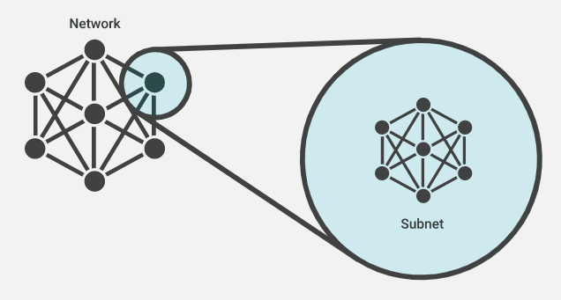
Subnetwork
A subnetwork or subnet is a logical subdivision of an IP network.
The practice of dividing a network into two or more networks is called subnetting.
Computers that belong to a subnet are addressed with an identical most-significant bit-group in their IP addresses.

Slide 49
Subnetwork
A subnet, or subnetwork, is a network inside a network.
Subnets make networks more efficient. Through subnetting, network traffic can travel a shorter distance without passing through unnecessary routers to reach its destination.

