Slide 1
Ansible Project
Infrastructure as Code Deployment by Yashwanth Naidu

Slide 2
Project Overview
Objective:
Create and deploy static and dynamic application infrastructure with Ansible as Infrastructure-as-Code (IaC).
Key Highlights:
Automating infrastructure setup
Hosting applications
Managing resources using Ansible scripts

Slide 3
Method 1: Standard Approach
Steps:
Launch EC2 instances with required ports.
Install Ansible on Amazon Linux.
Configure hosts and ansible.cfg files.
Wirte 2 Bash Script for host 2 applications.
Write playbooks to:
Create VPC, Subnets, Route Tables, Security Groups, Instances.
Host static and dynamic applications.
Run playbooks to provision infrastructure and deploy applications.

Slide 4
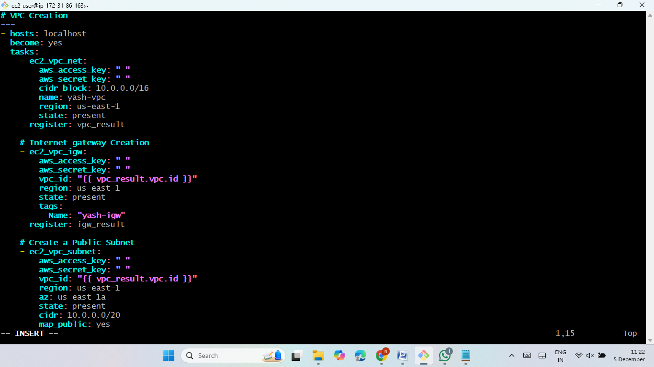
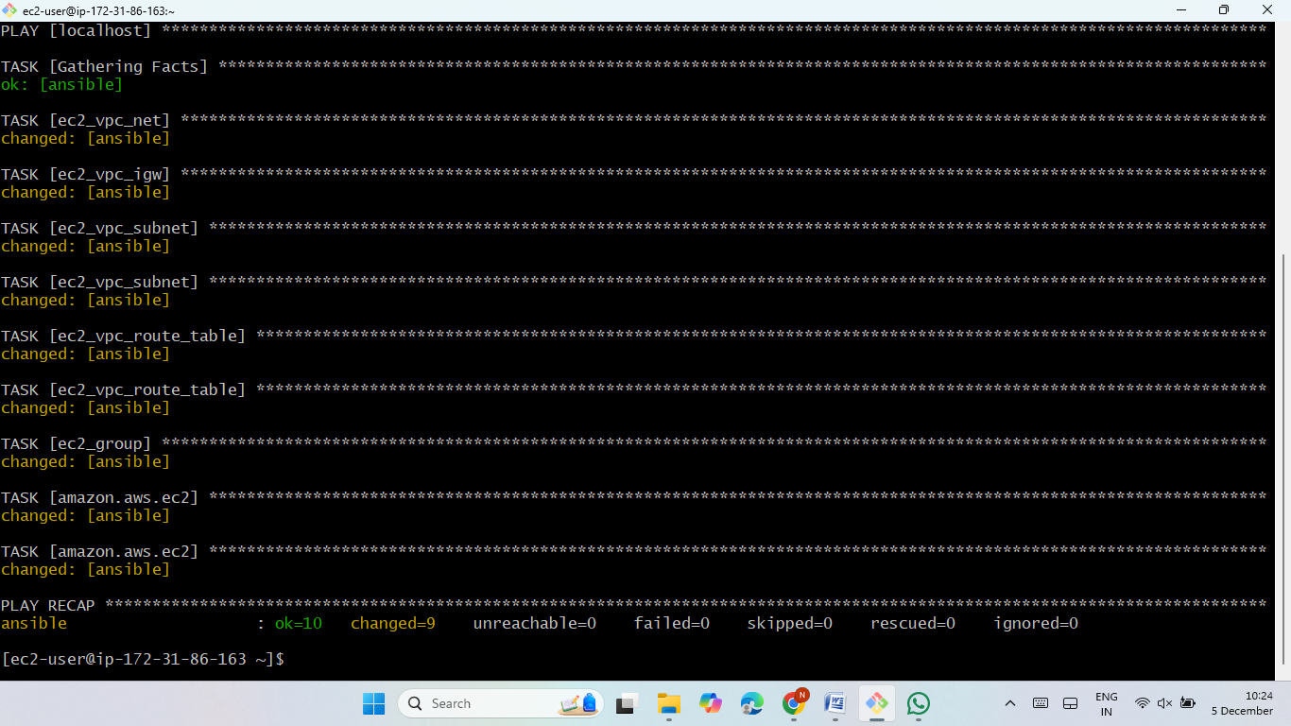
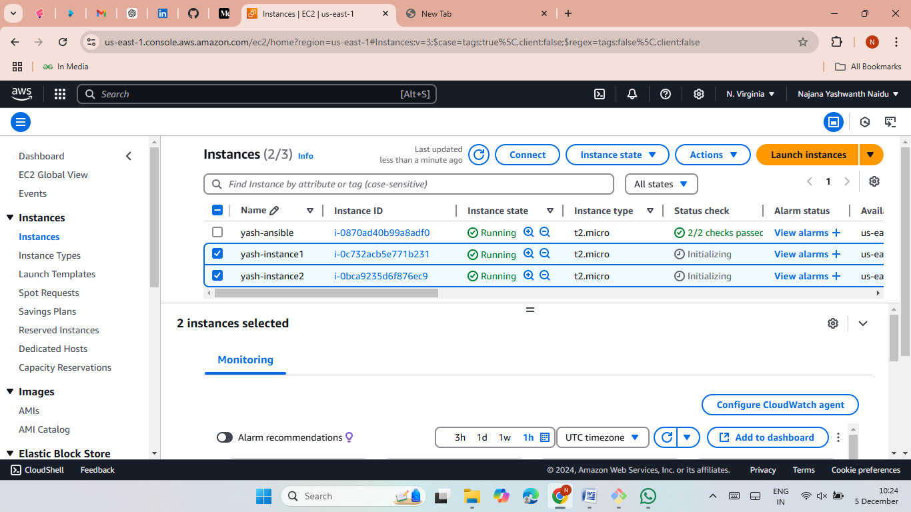


Slide 5
Method 2: Inline Approach
Steps:
Launch instances and install Ansible.
Write a single script including variables inline.
Wirte 2 Bash Script for host 2 applications.
Configure the script to:
Create infrastructure (VPC, Subnets, etc.).
Deploy static and dynamic applications.
Execute the playbook to provision resources and deploy applications.

Slide 6
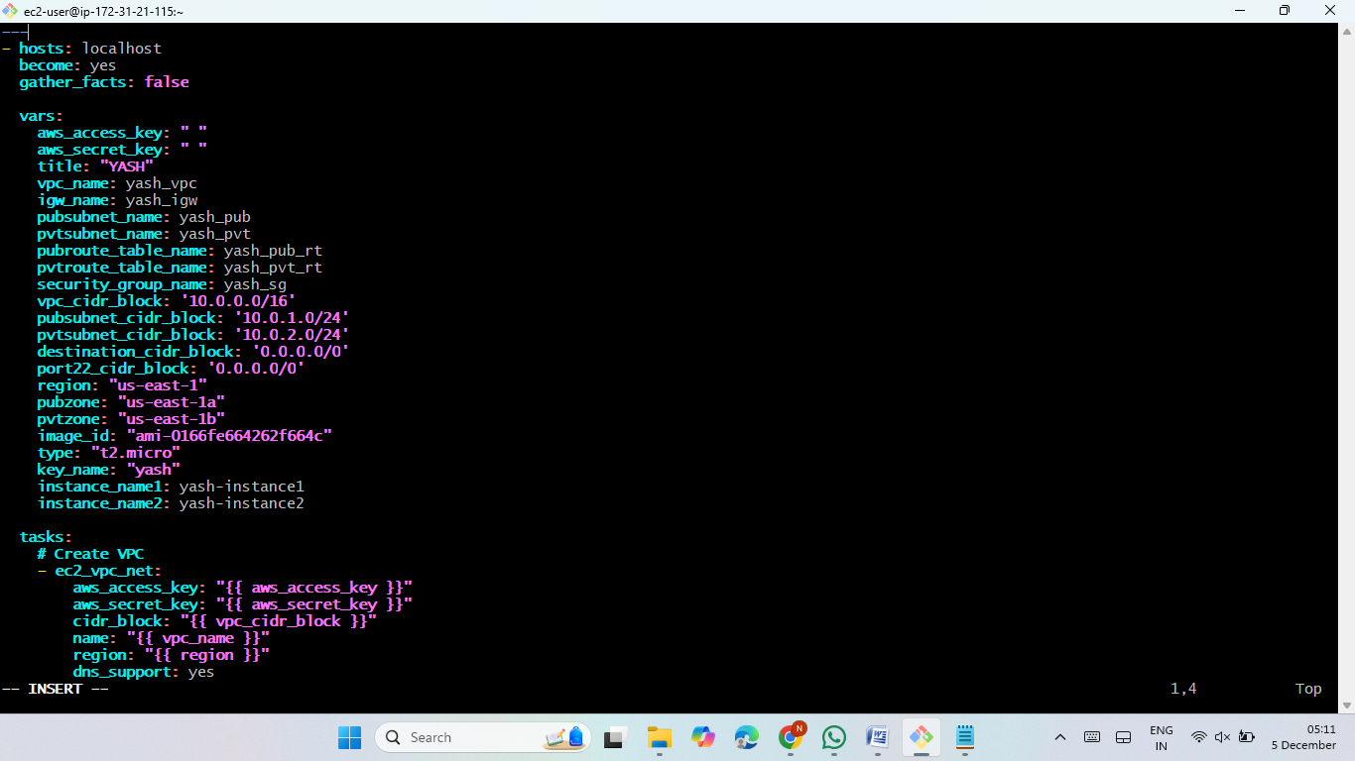
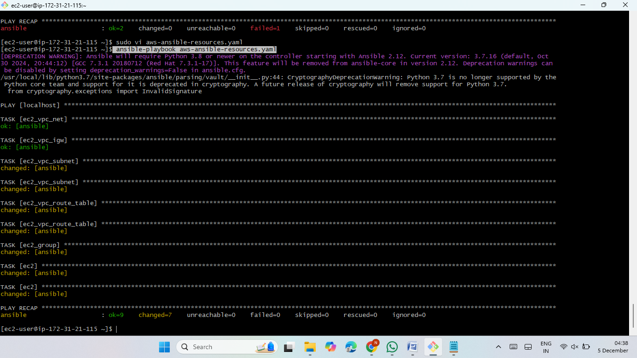
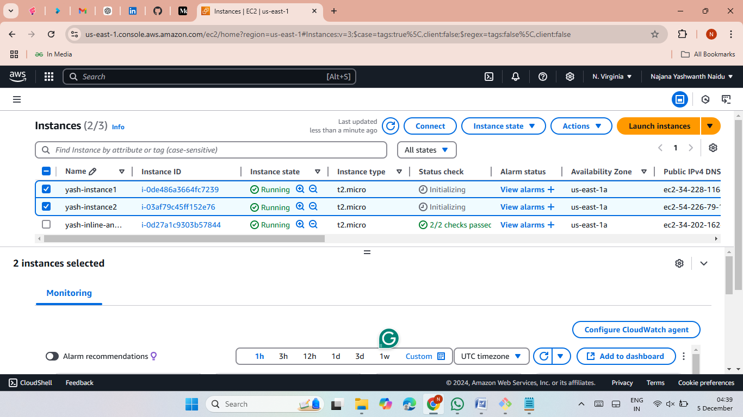
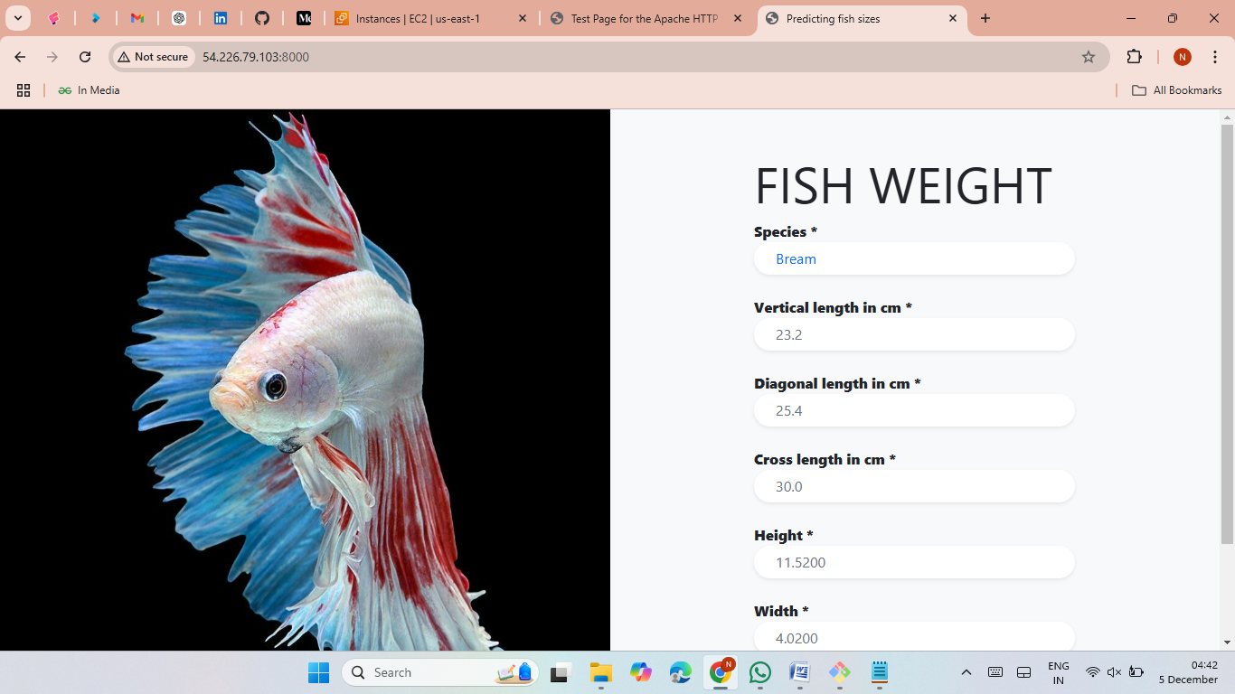

Slide 7
Method 3: Outline Approach
Steps:
Launch instances and configure Ansible.
Write separate variable files for configurations.
Wirte 2 Bash Script for host 2 applications.
Playbooks include:
Resource creation (VPC, Subnets, etc.).
Hosting applications.
Execute playbooks for deployment and manage resources effectively.

Slide 8
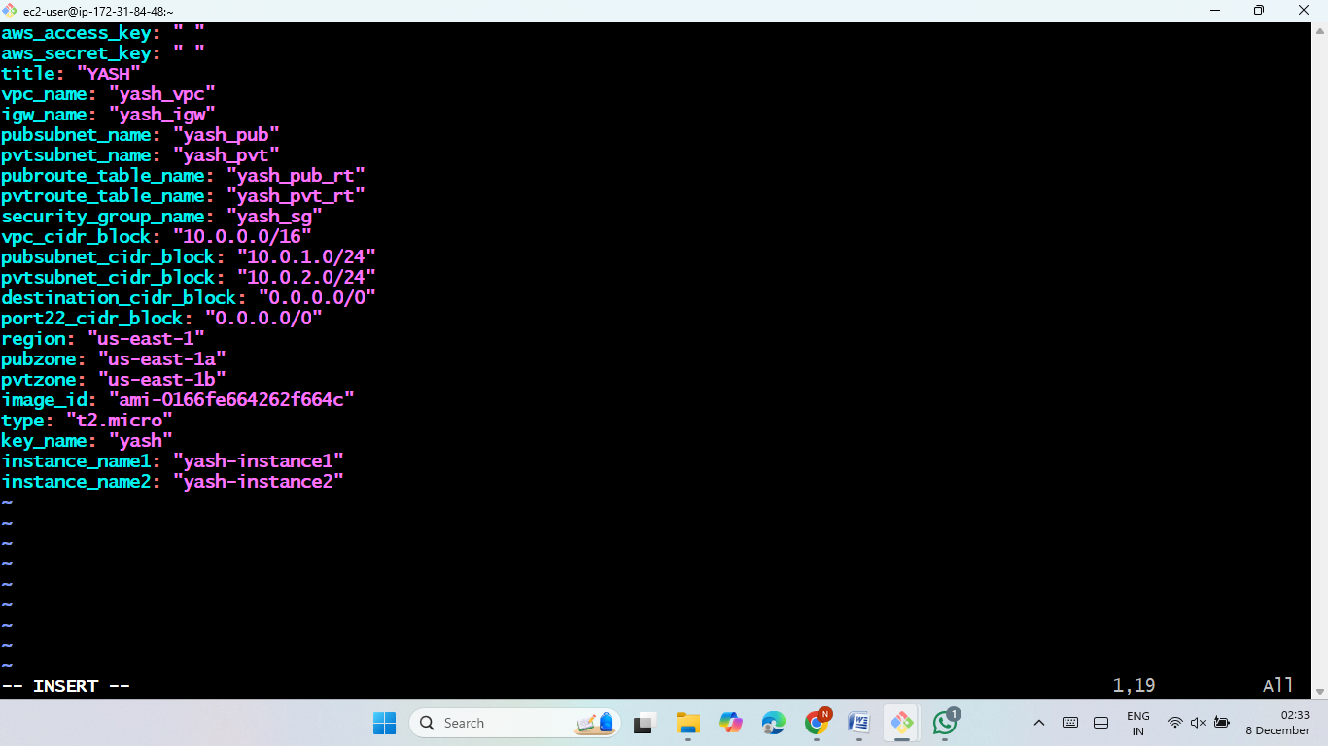
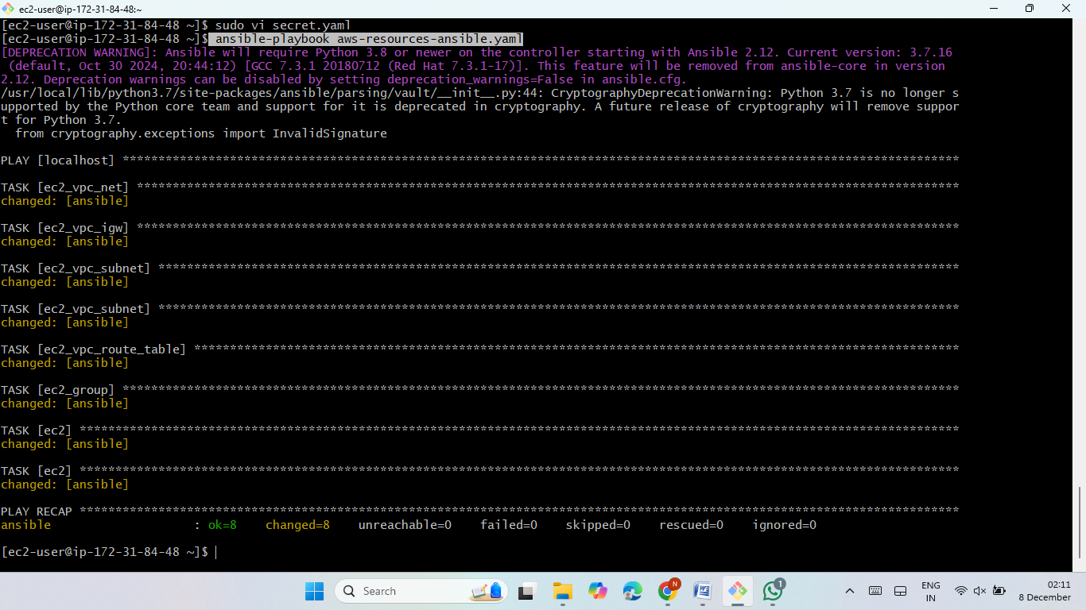
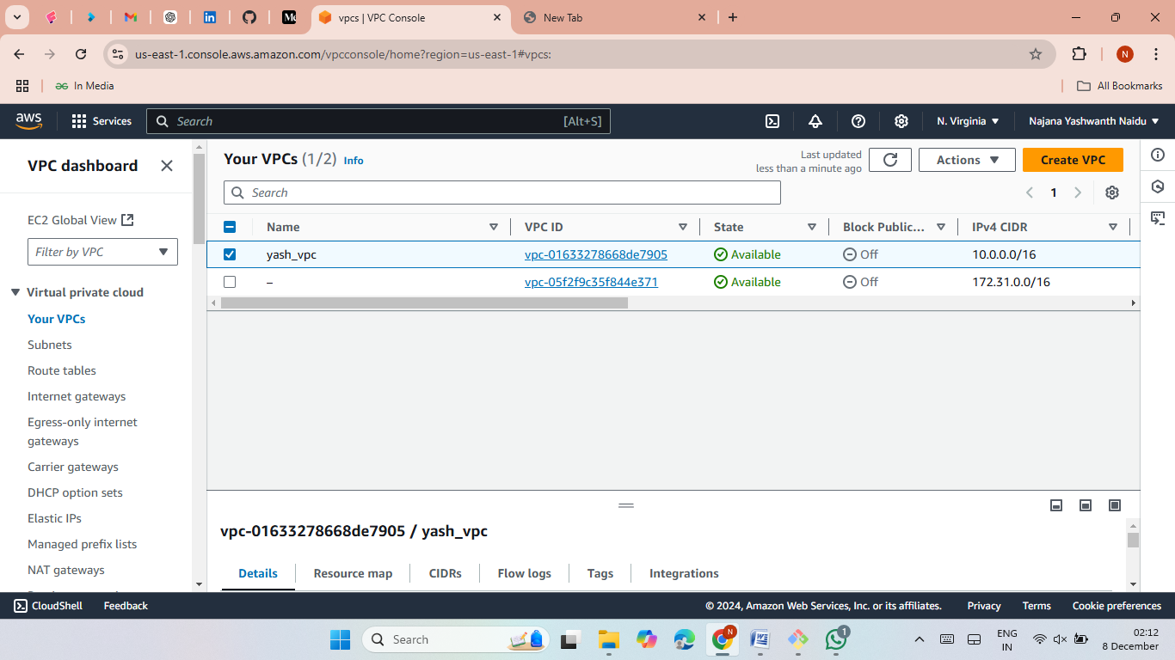


Slide 9
Resource Cleanup
Steps:
Write a playbook to delete created resources.
Execute the playbook to:
Delete EC2 instances.
Remove VPC and associated components.
Outcome:
All resources are cleaned up successfully.

Slide 10
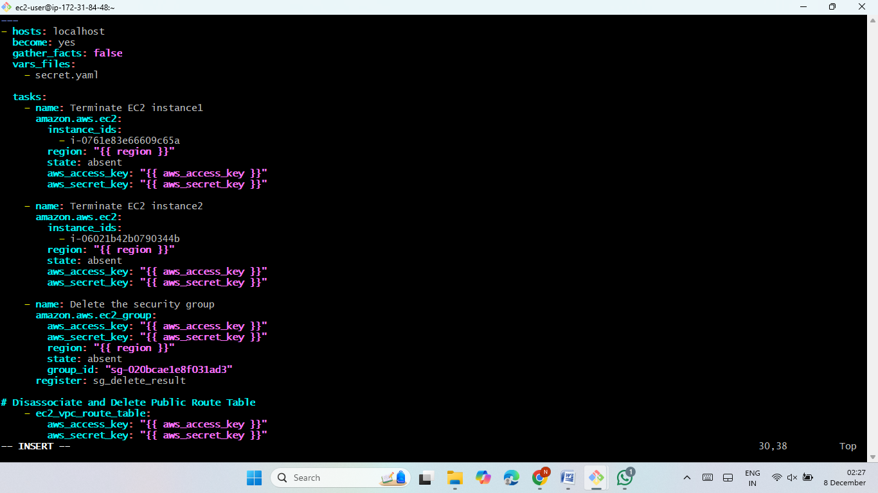
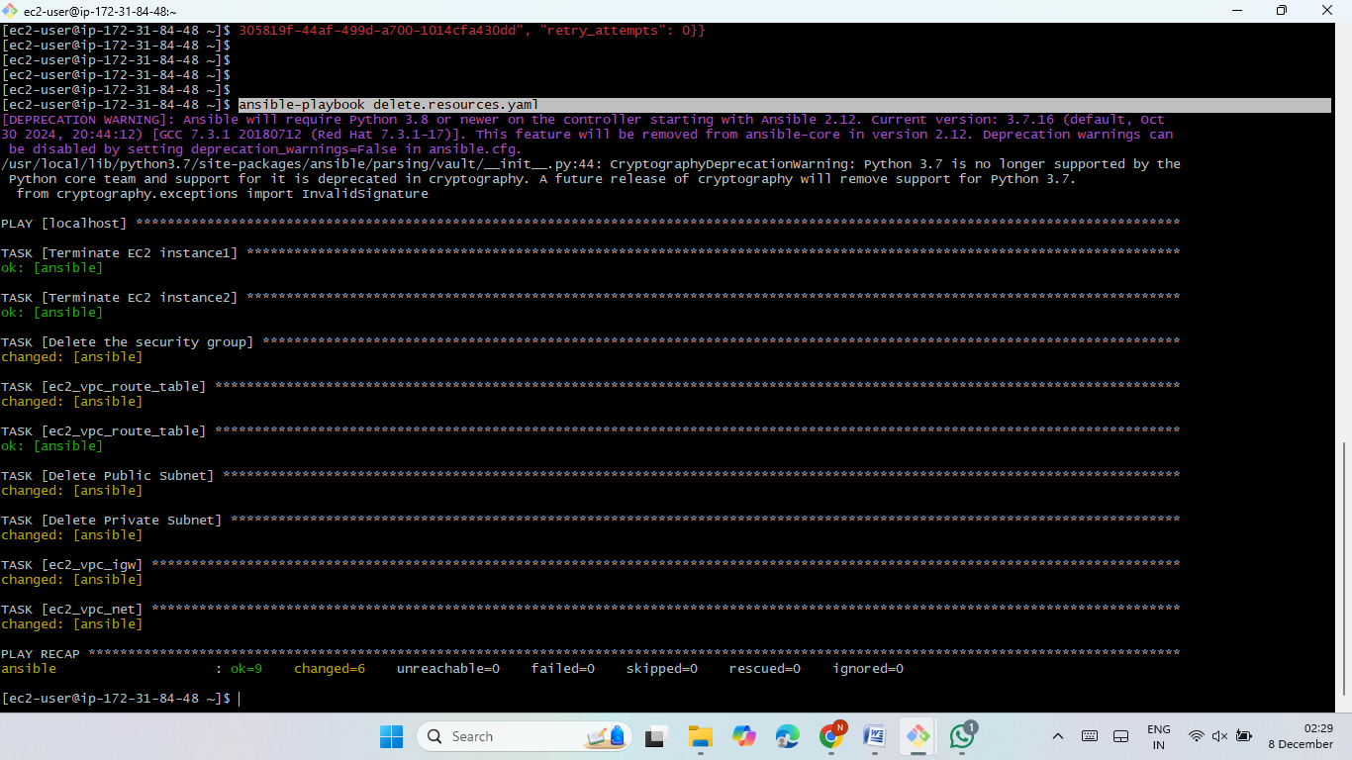
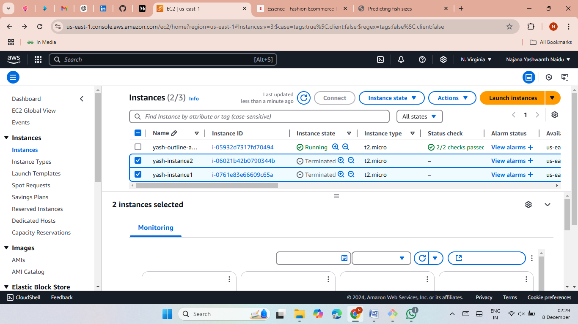

Slide 11
Security with Ansible Vault
Encrypt files using Ansible Vault:
ansible-vault encrypt <file>
Decrypt files:
ansible-vault decrypt <file>
Manage and reset file passwords:
ansible-vault rekey <file>

Slide 12
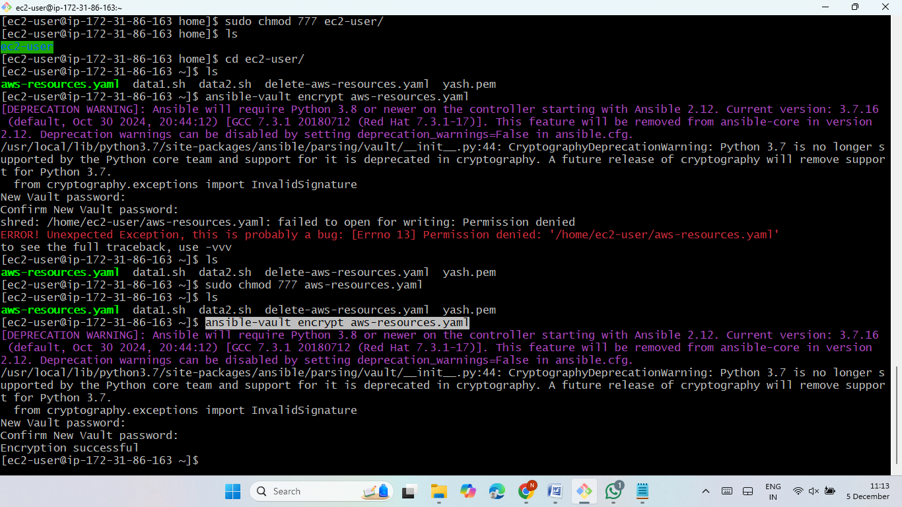
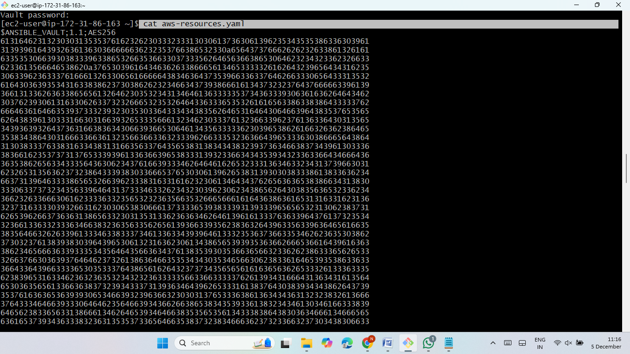
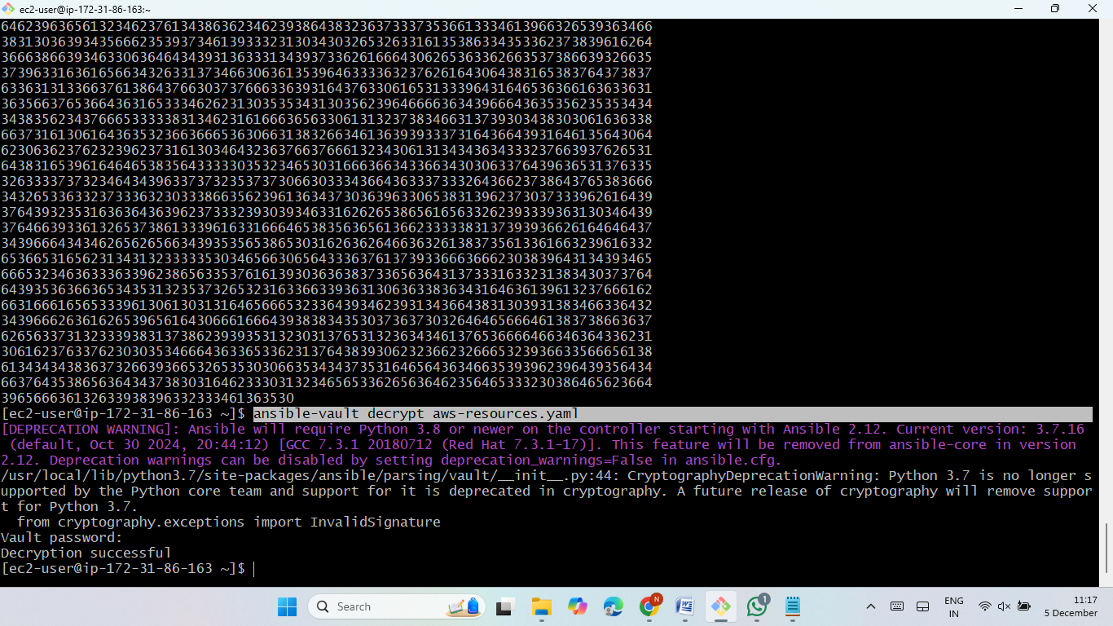
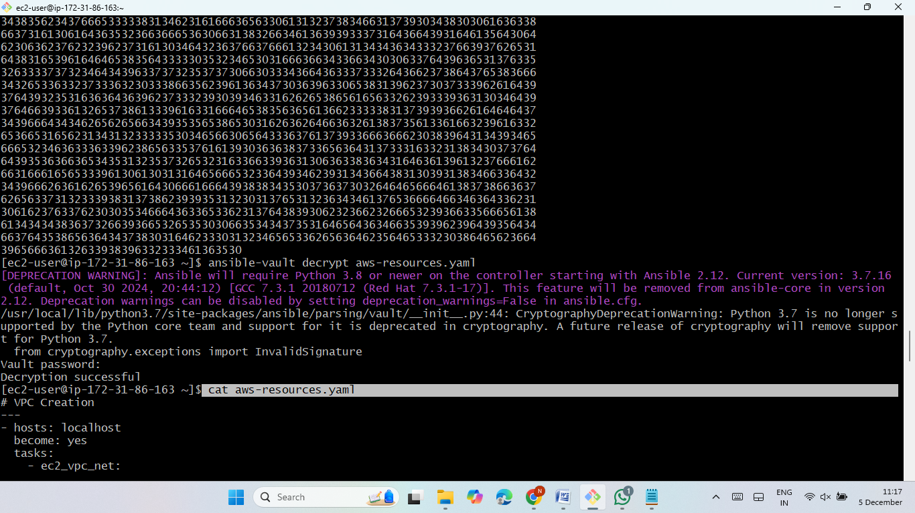

Slide 13
Conclusion
This project demonstrates:
Infrastructure automation using Ansible.
Hosting applications with efficient resource management.
Enhancing security with Ansible Vault.
Outcome:
Successful deployment of static and dynamic applications.
Automated and secure resource lifecycle management.

Slide 14
THANK YOU

