Slide 1

UE23CS320A – Project Phase -1 Review-2
Project Title :Drishti: AI-Powered Early Crisis Prediction and Advisory System.
Project ID :80
Project Guide :Prof.Nivedita Kasturi
Project Team :Varun Kumar Suresha (PES2UG23CS677)
Yashwanth S (PES2UG23CS717)
Varun S Mogaveera (PES2UG23CS680)
Yashwanth H S (PES2UG23CS716)

Slide 2
Drishti:
ai -powered early crisis prediction and advisory system

Slide 3
Proposed Solution:
INDEX
Introduction and Motivation
Problem Statement
Abstract and Scope
Suggestions from Review – 1
Research / Technology gap and Challenges
Objectives
Literature Survey / Existing System
References

Slide 4
MOTIVATION
Reactive Analysis Limitation: Current systems detect the effects of global crises only after they occur, leaving no scope for early preparedness.
Gap in Existing AI Solutions: Most AI models in agriculture focus on yield, weather, or price forecasting, overlooking the impact of geopolitical events.
Need for Economic Resilience: India’s agriculture sector, employing over half the population, remains highly exposed to external shocks like tariffs and trade bans.
Timely Decision-Making: Predictive insights can help farmers, policymakers, and industries take proactive, data-driven actions before a crisis unfolds.
Vision: Develop a scalable AI framework that begins with agriculture and extends to other vital sectors of the Indian economy.

Slide 5
Past Geopolitical Scenarios Affecting India:
USA imposed 50% tariff on Indian goods citing India’s import and resale of Russian oil (Aug 6, 2025).
Russia-Ukraine conflict (2022) led to a surge in global crude oil prices, impacting India’s oil import costs
China’s Ban on Certain Agricultural fertilizers to India (2021–2022)
India-Bangladesh trade curbs (2024–25): Bangladesh restricted Indian cotton yarn, rice, and imposed transit fees, disrupting exports and raising friction
Drishti: AI-Powered Early Crisis Prediction and Advisory System

Slide 6
Problem Statement:
Global geopolitical crises—manifesting through tariffs, sudden policy shifts, international conflicts, and large-scale trade disruptions—exert profound and multidimensional impacts on the Indian economy, with agriculture being disproportionately vulnerable. These exogenous shocks cascade across multiple economic layers, influencing export competitiveness, depressing GDP growth, destabilizing employment in rural and allied sectors, straining foreign exchange reserves, and triggering inflationary pressures. However, the systemic challenge lies in the fact that such consequences are often recognized only in a reactive manner—once significant losses have already materialized—rather than being anticipated and mitigated proactively.
Drishti fills this gap by providing an AI-powered early warning and advisory system, starting with Indian agriculture and scalable to other key sectors.
Drishti: AI-Powered Early Crisis Prediction and Advisory System

Slide 7
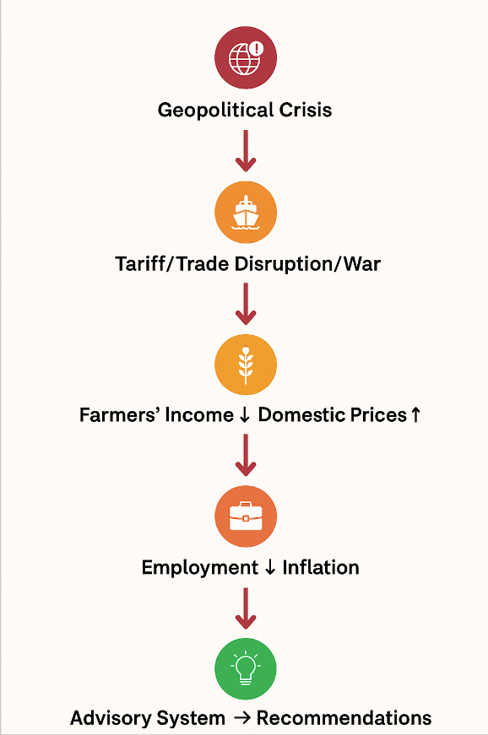
Real-Time News Monitoring
Continuously collect and analyse breaking news from global and local sources (News APIs, GDELT, verified media feeds).
Use NLP to classify and flag stories related to trade disruptions and other crisis triggers as they emerge.
Feed these flagged events straight into the impact-prediction model to forecast future effects.
Cascading Impact Modelling – Map cause-effect chains: Crisis → Trade disruption → Income ↓ → Prices ↑ → Employment ↓ → Inflation ↑ → GDP/Forex strain – Build dynamic knowledge graphs linking sectors, actors & regions
AI-Based Prediction & Advisory – Forecast sectoral and regional impacts with ML models – Deliver actionable recommendations to farmers, government & policymakers (e.g. buffer stocks, subsidies, crop diversification) – Provide risk dashboards with levels, timelines & scenarios
Proposed Solution: (with Cascading Effects)

Slide 8
ABSTRACT AND SCOPE
Problem & Context:
Global geopolitical crises (wars, tariffs, trade restrictions) severely impact India’s economy, especially agriculture.
These affect exports, GDP, and inflation, but impacts are understood only after losses occur.
No existing predictive system anticipates such consequences in advance.
Project Introduction & Scope:
Drishti is an AI-powered early warning and advisory system that uses ML and NLP to analyze global news, trade data, and policy trends.
It forecasts the economic and agricultural impacts of global events.
It forecasts the economic and agricultural impacts of global events, focusing specifically on Indian agriculture.
Objective & Adopted Approach: Aim: Predict and mitigate the effects of global geopolitical changes through data-driven insights.
Approach: Collect and process global data, extract patterns using NLP, train ML models to forecast impacts, and validate results for better decision-making and preparedness.

Slide 9
Proposed Solution:
Suggestions from Review - 1
How correct is the news data which you get on geopolitical events?
To ensure accuracy and reliability of geopolitical event data, the system follows a multi-layered verification approach:
Data Source Reliability:
News and event data are collected from trusted, high-reputation sources such as Reuters, Bloomberg, The Hindu Business Line, and government press releases.
APIs like GDELT (Global Database of Events, Language and Tone) and News API are used, which tag verified global events with metadata such as source reliability and geographic location.
Event Validation Module:
Each collected event is cross-checked against multiple independent news outlets.
Only events with at least two verified mentions and consistent metadata (location, time, involved countries) are accepted.
Noise Filtering & NLP-based Cleaning:
NLP filters remove rumors, opinions, and irrelevant mentions.
Named Entity Recognition (NER) ensures that events actually involve recognized geopolitical entities (e.g., India, Russia, OPEC)

Slide 10
Research / Technology Gap
Existing AI models in agriculture focus mainly on crop yield and price prediction.
They do not capture the indirect effects of global geopolitical crises such as trade bans, conflicts, or policy changes.
Current systems are largely reactive, offering insights only after economic losses occur.
There is a lack of integrated modeling that connects cascading economic impacts — (Trade → Income → Inflation → GDP).
Real-time integration of global event data from news and policy sources is still limited.
Sector-specific advisories based on geopolitical impact analysis remain underexplored.
These gaps highlight the need for an AI-powered early prediction and advisory system, which Drishti aims to fulfill.

Slide 11
Challenges for Proposed Work
Data Gaps: Incomplete/irregular data on crises & trade.
Uncertainty: Geopolitical events are sudden & unpredictable.
Model Complexity: Integration of time-series, NLP, sentiment analysis.
Interpretability: Need to simplify outputs for non-technical users.

Slide 12
OBJECTIVES
1. Event Identification & Categorization:To systematically identify and classify global geopolitical events (conflicts, trade sanctions, policy shifts, etc.) that can potentially impact the Indian economy, especially agriculture.
2. Sector Mapping:To establish a linkage between specific event types and the Indian agricultural sector — by mapping affected trade partners, commodities, and dependencies.
3. Data Integration:To build a comprehensive dataset combining geopolitical event data, trade statistics, and economic indicators for India.
4. Impact Analysis & Prediction:To quantify and predict the magnitude of impact (on exports, production, prices, farmer income, etc.) caused by such events using machine learning models (e.g., regression, neural networks)
5. Cascading Effect Modeling:To analyze the indirect or spillover effects of agricultural disruptions on related sectors such as manufacturing, logistics, and retail.
6. Advisory & Decision Support:To generate policy and business advisory insights that can guide stakeholders (government, traders, farmers) to mitigate risks and respond proactively to global shocks.
7. Validation & Visualization:validate model accuracy using historical data (e.g., Russia–Ukraine war, COVID trade disruption) and visualize results using dashboards or maps.

Slide 13
SCOPE
Domain: Impact analysis of global geopolitical events on Indian sectors (starting with agriculture).
Focus: Early warning, forecasting, and advisory system.
Coverage:
Agriculture (exports, yields, pricing, farmer income, supply chain).
Ripple effects on GDP, employment, forex, inflation.
Stakeholders: Farmers, policymakers, trade bodies, financial institutions.

Slide 14
Sl.No | Title of the publication with Publisher | Authors/Year | Methodology Used | Result | Limitations
1. | The Interplay of Geopolitics and Agricultural Commodity Prices | Raghav Goyal December 9, 2023 | Time-Varying Parameter Vector Autoregression (TVP-VAR) model to estimate direct and indirect impacts of geopolitical risks on corn and soybean futures prices | Geopolitical Risk (GPR) significantly affects corn and soybean futures prices, especially through exports, input costs, and speculation. Effects vary over time — negative before 2018 and positive after. | Limited to corn and soybean markets; does not include other agricultural commodities or long-term structural impacts. The GPR (Geopolitical Risk) index may not fully capture all forms of geopolitical uncertainty.
2 | GEOPOLITICS, GEOECONOMICS AND RISK: A MACHINE LEARNING APPROACH | Alvaro Ortiz Tomasa Rodrigo 2025 | Used a TVP-VAR model to analyze direct and indirect impacts of Geopolitical Risk (GPR) on U.S. corn and soybean futures. Data from GPR Index (Caldara & Iacoviello, 2022), CME, Bloomberg, and FRED. | Geopolitical risks have a significant and time-varying impact on corn and soybean prices. Strongest effects occur through exports and input prices. Market reactions shifted from negative (pre-2018) to positive (post-2018). Major shocks like the U.S.–China trade war and Russia–Ukraine conflict influence speculation and stock behavior. | Focuses only on U.S. corn and soybean markets. Does not include other crops or long-term structural shifts. The GPR index may not fully capture all geopolitical tensions or country-specific shocks.

Slide 15
Sl.No | Title of the publication with Publisher | Authors/Year | Methodology Used | Result | Limitations
1. | Machine Learning-Driven Governance: Predicting the Effectiveness of International Trade Policies through Policy and Governance Analytics. | Emran Hossain 2024 | Used multiple ML algorithms such as Random Forest, Gradient Boosting, LSTM, Regression, NLP, and Clustering on datasets covering 70+ countries over 20 years. Compared against traditional econometric models | ML models improved trade policy outcome prediction accuracy by up to 25–30% over traditional econometric methods. Feature importance showed GDP, world events, and commodity prices as key drivers. Enabled faster, data-driven policy decisions. | Data quality inconsistencies; model transparency issues (black-box models); ethical concerns (privacy, bias); limited generalizability to unseen policy contexts; need for explainable AI in policymaking.
2 | News Event-Driven Forecasting of Commodity Prices | Chakraborty, Subramanian 2024 | Proposed a Recurrent Event Network (REN) — a neural network combining LSTM-based RNNs with automatically extracted news events from 1.6M news articles (15 years) and daily price data of onions, potatoes, rice, and wheat in India. | The model outperformed traditional models (ARIMA, word2vec, doc2vec, LDA) by up to 13% in accuracy. Identified key event types (“natural”, “hike”, “policy”, “elections”) influencing prices. Demonstrated interpretability through event importance scores. | Dependent on availability and reliability of large-scale news data; potential noise in event extraction; limited to Indian commodities; requires high computational resources; possible lag in response to unseen event types.

Slide 16
Sl.No | Title of the publication with Publisher | Authors/Year | Methodology Used | Result | Limitations
1. | A Study on the Impact of External Shocks on the Resilience of China’s Grain Supply Chain | [Author names vary by version; China Agricultural University Research Team, 2022 / 2023]* | • Used daily data (2000–2022) of GPR and agricultural futures. • Applied ADF test for stationarity. • Employed VAR & Granger causality tests to find impact of GPR on commodity prices. | • Shows how pandemics, wars, and trade bans impact China’s grain production, imports, and logistics. • Highlights importance of building resilient food systems under global shocks. | • Country-specific (China only). • Focused only on supply chain resilience, not prices or economy. • Uses historical data—no forecasting. • Lacks early-warning or AI-based predictive model.
2 | Assessing the Causality Relationship between the Geopolitical Risk Index and the Agricultural Commodity Markets (MDPI – Risks Journal, 2023) | Joseph Micallef, Simon Grima, Jonathan Spiteri, Ramona Rupeika-Apoga (2023) | • Used daily data (2000–2022) of GPR and agricultural futures. • Applied ADF test for stationarity. • Employed VAR & Granger causality tests to find impact of GPR on commodity prices. | • Shows how GPR Threat & GPR Act affect commodity prices like wheat, oats, coffee, and soybean oil. • Demonstrates link between geopolitical instability and agricultural price volatility. • Highlights the importance of including GPR in food security policies. | • Focuses only on historical daily data (2000–2022). • VAR model limited to causality, not prediction. • Doesn’t classify events (e.g., war, trade ban, policy). • No regional (India-specific) focus..

Slide 17
Sl.No | Title of the publication with Publisher | Authors/Year | Methodology Used | Result | Limitations
1. | The Effects of Geopolitical Uncertainty in Forecasting Financial Markets: A Machine Learning Approach | Vasilios Plakandaras, Periklis Gogas, and Theophilos Papadimitriou; 20-12-2018 | Support Vector Regression (SVR) & OLS models using 120-observation rolling windows; MAPE metric | Gold prices: strong forecasting ability; Oil & exchange rates: limited predictive power; Stock indices: failed to outperform baseline dataset-14 emerging countries ; tested on oil, exchange rates, gold, stock indices | Geopolitical effects are transitory & regional; difficult to detect in monthly data; limited newspaper coverage of emerging markets
2 | Enhancing Financial Crisis Prediction with AI: Leveraging Historical Data and Machine Learning for Systemic Risk Management | N. Rajeswaran, IMS Unison University, Dehradun (2025) | Random Forest (RF) algorithm with data preprocessing (mean imputation, min-max normalization, Z-score outlier detection, RFE feature selection); Binary classification on MacroHistory database | Key Predictors: Credit growth + asset bubbles + liquidity constraints + volatility​ Critical Pattern: Domestic credit expansion + flat/inverted yield curves = crises​ Superiority: Machine learning > Traditional econometric models in pattern detection​ | Data quality issues, algorithm bias, interpretability challenges, regulatory compliance concerns; overfitting risks; limited to advanced economies ​

Slide 18
PROJECT TIME LINE
2
3
4
1
Literature survey on global crises &agriculture.
Define scope, stakeholders, and deliverables
. Design high-level system architecture.
Collect crisis, trade & agriculture datasets.
Preprocess data & engineer features.
Build baseline ML models for impact prediction
Develop advanced forecasting models.
Add scenario-based “what-if” simulations.
Build advisory framework with sectoral alerts
Run final experiments & validate outputs.
Refine advisory system for usability.
Write report, publish findings, and propose future work

Slide 19
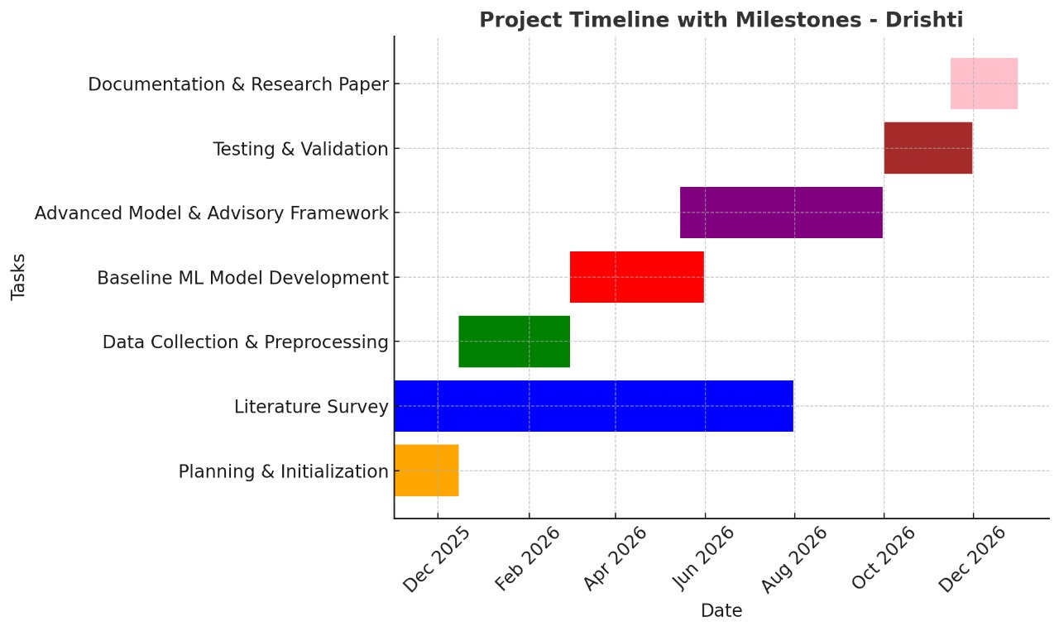
Gantt chart
T

Slide 20
References
Frontiers in Operations: News Event-Driven Forecasting of Commodity Prices | Manufacturing & Service Operations Management
https://www.mdpi.com/2227-9091/11/5/84
https://acr-journal.com/article/download/pdf/1359/
https://ouci.dntb.gov.ua/en/works/4bzb32W4/

Slide 21
Thank
YOU

