Slide 1
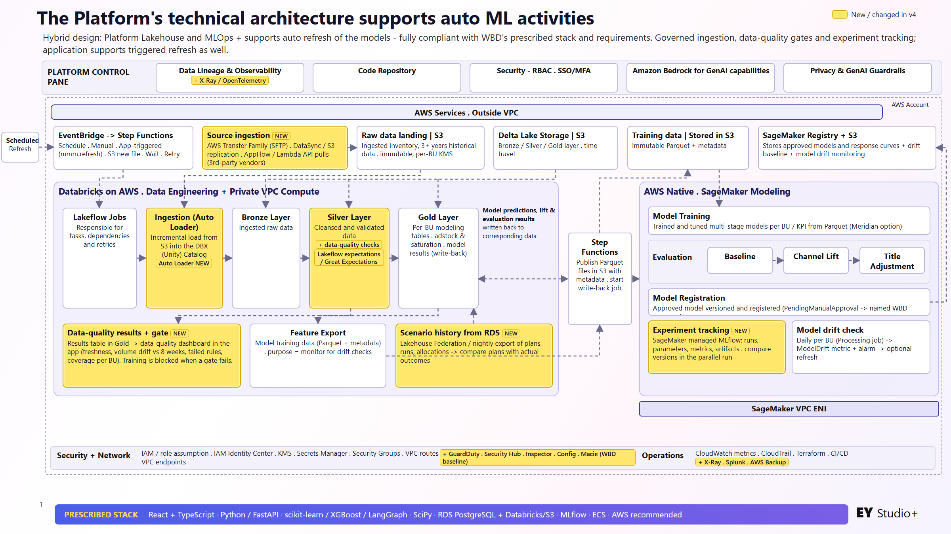
Notes:
v4 auto ML architecture. Yellow = new or changed vs wbd_Presentation_3: source ingestion, Auto Loader, data-quality checks and gate, scenario history from RDS, SageMaker managed MLflow, X-Ray/OpenTelemetry, WBD security baseline, AWS Backup.

Slide 2
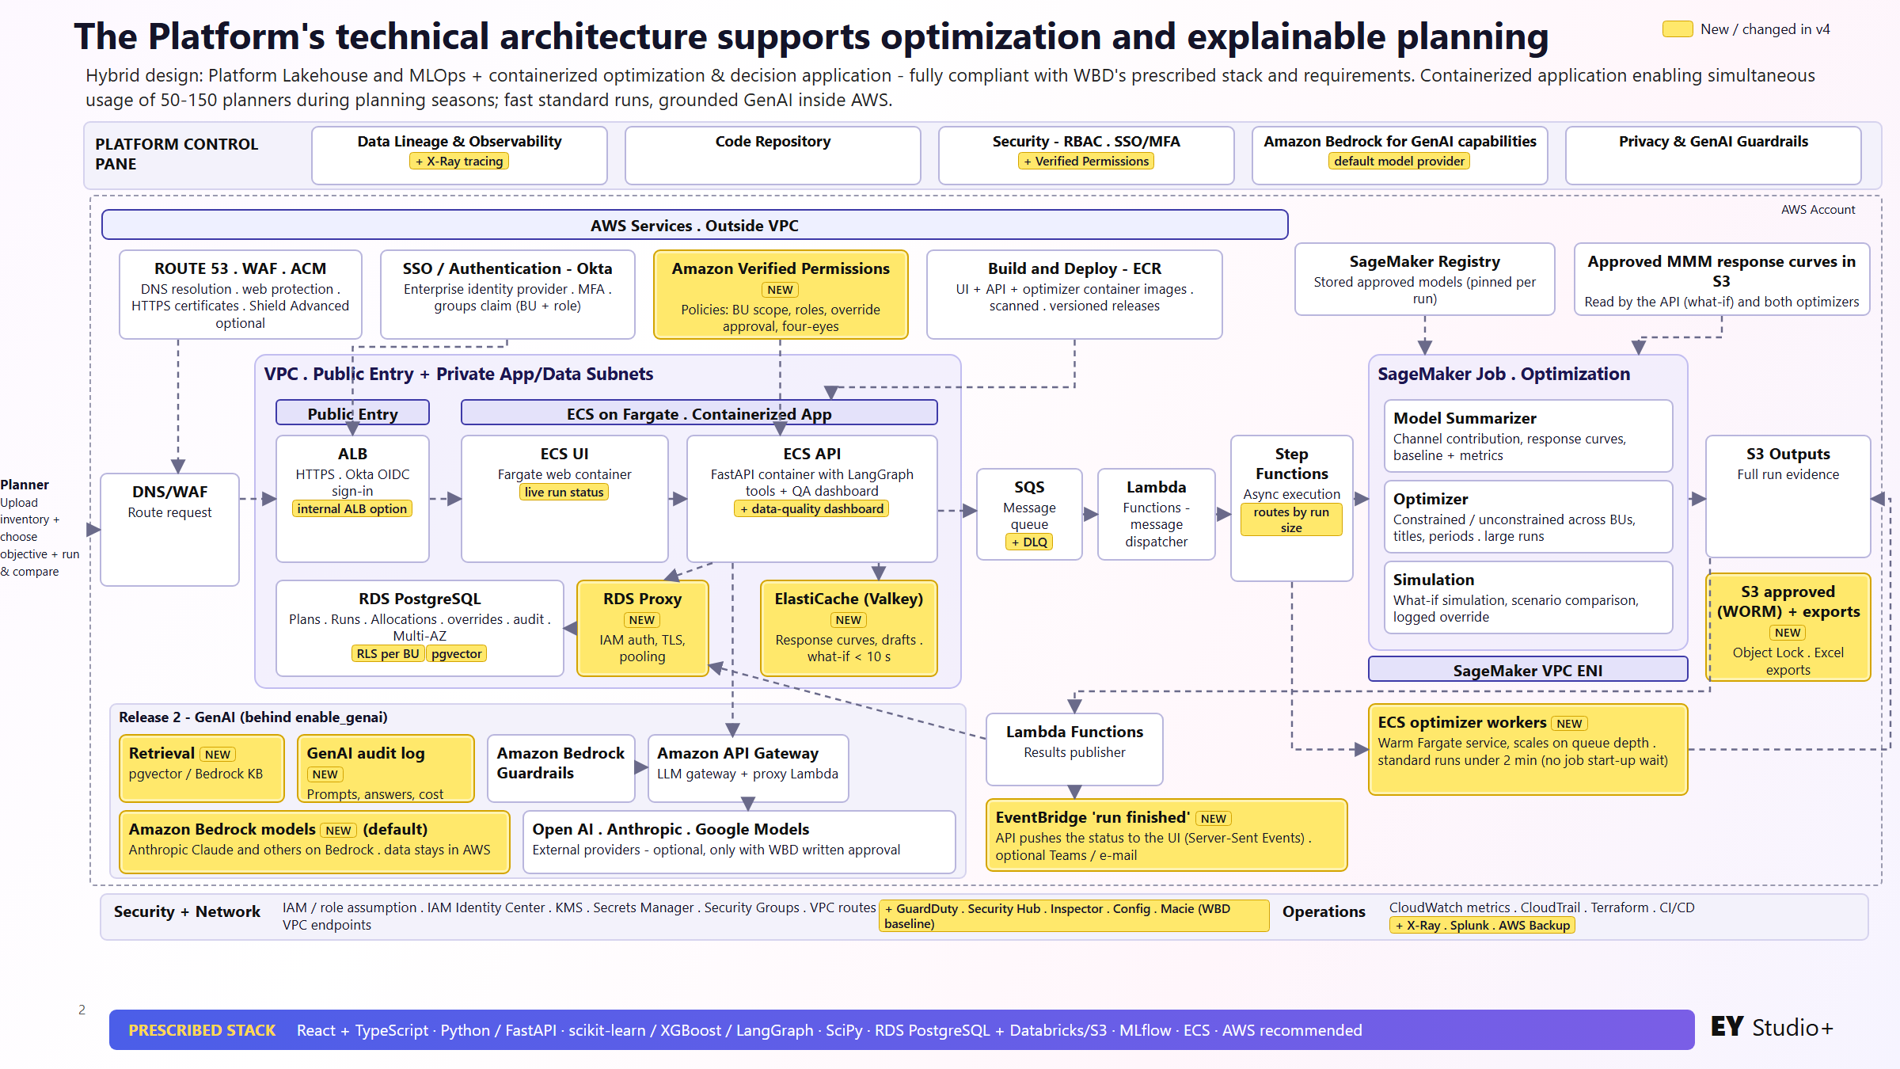
Notes:
v4 optimization and planning architecture. Yellow = new or changed: Verified Permissions, RDS Proxy, ElastiCache, ECS optimizer workers, S3 WORM + exports, EventBridge run finished, retrieval, GenAI audit log, Bedrock models as default, DLQ, routing by run size, RLS/pgvector.

Slide 3
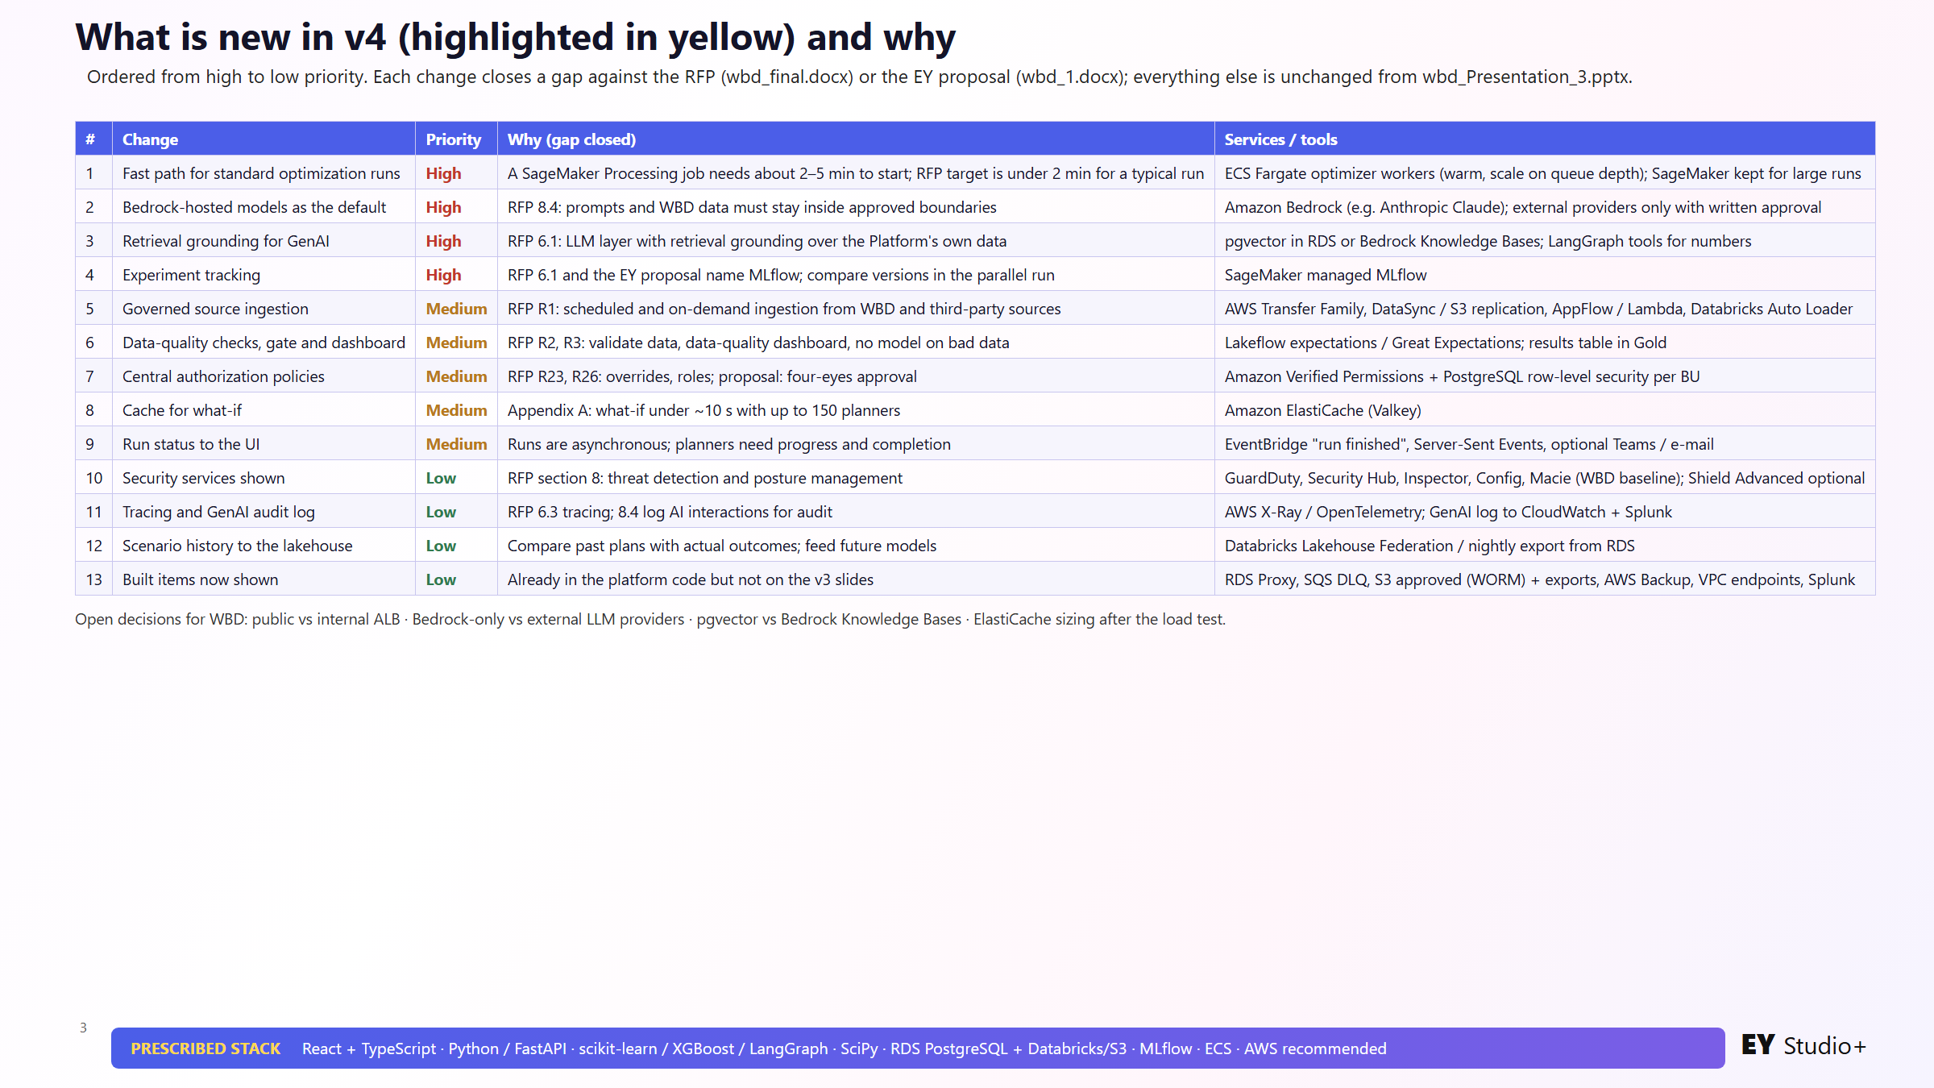
Notes:
Summary of the 13 v4 changes ordered high to low priority with the RFP gap each one closes.

