Slide 1



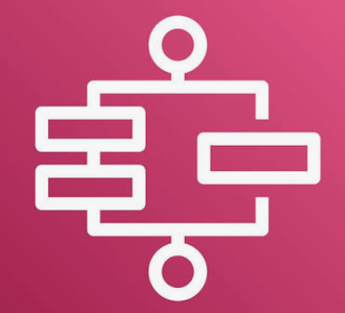
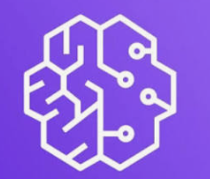





The Platform’s technical architecture supports auto ML activities
Hybrid design: Platform Lakehouse and MLOps + supports auto refresh of the models — fully compliant with WBD's prescribed stack and requirements. Application supports triggered refresh as well.
PLATFORM CONTROL PANE
Data Lineage & Observability
Code Repository
Amazon Bedrock for GenAI capabilities
Privacy & GenAI Guardrails
Security – RBAC . SSO/MFA
AWS Services . Outside VPC
AWS Account
EventBridge -> Step Functions
Schedule / Manual . Wait / Retry
Raw data coming from Databricks coming to S3
Ingested inventory 3+ years historical data
Delta Lake Storage | Backed by S3
Bronze / Silver / Gold layer
Training data | Stored in S3
Immutable Parquet + metadata
SageMaker Registry + S3
Stores approved models and response curves + model drift monitoring
Scheduled Refresh
Glue Export
Databricks on AWS
AWS Glue
AWS Native . SageMaker Modeling
Databricks Source Catalog
Responsible Export via jobs APIs
Bronze Layer Ingested Raw data
Silver Layer
Cleansed and validated data
Gold Layer
Per-BU modeling tables
Adstock & saturation
Lambda Functions
Results publisher
Glue Export
Model Training
Trained and Tuned multi-stage models from the Parquet files
Databricks API connector
Evaluation
Baseline
Channel Lift
Title Adjustment
INGEST
Lambda Functions
Results publisher
Model Registration
Approved model versioned and registered
SageMaker VPC ENI
Glue Export
RDS PostgreSQL
Plans . Runs . Allocations
Model Predictions, Lift & Evaluation results written in RDS for corresponding dataset
Security + Network IAM / role assumption . IAM Identity Center . KMS . Secrets Manager . Security Groups . VPC routes Logging/Operations CloudWatch metrics . CloudTrail . Terraform . CI/CD
PRESCRIBED STACK
React + TypeScript · Python / FastAPI · scikit-learn / XGBoost/LangGraph · SciPy · RDS PostgreSQL + Databricks/S3 · ECS · AWS recommended

Slide 2




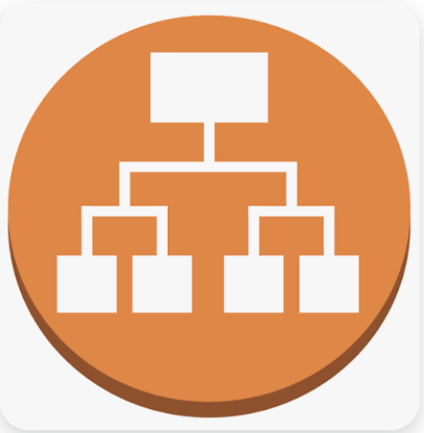




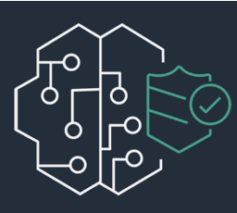


The Platform’s technical architecture supports optimization and explainable planning
Hybrid design: MLOps + containerized optimization & decision application with GenAI capabilities — fully compliant with WBD's prescribed stack and requirements. Containerized application enabling simultaneous usage of 50-150 planners during planning seasons.
PLATFORM CONTROL PANE
Data Lineage & Observability
Code Repository
Amazon Bedrock for GenAI capabilities
Privacy & GenAI Guardrails
Security – RBAC . SSO/MFA
AWS Services . Outside VPC
AWS Account
ROUTE 53 . WAF . ACM
DNS Resolution . Web Protection . HTTPS Certificates
SSO / Authentication - Okta
Enterprise Identity Provider used for authentication and RBAC
Build and Deploy – ECR
UI + API container Images . Versioned releases
S3
Store user input files
SageMaker Registry
Stored approved models
Approved MMM response curves in S3
VPC . Public Entry + Private App/Data Subnets
Public Entry
ECS on Fargate . Containerized App
DNS/WAF
Route request
ALB
HTTPS
ECS UI
Fargate Web Container with QA Dashboard
ECS API
Fargate API Container
With LangGraph tools (invoke explanation tool by default for every run)
Step Functions
Async Execution
Upload Inventory + choose objective + run & Compare
OR
Upload Future titles
ECS Inference and Optimization Fargate container
SQS
Lambda functions – message dispatcher
Model Summarizer
INGEST
Optimizer
Simulation
RDS PostgreSQL
Plans . Runs . Allocations
S3 Outputs
Full Run Evidence
Amazon API Gateway
Amazon Bedrock Guardrails
Lambda Functions
Results publisher
Open AI Models
Anthropic Models
Google Models
Security + Network IAM / role assumption . IAM Identity Center . KMS . Secrets Manager . Security Groups . VPC routes Logging/Operations CloudWatch metrics . CloudTrail . Terraform . CI/CD
PRESCRIBED STACK
React + TypeScript · Python / FastAPI · scikit-learn / XGBoost/LangGraph · SciPy · RDS PostgreSQL + Databricks/S3 · ECS · AWS recommended

