Slide 1


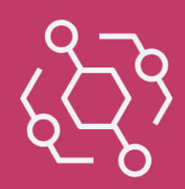
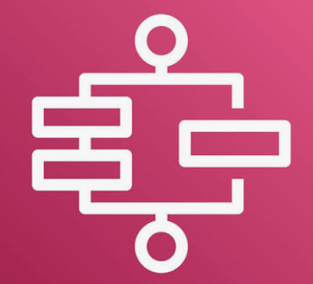
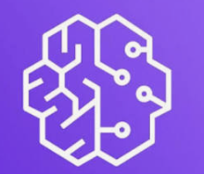





The Platform’s technical architecture supports auto ML activities
Hybrid design: Platform Lakehouse and MLOps + supports auto refresh of the models — fully compliant with WBD's prescribed stack and requirements. Application supports triggered refresh as well.
PLATFORM CONTROL PANE
Data Lineage & Observability
Code Repository
Amazon Bedrock for GenAI capabilities
Privacy & GenAI Guardrails
Security – RBAC . SSO/MFA
AWS Services . Outside VPC
AWS Account
EventBridge -> Step Functions
Schedule / Manual . Wait / Retry
Raw data coming from Databricks coming to S3
Ingested inventory 3+ years historical data
Delta Lake Storage | Backed by S3
Bronze / Silver / Gold layer
Training data | Stored in S3
Immutable Parquet + metadata
SageMaker Registry + S3
Approved models and response curves + lineage + model drift monitoring
KMS
KMS
KMS
Scheduled Refresh
KMS
Glue Export
Databricks on AWS
AWS Glue + Data Catalog (Lineage)
AWS IAM
AWS Native . SageMaker Modeling
Databricks Source Catalog
Responsible Export via jobs APIs
AWS IAM
Bronze Layer Ingested Raw data
Silver Layer
Cleansed and validated data
Gold Layer
Per-BU modeling tables
Adstock & saturation
Lambda Functions
Export Trigger
Glue Export
Model Training
Trained and Tuned multi-stage models from the Parquet files
AWS IAM
Databricks API connector
Evaluation
AWS IAM
Baseline
Channel Lift
Title Adjustment
INGEST
Lambda Functions
Results/data publisher
Model Registration
Approved model versioned and registered
Environment Level component
Secrets Manager – Stores credentials for APIs, RDS and other integration secrets
VPC Routes – Private network paths for integrations between services
CloudWatch – To be enabled across all components
CloudTrail – To be enabled across all components
Glue Export
SageMaker VPC ENI
RDS PostgreSQL
Plans . Runs . Allocations
Model Predictions, Lift & Evaluation results written in RDS for corresponding dataset
Security + Network IAM / role assumption . IAM Identity Center . KMS . Secrets Manager . Security Groups . VPC routes Logging/Operations CloudWatch metrics . CloudTrail . Terraform . CI/CD
PRESCRIBED STACK
React + TypeScript · Python / FastAPI · scikit-learn / XGBoost/LangGraph · SciPy · RDS PostgreSQL + Databricks/S3 · ECS · AWS recommended

Slide 2




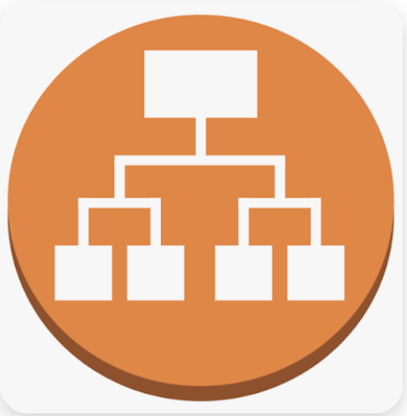




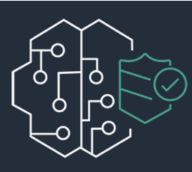


The Platform’s technical architecture supports optimization and explainable planning
Hybrid design: MLOps + containerized optimization & decision application with GenAI capabilities — fully compliant with WBD's prescribed stack and requirements. Containerized application enabling simultaneous usage of 50-150 planners during planning seasons.
PLATFORM CONTROL PANE
Data Lineage & Observability
Code Repository
Amazon Bedrock for GenAI capabilities
Privacy & GenAI Guardrails
Security – RBAC . SSO/MFA
AWS Services . Outside VPC
AWS Account
ROUTE 53 . WAF . ACM
DNS Resolution . Web Protection . HTTPS Certificates
Build and Deploy – ECR
UI + API container Images . Versioned releases
S3
Store user input files
SageMaker Registry
Stored approved models
Approved MMM response curves in S3
SSO / Authentication - Okta
Enterprise Identity Provider used for authentication and RBAC
IAM Identity Center
KMS
AWS IAM
KMS
AWS IAM
AWS IAM
User file upload to S3
VPC . Public Entry + Private App/Data Subnets
Public Entry
ECS on Fargate . Containerized App
AWS IAM
DNS/WAF
Route request
ALB
HTTPS
ECS UI
Fargate Web Container with QA Dashboard
ECS API
Fargate API Container
With LangGraph tools (invoke explanation tool by default for every run)
AWS IAM
Step Functions
Async Execution
AWS IAM
Upload Inventory + choose objective + run & Compare
OR
Upload Future titles
ECS Inference and Optimization Fargate container
SQS
Lambda functions – message dispatcher
Model Summarizer
INGEST
Optimizer
AWS IAM
Simulation
RDS PostgreSQL
Plans . Runs . Allocations
S3 Outputs
Full Run Evidence
AWS IAM
Amazon API Gateway
Amazon Bedrock Guardrails
AWS IAM
Lambda Functions
Results publisher
Not part of R1
Environment Level component
Secrets Manager – Stores credentials for APIs, RDS and other integration secrets
VPC Routes – Private network paths for integrations between services
CloudWatch – To be enabled across all components
CloudTrail – To be enabled across all components
Open AI Models
Anthropic Models
Google Models
Security + Network IAM / role assumption . IAM Identity Center . KMS . Secrets Manager . Security Groups . VPC routes Logging/Operations CloudWatch metrics . CloudTrail . Terraform . CI/CD
PRESCRIBED STACK
React + TypeScript · Python / FastAPI · scikit-learn / XGBoost/LangGraph · SciPy · RDS PostgreSQL + Databricks/S3 · ECS · AWS recommended

