Slide 1


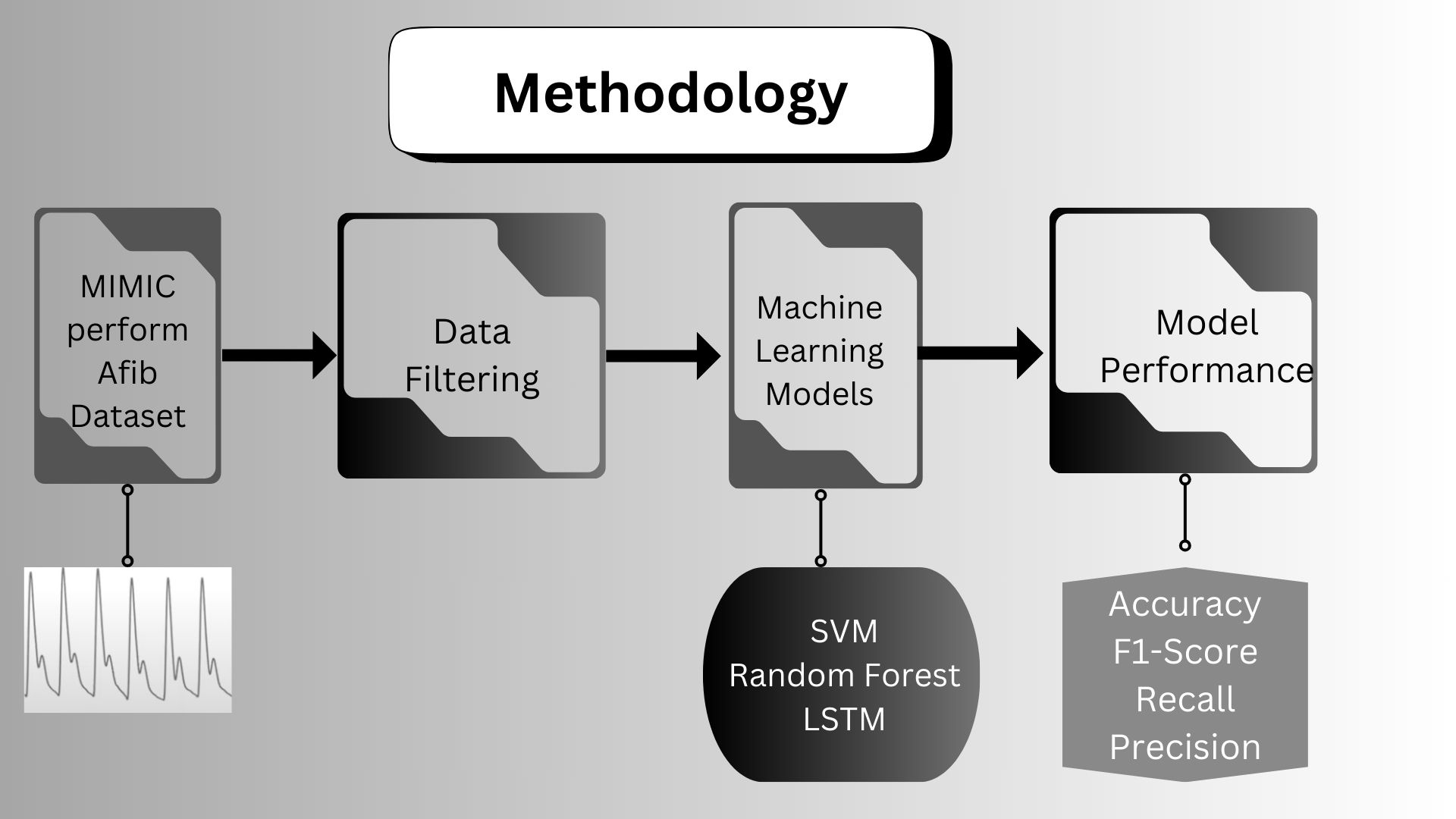
Detection of Atrial Fibrillation Using PPG
Team: Yashwanth,B.Tech CSE; Ravi Kiran,B.Tech CSE, Dinesh, B.Tech CSE,
Mentor: Dr.Mamta Arora Associate Professor, Dept. of CST
Manav Rachna University, Faridabad
Motivation
Methododology
Photoplethysmography (PPG) sensors are one of the widely used sensors today. From wearable bands to clinical machines, PPG is widely used to detect heart rate and rhythm. Although the origins of the components of the PPG signal are not fully understood, it is generally accepted that they can provide valuable information about the cardiovascular system. There has been a resurgence of interest in the technique in recent years, driven by the demand for low-cost, simple, and portable technology for primary care and community-based clinical settings, the wide availability of low-cost and small semiconductor components, and the advancement of computer-based pulse wave analysis techniques. PPG signal is potentially used in Atrial fibrillation (AF) detection for its convenience and similarity in physiological origin to electrocardiogram (ECG). Previous studies have shown the possibility of using the peak-to-peak interval of the PPG signal in AF detection. In this study, we implement a model that combines time-frequency analysis with deep learning and identifies AF based on PPG.
Introduction
Performance
In recent years, PPG has been studied for long-term monitoring of AF, because of the ease of use and their utilization using wearable and mobile devices. PPG monitoring incorporated into wearable technologies might permit improvements in the detection rate of AF in high-risk patients. Past studies using PPG for AF detection relied on predetermined feature extractions, for example, root-mean-square of successive difference of RR intervals (RMSSD) with Shannon entropy (ShE), and machine learning techniques such as the support vector machine (SVM), artificial neural network, and k-nearest neighbor (KNN)
Model | Epochs | Training accuracy | Training Loss | Validation accuracy | Validation loss
CNN | 10 | 0.57 | 0.95 | 0.61 | 0.79
 | 15 | 0.72 | 0.63 | 0.72 | 0.62
 | 45 | 0.83 | 0.46 | 0.76 | 0.55
 | 100 | 0.97 | 0.6 | 0.91 | 0.29
Figure 1.Sample Dataset
Aim
Results
Table : Performance of model through various epochs
The objective is to develop efficient, non-invasive machine learning model for diagnosing and monitoring AF, a common cardiac arrhythmia characterized by irregular and rapid heart rhythms.
Conclusions
classes | No of Images before Augmentation | No of Images after Augmentation
C0(No cavity) | 20 | 238
C1(Beginning stage) | 76 | 867
C2(Moderate Stage) | 40 | 464
C3(Severe stage) | 52 | 694
Total | 196 | 2550
In conclusion, our project demonstrates effectiveness of machine learning in detecting and classifying dental cavity. After data augmentation, a CNN model was used to detect and classify the cavity. After many experiments and hyper parameter tuning, the highest training accuracy achieved by the model is around 97%.
Table 1.Sample Dataset
Figure2 : Performance of Model
Contact:
References:
​[1] N. Bhattacharjee, “Automated Dental Cavity Detection System Using Deep Learning and Explainable AI.”
​[2] E. Y. Park, H. Cho, S. Kang, S. Jeong, and E. K. Kim, “Caries detection with tooth surface segmentation on intraoral photographic images using deep learning,” BMC Oral Health, vol. 22, no. 1, Dec. 2022, doi: 10.1186/s12903-022-02589-1.
​[3] International Conference on Software Engineering Advances 11. 2016 Rom et al., ICSEA 2016 the Eleventh International Conference on Software Engineering Advances : August 21-25, 2016, Rome, Italy.
​[4] F. Casalegno et al., “Caries Detection with Near-Infrared Transillumination Using Deep Learning,” J Dent Res, vol. 98, no. 11, pp. 1227–1233, Oct. 2019, doi: 10.1177/0022034519871884.
​[5] M. T. G. Thanh, N. Van Toan, V. T. N. Ngoc, N. T. Tra, C. N. Giap, and D. M. Nguyen, “Deep Learning Application in Dental Caries Detection Using Intraoral Photos Taken by Smartphones,” Applied Sciences (Switzerland), vol. 12, no. 11, Jun. 2022, doi: 10.3390/app12115504.,
6] S. Ngnamsie Njimbouom, K. Lee, and J. D. Kim, “MMDCP: Multi-Modal Dental Caries Prediction for Decision Support System Using Deep Learning,” Int J Environ Res Public Health, vol. 19, no. 17, Sep. 2022, doi: 10.3390/ijerph191710928. etc
Baddipadaga Yashwanth
Manav Rachna University Email:yashwanthreddy2616@gmail.com
Phone: 9391303369
Jami Ravi Kiran
Manav Rachna University Email:ravikiran1357924680@gmail.com
Phone: 7981380305
Dinesh Chowdary
Manav Rachna University Email:dineshchowdary343@gmail.com
Phone: 9182289420
Dr. Mamta Arora(Mentor)
Manav Rachna University
Email: mamta@mru.edu.in
Phone: 9873599315

