Slide 1
A Comparison of Algorithms for the Generation of Layouts based on Reconfigurable Slots on FPGAs
Supervisors: Prof. Dr. Marco Platzner and Prof. Dr. Sybille Hellebrand
Student: Yashwanth Tadakamalla
ID:6896890
Yashwant@mail.uni-Paderborn.de

Slide 2
Outline
Introduction
Background
Optimization Problem
Decision Problem
Results and Experimentation
Conclusion

Slide 3
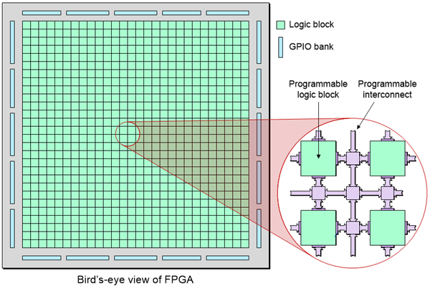
Introduction
What is a Field Programmable Gate Array (FPGA) ?
Placement is one of the most critical
stages in the design of FPGAs.
While executing real-time tasks on
FPGA there is always a tight
interdependency between scheduling
and placement.
Notes:
Field Programmable Gate Array is an integrated circuit that can be reprogrammed after manufacturing to perform any desired logic function. Unlike application-specific integrated circuits, FPGAs offer fexibility and customization to meet specific requirements.FPGAs provide several advantages over traditional CPUs and GPUs, such as higher processing speeds and lower latency. FPGAs find extensive applications in various domains, specially embedded systems.
Within the field of FPGA design, the placement of logic components is a critical stage that significantly influences the system performance. Placement involves establishing precise locations for the various logic components. Placement generally considers routing between the modules. However, there are scenarios where modules exist independently.By removing the constraint of interconnections, we can focus on optimizing other aspects of placement, such as area utilization, resource allocation, and overall performance.
When working with FPGAs in real-time settings, placement becomes even more critical as it directly affects the performance of the system. When executing real-time tasks on FPGA there is always a tight interdependency between scheduling and placement. While scheduling determines the sequence of task executions, placement decides to which location on the reconfigurable fabric a specific task is mapped.

Slide 4
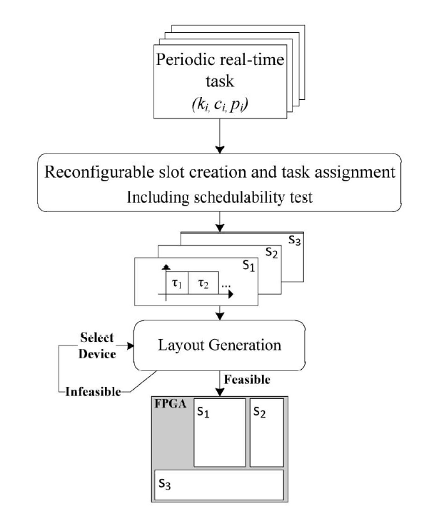
Introduction
In [1], the authors have proposed a 2D slot-based reconfiguration model.
Simulated Annealing and Evolutionary Strategy algorithms.
Layout generation Problem
Optimization problem
Decision problem
Notes:
In a paper, the authors have re-visited the problem of scheduling and placing of periodic real-time tasks on FPGAs. Here a 2D slot based reconfiguration area model has been introduced. The picture depicts the approach for mapping periodic real time tasks on the FPGA. In this approach scheduling and the placement problem is turned into the two
novel problems of creating reconfigurable slots of proper size and allocating them on the FPGA. In this approach the real time task first undergo slot creation and task assignment step which in turn provides us the reconfigurable slots with proper size in micro slots. These reconfigurable slots under go layout generation to get placed on the FPGA. Here in this work we concentrate on the layout generation problem. Authors have proposed heuristic and optimal solutions for rsc and lg.
In this work, the layout generation problem is divided into optimization Problem and decision Problem.
Both the problem are solved using Simulated Annealing and Evolutionary Strategy algorithms.
Further we will discuss the area model

Slide 5
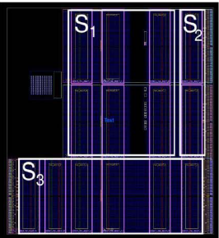
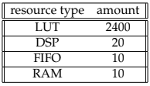
Background
Area model in [1]:
The area model is based on two ideas:
FPGA is subdivided into rectangular reconfigurable regions, so-called micro-slots.
Task executed on an FPGA is mapped to one or multiple micro-slots.
Required number of resources for a micro slot
Notes:
A micro slot is defined as a certain rectangular area on the FPGA with a given set of logic resources.
A reconfigurable slot is a rectangular area of logic resources comprising a number of such micro slots.

Slide 6
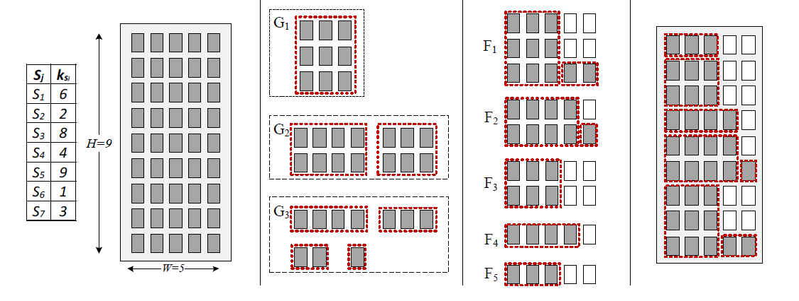
Heuristic Approach for Layout Generation
The Heuristic approach in [1] is divided into 3 parts:
Construction of groups
Construction of frames
Allocation of frames on the FPGA
Notes:
if you see the example here at first we have the list of reconfigurable slots that needs to be placed on a given FPGA of Width 5 and H=9. In the first step. we will convert the given reconfigurable slots in to rectangular modules. Certain rules have been incorporated while converting into rectangular modules. if the area requirement is less than or to the width of the FPGA then the shape of the slot will be W*1. if area req exceeds W, we form a shape with multiple rows with the constraint that all rows of the shape are fully utilized. Formally, we try to find rectangular
shapes cols × rows = kSj. The resulting shaped slots are grouped according to the height of the shaped slots. The set of groups G is then sorted according to non-increasing i.
A frame corresponds to a rectangular stripe of the FPGA surface. we create the first frame by placing the first shaped slot of the group with maximum height into it. Shaped slots are removed from their group once
they are placed. In our example, we place S5 into F1 which determines the frame to be of size W × 3. If there is space left in a frame, we scan the remaining shaped slots in G in sorted order and try to horizontally stack more of them into the frame.
The third step places the frames onto the FPGA fabric. We consider the actual widths of frames in F, i.e., the number of actually (partly) utilized columns, and start by placing the frame with the largest actual width, F1, at the bottom-right corner of the fabric. Then we proceed with the remaining frames in order of non-increasing actual widths.

Slide 7
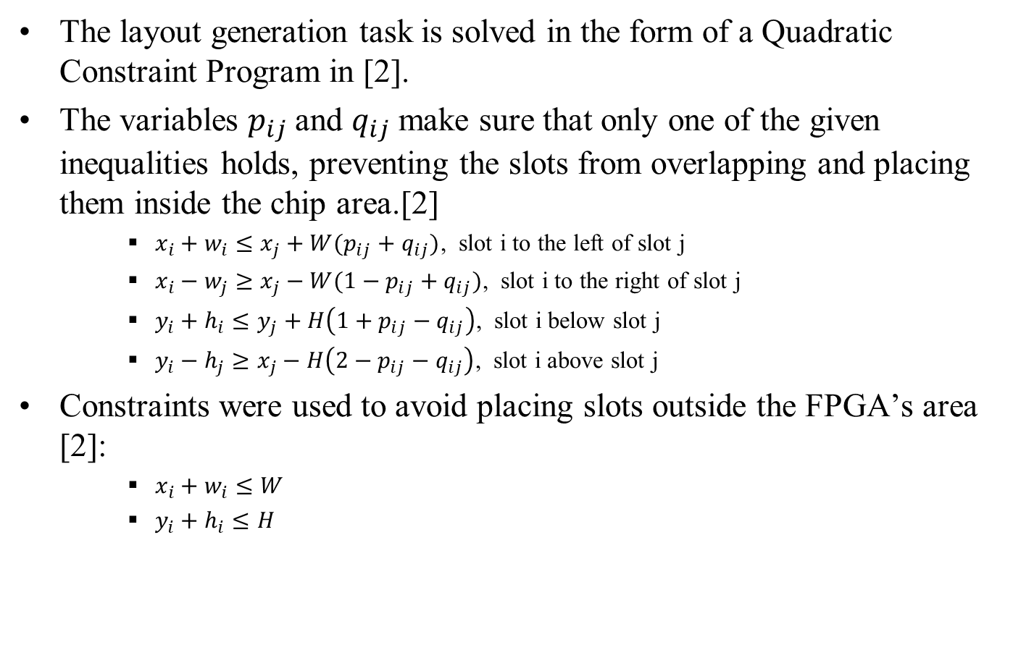
Optimal Approach for Layout Generation
The layout generation task is solved in the form of a Quadratic Constraint Program in [2].
The variables $p_{ij}$ and $q_{ij}$ make sure that only one of the given inequalities holds, preventing the slots from overlapping and placing them inside the chip area.[2]
$x_{i}+w_{i}≤x_{j}+W(p_{ij}+q_{ij})$, slot i to the left of slot j
$x_{i}−w_{j}≥x_{j}−W({1−p}_{ij}+q_{ij})$, slot i to the right of slot j
$y_{i}+h_{i}≤y_{j}+H\left(1+p_{ij}−q_{ij}\right)$, slot i below slot j
$y_{i}−h_{j}≥x_{j}−H\left(2−p_{ij}−q_{ij}\right)$, slot i above slot j
Constraints were used to avoid placing slots outside the FPGA’s area [2]:
$x_{i}+w_{i}≤W$
$y_{i}+h_{i}≤H$
Notes:
The layout generation in the form of a Quadratic Constraint Program.
For placing the reconfigurable slots optimally on the FPGA fabric the authors have defined the geometrical position of each slot 𝑆_𝑗in terms of its lower-left corner (𝑥_𝑖,𝑦_𝑖) width 𝑤_𝑖 and height ℎ_𝑖. Binary variables 𝑝_𝑖𝑗and 𝑞_𝑖𝑗 has been added for each slot to impose these limitations. Here the main constraints are slots should not overlap, and they
should not be placed outside the chip area with width W and height H. The objective of the QCP is to minimize the area xy of the rectangle enclosing all slots. However, to avoid a quadratic objective function, we minimize the rectangle’s perimeter 2x+2y, which implicitly minimizes the area.

Slide 8
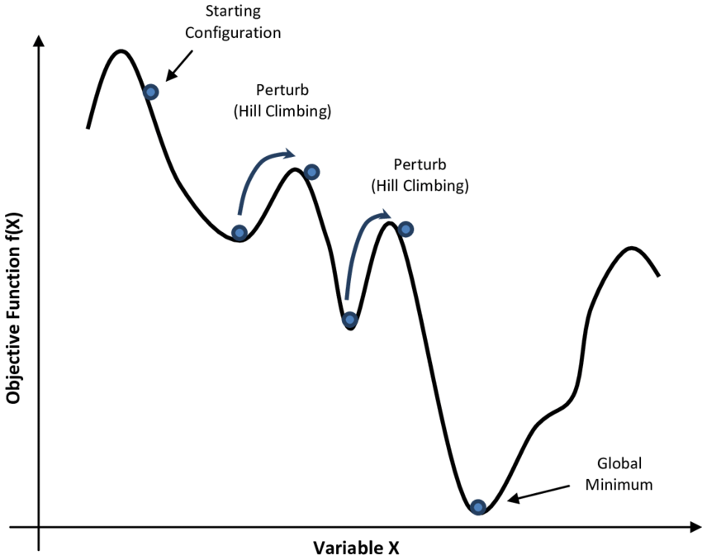
Simulated Annealing
Simulated Annealing (SA) is a popular metaheuristic optimization algorithm.
Unlike greedy approaches, SA adopts a hill-climbing technique to escape from the local optimum solution.
Notes:
Simulated Annealing (SA) is a popular metaheuristic optimization algorithm. that is inspired by the physical process of heating a material and then slowly lowering the temperature to decrease defects, thus minimizing the system energy.
The algorithm starts with an initial layout. Then the algorithm iteratively improves the initial solution through random changes and accepting changes that lead to better solution. SA provides a non-zero probability to move from the current solution to the neighboring solution with a higher cost. The algorithm accepts the worse solutions (layout with a higher cost than the current layout cost) during the optimization process with a decreasing probability over time.

Slide 9

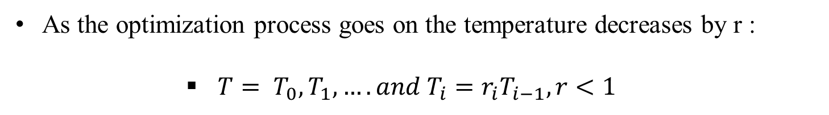
Simulated Annealing
The probability of accepting the worse solution is dependent on two factors.
The magnitude of the uphill move
The annealing time
$Prob\left(S→S^{´}\right)=\left\{\begin{aligned}1 if ∆C≤0(down−hill move) \\ e^{{−∆C}/T} if ∆C>0(up−hill move)\end{aligned}\right.$
As the optimization process goes on the temperature decreases by r :
$T=$ $T_{0},T_{1},…. and T_{i}=r_{i}T_{i−1},r<1$
Notes:
Here delta C is the cost difference between new and the current layout. and T is the annealing temperature. Intially we assign a high temperature. As the optimization process goes on the temperature decreases by a certain constant r. At each temperature, wwe perturb the current solutions to search for a number of neighboring soltuons for k times. here r is the rate at which temperature decreases in every iterations. In this work we kept the r as adaptiive. For deciding the r value after every iteration, we calculate the acceptance rate.
𝐴𝑐𝑐𝑒𝑝𝑡𝑎𝑛𝑐𝑒 𝑟𝑎𝑡𝑒=(𝑇𝑜𝑡𝑎𝑙 𝑛𝑢𝑚𝑏𝑒𝑟 𝑜𝑓 𝑎𝑐𝑐𝑒𝑝𝑡𝑒𝑑 𝑚𝑜𝑣𝑒𝑠 )/(𝑇𝑜𝑡𝑎𝑙 𝑖𝑡𝑒𝑟𝑎𝑡𝑖𝑜𝑛𝑠 𝑖𝑛 𝑡ℎ𝑒 𝑖𝑛𝑛𝑒𝑟 𝑙𝑜𝑜𝑝) . The value of r is raised to enable more exploration if the acceptance rate falls below a predetermined cutoff. The value of r is decreased to allow for greater exploitation if the acceptance rate rises above a particular threshold.

Slide 10
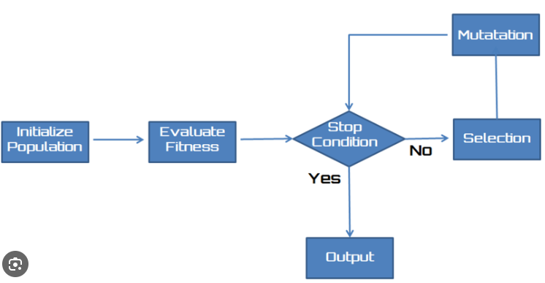



Evolutionary Strategy
Evolutionary Strategy (ES) is an optimization algorithm that is based on the ideas of natural evolution, where individuals with favorable traits are more likely to survive and reproduce.
ES is an iterative process that uses the concepts of population, fitness, selection, and mutation to generate a set of candidate solutions that evolve toward an optimal solution.
Notes:
Evolutionary Strategy (ES) is an optimization algorithm that is based on the ideas of natural evolution, where individuals with favorable traits are more likely to survive and reproduce.
The figure depicts the process of ES algorithm. The ES process starts with a population of potential solutions that are generated at random and are each represented by a set of parameters. The fitness function evaluates each potential solution’s effectiveness in solving the optimization problem. A parent is selected using the selection function. The selected parent is then mutated to get the offsprings with better fitness value. Additionally, the termination criteria must be chosen appropriately to avoid premature convergence or excessively long computation times.

Slide 11
Outline
Introduction
Background
Optimization Problem
Decision Problem
Results and Experimentation
Conclusion

Slide 12
Optimization Problem
Reconfigurable slots:
S1:8
S2:9
S3:3
S1
S1
S3
S3
S2
S2
Notes:
The floorplan optimization problem F can be
stated as follows: Let 𝑆=𝑆_1,𝑆_2,…,𝑆_𝑛 be a set of reconfigurable slots These reconfigurable slots are associated with respective areas 𝑎_𝑖, 1≤𝑖≤𝑛 and have no connection between them.These reconfigurable slots needs to be converted into rectangular modules and
Let (𝑥_𝑖,𝑦_𝑖)be the coordinates of the bottom left corner of the module 𝑆_𝑖, 1≤𝑖≤𝑛, on the chip. The optimization problem is a placement of (𝑥_𝑖,𝑦_𝑖) of each module 𝑆_𝑖, 1≤𝑖≤𝑛 , such that no two modules overlap with each other and also cannot be placed outside the FPGA boundary. Here the main goal is to reduce the Minimum bounding rectangle (MBR) area. MBR encloses all the given reconfigurable slots on an FPGA.

Slide 13
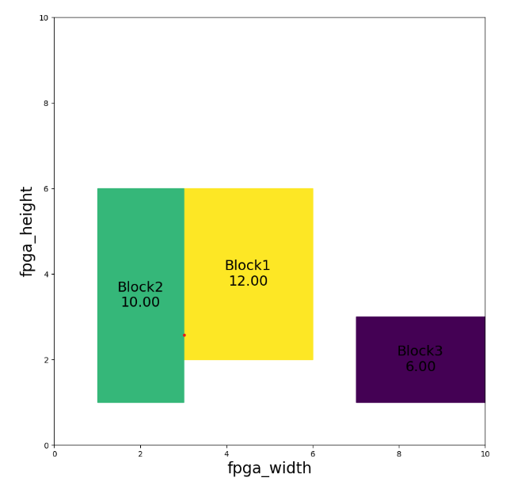
Optimization Problem
Floorplan representation:
A coordinate-based floorplan representation is used where each slot is shown as a rectangle, with its dimensions(w, h) and bottom-left coordinate (x, y).
Slot Name | Area
S1 | 12
S2 | 10
S3 | 6
S1
12
S2
10
S3
6
Notes:
Floorplan representation is very important while working with the SA and ES algorithm. It provides the geometrical information regarding the blocks that are on the FPGA layout. In our work, we have used a coordinated based floorplan representation. Where each slot is shown as a rectangle, with its bottom-left coordinate and its dimensions. The placement of each block is determined by its bottom left coordinate. The bottom-left corner’s coordinates can be used for determining the location of the entire block.
Rectangle(xy=(3, 2), width=3, height=4)
Rectangle(xy=(1, 1), width=2, height=5)
Rectangle(xy=(7, 1), width=3, height=2)

Slide 14
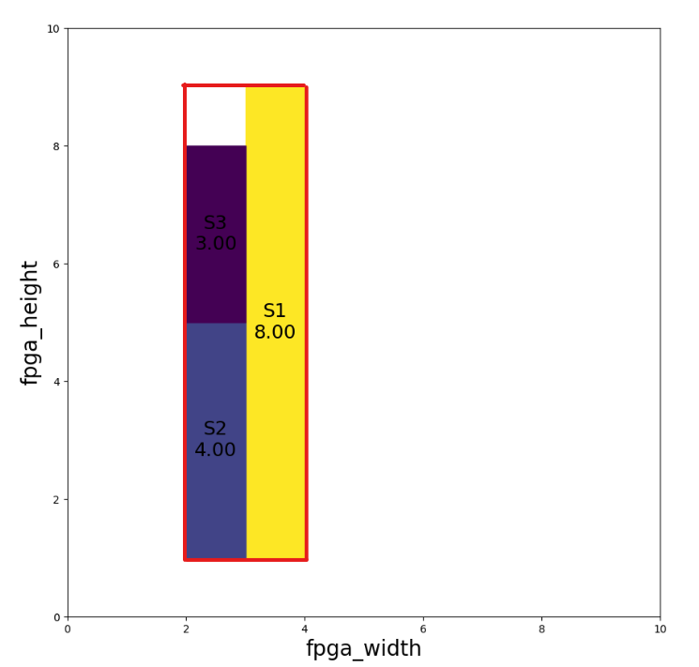
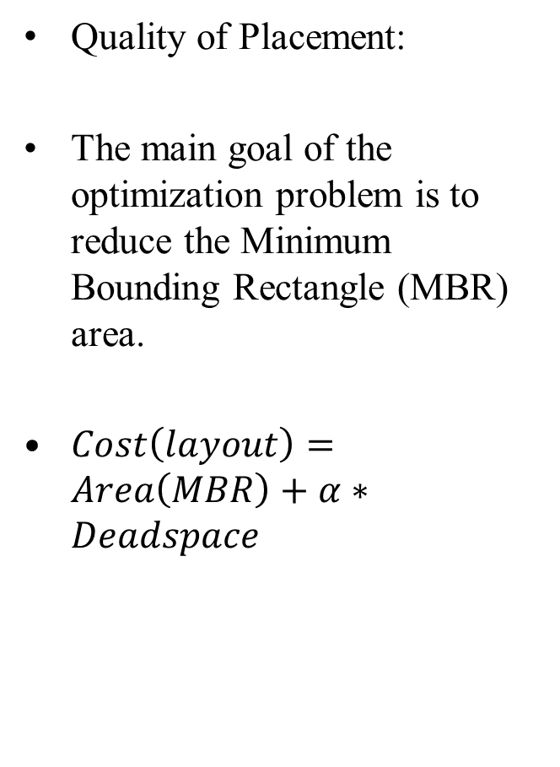
Optimization problem
Quality of Placement:
The main goal of the optimization problem is to reduce the Minimum Bounding Rectangle (MBR) area.
$Cost\left(layout\right)=Area\left(MBR\right)+α∗Deadspace$
Notes:
In SA and ES algorithms, the cost or the fitness function is a measure of how well a particular layout of blocks satisfies the constraints of the problem.
The floorplan area is directly dependent on the chip silicon cost which means the higher the floorplan area, the higher the silicon cost. Dead space, or white space, refers to the unoccupied area within the bounding rectangle that is not covered by any module.
we have devised a cost function that incorporates both the MBR area and the deadspace within the MBR. By including deadspace in the cost function, we actively encourage the optimization algorithm to reduce unused or wasted space within the MBR. To find the MBR for the given layout. We need to find the minimum and maximum of xi and yi coordinates among all the reconfigurable slots.
AreaofMBR = (maximum(xi)−minimum(xi))(maximum(yi)−minimum(yi))
The dead space is calculated by finding the MBR area of the layout minus the total required area of the modules that need to be placed.
here alpha acts as a weighting factor to balance the significance of reducing the MBR area and decreasing the MBR’s dead space.

Slide 15
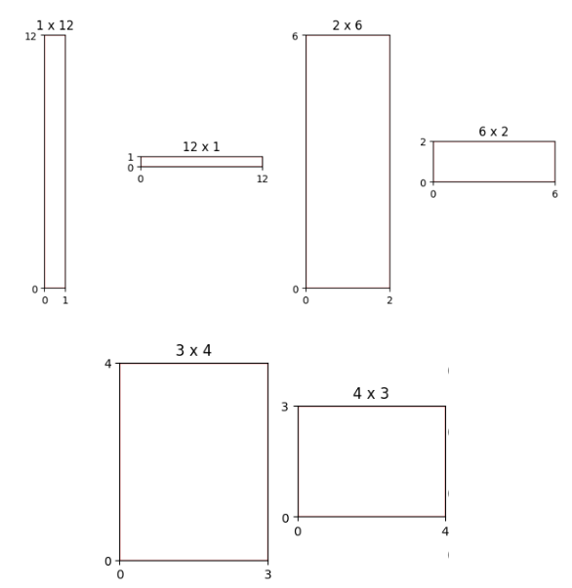
SA Approach for Optimization Problem
Solution Space:
S1
4
S1
4
Slot Name, Area
S1, 3
S1
3
Area+1
S1
3
S1
4
Notes:
The solution space contains all possible solutions that can be formed using given rectangular soft modules in the given width W and height H of the FPGA. It contains all possible rectangular configurations of soft modules within a given layout area. if the modules can vary in their aspect ratio the solution space can become much bigger, allowing a greater range of possible layouts.#
This technique involves a clever strategy that increases the total number of shapes for certain blocks. Specifically, we apply this strategy to blocks whose area is a prime number or can only be formed by two rectangular shapes.

Slide 16
SA Approach for Optimization Problem
Neighborhood Structure:
There are two main types of moves that have been considered to get a neighboring solution.
They are
Change the location of the module.
Change the shape of the module.
Slot1
Slot1
Slot1
Notes:
Given an initial solution, the algorithm can perturb it to obtain a new "neighboring" solution. The perturbation plays a vital role in finding the desired solution or layout[7]. In this work, there are two main types of moves have been considered to get a neighboring solution.
The process of changing the location of the module involves randomly selecting a module from the layout and changing its position inside the current bounding rectangle area.
The algorithm ensures that the new location does not violate the constraints of the problem, i.e., it should not go outside the bounds of the FPGA and also ensures that the module does not overlap with the other modules.
Changing the shape of the module involves randomly selecting a module from the layout and changing its shape such that the shape has the aspect ratio in the given aspect ratio bounds and also maintaining the same module area.

Slide 17
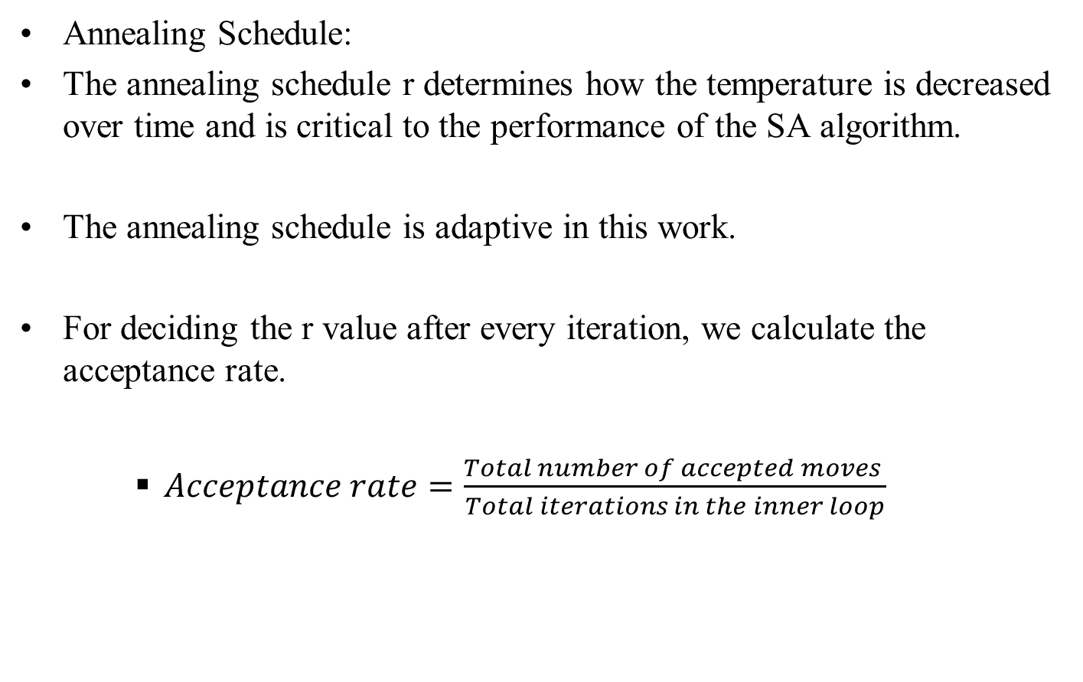
SA Approach for Optimization Problem
Annealing Schedule:
The annealing schedule r determines how the temperature is decreased over time and is critical to the performance of the SA algorithm.
The annealing schedule is adaptive in this work.
For deciding the r value after every iteration, we calculate the acceptance rate.
$Acceptance rate=\frac{Total number of accepted moves }{Total iterations in the inner loop}$
Notes:
In this work, r is adaptive.
The value of r is raised to enable more exploration if the acceptance rate falls below a predetermined cutoff. The value of r is decreased to allow for greater exploitation if the acceptance rate rises above a particular threshold.

Slide 18
ES Approach for Optimization problem
In this work, (1 + λ) ES has been used.
Included elitism and tournament selection.
Next Generation
Current Generation
1+λ solutions
λ Offsprings
1 Parent
1 Parent
Mutation
Sorting
Selection
Notes:
Here the "1" represents the single parent and the "λ" represents the number of offsprings that will be produced in every generation using the mutation operator.
In every generation the best individuals from the current generation are directly carried over to the next generation without any modifications this technique is known as elitism.
Selection process is a crucial step in ES since it determines which candidate solution is selected further to generate the next generation off-springs.
Tournament selection involves selecting a random subset of individuals from the population and the individual with the highest fitness score from the subset is selected as the parent for the following generation.

Slide 19
ES Approach for Optimization problem
Evolutionary Operators:
The mutation operator helps to explore the search space and generate diverse candidate solutions.
Mutation involves using two operators to mutate the selected gene.
They are :
Change the shape of the module.
Change the location of the module.
Notes:
The evolutionary operators, such as mutation is used to modify the solution and produce new candidate solutions.
The mutation operator helps to explore the search space and generate diverse candidate solutions. It also helps the algorithm not to stuck at the local minima [26]. In this work, the mutation operator involves two ways of modifying the selected gene. The mutation operation starts by selecting a random gene in the chromosome and then applying one of the two modifications to the selected gene. The mutation function also has a mutation rate that controls the frequency at which mutations are applied to the given chromosome in the population. The mutation rate determines the probability of any gene in the chromosome being randomly changed in each generation.
Algorithmic details:
The population size is set to 4 times to the total number of reconfigurable slots that need to be placed on FPGA.
The size of the tournament was set at twice the total number of reconfigurable slots or half the size of the population.
The number of generations was set to 150, which provided enough time for the algorithm to converge to a reasonable solution.
The mutation rate is set between 0.03 to 0.08.

Slide 20
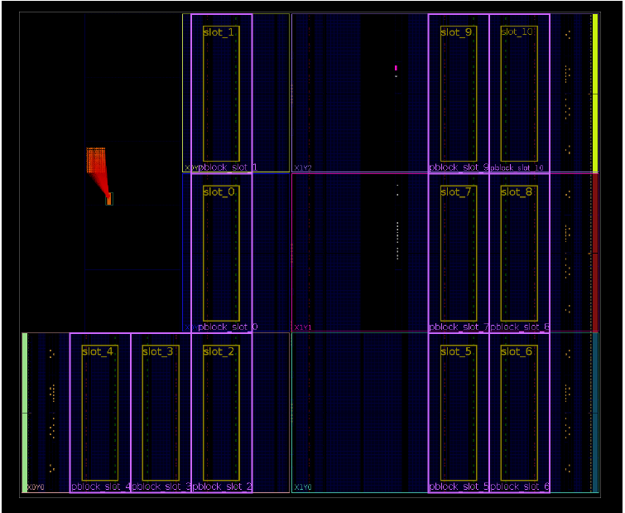
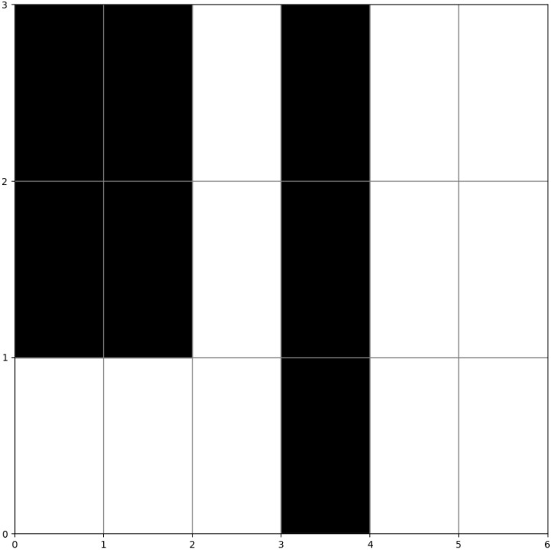
Decision Problem
In the decision problem, we have considered preplaced blocks and reconfigurable slots.
Selected Zynq-7020 comprises 11 micro slots.
Research on Zynq devices regarding micro slots is done by Christian Lienen.
Notes:
Preplaced blocks are used to cover the region of FPGA where there are no processing units.
The decision problem is to state whether the algorithm can find a feasible layout with reconfigurable slots where there is no overlapping between the modules and there is also no overlapping between the preplaced blocks.

Slide 21

Decision Criteria
Considered number of overlaps between the slots as the cost function for both SA and ES algorithms.
$$f\left(x\right)=0$$
Here x represents the layout.
Notes:
The cost and fitness functions has been designed to penalize layouts with intersecting or overlapping blocks, by counting the number of overlaps between the reconfigurable slots.
Both the SA and ES approach's for solving the Decision problem is very similar to the approach’s used for solving the Optimization problem.
In Decision Problem, we allowed overlapping between the blocks and algorithms ensures that the modules are not placed outside the boundaries of FPGA and does not overlap with the preplaced blocks.

Slide 22
Outline
Introduction
Background
Optimization Problem
Decision Problem
Results and Experimentation
Conclusion

Slide 23
Test Data
The input for both optimization and decision problem is a list of reconfigurable slots and required areas in number of micro slots.
Two different types of test data is generated for optimization problem. They are More Blocks Less Area (MBLA) and Less Blocks More Area (LBMA).
We considered the maximum number of available micro slots on Xilinx Zynq 7020 device for decision problem.
MBLA Data
LBMA Data

Slide 24
Experimentation
Runtime and Quality experiments are conducted with SA and ES algorithms.
Optimal algorithm to Optimal* algorithm.
The experiments were carried out using a High-Performance Computing (HPC) cluster using five nodes. Each node was configured with 2x AMD Milan 7763 processors running at 2.45 GHz. each processor had a total of 128 cores per node.
Notes:
Runtime Experiment: To evaluate the runtime of the SA and ES algorithms, we ran the algorithms until the MBR area of each file from the test data reaches the MBR area produced by the heuristic algorithm. Specifically, we measured the time it took for each algorithm to converge to the heuristic output and compared the quality of the solutions generated by each algorithm.
Quality Experiment: To evaluate the quality of the SA and ES algorithms, we have conducted a runtime experiment where we run each test data for a constant amount of time to see how the quality of the output changes over time.
We have made significant changes to the optimal algorithms in order to compare their results with the SA, ES, and Heuristic algorithms in our study. Optimal algorithms aims optimize the height of the floorplan.
The floorplan with the minimum height generated by the Optimal algorithm might not necessarily have the optimal MBR area.
We introduced a modification by setting the FPGA width to the width of the MBR obtained from the SA algorithms in order to guarantee that we obtain the best MBR area from the Optimal algorithms for each test case. We stated this as Optimal* algorithm.

Slide 25
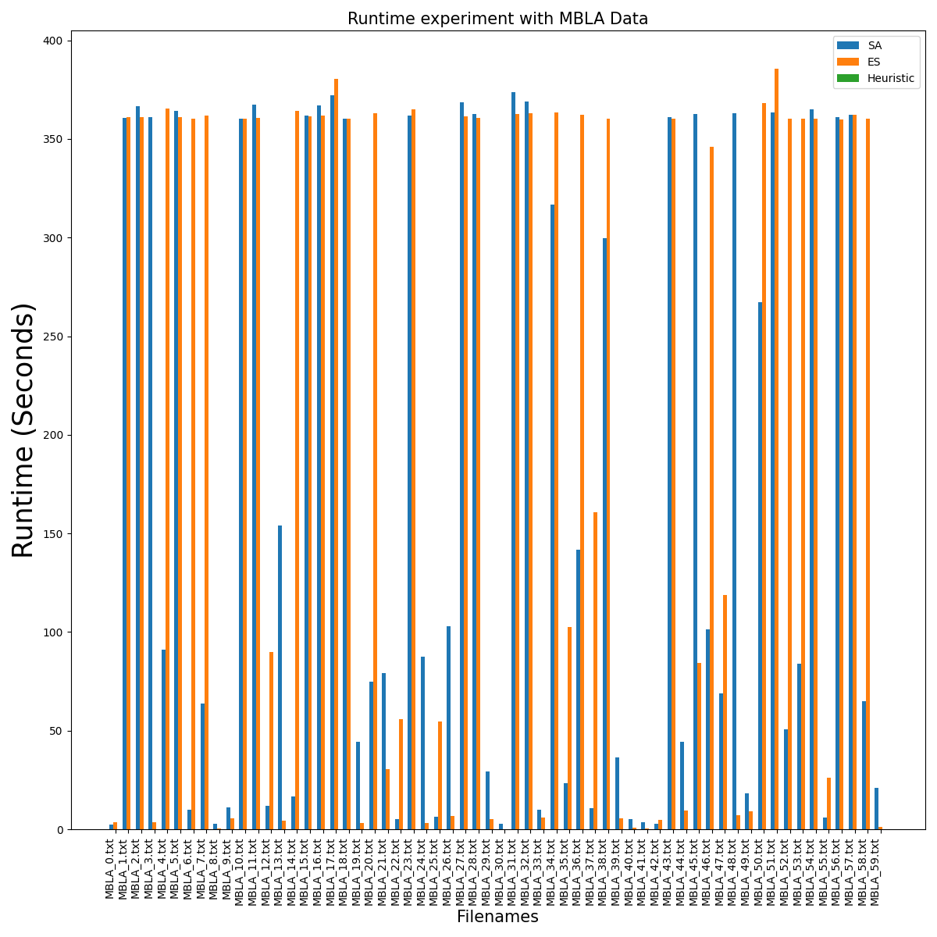
Runtime Experiment with MBLA data
Notes:
here we are looking at the plot filenames and runtime in seconds. This is runtime experiment with MBLA data. the runtimes of the Optimal* algorithms have been excluded from Figure 5.6. It is worth mentioning that the Optimal* algorithms often required several hours to reach the optimal results. When compared to the Optimal* algorithms, the SA, ES, and Heuristic algorithms produced significantly faster results. The Heursitic results gives the output in no time. both the SA and ES algorithms took more time to produce results than the heuristic algorithm. This outcome was expected, given that the SA and ES algorithms are known to take more time to solve problems. The reason for the long runtime of SA and ES algorithms is that they perturb the initial layout and population multiple times to find the desired solution. In contrast, the heuristic algorithm is tailored to solve the specific problem and does not require a specific number of generations or inner iterations to generate the desired output.
In 46 percent of the cases SA has reached heurstic results faster than ES. In 53 percent of cases ES surpassed SA in reached heursitics.

Slide 26
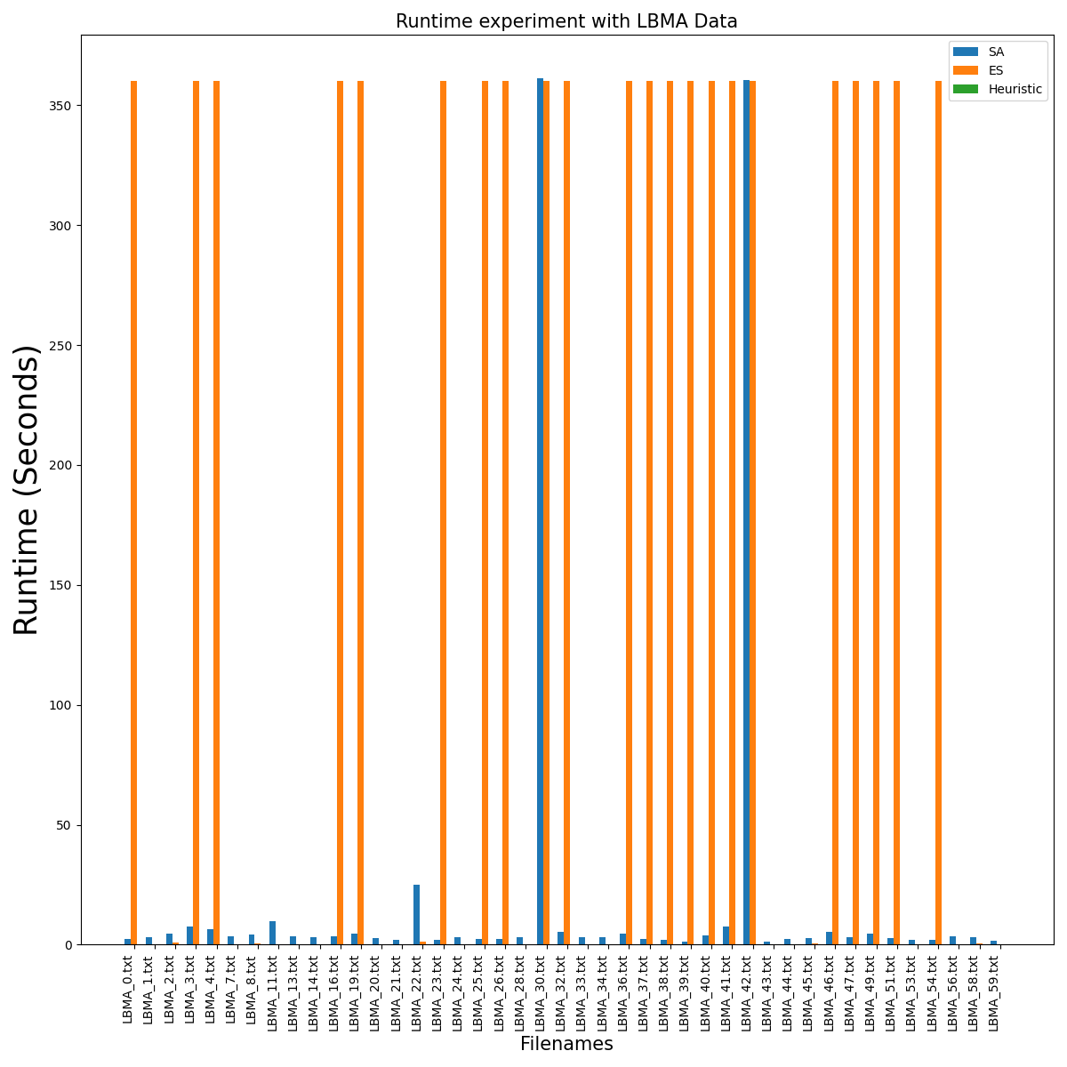
Runtime Experiment with LBMA data
Notes:
Runtime with LBMA data. both the algorithms have reached the herustic results in most cases. In 46 percent of the cases SA has reached heurstic results faster than ES. In 53 percent of cases ES surpassed SA in reached heursitics.

Slide 27
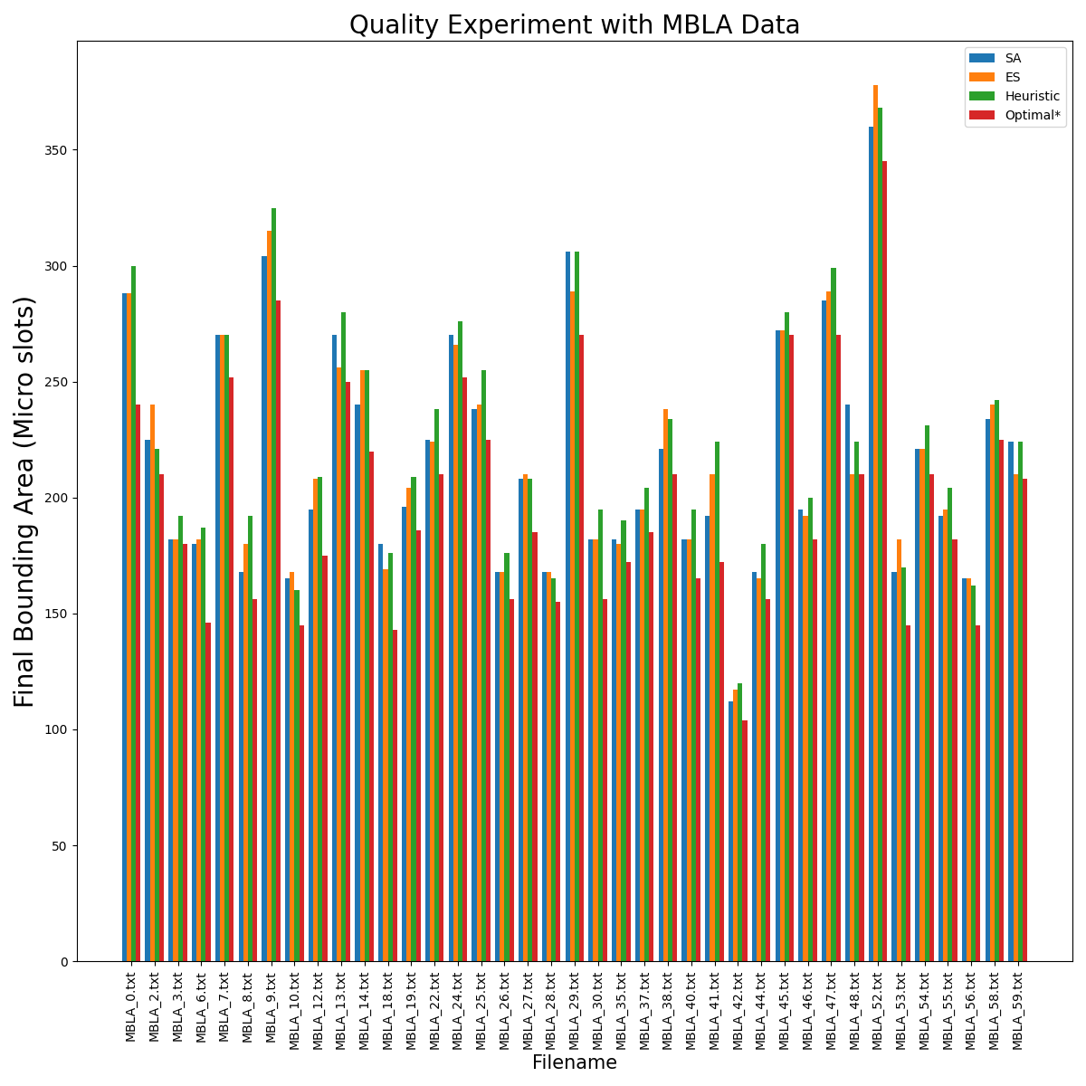
Quality Experiment with MBLA data
Notes:
SA emerged as the dominant algorithm, outperforming ES
in roughly 70% of the cases. ES, on the other hand, outperformed SA in 15% of the
cases, demonstrating its ability to outperform in speciőc scenarios When compared to
the Heuristic algorithm, SA proved to be more effective, outperforming it in nearly 70%
of the files. However, it is worth noting that the Heuristic algorithm outperformed the
SA algorithm in 20% of the cases, highlighting the contextual dependency of algorithm
performance. Furthermore, when compared to the Optimal* algorithm, SA achieved
identical results in 20% of the cases. ES, on the other hand, demonstrated its superiority by outperforming the Heuristic
algorithm in roughly 54% of the cases. When compared to the Optimal* algorithm, ES
produced layouts that achieved the same results in 10% of the cases

Slide 28
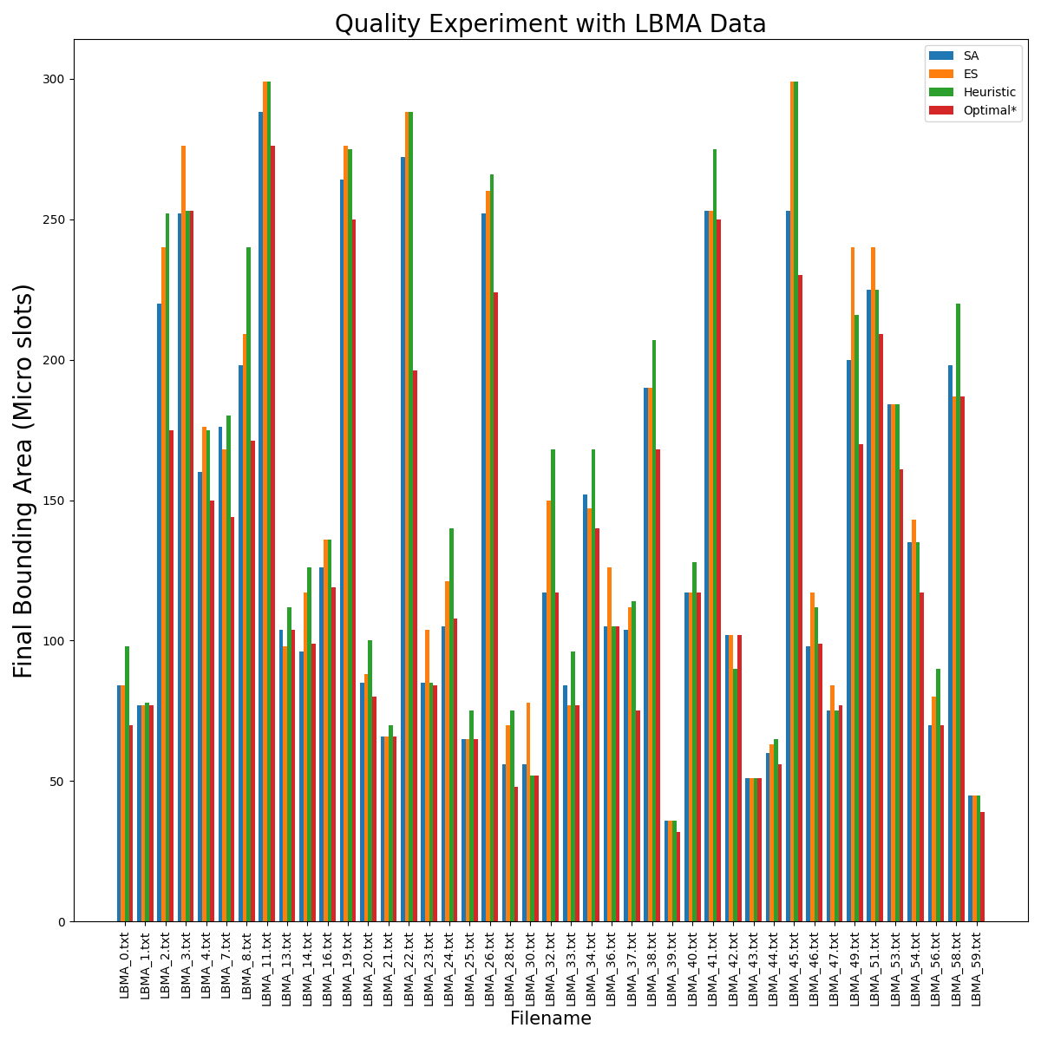
Quality Experiment with LBMA data
Notes:
SA outperformed ES in nearly 60% of the cases, demonstrating its ability to achieve
better results in the majority of scenarios. Furthermore, when compared to Heuristic
algorithms, SA outperformed them in approximately 75% of the cases, highlighting its
effectiveness in outperforming Heuristic-based solutions.
When evaluated against the Optimal* algorithms, SA achieved the same results as the
Optimal* algorithms in 32% of the FIles, demonstrating its ability to generate solutions
on the level with the globally optimal ones. In approximately 11% of the cases, ES outperformed SA, demonstrating its ability to
produce superior results in speciőc scenarios.
When compared to Heuristic results, ES outperformed Heuristic by providing better
layouts in nearly 53% of the cases.
Evaluating ES against Optimal* algorithms revealed for almost 19% of the őles, ES
achieved the same results as the Optimal* algorithms.

Slide 29
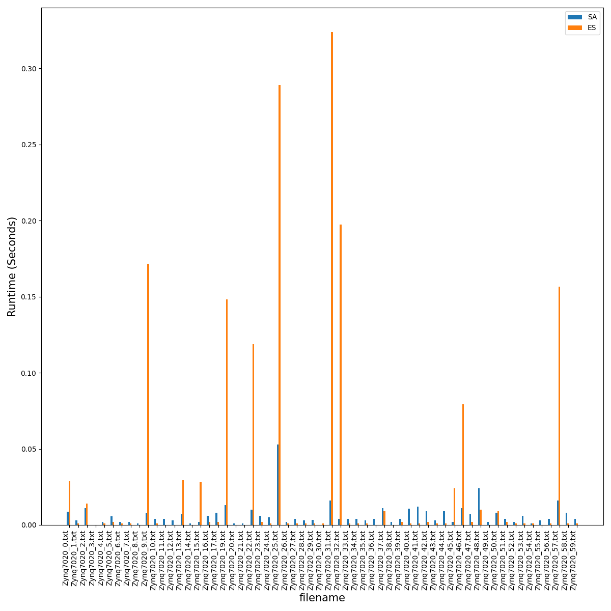
Decision Problem
Notes:
The final output from SA and ES algorithms for the decision problem is TRUE or FALSE.
Both the SA and ES algorithm returned TRUE for 98% of the files and 2% of total files returned FALSE.
SA and ES may not be able to find a feasible arrangement for all test files.
ALmost for 71 percent of the files. ES has got faster results than SA. In 28 percent of the cases SA has less runtime than ES

Slide 30
Conclusion
We have addressed the layout generation problem of a 2D slot-based reconfiguration area model using optimization algorithms, especially SA and ES algorithms.
Optimization experiments are done using MBLA and LBMA data.
SA and ES has reached near to optimal* results.
Heuristics outperform SA, ES and optimal* in runtime.
SA has outperformed ES and heuristic results in terms of MBR area.
ES has outperformed SA in terms of runtime.
SA + ES for future work.
Notes:
However, both SA and ES require more computational time to reach desirable solutions.

Slide 31
References
Zakarya Guettatfi, Marco Platzner, Omar Kermia, and Abdelhakim Khouas. An approach for mapping periodic real-time tasks to reconfigurable hardware. In 2019 IEEE International Parallel and Distributed Processing Symposium Workshops (IPDPSW). IEEE, 2019.
Zakarya Guetttatfi, Paul Kaufmann, and Marco Platzner. Optimal and greedy heuristic approaches for scheduling and mapping of hardware tasks to reconfigurable computing devices. In Proceedings of the International Workshop on Applied Reconfigurable Computing (ARC), 2020.

