Slide 1

A Comparison of Algorithms for the Generation of Layouts based on Reconfigurable Slots on FPGAs.
Supervisors: Prof. Dr. Marco Platzner and Prof. Dr. Sybille Hellebrand
Student: Yashwanth Tadakamalla
ID: 6896890
Notes:
Hellöo

Slide 2
Outline
Background
Problem Statement
Algorithms for Implementation
Optimization Problem
Decision Problem
Test Data
Time plan

Slide 3
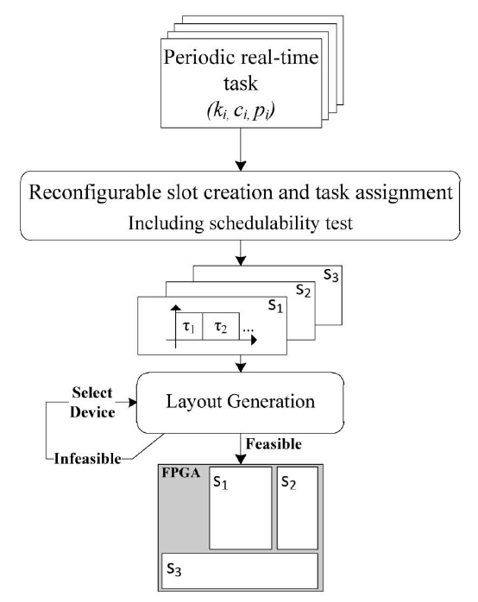
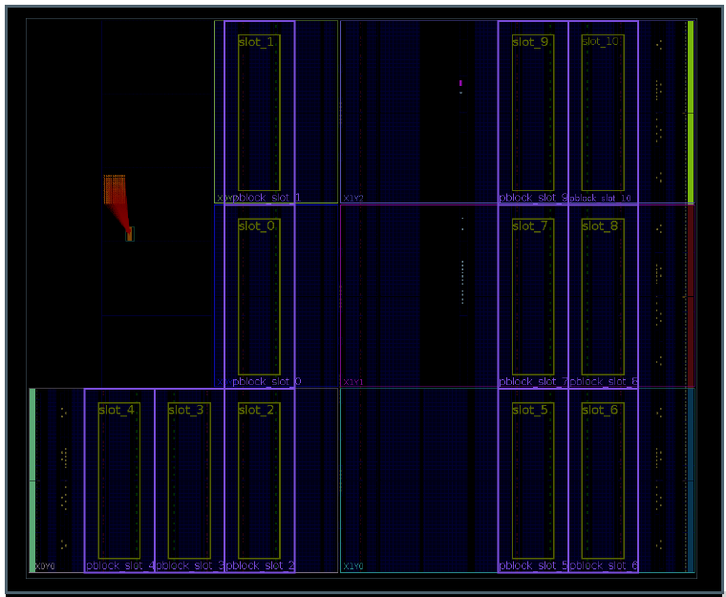
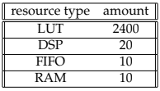
Background:
Executing real-time tasks on dynamically reconfigurable FPGAs requires one to solve the challenges of scheduling and placement.
In [1] a special 2D slot-based reconfiguration model has been introduced for mapping real time tasks to FPGA.
Here S1,S2 and S3 are the reconfigurable slots.
Every reconfigurable slot has a required scalar area, given in number of micro slots.
For layout generation task heuristic [1] and optimal [2] solutions have been presented.
Fig.2. Partitioning in to micro slots: The Xilinx Zynq 7020 [1]
Fig.1. Approach for mapping periodic real time tasks on FPGA[1]
Fig.3. Minimum required resources for a micro slot.

Slide 4
Problem Statement
Layout generation problem involves placing a set of reconfigurable slots with their respective required area on the FPGA.
The objective here is to maximize the utilization of FPGA.
The problem is to find the optimal or near to optimal placement of the reconfigurable slots on the 2D layout of FPGA while satisfying certain constraints such as the area requirements of the slots, the utilization of the FPGA resources and no overlapping between the reconfigurable slots.
Reconfigurable slots:
S1:8
S2:9
S3:3
S1
S3
S2

Slide 5
Algorithms for Implementation
Simulated Annealing (SA) and Genetic Algorithms (GA) will be used to solve this layout generation problem.
SA is a stochastic optimization algorithm that mimics the process of annealing in metallurgy, where a material is slowly cooled to reduce defects.
GA is a population-based optimization algorithm that mimics the process of natural selection.
These algorithms will be implemented and then compared with heuristic [1] and optimal [2] solutions which are already implemented.
Here I am using Python as my coding language.

Slide 6
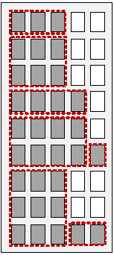
Optimization Problem
There is no specific FPGA selected.
A set of reconfigurable slots with required area on FPGA are given.
The objective here is to find the minimum bounding rectangle area.
Here each rectangular shape represents a reconfigurable slot with respective
required area in number of micro slots.
Here the total number of required slots of FPGA are 45 because here bounding rectangle width is 5 and height is 9.
Metrics to compare: run time and area of the bounding rectangle.
Fig.4. final layout after placing reconfigurable slots on FPGA [1].

Slide 7
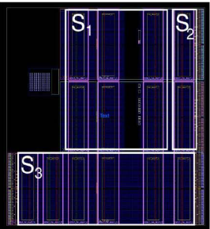
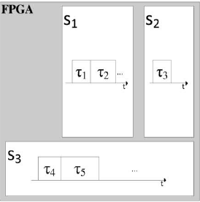
Decision Problem
Here a specific FPGA of Zynq family is selected.
A set of reconfigurable slots with required area on FPGA are given.
Here the objective is to say is it possible to place all the given reconfigurable slots on to the given FPGA?
The layout for the Xilinx Zynq 7020 with three reconfigurable slots can be seen below.
Here S1, S2 and S3 are the reconfigurable slots.
Metrics used run time and FPGA utilisation.
Fig.5. layout for the Xilinx Zynq 7020 with three reconfigurable slots [1].
Fig.6. mapping of tasks to these slots[1].

Slide 8
Test Data
The input here is reconfigurable slot names and required area in number of micro slots.
The test data is generated using different techniques.
More reconfigurable slots with less area requirement and vice versa with certain bounds.
Considered the number of micro slots available in Zynq devices.

Slide 9
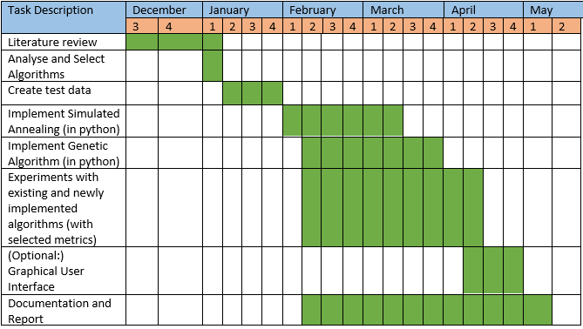
Time Plan

Slide 10
References
Zakarya Guettatfi, Marco Platzner, Omar Kermia, and Abdelhakim Khouas. An approach for mapping periodic real-time tasks to reconfigurable hardware. In 2019 IEEE International Parallel and Distributed Processing Symposium Workshops (IPDPSW). IEEE, 2019.
Zakarya Guetttatfi, Paul Kaufmann, and Marco Platzner. Optimal and greedy heuristic approaches for scheduling and mapping of hardware tasks to reconfigurable computing devices. In Proceedings of the International Workshop on Applied Reconfigurable Computing (ARC), 2020.

Slide 11
Thank you for your attention!

