Slide 1
RESEARCH PRACTICE
Session -1
Security issues in Blockchain network
Yashwanth Kothakota - 2021H1030087H
Goli Akhil Kumar - 2021H1030079H

Slide 2
Initial Readings
Blockchain Introduction

Slide 3
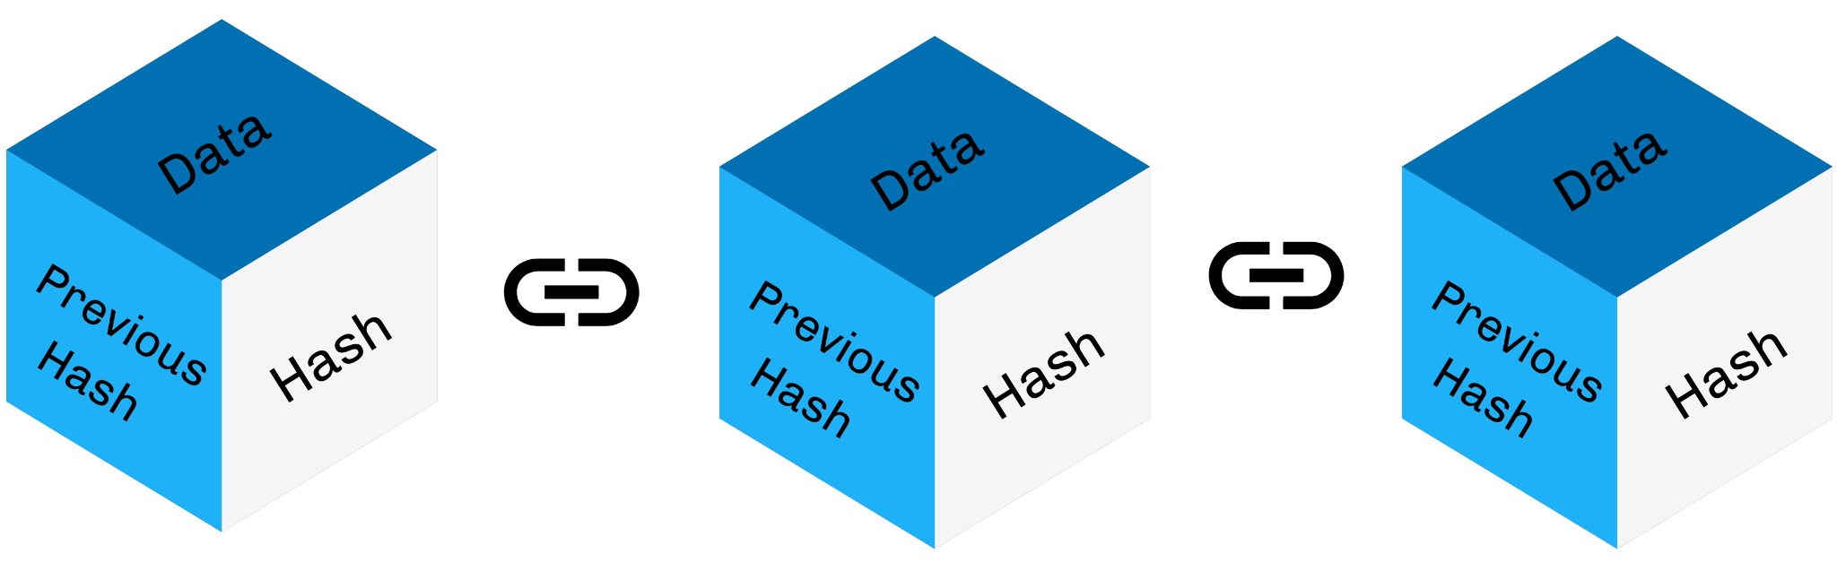
What is Blockchain?
A blockchain is essentially a digital ledger of transactions that is duplicated and distributed across the entire network of computer systems on the blockchain.
Each block in the chain contains a number of transactions along with its own hash value and previous block’s hash value, and every time a new transaction occurs on the blockchain, a record of that transaction is added to every participant’s ledger.
Types of Blockchains :
Public
Private
Hybrid
Consortium

Slide 4

What is Blockchain?
The Decentralised database managed by multiple participants is known as Distributed Ledger Technology (DLT).
Blockchains are considered to be highly secured because of its design and can be considered as an example of distributed computing system with high Byzantine fault tolerance.
Blockchain technology makes middlemen (so-called trusted third parties) obsolete in many applications. Bitcoin can serve as an example here. Bitcoins are not routed via a central instance, e.g. a bank, but can be transferred directly between the parties.
Cutting the Middlemen

Slide 5
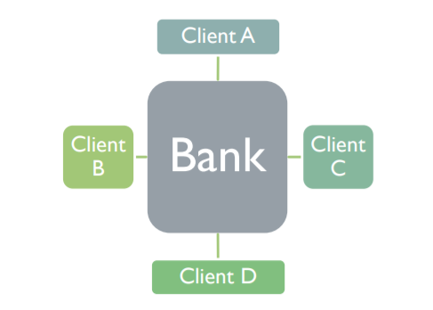
What is Distributed Ledger?
There are multiple ledgers, but Bank holds the “golden record”
If there is any discrepancy, then Client A or B must reconcile(make consistent) its own ledger against that of Bank and must convince the Bank of the “true state” of the Bank ledger.
Centralized Ledger

Slide 6
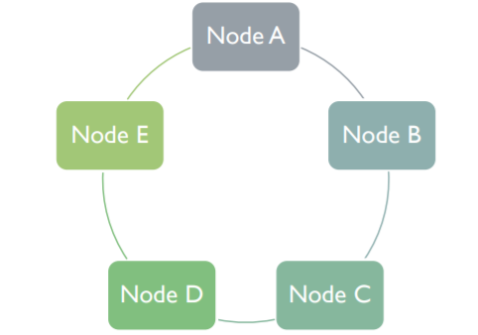
What is Distributed Ledger?
There is one ledger. All Nodes have some level of access to that ledger.
All Nodes(participants of the network) agree to a protocol that determines whether the transaction is valid or not, whether a ledger is manipulated or not at any point of time.
The application of this protocol is sometimes called “achieving consensus.”
If more than 51% of participants agrees that a block is valid, then the block is considered as a valid block.
Distributed Ledger

Slide 7
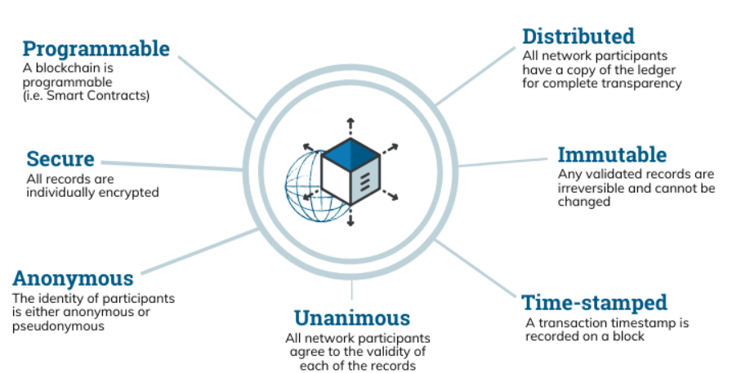
Properties of Distributed Ledger Technology

Slide 8
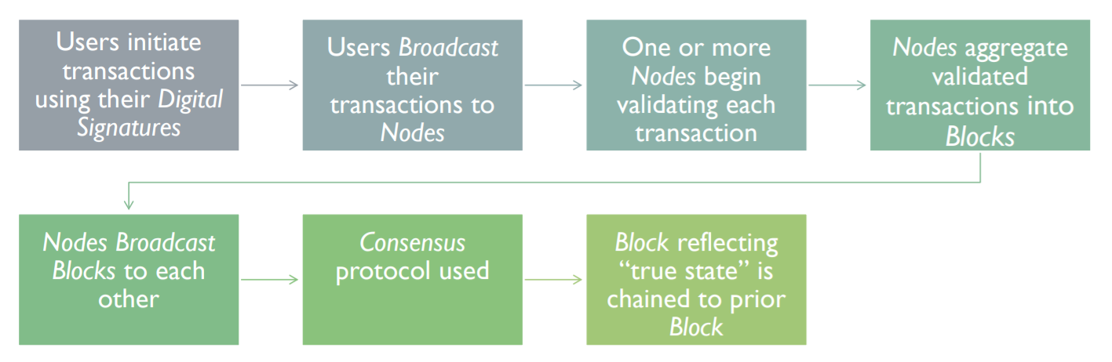
How Distributed Ledger works?

Slide 9
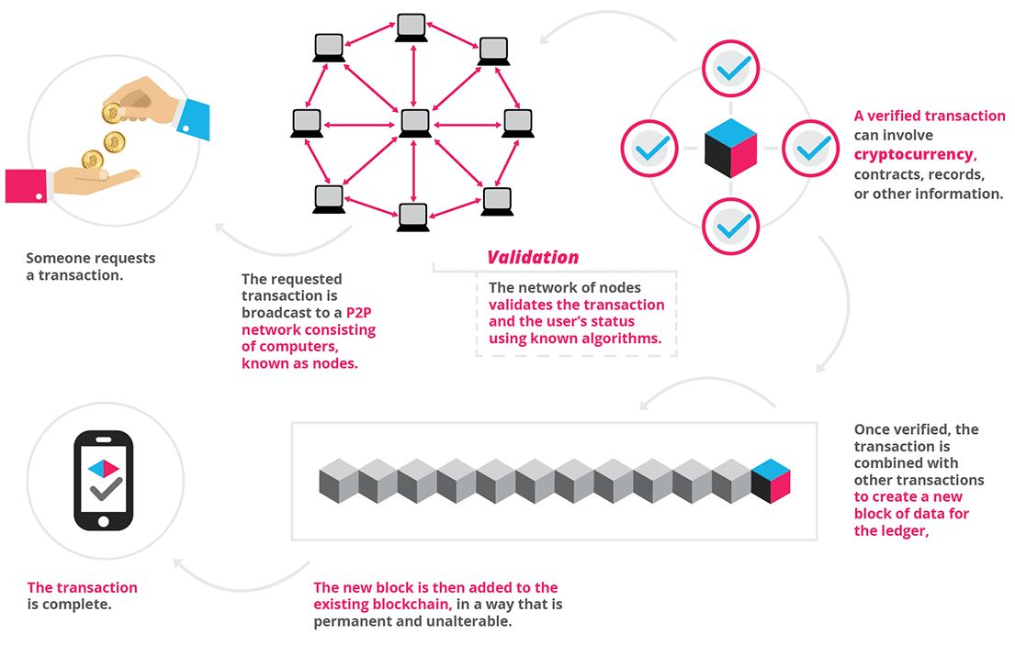
How exactly Blockchain works?

Slide 10
Blockchain Consensus mechanisms
Proof of Work : Involves miners who solve complicated mathematical puzzles to produce a new block.
Proof of Stake : Randomized process to figure out who gets a chance to produce the next block.
Proof of Capacity : In Proof of Capacity method, solutions to complex mathematical puzzles are stored in digital storages such as hard disks. Users with the highest storage capacity will have to higher chances of producing a new block.
Proof of Identity : Proof of Identity compares the private key of a user with an authorized identity. Proof of Identity ensures integrity and authenticity of created data.
Proof of Elapsed Time : Proof of Elapsed Time process randomly and fairly decides the producer of a new block based on the time they have spent waiting.
Proof of Activity : Combination of Proof of Work and Proof of Stake.

Slide 11
Examples of Blockchain Technology
1.Bitcoin Mining
In Bitcoin implementation, there is an extra field added in each block called nonce.
Bitcoin adds nonce value such that block hash of new block with nonce has x number of trailing zeros.
This x is adjusted by protocol to control speed of coin generation.
The higher value of x, harder it is to calculate a nonce.
Since hash functions are one way, the nonce cannot really be calculated.
Miners do a hit and trail kind of algorithm to see if they can find nonce that satisfies the requirement for next block.
Properties of Bitcoin :
It allows you to store value
It allows you to consume value (better than fiat)
It allows you to exchange value (better than fiat).

Slide 12
Examples of Blockchain Technology
2.HyperLedger
Hyperledger fabric is a blockchain platform for enterprise.
Hyperledger is a open source and modular allowing different modules to be plug and play style.
It is designed to provide speed and scalability that is lacking in public chains due to proof of work requirement.
It is ideal for building a permissioned, private blockchain business network.
Smart contracts hold logic that defines who can change what on ledger and participants write transactions on ledger by involving smart contracts.
https://www.hyperledger.org/

Slide 13
Resources
https://www.educative.io/courses/hands-on-blockchain/
https://www.hyperledger.org/
https://andersbrownworth.com/blockchain/public-private-keys/keys
https://andersbrownworth.com/blockchain/hash

Slide 14
THANK YOU

