Slide 1
Research Practice
Session-3
SECURITY ISSUES IN BLOCKCHAIN
YASHWANTH KOTHAKOTA - 2021H1030087H
ME CSIS 2021

Slide 2
CONTENTS
What is the need to talk about security in blockchain?
Overview of Blockchain technologies
Technology development
Blockchain 1.0
Blockchain 2.0
Risks to blockchain
Attack cases
Security enhancements

Slide 3

NEED FOR SECURITY IN BLOCKCHAIN
Debut of Bitcoin in 2009, its underlying technique, Blockchain.
Application of blockchain to many fields
Core technology in FinTech (Financial technology)
Security vulnerabilities
Vulnerable smart contracts
Attack on smart contract DAO
Attack on bitcoin trading platform MtGox

Slide 4
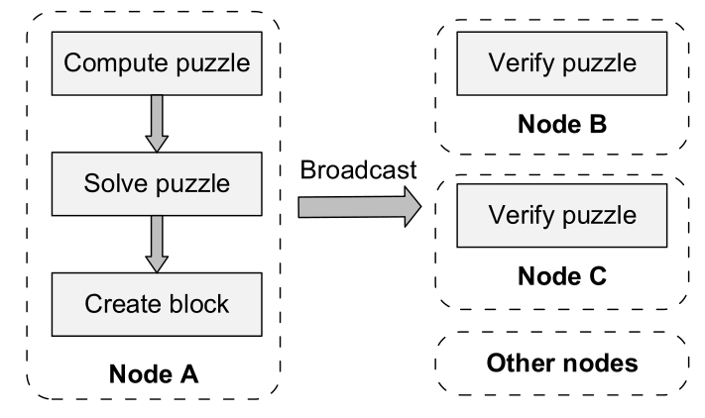
OVERVIEW OF BLOCKCHAIN TECHNOLOGIES
Consensus mechanism
PoW
PoS
Block Propagation and synchronization
Advertisement - based
Unsolicited push
Hybrid

Slide 5

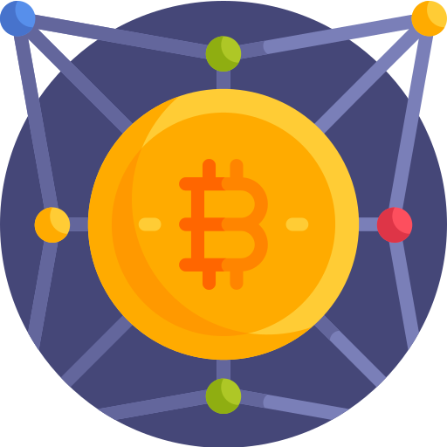
TECHNOLOGY DEVELOPMENT
BLOCKCHAIN 1.0 :-
Cryptocurrency
Characteristics:
Irreversible & Traceable
Decentralized & anonymous
Secure & permissionless
Fast & global
BLOCKCHAIN 2.0:-
Smart contracts
Characteristics:
Autonomy
Stable
Traceable
Secure

Slide 6
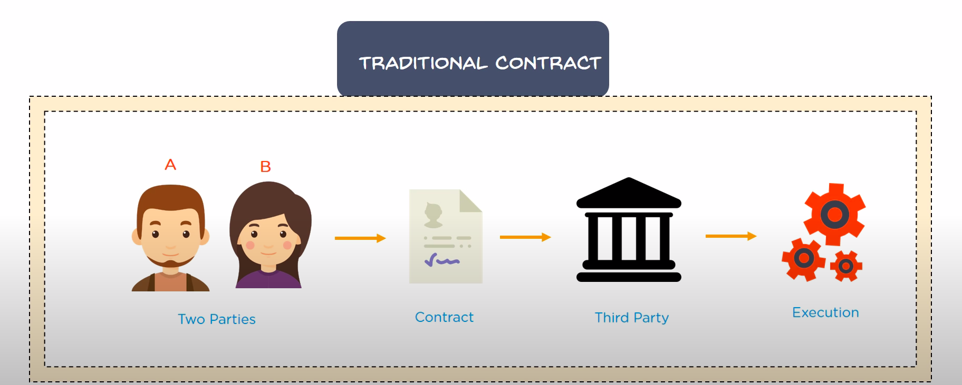
SMART CONTRACTS
Traditional Contract:

Slide 7
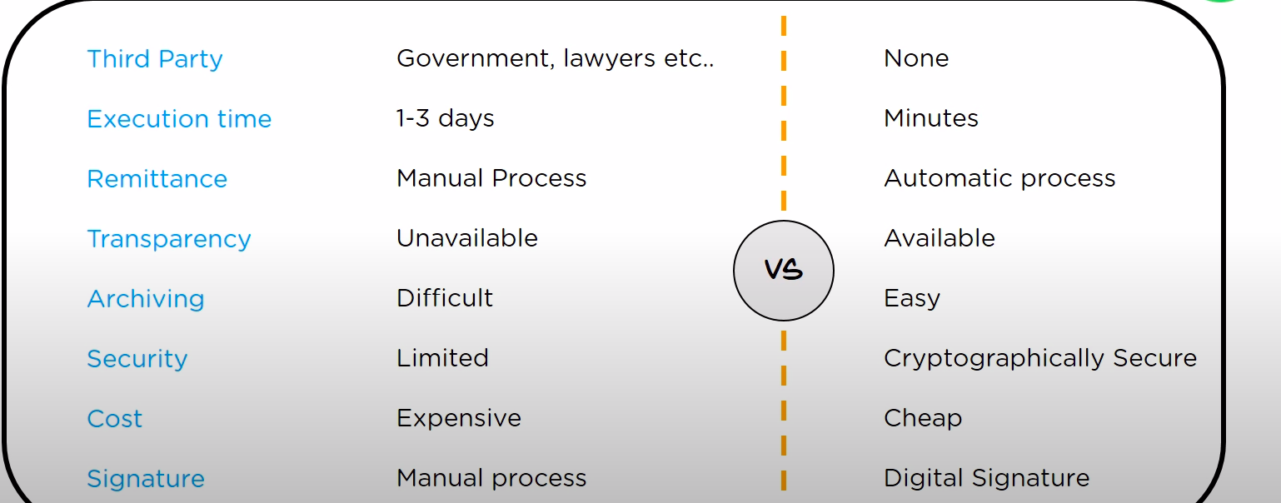
SMART CONTRACTS
Differences : Traditional Contracts Smart Contracts

Slide 8


SMART CONTRACTS
Programming languages used
SOLIDITY
SERPENT
Advantages
No intermediaries
Automated
High Speed
Secure
Accuracy

Slide 9
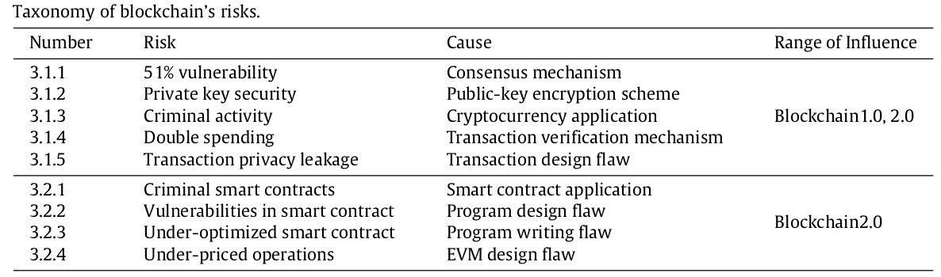
RISKS TO BLOCKCHAIN

Slide 10
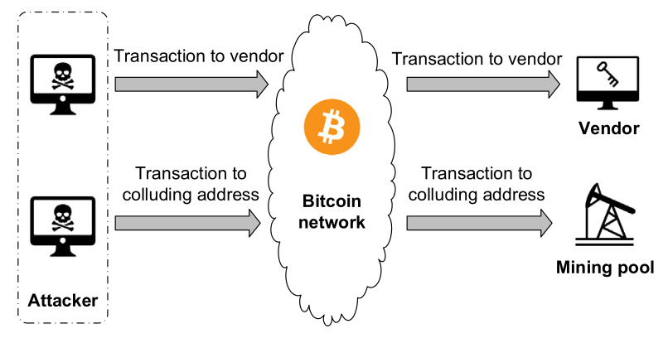
RISKS TO BLOCKCHAIN
Double Spending Attack model in Bitcoin

Slide 11
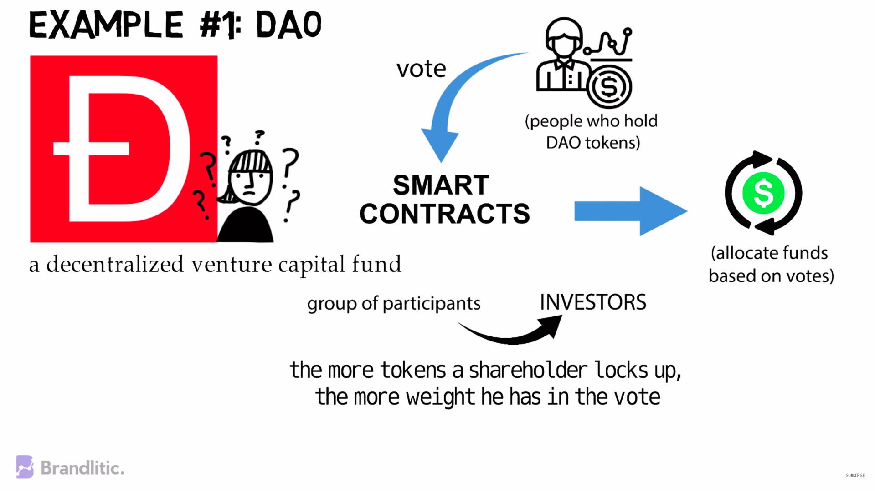
ATTACKS
Self mining attack
DAO attack

Slide 12
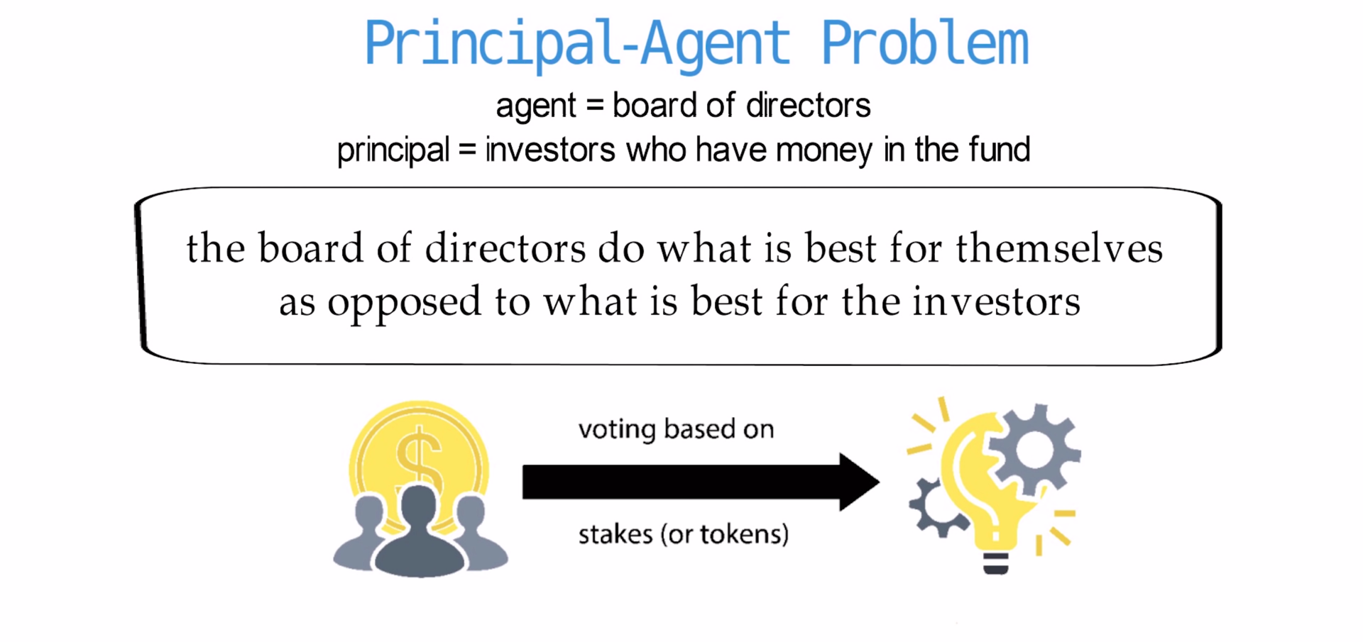
ATTACKS
Self mining attack
DAO attack

Slide 13
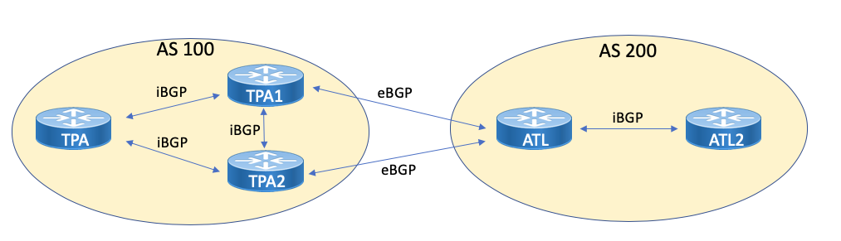
ATTACKS
Self mining attack
DAO attack
BGP hijacking attack

Slide 14
ATTACKS
Self mining attack
DAO attack
BGP hijacking attack
Eclipse attack
Botnet attack
Infrastructure attack

Slide 15
REFERENCES
A survey on the security of blockchain systems Xiaoqi Li, Peng Jiang, Ting Chen, Xiapu Luo a, Qiaoyan Wen, http://dx.doi.org/10.1016/j.future.2017.08.020.
https://www.youtube.com/watch?v=dl8Hl91siM8
https://www.coindesk.com/learn/2016/06/25/understanding-the-dao-attack/
https://www.pcmag.com/news/blockchain-the-invisible-technology-thats-changing-the-world

Slide 16

THANK YOU

