Slide 1
Research Practice
Session-4
Routing attacks in Blockchain
YASHWANTH KOTHAKOTA - 2021H1030087H
ME CSIS 2021

Slide 2
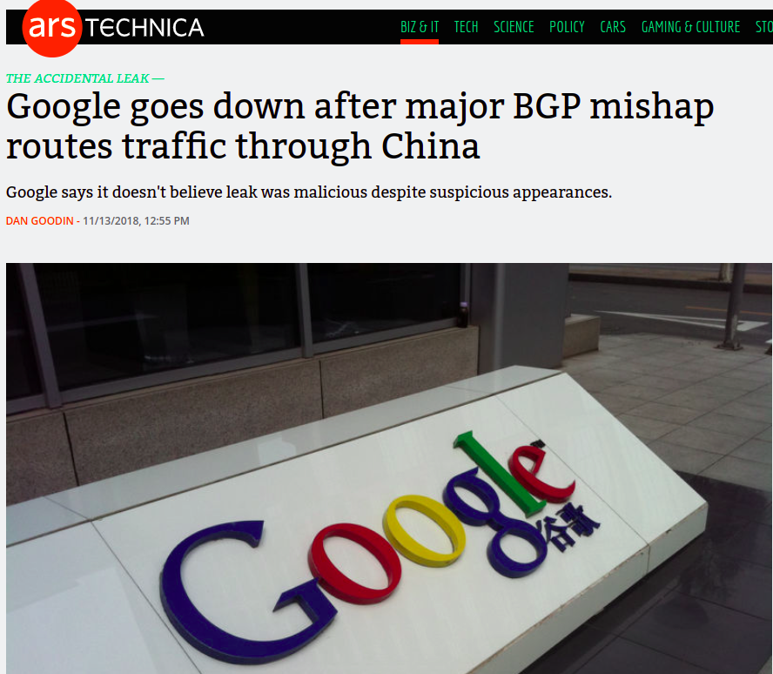
Source : arstechnica.com

Slide 3
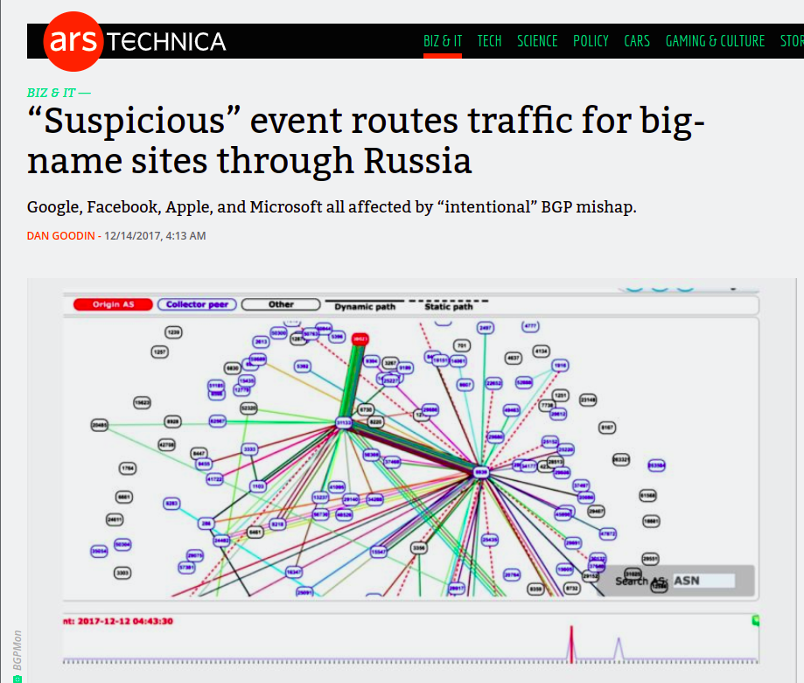
Source : arstechnica.com

Slide 4
CONTENTS
Can routing attacks impact bitcoin?
Partitioning attack
Splitting the network
Delay attack
Slowing the network down
Countermeasures

Slide 5

CAN ROUTING ATTACKS IMPACT BITCOIN
Bitcoin is highly decentralized making it robust to routing attacks
Bitcoin nodes
Are scattered all around the world
Establish random connections
Use multihoming and relay networks

Slide 6
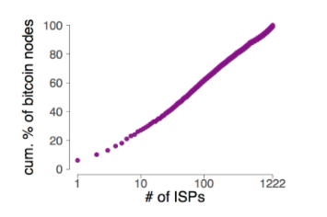
CAN ROUTING ATTACKS IMPACT BITCOIN
When come to practice, Bitcoin is highly centralized both from routing and mining point of view.
Mining power is centralized to few hosting networks
Source : https://btc-hijack.ethz.ch/

Slide 7
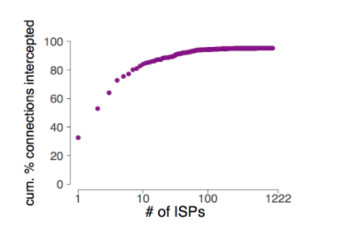
CAN ROUTING ATTACKS IMPACT BITCOIN
Also few ISPs can intercept large fraction of bitcoin connections
Source : https://btc-hijack.ethz.ch/

Slide 8
ATTACKS
Partitioning attacks - split the network into half
It is visible
It’s impact is network wide attack
Delay attacks - Delay block propogation
It is invisible
It’s impact - set of nodes

Slide 9
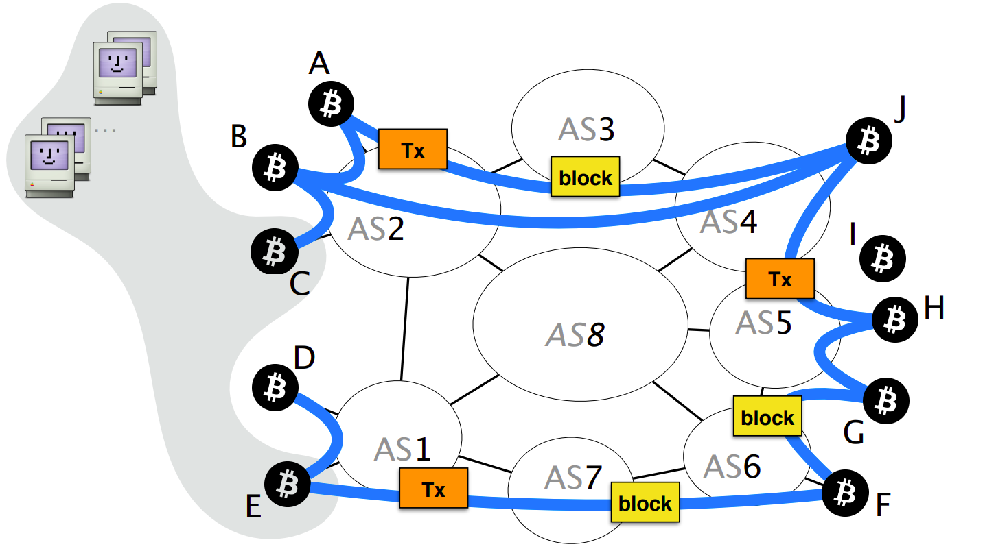
BACKGROUND OF BGP & BITCOIN
Source : Hijacking Bitcoin: Routing Attacks on Cryptocurrencies, https://btc-hijack.ethz.ch/

Slide 10
PARTITIONING ATTACKS
The main goal of partitioning network is to split Bitcoin network into two disjoint components.
Impact
Denial of service
Revenue loss
Double spending

Slide 11
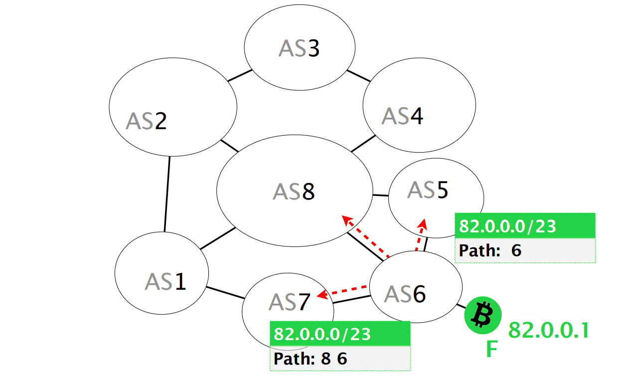
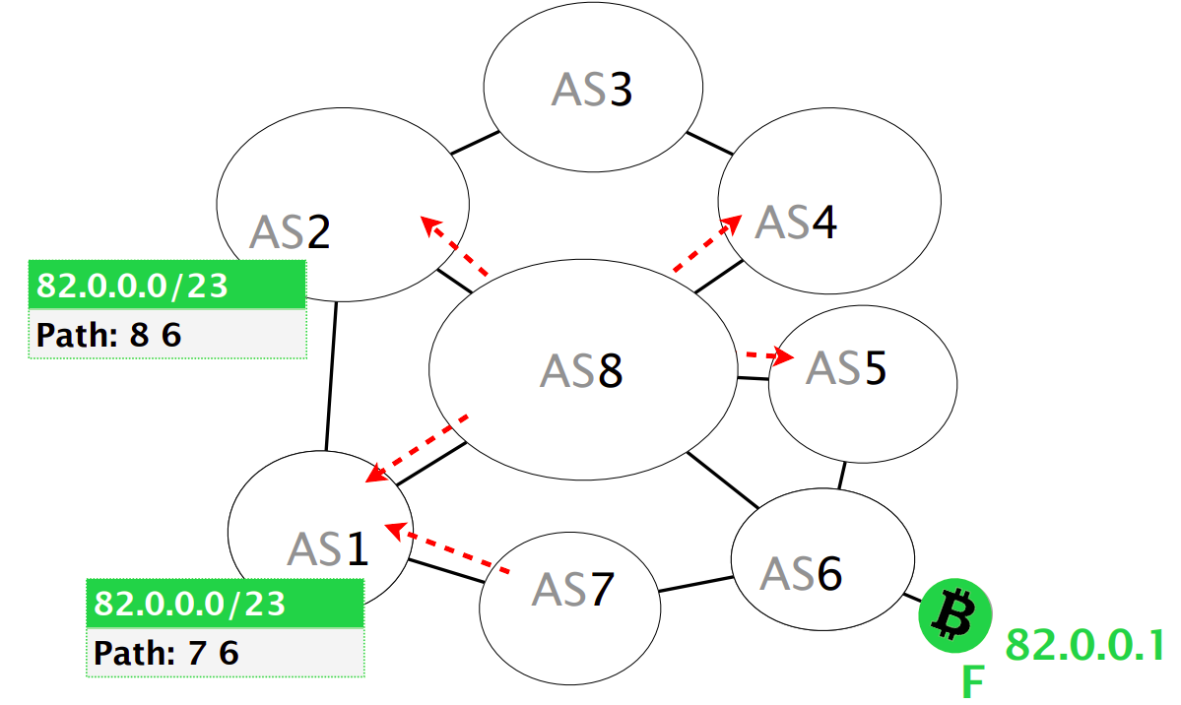
How does the attack work?
Assume there is node F and attacker decides to hijack it.
Source : Hijacking Bitcoin: Routing Attacks on Cryptocurrencies, https://btc-hijack.ethz.ch/

Slide 12
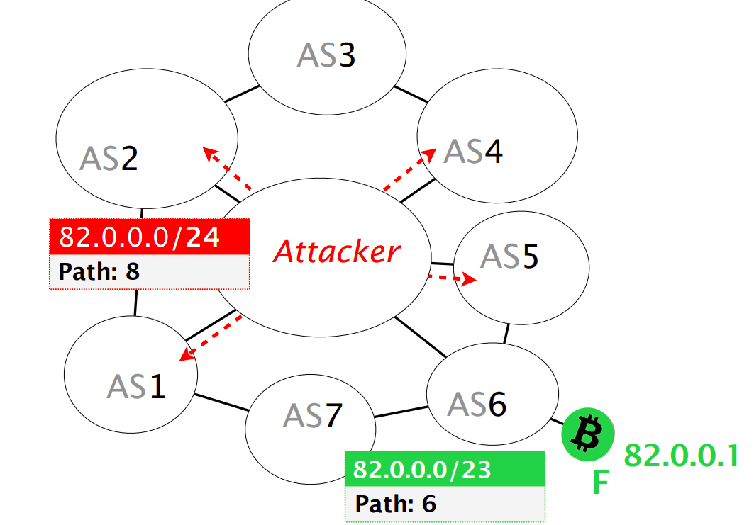
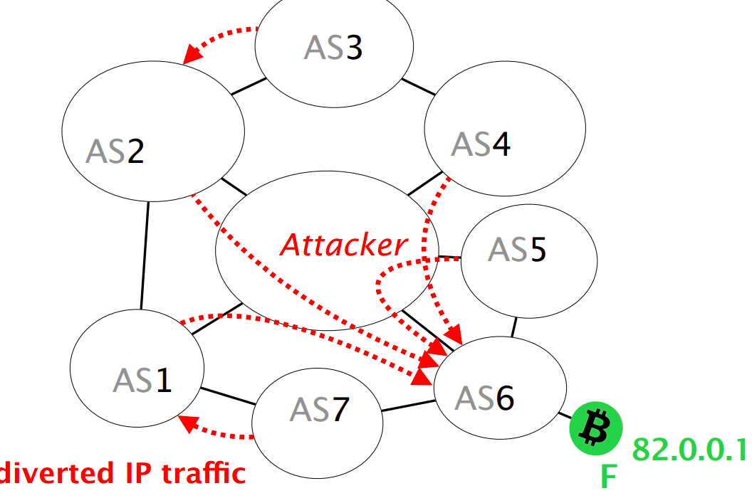
How does the attack work?
Assume there is node F and attacker decides to hijack it.
Source : Hijacking Bitcoin: Routing Attacks on Cryptocurrencies, https://btc-hijack.ethz.ch/

Slide 13
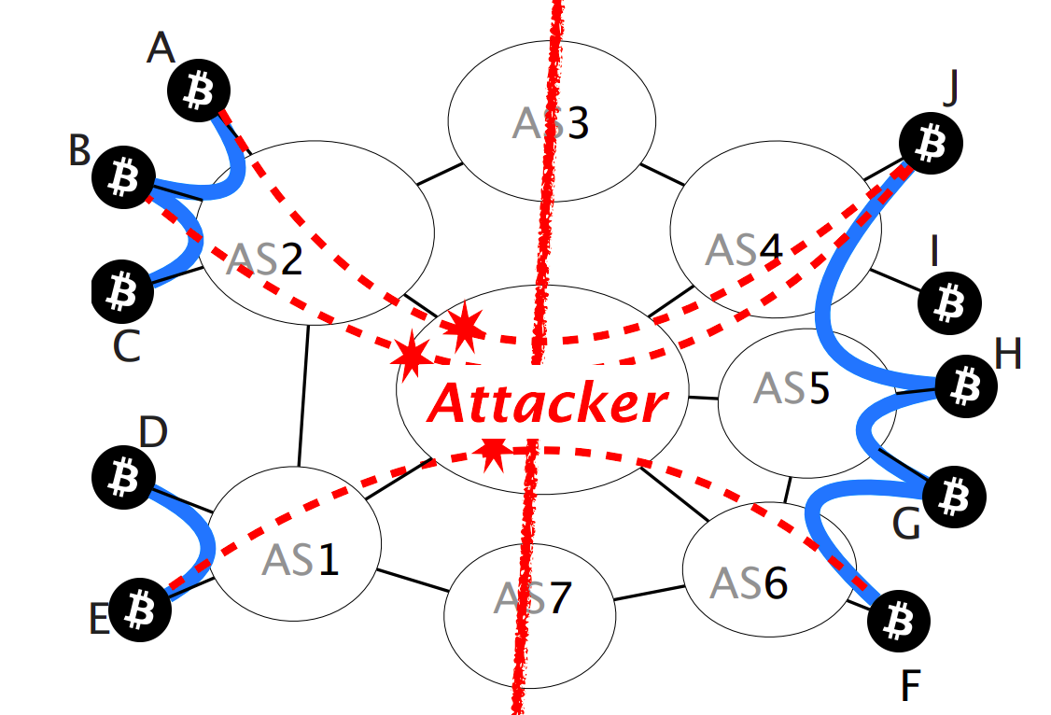
How does the attack work?
The attacker can drop all the connections crossing the partition. The partition is created.
Source : Hijacking Bitcoin: Routing Attacks on Cryptocurrencies, https://btc-hijack.ethz.ch/

Slide 14
How does the attack work?
There will be some connections which can not be intercepted.
Like Bitcoin connections established
Within a mining pool
Within an AS
Between mining pools with private connections
Source : Hijacking Bitcoin: Routing Attacks on Cryptocurrencies, https://btc-hijack.ethz.ch/

Slide 15
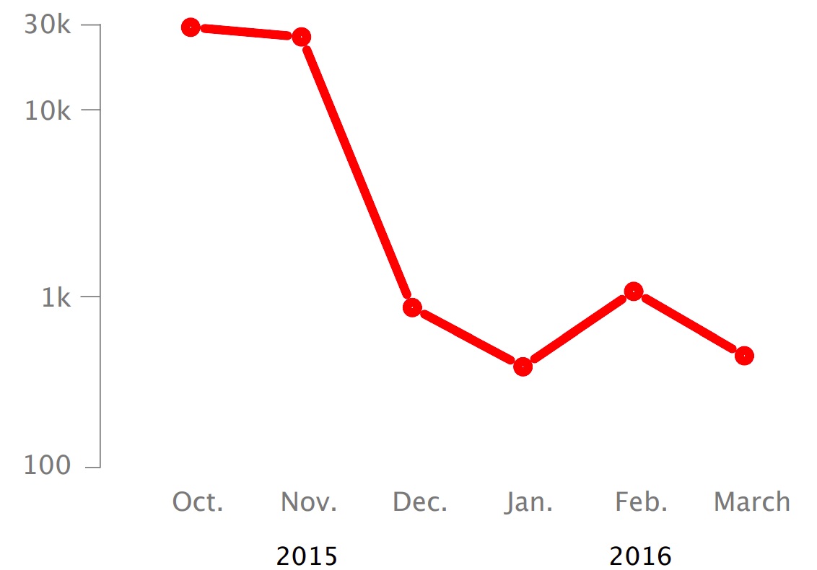
PARTITION ATTACK
Can it practically happen?
Splitting the mining power even to half can be done by hijacking less than 100 prefixes.
Hijacks involving upto 1k of prefixes are frequently seen in internet today.
Source : Hijacking Bitcoin: Routing Attacks on Cryptocurrencies, https://btc-hijack.ethz.ch/

Slide 16
DELAY ATTACK
The goal of delay attack is to make victim unaware of the latest block.
Impact
Double spending attacks
Wasting the mining power
Unable to be updated with peer-to-peer network
Source : Hijacking Bitcoin: Routing Attacks on Cryptocurrencies, https://btc-hijack.ethz.ch/

Slide 17
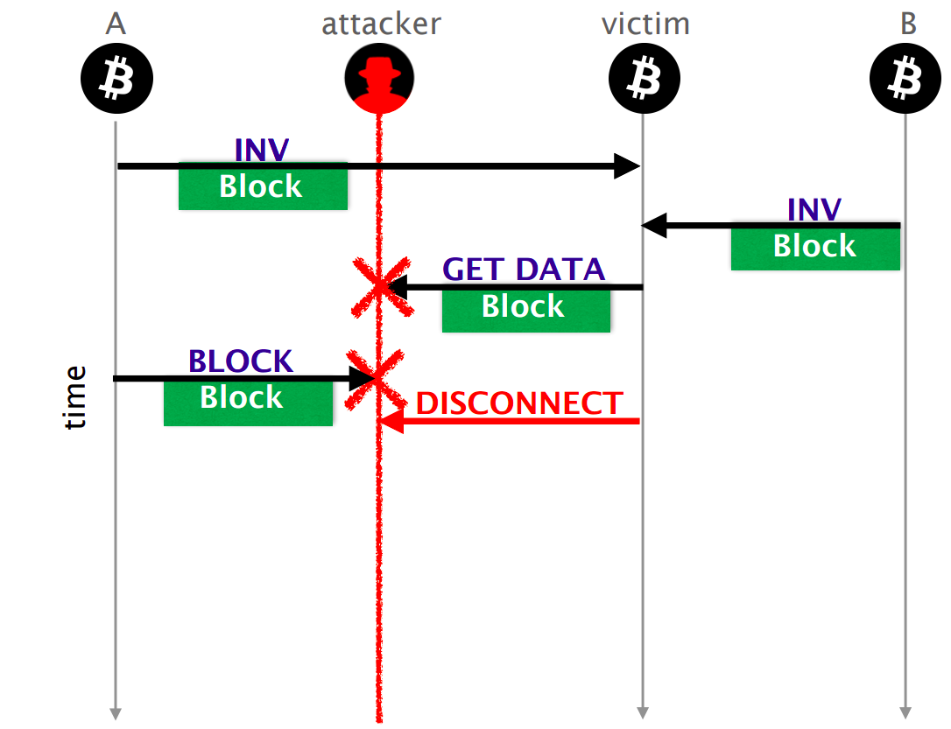
How does the attack work?
Source : Hijacking Bitcoin: Routing Attacks on Cryptocurrencies, https://btc-hijack.ethz.ch/

Slide 18
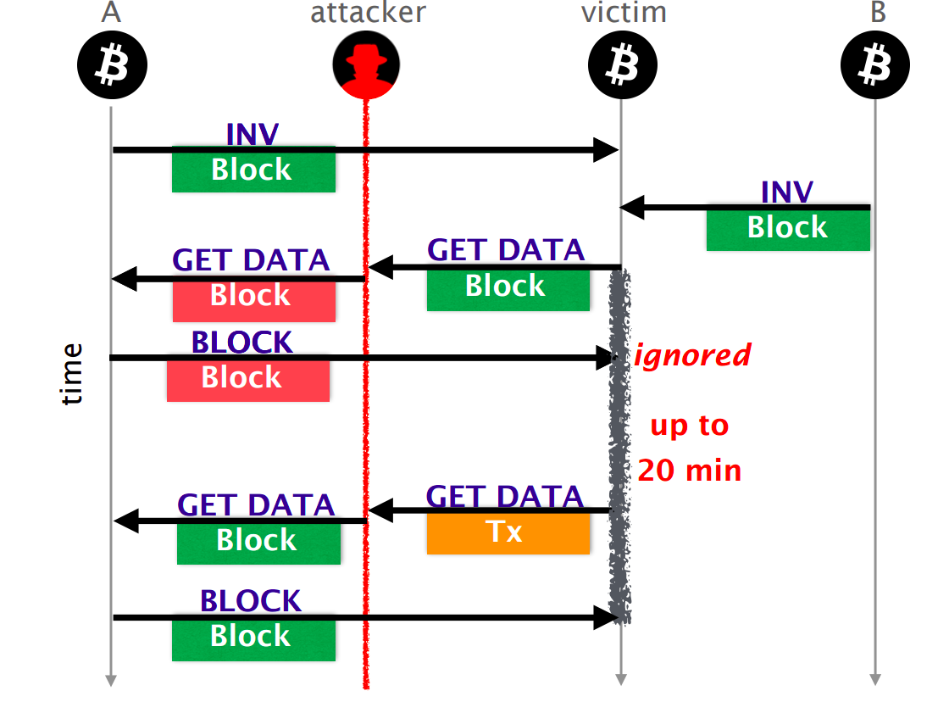
How does the attack work?
Source : Hijacking Bitcoin: Routing Attacks on Cryptocurrencies, https://btc-hijack.ethz.ch/

Slide 19
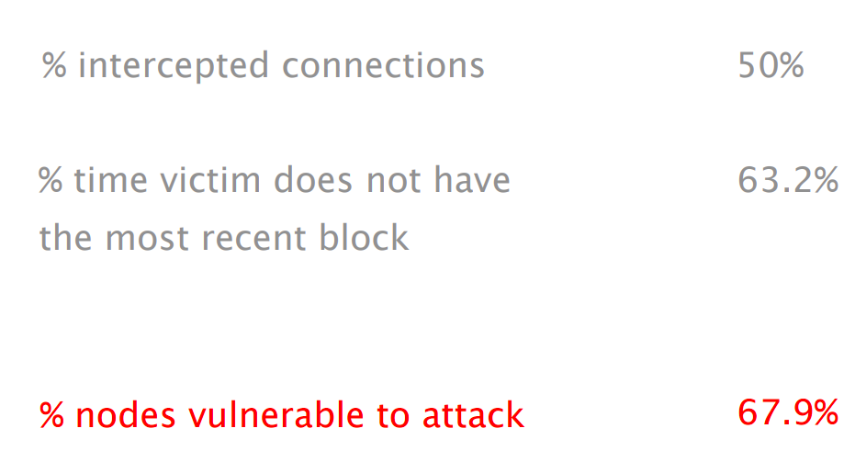
DELAY ATTACK
Source : Hijacking Bitcoin: Routing Attacks on Cryptocurrencies, https://btc-hijack.ethz.ch/

Slide 20
COUNTERMEASURES
Short term
Routing aware peer selection
Select Bitcoin peers while taking routing into account
Monitor changes in peer behaviour, statistics, etc.
Long term
Use end-to-end encryption
Not for partition attacks
Deploy secure routing protocols
Not for delay attacks
Source : Hijacking Bitcoin: Routing Attacks on Cryptocurrencies, https://btc-hijack.ethz.ch/

Slide 21
REFERENCES
Hijacking Bitcoin: Routing Attacks on Cryptocurrencies, https://btc-hijack.ethz.ch/
https://btc-hijack.ethz.ch/files/btc_hijack.pdf
https://www.youtube.com/watch?v=2RB-Gztfvpk&t=769s
https://btc-hijack.ethz.ch/#:~:text=An%20attacker%20can%20use%20routing,the%20creation%20of%20parallel%20blockchains.
https://www.youtube.com/watch?v=XAxfiaU0lzE
https://en.wikipedia.org/wiki/BGP_hijacking

Slide 22

THANK YOU

