Slide 1
QuickServe Localized Service Booking App
Submitted By
Nishanthini A
B Tech-IT

Slide 2
Objectives
Easy online booking of home services
Secure login using OTP email verification
Digital wallet with PIN-based payments
Real-time chat and smart notifications
Admin-controlled, scalable system

Slide 3
Technologies Used
Frontend: HTML, CSS, JavaScript
Backend: Java, Spring Boot, REST APIs
Database: MySQL
Email: JavaMailSender (OTP)

Slide 4
User Module
OTP-based registration and secure login
Book services and track booking status
Real-time chat with providers
Ratings, reviews, and complaints
Automatic booking notifications
Communicate with chatbot

Slide 5
Provider Module
Register and get admin approval
Accept / reject booking requests
Update service completion status
View earnings and booking history
Chat with users and receive alerts

Slide 6
Admin Module
Manage users and service providers
Approve providers and monitor bookings
Track payments, revenue, and reviews
Handle complaints and notifications
Dashboard with key statistics

Slide 7
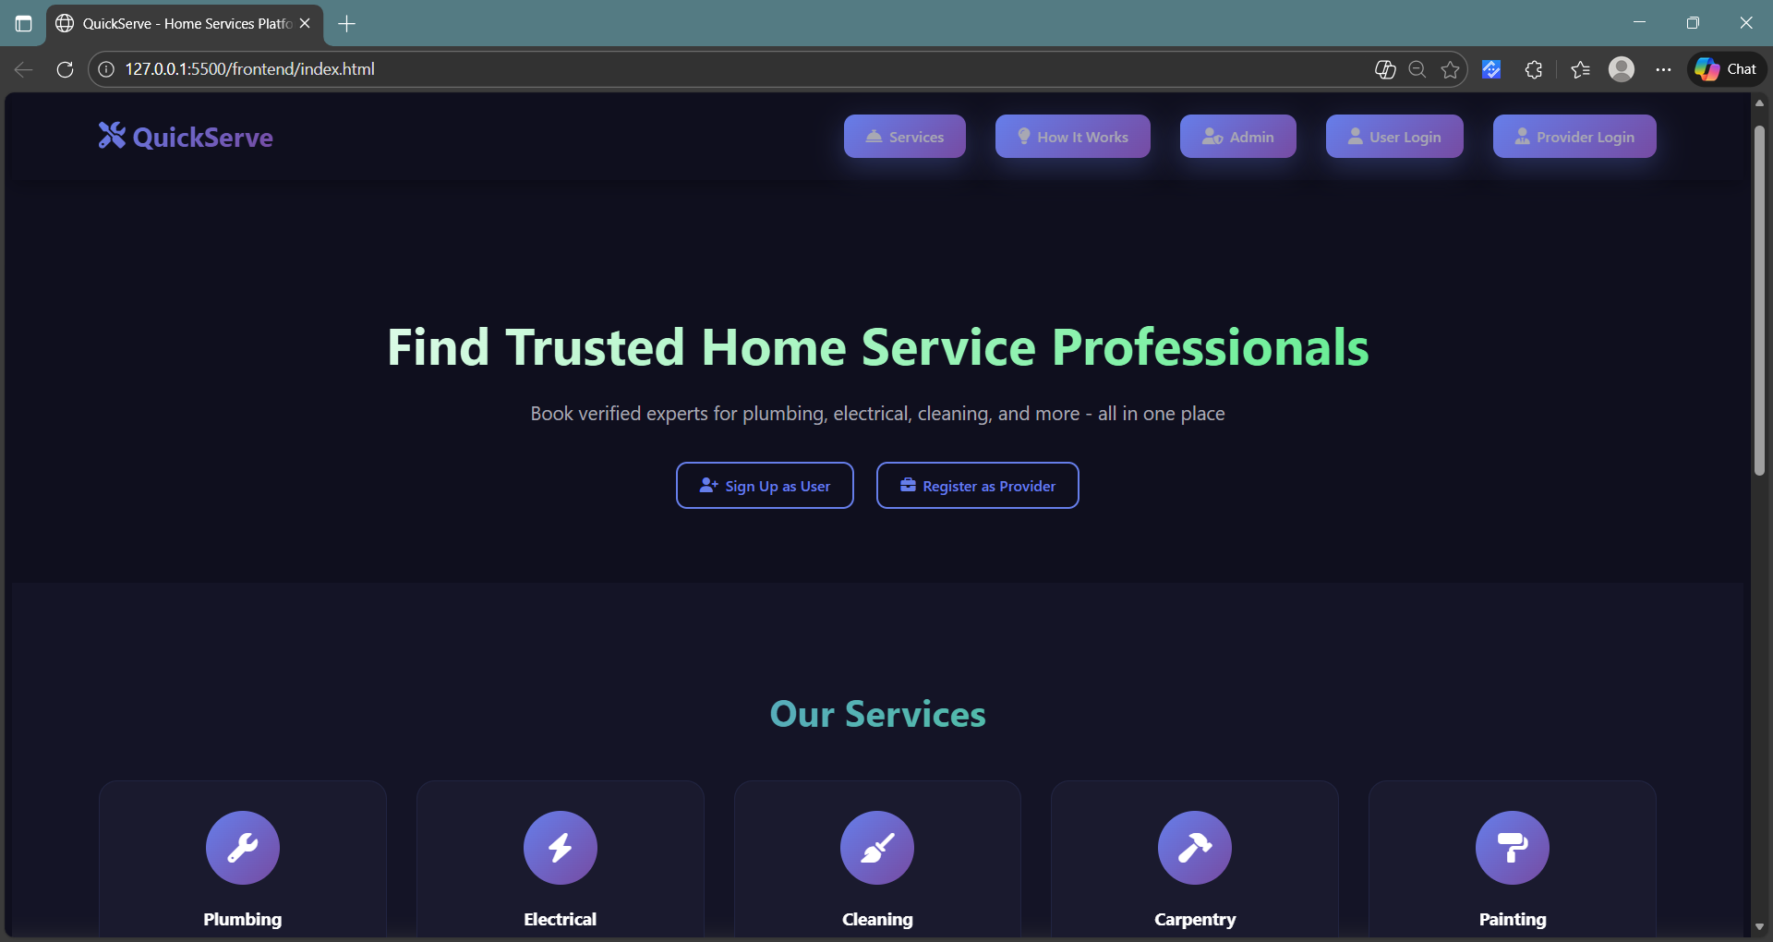
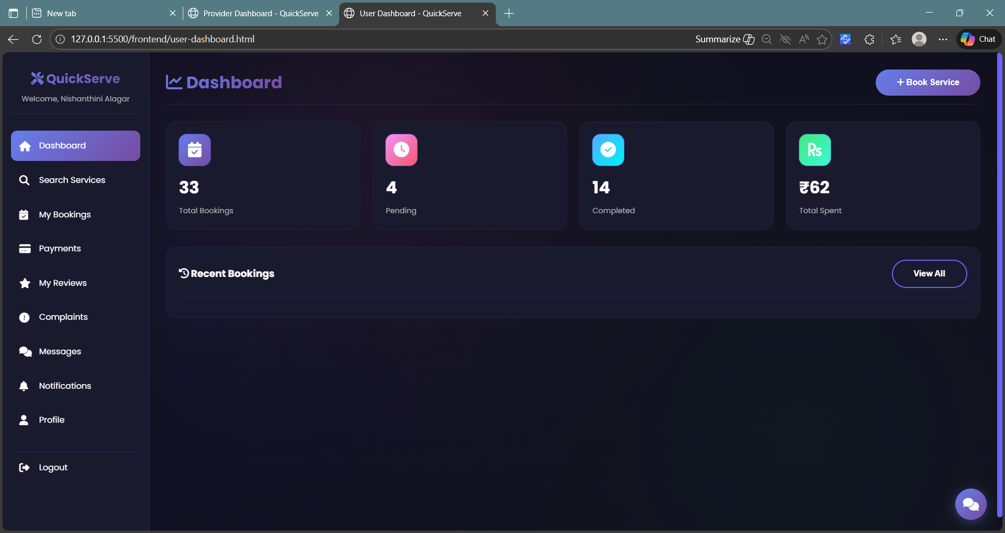
OUTPUT:
Index Page
User Module

Slide 8
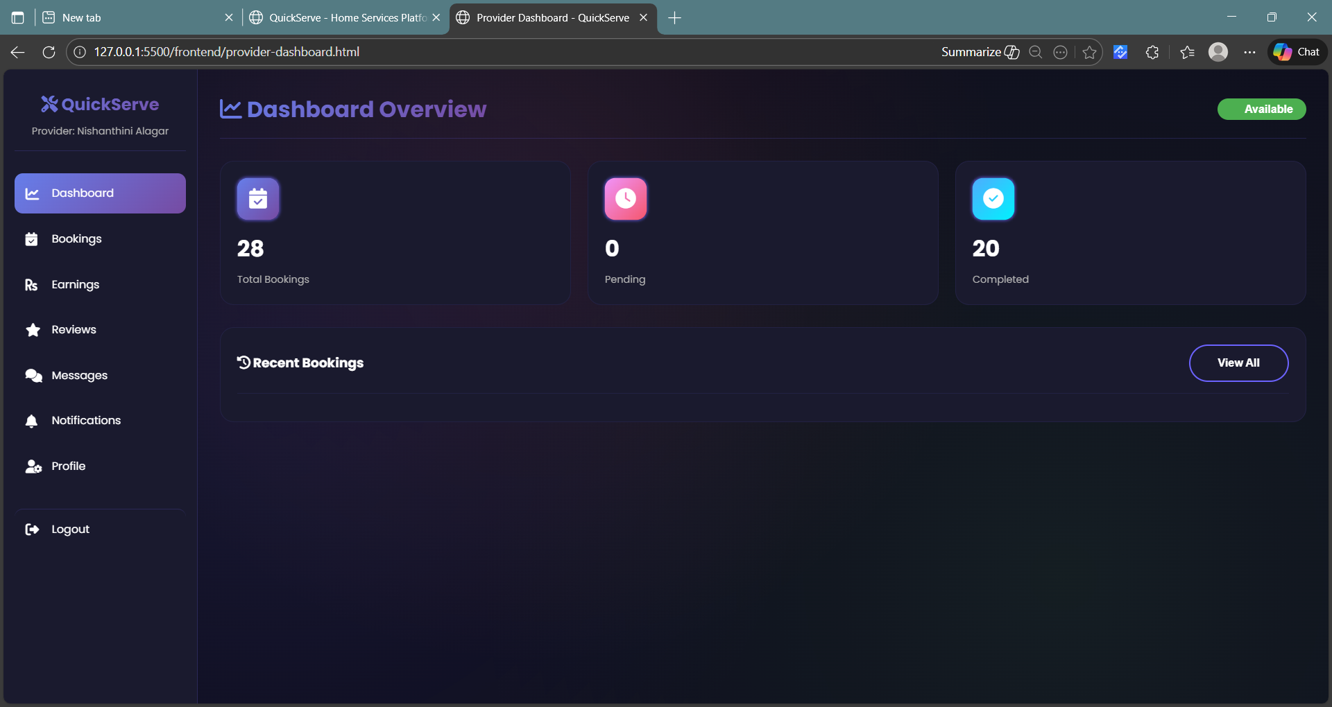
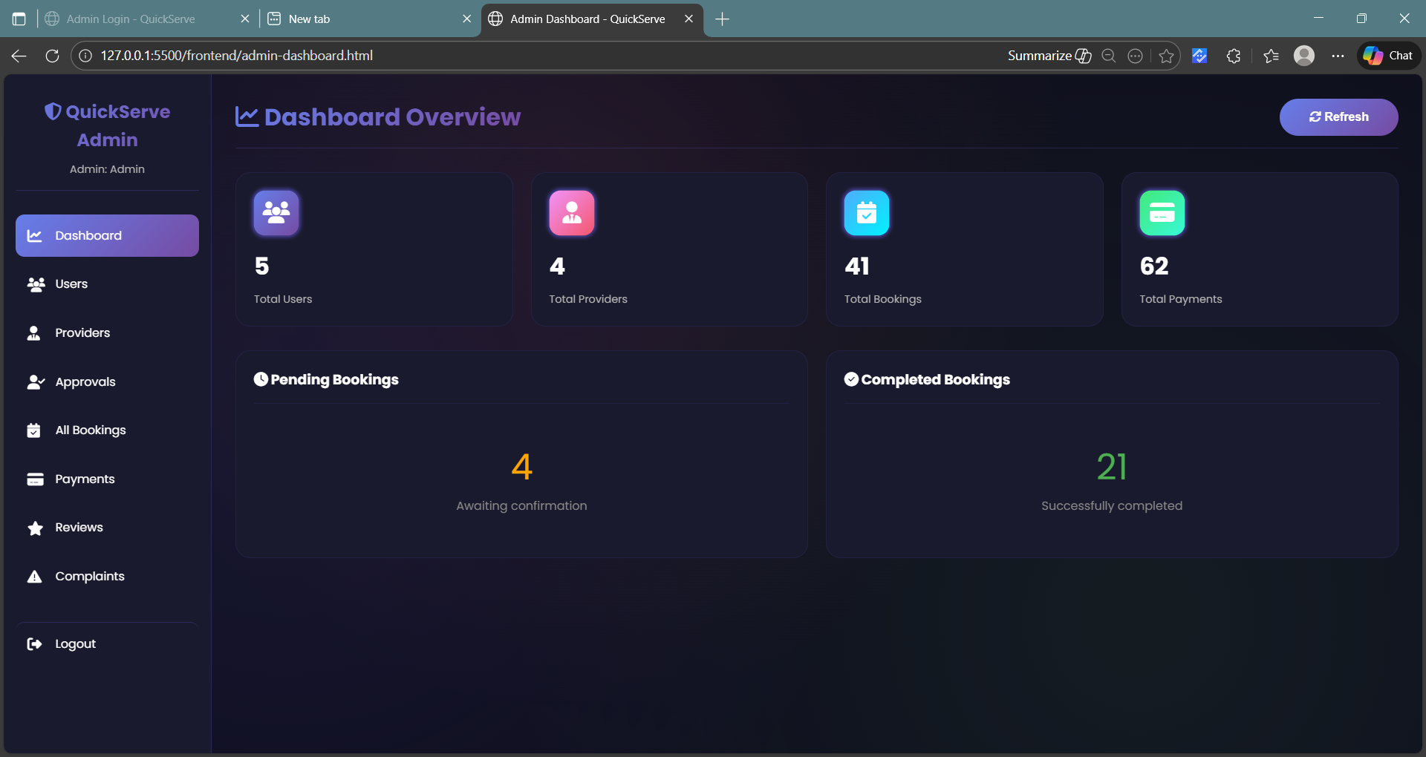
Output:
Provider Module
Admin Module

Slide 9
Conclusion
End-to-end secure service booking platform
Real-time communication and digital payments
Quality ensured through ratings and complaints
Full admin monitoring and control
Built with Java, Spring Boot, and MySQL

Slide 10
THANK YOU

