Slide 1

Talent Grid: Microservices ATS & Candidate Assessment Engine
SOA Project Review-1
Date& Time
 | Under the Guidance of Venkateswari ketineni Professor, Department of Computer Science and Engineering, KLH CSE Bowrampet Campus
Team Members K.Karthik 2420030432 M.Yashwanth Sai 2420090066 A.Nikeleswarredy 2420030087
R.Harshath- 2420090074

Slide 2
Outline of Project Work
Focus
Introduction
Literature Survey
Challenges
Research Objectives
Conclusion & Future Work
References
Publications Details

Slide 3
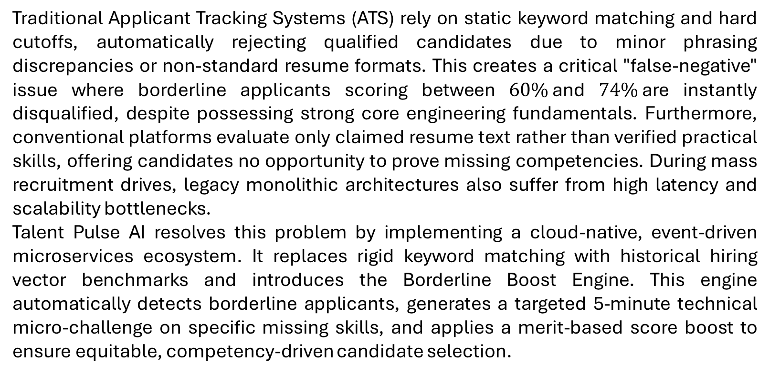
Problem Statement
Traditional Applicant Tracking Systems (ATS) rely on static keyword matching and hard cutoffs, automatically rejecting qualified candidates due to minor phrasing discrepancies or non-standard resume formats. This creates a critical "false-negative" issue where borderline applicants scoring between $60\%$and $74\%$are instantly disqualified, despite possessing strong core engineering fundamentals. Furthermore, conventional platforms evaluate only claimed resume text rather than verified practical skills, offering candidates no opportunity to prove missing competencies. During mass recruitment drives, legacy monolithic architectures also suffer from high latency and scalability bottlenecks.
Talent Pulse AI resolves this problem by implementing a cloud-native, event-driven microservices ecosystem. It replaces rigid keyword matching with historical hiring vector benchmarks and introduces the Borderline Boost Engine. This engine automatically detects borderline applicants, generates a targeted 5-minute technical micro-challenge on specific missing skills, and applies a merit-based score boost to ensure equitable, competency-driven candidate selection.

Slide 4
Objectives
Build a smart resume scanner that understands the actual meaning of words and compares candidates to past successful hires, instead of just searching for exact keywords.
Automatically catch candidates who are very close to passing (scoring between 60% and 74%).
Find the exact skills they are missing on their resume
Automatically create a 3-question, 5-minute technical quiz focused only on the candidate's missing skills.
Auto-grade the answers immediately and give the candidate a score boost of up to 15% if they perform well.
Automatically email candidates their special 5-minute test links and notify recruiters instantly when a candidate qualifies for an interview.

Slide 5
Literature Survey
Authors | Title of the Paper | Methodology | Inferences | Limitation/Future work
Sinha et al | Automated Resume Screening and Ranking Using Natural Language Processing and Semantic Similarity, IEEE Access, 2022 | TF-IDF, Word2Vec, and Cosine Similarity for keyword vector matching • Rule-based text tokenization and parsing algorithms | Successfully automated candidate resume ranking against static job descriptions with 86.4% matching precision. Significantly reduced initial manual screening time for recruiters. | • Relies purely on static resume text without verifying actual competencies.
Gao et al | Historical Hire Benchmarking and Machine Learning in Technical Recruitment, ACM Transactions on Information Systems, 2023 | • Dense vector embeddings (BERT/Sentence-BERT) • Cosine similarity against historical successful employee profiles | Demonstrated that benchmarking candidates against past high-performing employees yields 28% higher retention compared to pure keyword filters. | Implemented as a rigid batch-processing model with high latency.

Slide 6
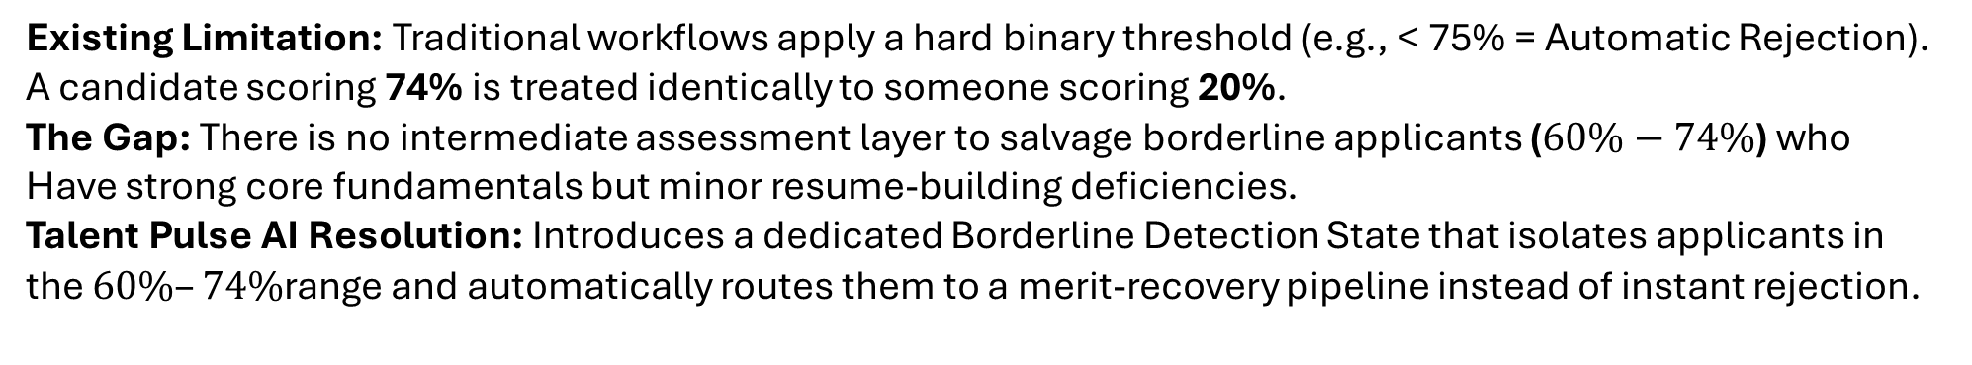
Problem Gap Identification
Existing Limitation: Traditional workflows apply a hard binary threshold (e.g., < 75% = Automatic Rejection).
A candidate scoring 74% is treated identically to someone scoring 20%.
The Gap: There is no intermediate assessment layer to salvage borderline applicants ($60\%−74\%$) who
Have strong core fundamentals but minor resume-building deficiencies.
Talent Pulse AI Resolution: Introduces a dedicated Borderline Detection State that isolates applicants in
the $60\%–74\%$range and automatically routes them to a merit-recovery pipeline instead of instant rejection.

Slide 7
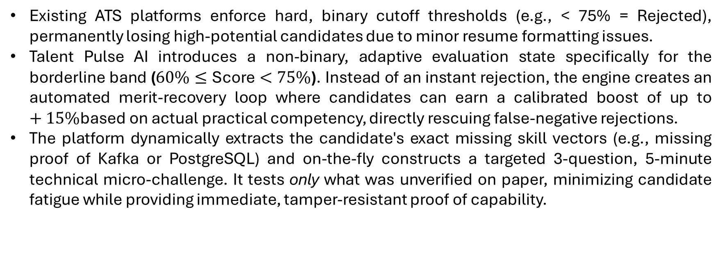
Innovation, Creativity, and Novelty
Existing ATS platforms enforce hard, binary cutoff thresholds (e.g., < 75% = Rejected), permanently losing high-potential candidates due to minor resume formatting issues.
Talent Pulse AI introduces a non-binary, adaptive evaluation state specifically for the borderline band ($60\%≤\text{Score}<75\%$). Instead of an instant rejection, the engine creates an automated merit-recovery loop where candidates can earn a calibrated boost of up to $+15\%$based on actual practical competency, directly rescuing false-negative rejections.
The platform dynamically extracts the candidate's exact missing skill vectors (e.g., missing proof of Kafka or PostgreSQL) and on-the-fly constructs a targeted 3-question, 5-minute technical micro-challenge. It tests only what was unverified on paper, minimizing candidate fatigue while providing immediate, tamper-resistant proof of capability.

Slide 8
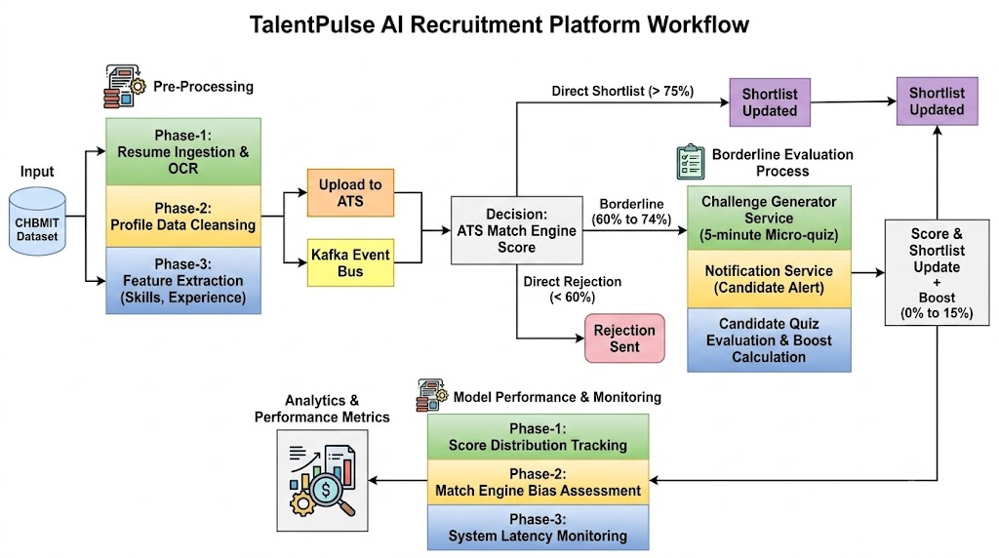
Feasibility and Project Plan

Slide 9

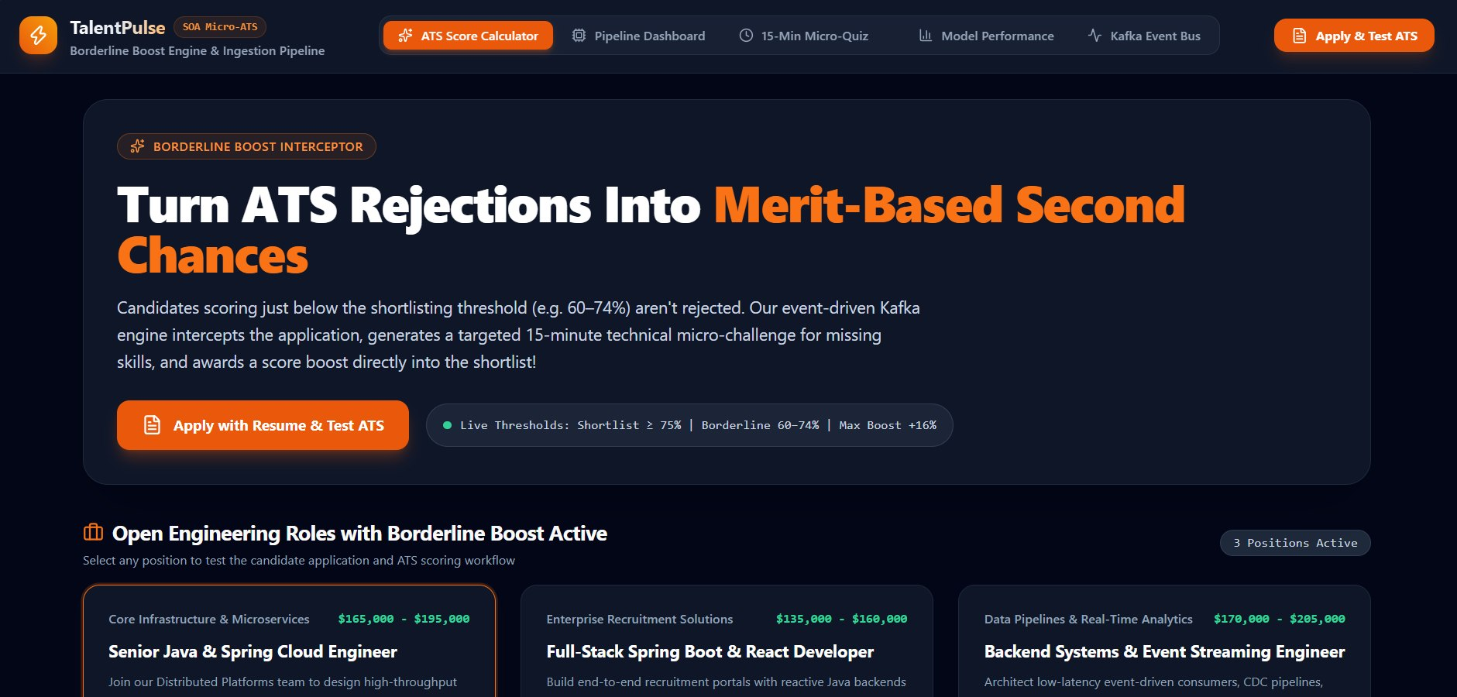

Slide 10
