Slide 1

PROGRAMMATIC EVALUATION OF APACHE GROOVY

Slide 2
Names, Binding & Scopes
Names start with letters, digits & underscore character.
Uses Static type binding
All variables are created public by default
Global variables – no keyword required, accessed throughout the script
Local variables, block-scoped – use ‘def’ keyword

Slide 3
Data Types
Primitive Types: byte, short, int, long, float, double, char, Boolean, String
Object Types:
Java.lang: Byte, Short, Integer, Long, Float, Double
Java.math: BigInteger, BigDecimal

Slide 4
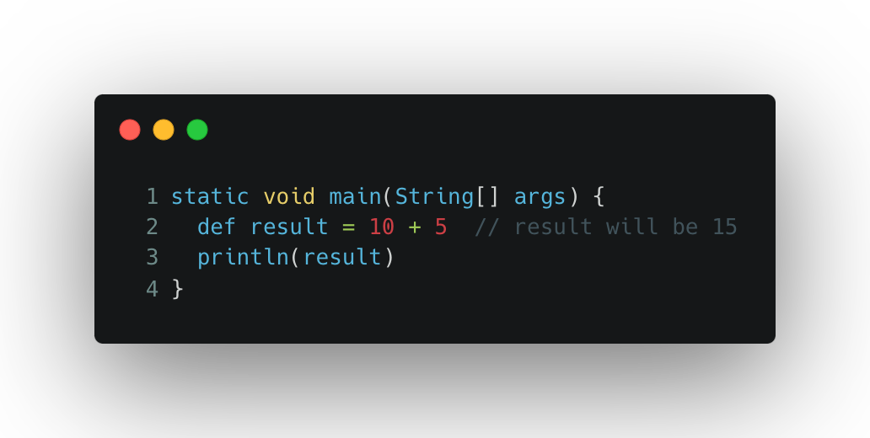
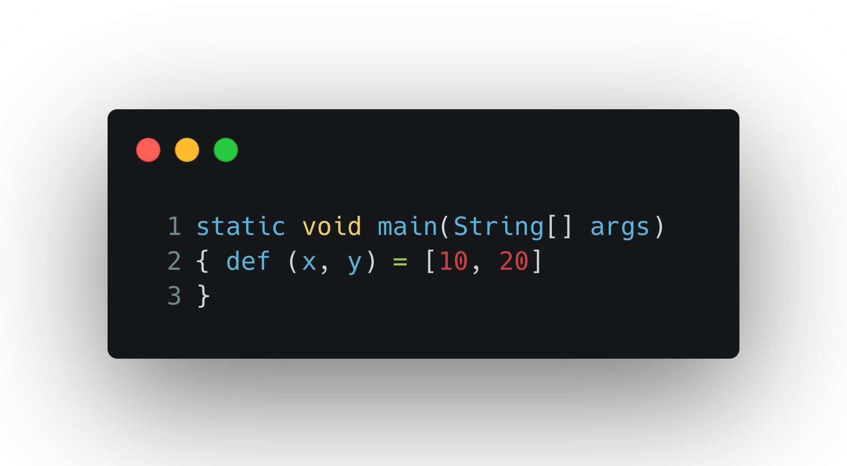
Expressions and Assignment Statements
To initialize a variable, we have to use the ”def” keyword.
Single assignment
Multiple Assignment

Slide 5
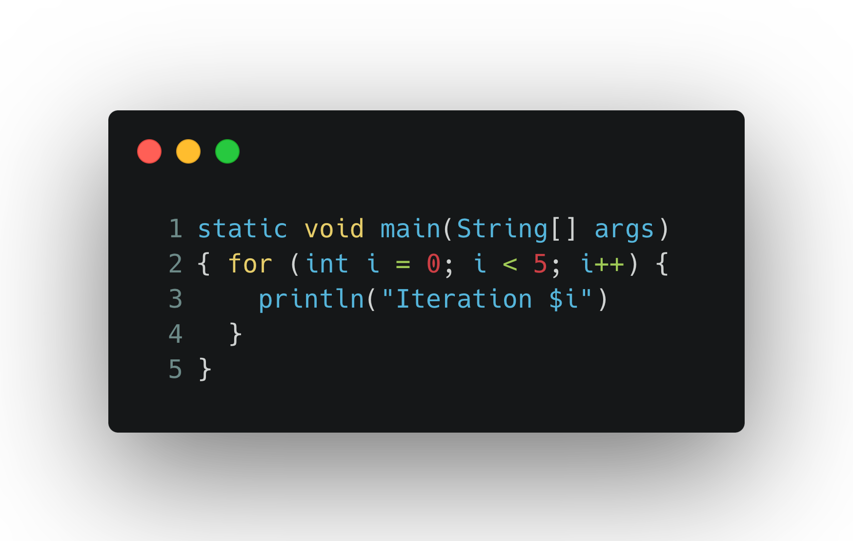
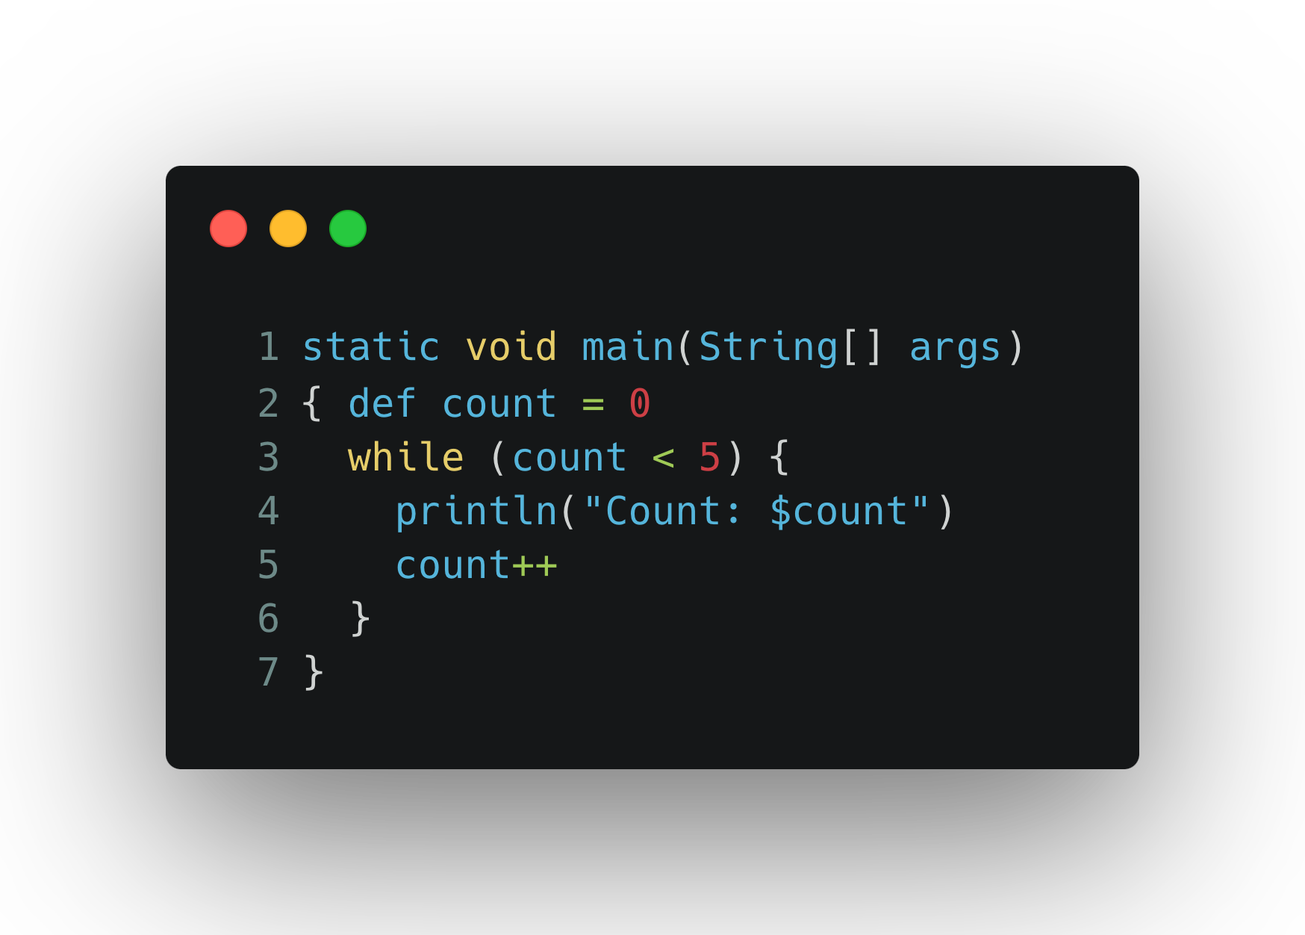
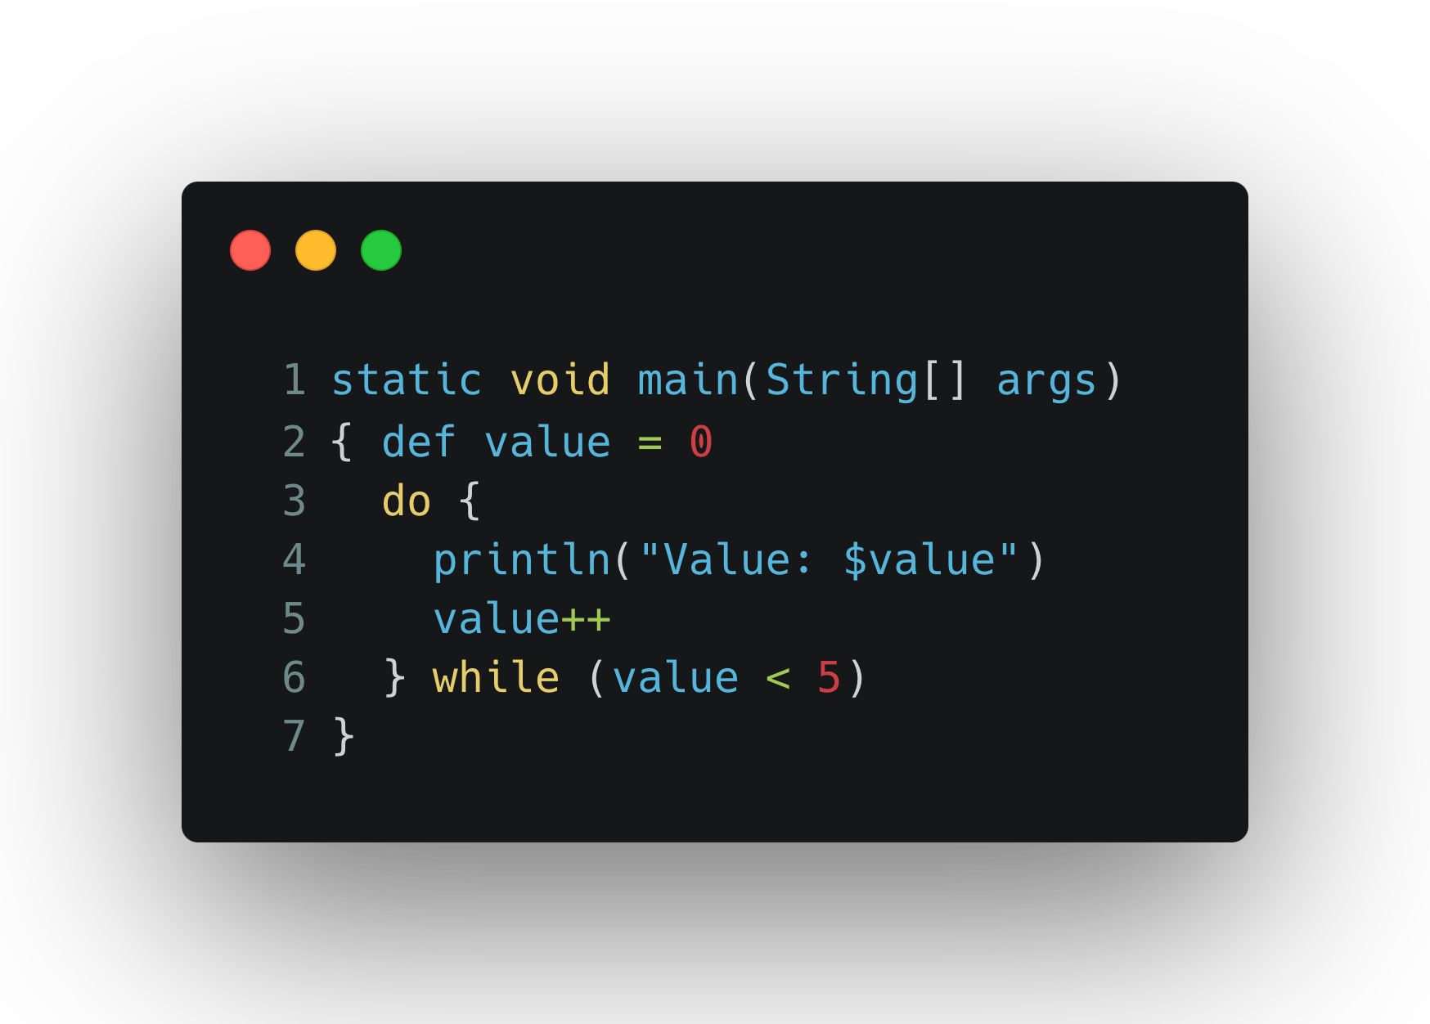
Loops
While Loop
Do While
For Loop
Apace Groovy also supports for loops like for-each, and for-in like python.

Slide 6
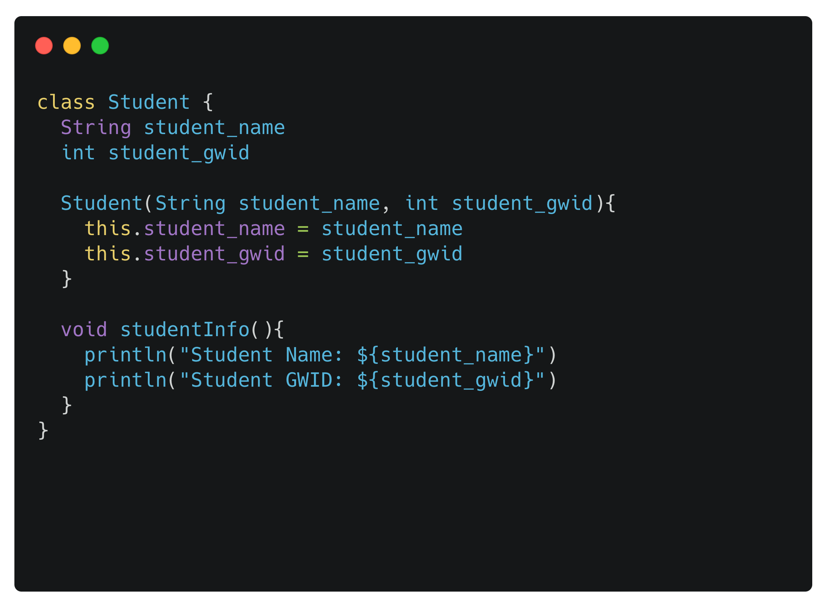
Object-Oriented Programming
Apache Groovy fully supports Object-Oriented Programming (OOP) principles
Class:
We have created a class called Student inside which we have two variables, student name and gwid number, default constructor and function to display the values of the variables

Slide 7
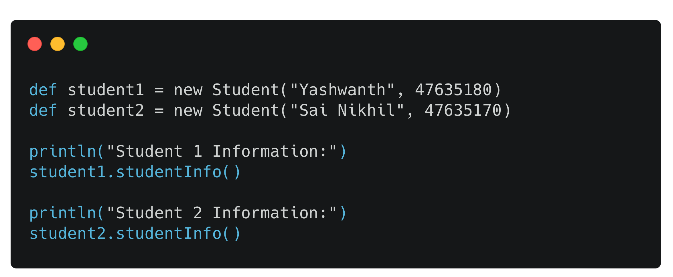
Object-Oriented Programming
Object
We now create two objects, student1 and student2. We have assigned two different values to the objects and use the studentInfo() function inside the class and print the values.

Slide 8
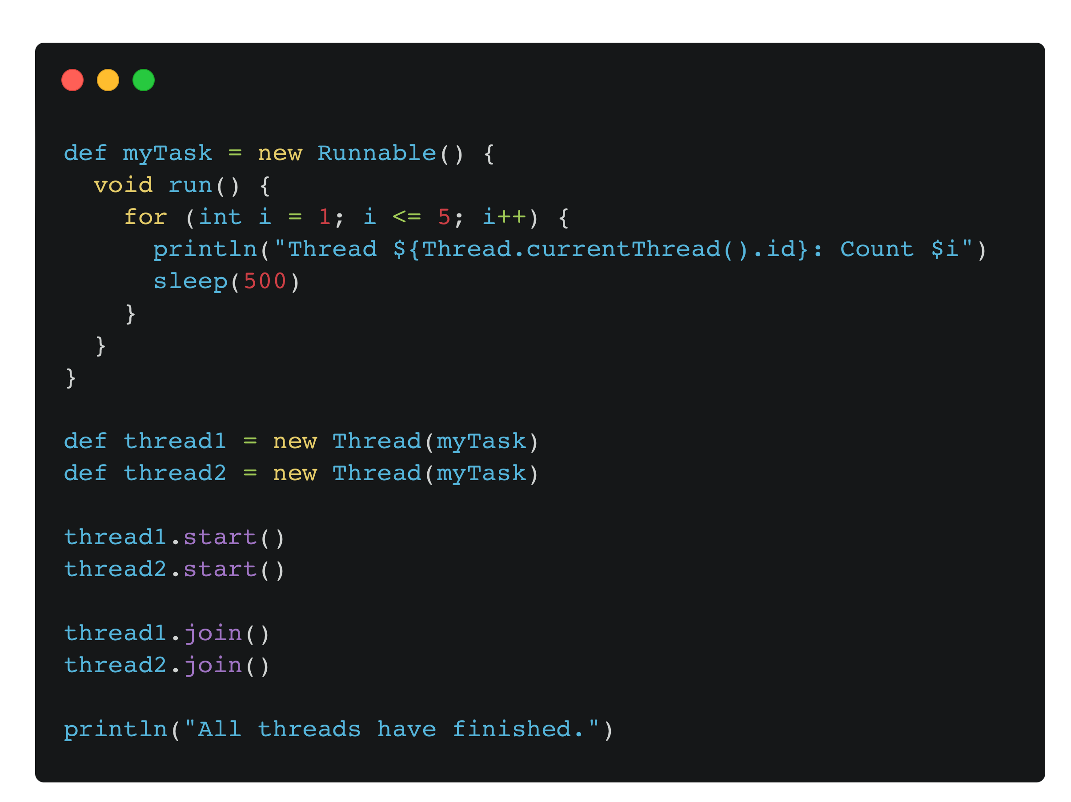
Concurrency
Apache groovy is a versatile language that is capable of running multiple processes simultaneously.
In the provided example, we have developed a program called "myTask" with two threads, named "thread1" and "thread2." We have utilized the "sleep" function to better visualize the working of program.
When we execute the program, we can observe that both "thread1" and "thread2" run at the same time.

Slide 9
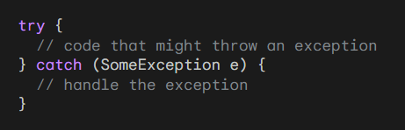
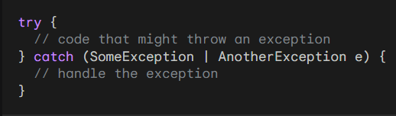
Exception Handling and Event Handling
Exception Handling
Exception handling in Apache Groovy is the same as in Java. We use the try-catch block to catch an exception and handle it.
We can also use the multi-catch block to catch multiple exceptions at the same time.

Slide 10
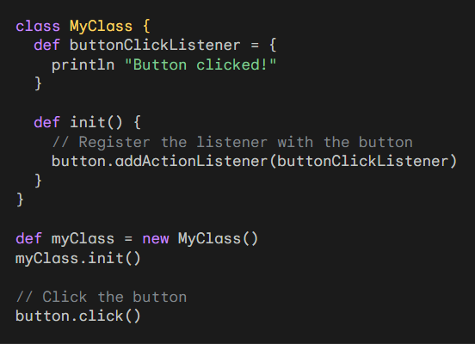
Event Handling
Event handling in Apache Groovy is similar to other programming languages, but it has some additional features and syntax that make it easier to implement.
Groovy also provides an event bus that can be used to communicate between different parts of an application using events.
Event handling is a powerful way to decouple different parts of an application and make it more modular and reusable. Groovy provides a number of features that make it easy to implement event handling in your applications.

Slide 11
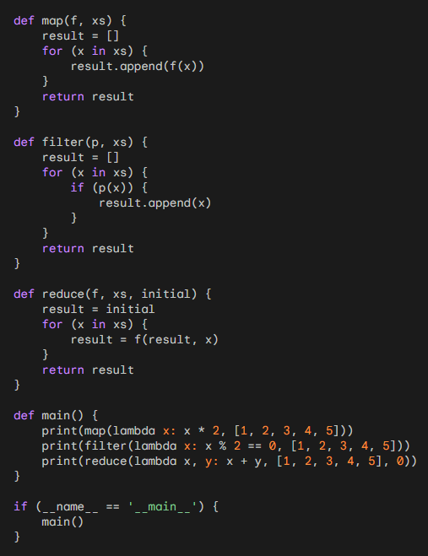
Functional Programming
Apache Groovy is a dynamic programming language for the Java platform that supports multiple programming paradigms, including functional programming.
Groovy provides a number of features that make it well-suited for functional programming, including:
Closures
Higher order functions
Currying
Function composition
Pure functions
Immutability
Recursion
Tail call optimisation

Slide 12
Command pattern
Execute Around pattern
Memoization
Collect - map operation
Filter
Reduce
Map filter reduce
Strategy pattern

