Slide 1

SCALA

Slide 2
CSCI 6221 ADVANCED SOFTWARE PARADIGMS
Professor : Walcelio Melo
Bhavya Sree Gudiseva Rithik Reddy Pentareddy Saiteja Singirikonda Prima Sunil Sanghvi Praveen Chowdary Vadde

Slide 3

Concepts
Names, Binding and Scopes
Data Types
Expressions & Assignment Statements
Support to OO Programming
Concurrency
Exception and Event Handling
Functional Programming
Project Proposal

Slide 4
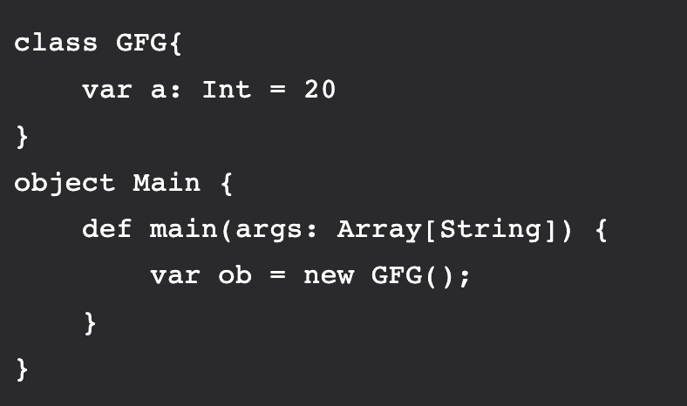
Names, Binding and Scope
Names:
In programming languages, Identifiers are used for identification purpose. In Scala, an identifier can be a class name, method name, variable name or an object name.
In this program we have 6 identifiers:
GFG: Class name
a: Variable name
Main: Object name
main: Method name
args: Variable name
ob: Object name

Slide 5
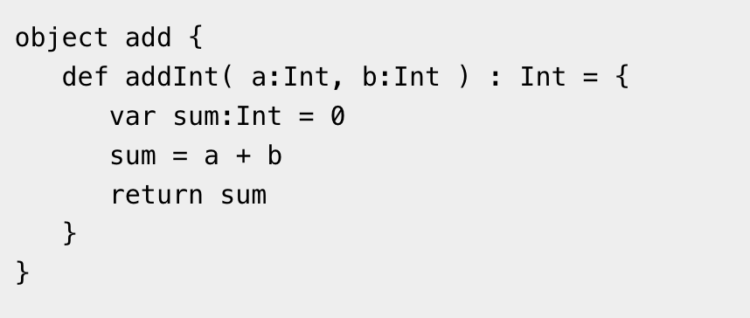
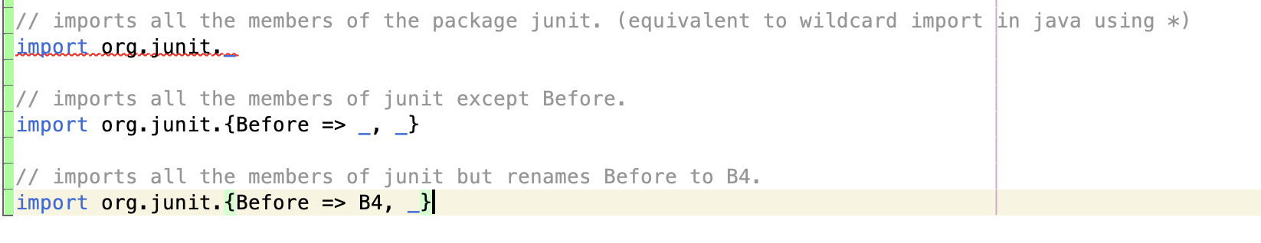
Names, Binding and Scope
Names
Methods :- def keyword is used to define method . Names should start with a lowerCase letter
Packages:- Similar to Java. Underscore can be used to indicate if some members or all members are to be included. For example,

Slide 6
Names, Binding and Scope
Binding
Association between name and the entity it represents.
Variable definitions and for expressions are loosely typed.
Variables can be defined as value: it can be constant or change its value. For example:
i) var keyword is used for mutable variable i.e its value can be changed
var myVar : String = "Foo"
ii) val keyword is used for immutable variable i.e its value cannot be changed
val myVal : String = "Foo"

Slide 7
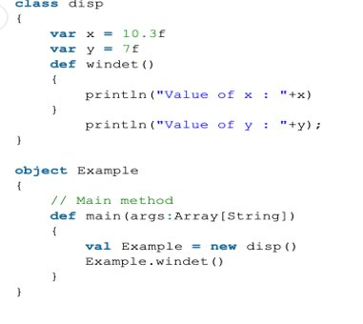
Names, Binding and Scope
Scope
Variables in Scala have three different scopes depending on their use.
They can exist as:
Fields
Method Parameter
Local Variable
Fields:- These variables can be accessed from every method
in the object & from outside the object, depending on
whether they are mutable or immutable.

Slide 8
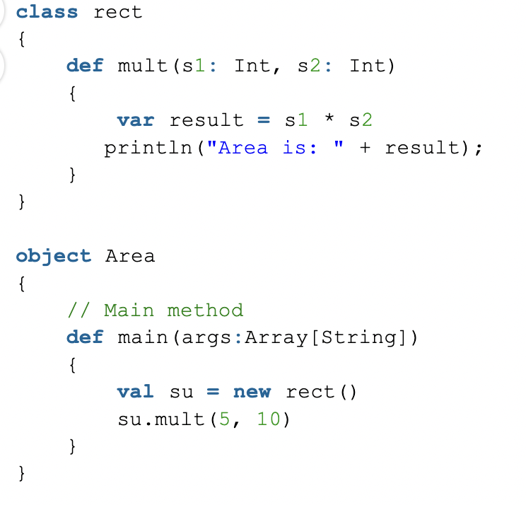
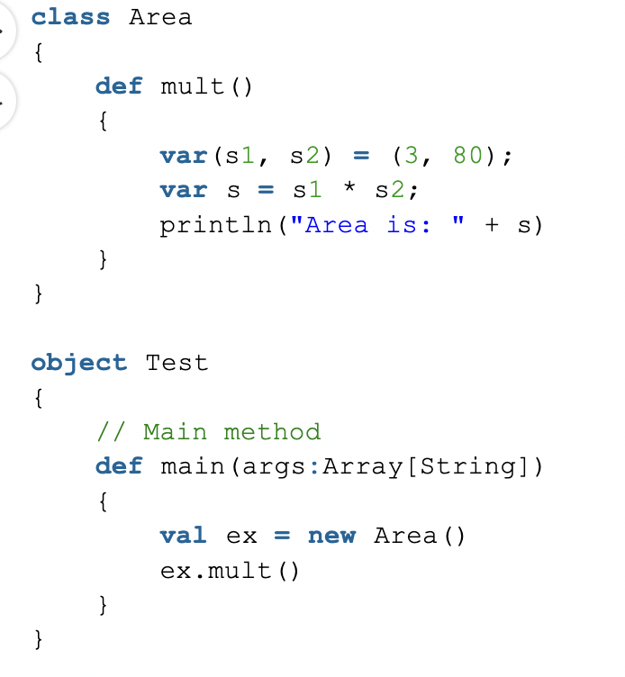
Names, Binding and Scope
Scope
Method Parameter:- Can be referenced from inside or
outside the method. They are always mutable.
Local Variables :- Declared inside the method and only
accessible inside the method. They can mutable as well
as immutable.

Slide 9
Data Types
Scala has same data types as java.
Examples:
Any: Any
AnyRef: AnyRef
Null: Null
Nothing: Nothing
String, Char, Double, Long, Float, Int etc.

Slide 10
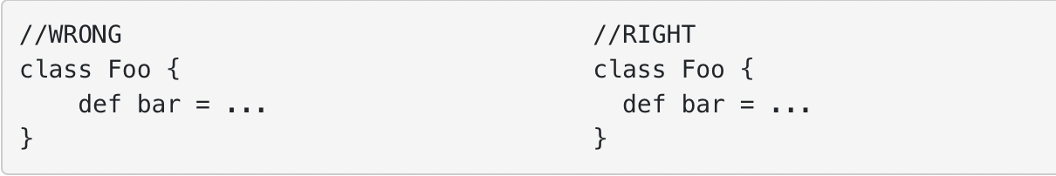
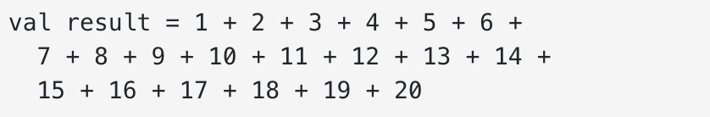
Coding Styles
Indentation:- Scala follows 2 space indentation instead of 4 spaces.
Line Wrapping:- Scala coding style prefers if length of a line crosses 80 characters then, split the same in multiple lines i.e

Slide 11
Expression and Assignment Statements
Scala is rich in built-in operators such as Arithmetic Operators, Relational Operators, Logical Operators, Bitwise Operators and Assignment Operators. Below are few Expression Statements in Scala:
A literal value, such as 42 or "hello world"
A variable or a constant, such as val x = 1+1 or var y: Int = 7
A function call, such as Math.sqrt(25) or println("hello")
A block of expressions enclosed in curly braces, such as { val a = 10; a * 2 }
A simple assignment statement in scala, ​
var <variablename> = "expression/value"​
​Scala supports multiple assignment statements. ​ ​For example:​ val (x: Int, y: String) = Pair(5, "Hello World")​ val (x, y) = Pair(5, "Hello World")

Slide 12
Support to OO Programming
Scala fully supports object-oriented programming (OOP) and provides a rich set of features for developing object-oriented applications. In Scala, you can create classes, objects, and traits to define types and their behavior. Classes are used to define blueprints for objects, objects are single instances of classes, and traits define reusable behavior that can be mixed into classes.
Here are some of the key features of Scala's OOP support:
1. Classes: Scala classes are similar to classes in Java. They can have fields, methods, constructors, and can extend other classes or traits. 2. Objects: Scala objects are similar to Java's static classes or singletons. They can have fields, methods, and implement traits, but cannot be instantiated. 3. Traits: Scala traits are similar to Java's interfaces, but with additional functionality. They can define abstract methods and fields, provide default implementations, and mix-in with classes to provide reusable behavior.
4. Inheritance: Scala supports single and multiple inheritance. A class can inherit from one or more classes or traits.
5. Polymorphism: Scala supports both compile-time and runtime polymorphism. Compile-time polymorphism is achieved through method overloading, while runtime polymorphism is achieved through method overriding.
6. Type Inference: Scala supports type inference, which means that the compiler can infer the type of a variable or expression based on its context. This can reduce boilerplate code and make code more concise.

Slide 13
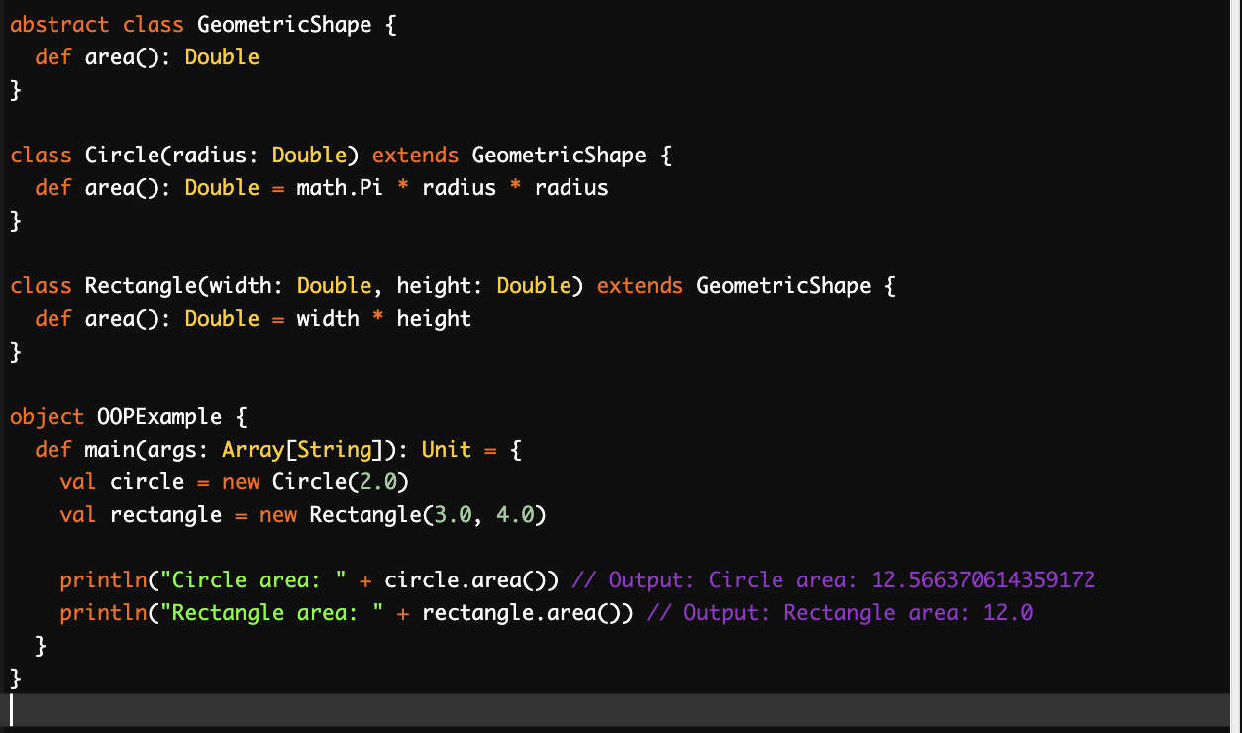
Support to OO Programming
This example demonstrates several key features of object-oriented programming support in Scala: such as Inheritance, Polymorphism, Encapsulation and Abstraction. In this example, we define an abstract class called GeometricShape that has a single abstract method called area(). We then define two concrete classes that extend the Shape class: Circle and Rectangle. Each of these classes overrides the area() method to provide a specific implementation for calculating the area of the shape.
We then define an object called OOPExample that contains the main() function. Within the main() function, we create instances of the Circle and Rectangle classes, passing in the necessary parameters to their constructors. We then call the area() method on each of these instances and print the results to the console.

Slide 14
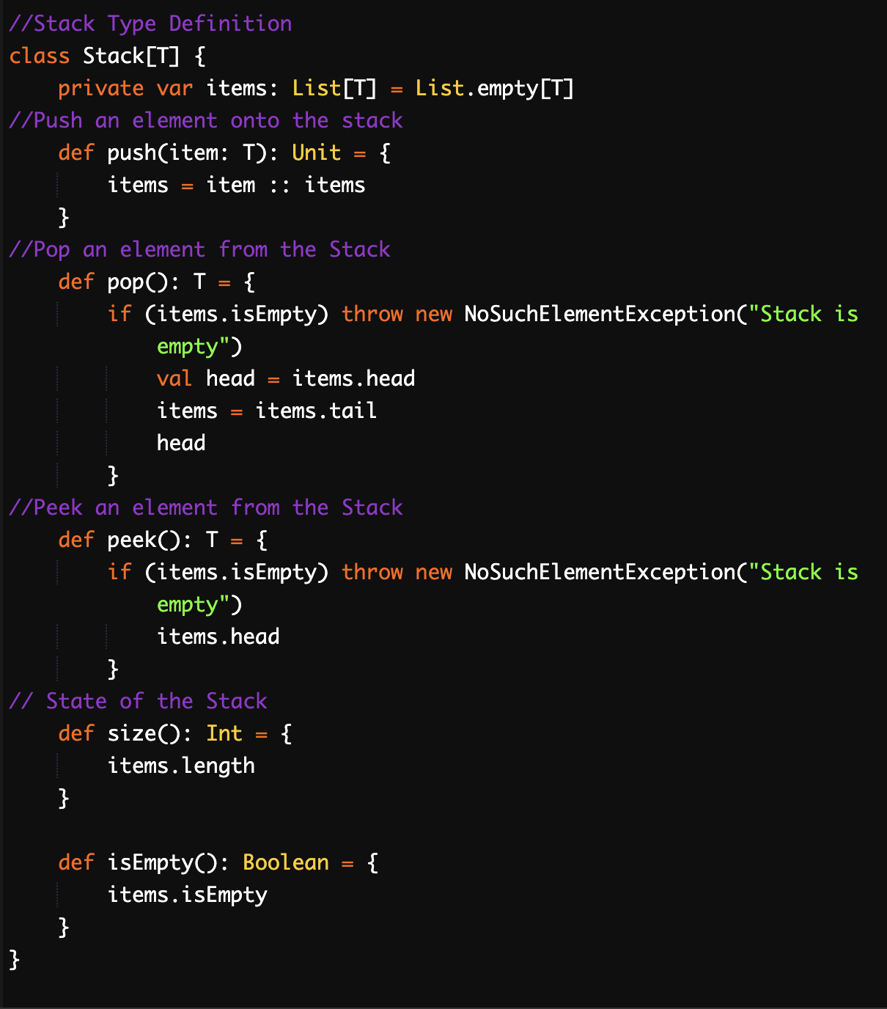
Scala Stack Implementation
In this implementation, we define a Stack in this implementation, we define a Stack class that is parameterized by a type T representing the type of the elements that will be stored in the stack. We use a List[T] to store the items in the stack. The push() method takes an item of type T and adds it to the top of the stack. The pop() method removes and returns the item at the top of the stack, throwing an exception if the stack is empty. The peek() method returns the item at the top of the stack without removing it, also throwing an exception if the stack is empty. The size() method returns the number of items in the stack, and the isEmpty() method returns true if the stack is empty.

Slide 15
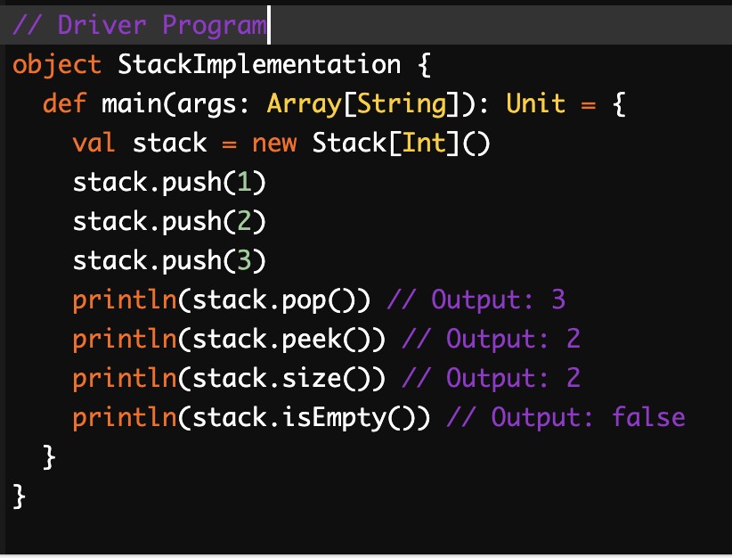
Scala Stack Implementation
In this example, we create a new Stack instance that can store integers. We then add three items to the stack using the push() stack using the push() method. We print the result of calling pop() and peek() to show how to access items in the stack.
Finally, we print the result of calling size() and isEmpty() to show how to get information about the state of the stack.

Slide 16
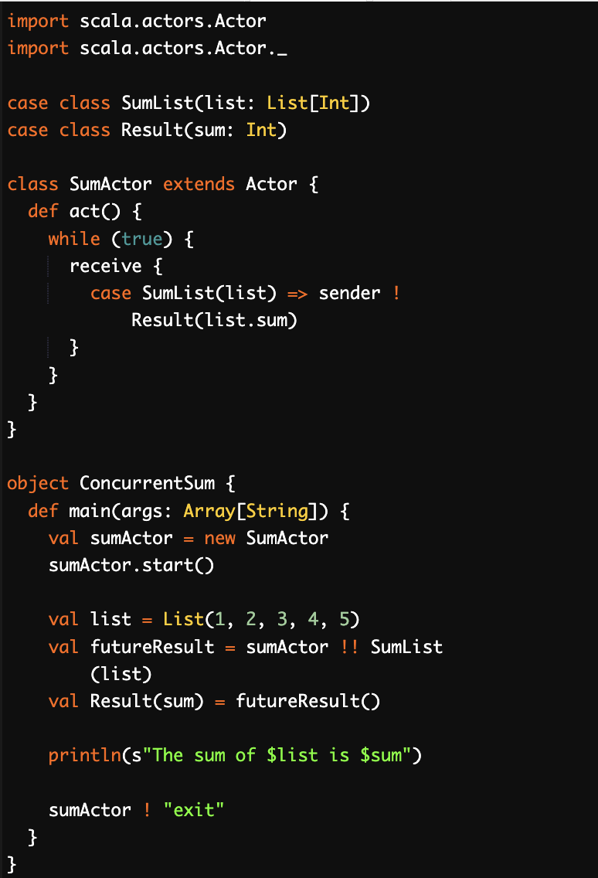
Concurrency
One of the most powerful features of Scala is its concurrency support through the use of actors. Actors are lightweight concurrent entities that process messages asynchronously. Each actor has a mailbox, a queue of messages that it has not yet processed, and processes messages one at a time.
Here is an example of an actor-based concurrent program that calculates the sum of a list of integers.

Slide 17
Concurrency
In the above example, we define an SumActor class that extends the Actor trait. This actor receives a SumList message that contains a list of integers and replies with a Result message that contains the sum of the list. The act method of the actor defines the behavior of the actor, which in this case is an infinite loop that waits for messages to arrive and processes them.
In the ConcurrentSum object, we create an instance of the SumActor and start it. We then send a SumList message to the actor and wait for a reply using the !! method, which returns a Future. Once the Result message is received, we extract the sum and print it. Finally, we send an "exit" message to the actor to terminate it.
This example demonstrates how easy it is to write concurrent programs in Scala using actors. Actors are lightweight and can process messages asynchronously, which makes them ideal for concurrent programming.

Slide 18
Exception and Event Handling
Scala's exceptions work like exceptions in many other languages like Java. However, scala doesn't have checked exceptions. In scala, All exceptions are unchecked. There is no concept of checked exception. you use a try{...} catch{...} block like you would in Java except that the catch block uses matching to identify and handle the exceptions. Catching Exceptions
Scala allows you to try/catch any exception in a single block and then perform pattern matching against it using case blocks.
Throwing Exceptions
Throwing an exception looks the same as in Java. You create an exception object and then you throw it with the throw keyword as follows.
Example: throw new IllegalArgumentException

Slide 19
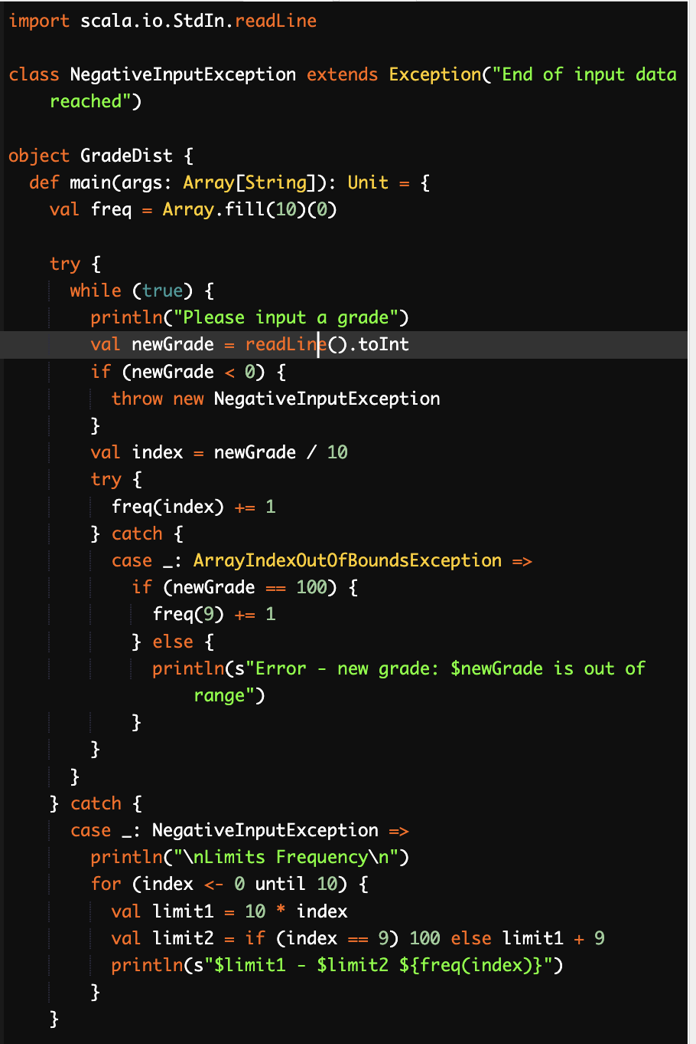
Exception and Event Handling
Here is an example of exception Handling using the conventional try-catch block in Scala.
Output:
NegativeInputException occurred.
In Scala, a single catch block can handle all kinds of exceptions thus providing flexibility.

Slide 20
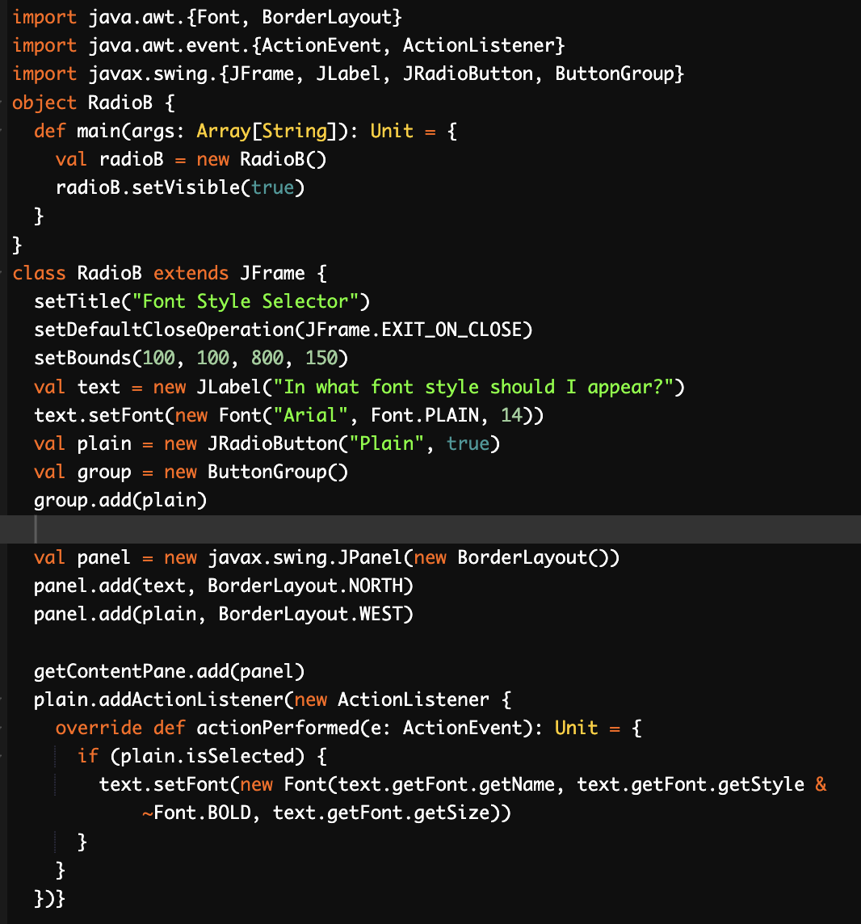
Exception and Event Handling
Here is an example to illustrate event handling with interactive radio buttons that control the font style of a string of text.

Slide 21
Functional Programming in Scala
Scala is also a functional language in the sense that every function is a value, and every value is an object so ultimately every function is an object. Scala provides a lightweight syntax for defining anonymous functions, it supports higher-order functions, it allows functions to be nested, and supports currying. Higher-order Functions
Functions that return other functions as outcomes or accept other
functions as arguments
It accepts one or more parameters that are functions.
It is important to note that this higher order function can be used with functions and methods that return functions as results or take functions as parameters.
This gives programmers a flexible way to write code.
Currying in Scala
Currying is the process of breaking down a function with several arguments into a series of one-argument functions.
It is applied widely in multiple functional languages.
Pure Functions
A pure function should only return a specific result without changing an external condition that is outside of its control and relies only on the input parameters.
An excellent illustration of a pure function is one that just produces a result based on the parameter it is given.

Slide 22
Functional Programming in Scala
Non-pure Functions
Non-pure functions allow for internal and external context changes.
Pure functions can be tested and predicted with ease.
Yet, occasionally it's required to perform an action that affects state, such as writing a file or updating a database table.
Non-pure functions are thus possible.
Functional languages have a potential advantage in readability. In many imperative programs, the details of dealing with variables obscure the logic of
the program. Consider a function that computes the sum of the cubes of the
first n positive integers. In Scala, such a function would likely appear similar to
the following:

Slide 23
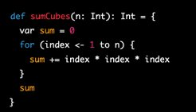
Functional Programming in Scala
In Scala, we declare functions using the def keyword. The function name sumCubes is in camelCase, which is the convention in Scala. The function takes an integer argument n and returns an integer result.
Inside the function, we use a mutable variable sum to accumulate the sum of cubes. The for loop is expressed using a range using the to method of the Int type. Inside the loop, we use the same expression as in the original program to calculate the cube of the loop index and add it to the sum.
Finally, we return the sum. Note that in Scala, the return keyword is optional if the last expression in the function body is the return value.
Below are the factorial and fibanocci series the two examples of functional programming

Slide 24
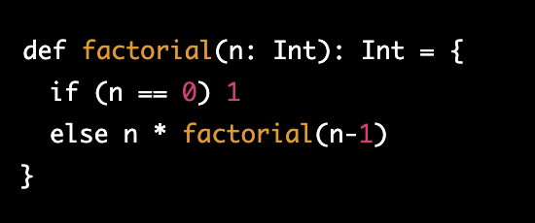
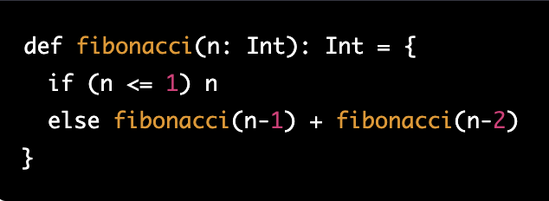
Functional Programming in Scala
The above code defines a function factorial that takes an integer argument n and returns the factorial of n.
The function starts with a base case, where if n is equal to 0, it returns 1. This is because 0! is defined to be 1.
If n is not equal to 0, the function recursively calls itself with n-1 as the argument, and multiplies the result by n. This continues until n reaches 0, at which point the recursion stops and the final result is returned.
The above function fibonacci takes an integer argument n and returns the nth number in the Fibonacci series.
The function starts with two base cases, where if n is equal to 0 or 1, it returns n. This is because the first two numbers in the Fibonacci series are defined to be 0 and 1, respectively.
If n is greater than 1, the function recursively calls itself with n-1 and n-2 as the arguments and adds the results together. This continues until n reaches 0 or 1, at which point the recursion stops and the final result is returned.

Slide 25
Objective
To build a task manager application to keep a note of errands and tasks to be done.
Constraints
Reminders or Events cannot be created in calendar
No Time tracking
Project Proposal

Slide 26
Features
Create/Update/Remove a task
Each task will have a checkbox to mark completed
Comments can be added to tasks
Technology Used
Scala
JSON API
PostGrey SQL
Project Proposal

Slide 27
THANK YOU

