Slide 1
Information of Data
num_passengers = number of passengers travelling sales_channel = sales channel booking was made on trip_type = trip Type (Round Trip, One Way, Circle Trip)
purchase_lead = number of days between travel date and booking date length_of_stay = number of days spent at destination
flight_hour = hour of flight departure flight_day = day of week of flight departure route = origin -> destination flight route
booking_origin = country from where booking was made
wants_extra_baggage = if the customer wanted extra baggage in the booking wants_preferred_seat = if the customer wanted a preferred seat in the booking wants_in_flight_meals = if the customer wanted in-flight meals in the booking flight_duration = total duration of flight (in hours)
booking_complete = flag indicating if the customer completed the booking

Slide 2
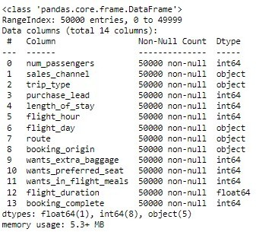
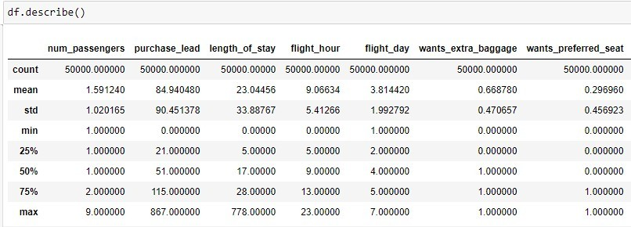
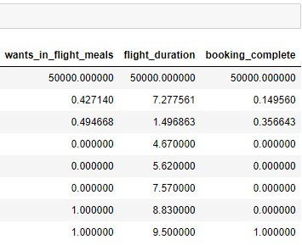
The data was loaded and information of the data.
The information of the data shows datatypes, null values in data with count. Number of columns, Number of records and Names of the columns.
There is no null values.there is a clear data without any missing values.
Here we can see the description of the data mean,standarddeviation,minimum,maximum

Slide 3
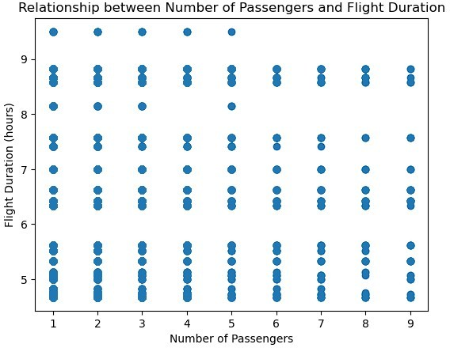
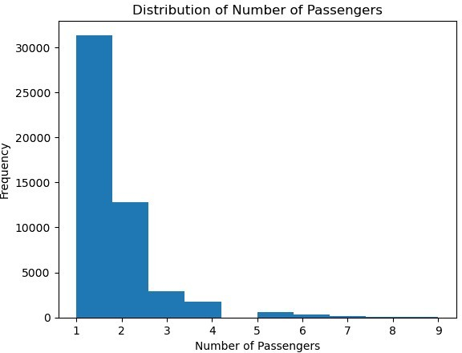
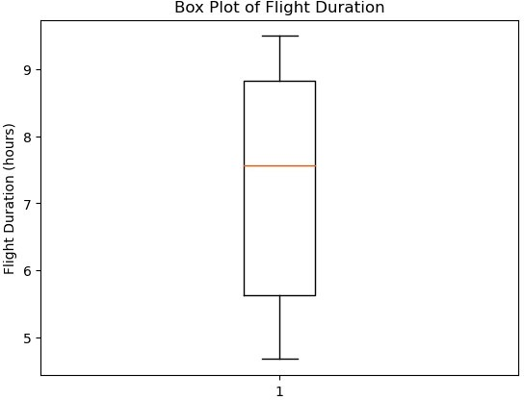
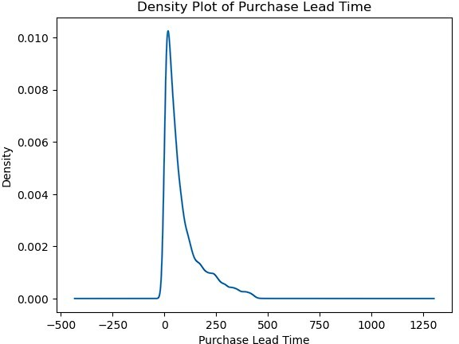
Data analysis:
1st plot : here is a distribution of no.of passengers its a distrubution plot the most no.of passengers are 1 to 4 and 5, to 9 are very rare.
2nd plot: the duration of filght in hours the average duration is 7 to 8 hours.
3rd plot : the density of purchase lead time is mostly at 0 to 250 and 500 is less.

Slide 4
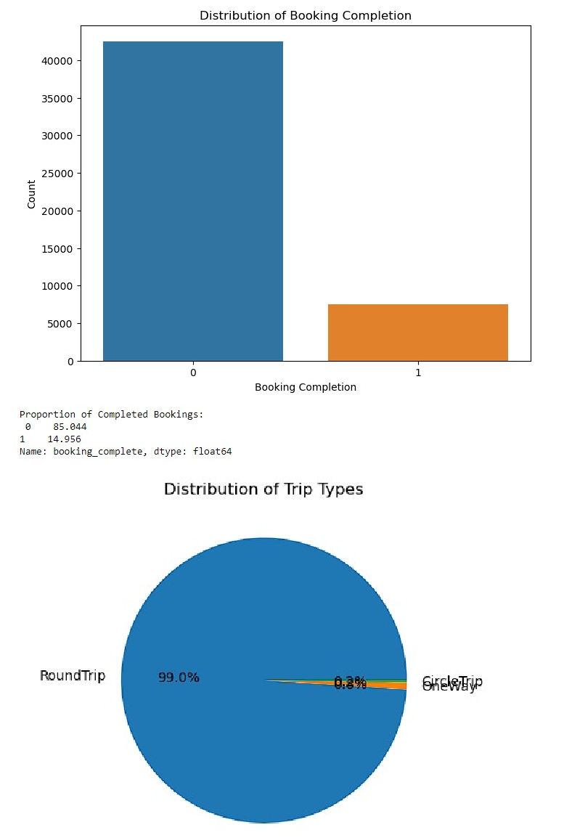
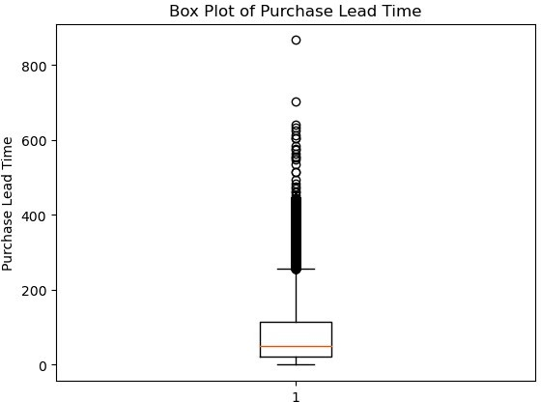
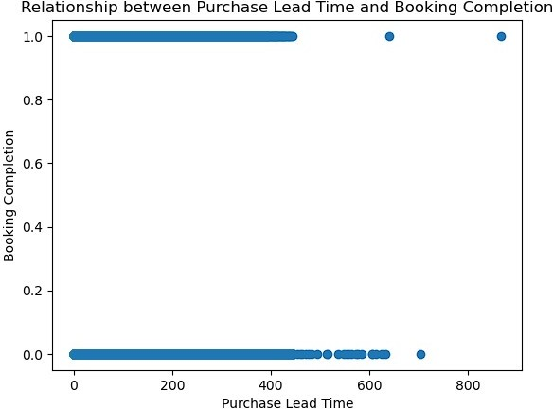
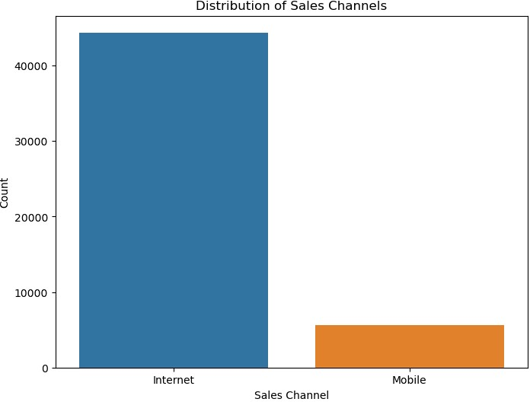
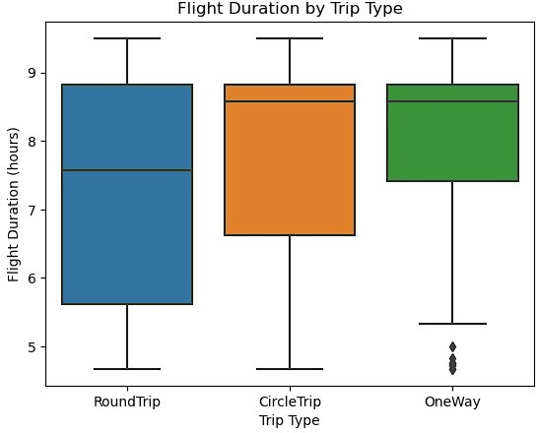
Here is the distributions andrelationships of the coustomer data.
The distributions of sales channels internet is high as compared to mobile.
The pie plot of trip type Here is a count of roundtrip,oneway,circletrip
RoundTrip OneWay CircleTrip
49497
387
116
where as we can see the relationship between purchase lead time and booking completion.They are related to each other the purchase lead time from500 and above is less booked when compared to the purchase lead time 1 to 500.

Slide 5
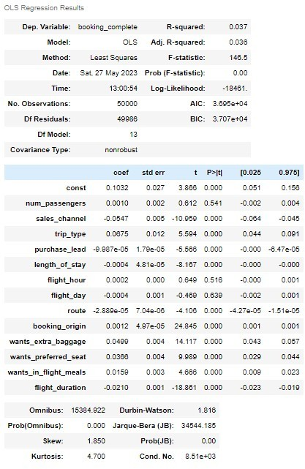
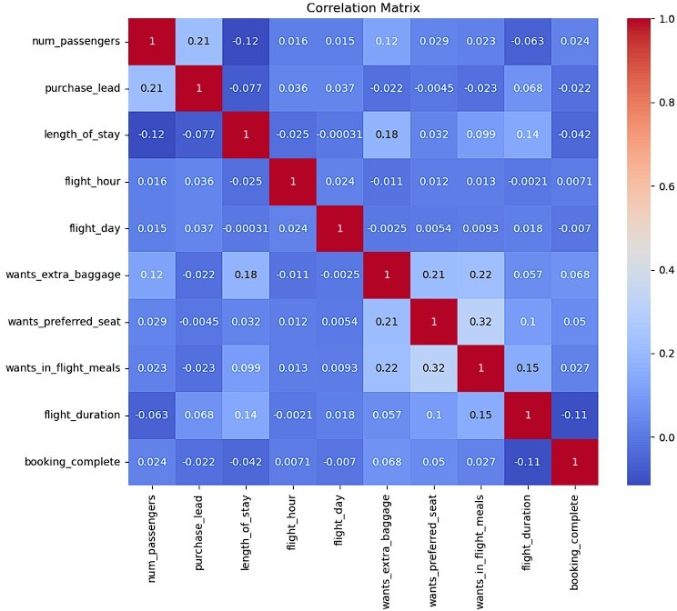
Here is a ols model which is basic statistical model and the correlation plot with heat map.
The R squared score is 0.037 and adj r_squared score is 0.038. There is no such big relationships between the columns.

Slide 6
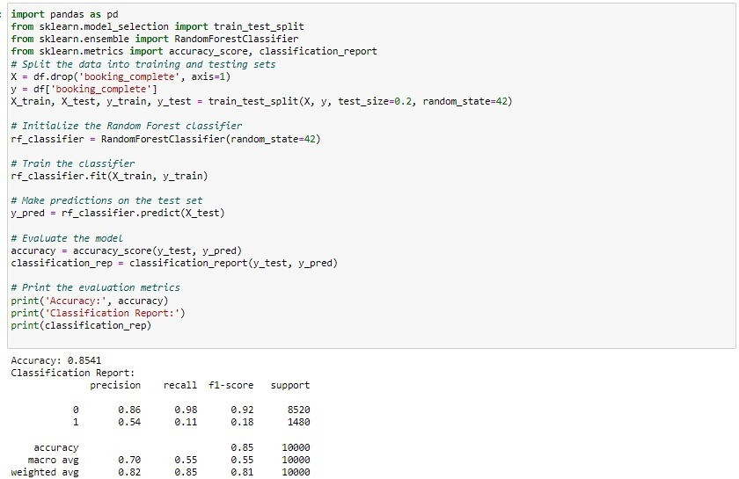
The target variable is booking complete.
Here is a machine learning model by the random forest classifier algorithm.
Done train with 80% of data and testing with 20% of data and the random state as 42. There we can see the classification report with matrics like precision,recall,f1score,accuracy.
The best metric is accuracy it was with 85% accuracy and f1 score of 0’s as 0.92 and 1’s as 0.18.

