Slide 1

AWS AUTOMATION PROJECT
EC2 Backup, Cleanup, AMI & Snapshot Automation
A serverless Lambda-driven system that automatically backs up, tags, and cleans up EC2 snapshots and AMIs — triggered every 3 minutes.
Cloud Infrastructure Automation | Serverless | Cost & Storage Optimization

Slide 2




01
Introduction
This project is an AWS-native automation solution — “AWS Automation for Backup, Cleanup, AMI & Snapshot” — built to protect EC2 instances without manual effort.
KEY IDENTITY
FUNCTION
EC2-Backup-Automation
Whenever an EC2 instance is created with the tags Environment: Production and ManagedBy: Terraform, a dedicated AWS Lambda function — EC2-Backup-Automation — takes over its entire backup lifecycle, running fully unattended on a scheduled trigger.
IAM ROLE
EC2-Backup-Lambda-Role
TRIGGER
EC2-Backup-3Min-Schedule (every 3 min)
TARGET TAGS
Environment: Production, ManagedBy: Terraform
2

Slide 3




02
Problem Statement
Manual EC2 backup management doesn't scale — and the gaps it leaves behind are costly.
No consistent backups
Manual cleanup
No visibility
Human error & delay
Production EC2 instances had no guaranteed, repeatable AMI or snapshot backup process.
Old snapshots piled up over time, driving up EBS storage cost with nobody tracking retention.
Teams had no easy way to know which instances were backed up, or when the last backup ran.
Manual, on-demand backups are inconsistent, easy to forget, and slow to respond to instance changes.
3

Slide 4





03
AWS Services Used
A lean, fully serverless stack — no servers to patch or manage.
AWS Lambda
Amazon EC2
EC2 AMI & Snapshots
Amazon EventBridge
Runs EC2-Backup-Automation — the core automation logic, invoked on schedule.
Source of the running instances that are discovered, backed up, and tagged.
Machine images and EBS snapshots created as the actual backup artifacts.
EC2-Backup-3Min-Schedule rule triggers the Lambda function every 3 minutes.
AWS IAM
Amazon S3
Amazon SNS
Amazon CloudWatch
EC2-Backup-Lambda-Role grants scoped access to EC2, CloudWatch, S3 & SNS.
Stores execution logs uploaded after every automation run, for audit history.
EC2-Backup-Notifications topic sends summary alerts for backup & cleanup runs.
Captures logs and metrics for monitoring and troubleshooting the function.
4

Slide 5

04
Functionalities
What EC2-Backup-Automation actually does on every invocation.
Reads configuration
Finds tagged instances
Loads tags, S3 bucket, SNS topic and retention limit from environment variables.
Locates all running EC2 instances matching the configured tags.
Checks existing AMIs
Creates AMI & snapshot
Verifies whether an AMI already exists before creating a new one.
Creates a new AMI and an EBS snapshot of the root volume, only when needed.
Retry on throttling
Tags backups
Snapshot creation includes retry logic to handle AWS API throttling errors.
Tags every created AMI and snapshot with source instance information.
Enforces retention
Logs & notifies
Retains only the latest 3 snapshots per instance and deletes older ones.
Uploads execution logs to S3 and sends an SNS summary of the run.
5

Slide 6
05
Workflow
End-to-end path from schedule trigger to notification, every 3 minutes.
1
2
3
4
5
EventBridge Trigger
Discover Instances
Backup Check & Create
Cleanup
Log & Notify
EC2-Backup-3Min-Schedule fires every 3 minutes
Find running EC2s tagged Production / Terraform
Create AMI if missing; snapshot root EBS volume
Keep latest 3 snapshots per instance, delete rest
Upload logs to S3, send SNS summary notification
6

Slide 7
06
Why It's Needed
Data protection
No manual effort
Cost control
Instant visibility
Guarantees production EC2 instances always have an up-to-date AMI and snapshot to recover from.
3-minute scheduled trigger removes the need for anyone to remember to take backups.
Automatic 3-snapshot retention prevents unbounded EBS storage growth and cost creep.
SNS notifications and S3 logs give the team real-time insight into every backup run.
Business impact: automated, reliable recovery posture for every Terraform-managed production instance — without adding operational overhead.
7

Slide 8

07
Challenges & Conclusion
CHALLENGES FACED
AWS API throttling
CONCLUSION
Frequent throttling errors during snapshot creation required building custom retry logic.
Despite throttling and timing challenges, the automation now reliably backs up, tags, and cleans up EC2 resources with zero manual intervention.
Duplicate detection
Avoiding duplicate AMIs/snapshots meant reliably checking existing backups before creating new ones.
It delivers consistent, cost-controlled backups for every Terraform-managed production instance, with full visibility through S3 logs and SNS alerts — turning a manual, error-prone process into a dependable, serverless safety net.
Safe retention cleanup
Deleting only the correct older snapshots — never the latest 3 — needed careful per-instance tracking.
Tight schedule window
Completing discovery, backup, and cleanup for all instances within each 3-minute cycle.
8

Slide 9
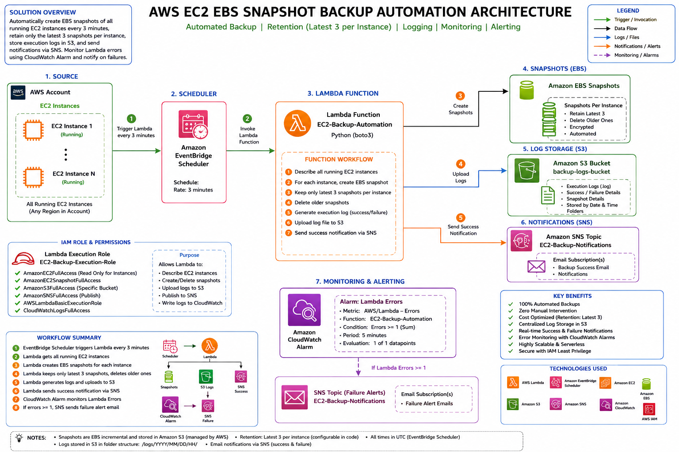
08
8

Slide 10
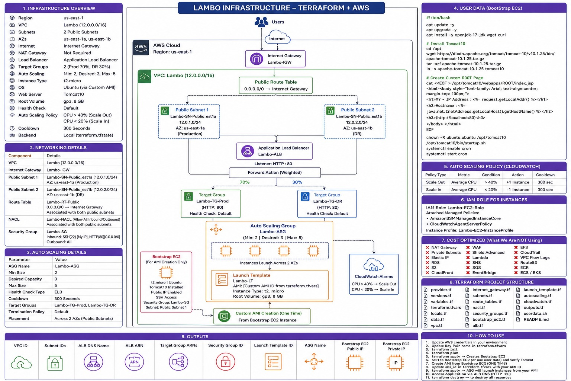
09
8

Slide 11
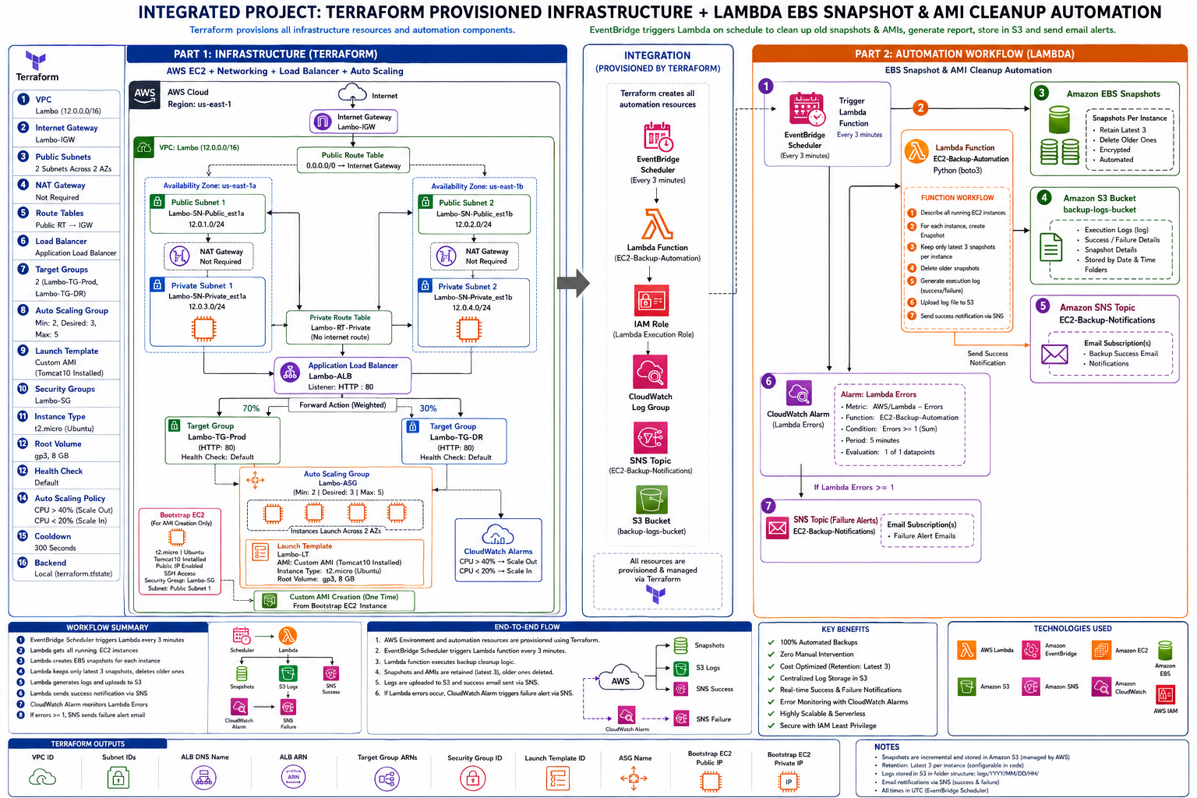
10
8

