Slide 1
JOB THREAT INDEX
BATCH 8 Guide:
B Navaneeth- 21071A6611 Mr. B Venkatesh
G. Ruchitha- 21071A6620 Assistant Professor
G. Aravind - 21071A6623
K. Yashwanth-21071A6626

Slide 2
ABSTRACT
"This work offers an insight into research investigating the utilization of machine learning algorithms, as outlined in the study titled 'Anticipating Job Disruption: An AI-Enhanced Model for Predicting Automation-Induced Threat Levels”. In this work, we are predicting how much percentage of a job can be replaced by AI
Several machine learning algorithms, including decision trees, random forests , Logistic Regression .

Slide 3
INTRODUCTION
The "Job Threat Index ML Project" is a data-driven initiative aimed at providing valuable insights into the ever-evolving landscape of employment and workforce dynamics.
This model aims to provide concise and accurate predictions, helping businesses, policymakers, and individuals navigate the evolving employment landscape effectively.
By analyzing various factors, it offers valuable insights into which job roles and industries are most vulnerable to automation, aiding in proactive workforce planning and reskilling efforts.
In an era of rapid technological change, this model serves as a vital tool for informed decision-making and long-term workforce sustainability.

Slide 4
LITERATURE SURVEY

Slide 5
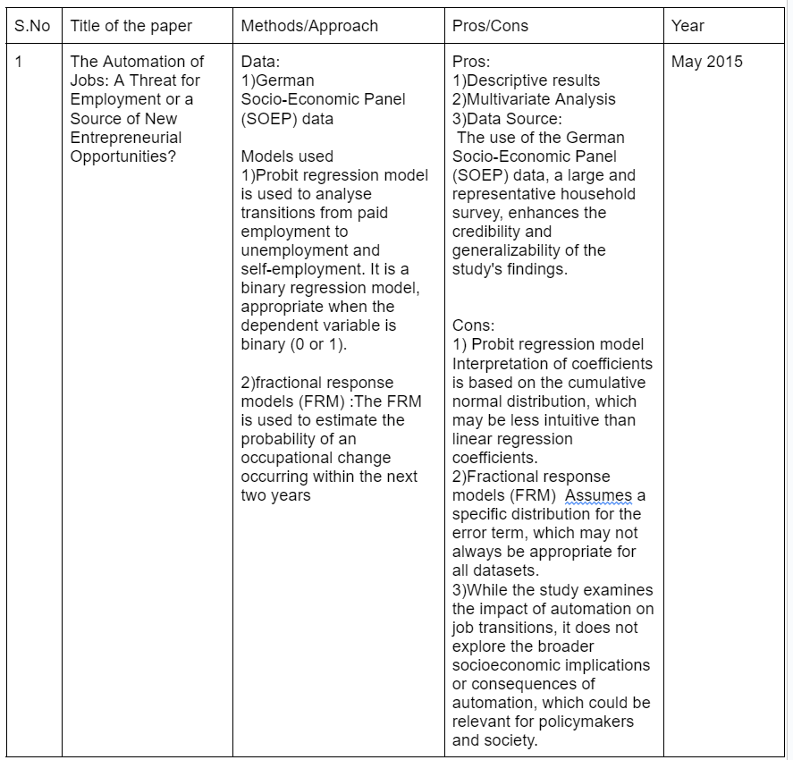

Slide 6
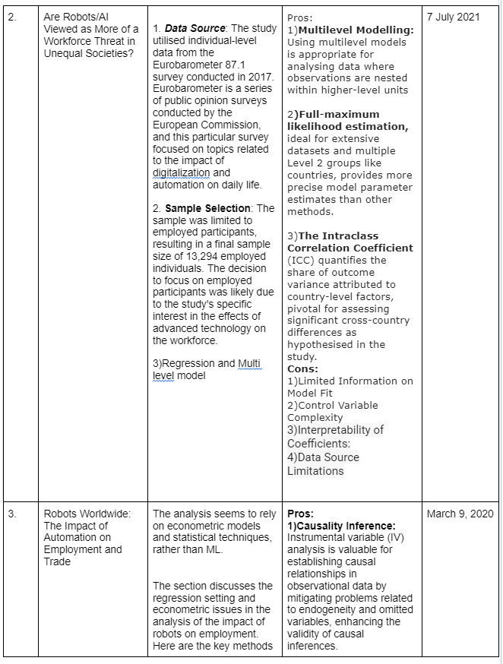

Slide 7
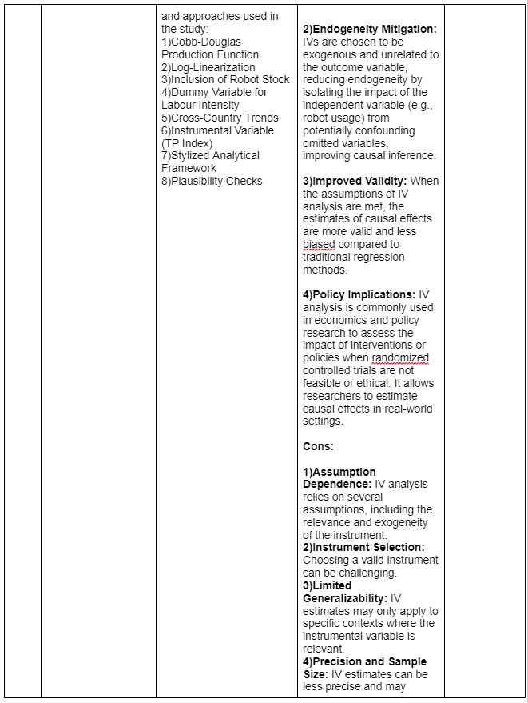

Slide 8
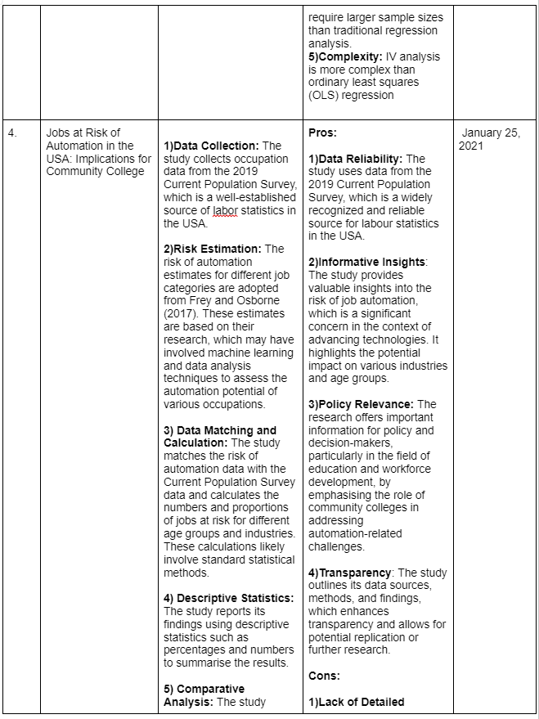

Slide 9
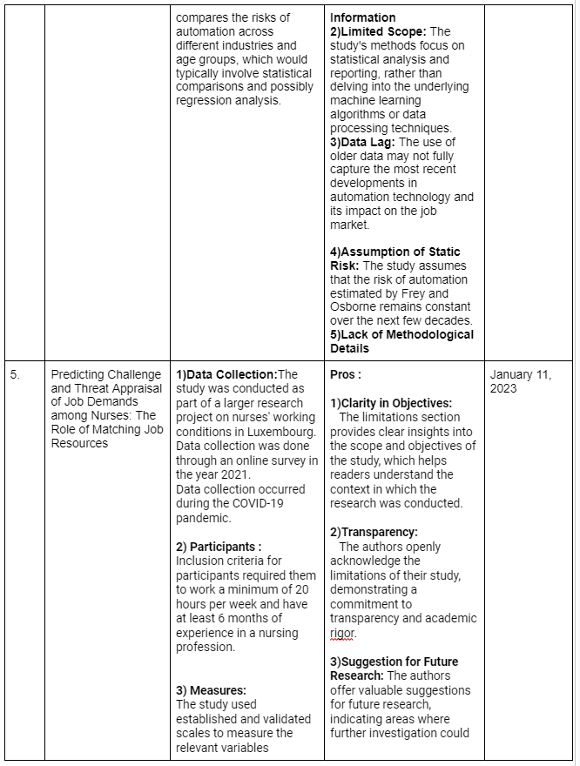

Slide 10
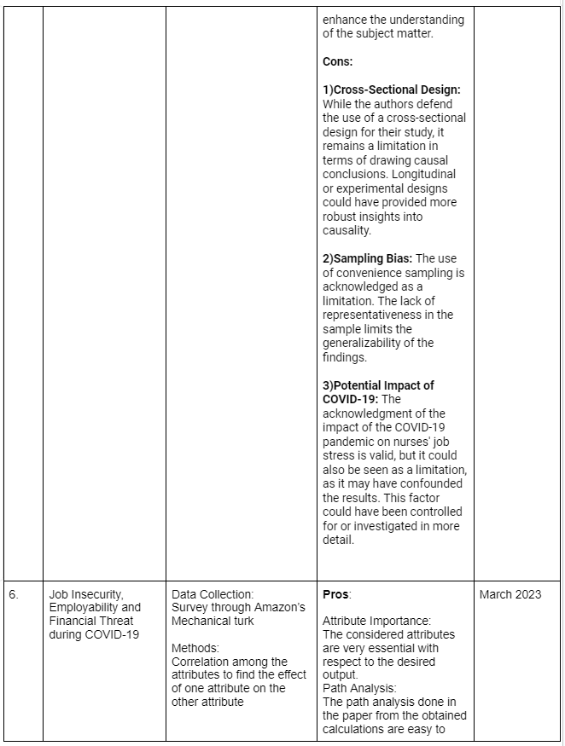

Slide 11
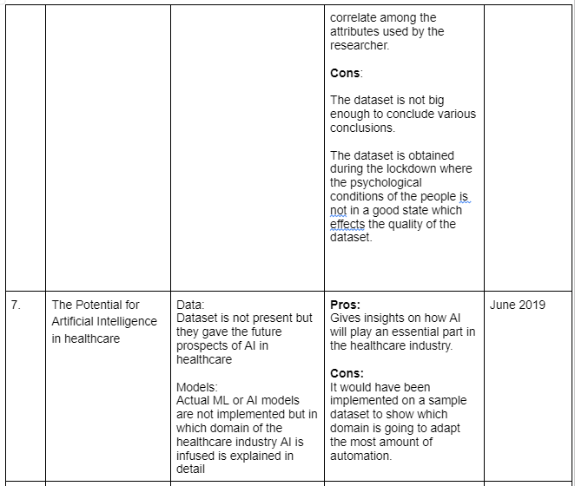

Slide 12
Existing System
McKinsey Global Institute (MGI) primarily relied on a combination of expert analysis, economic modeling, and data analysis rather than specific machine learning or deep learning models to conduct their Automation Impact Analysis.
O*NET Database
World Economic Forum's Future of Jobs Reports

Slide 13
Proposed System
We gathered historical data from various sources , such as Employment rates, job vacancies, industry trends, and wage data, GDP growth, inflation rates, unemployment rates, regional economic data. This dataset will be used for training and evaluating the model. The data is Cleaned and processed to remove outliers, missing values and inconsistencies. Relevant features, such as historical Job replaced data and usable variables(Potential AI innovation areas) are extracted from the raw data. Split the data into training and testing sets for model evaluation. With the extracted feature data we train a Random forest, KNM, Decision tree model. After training the model use it to make job treat index predictions on testing data and calculate the accuracy and forecast the errors by comparing the predicted Job threat index to the actual observations. Based on the error analysis, refine the model to reduce Job threat index errors. Consider using ensemble methods, such as bagging or boosting, for the Random Forest algorithm to improve Job threat index accuracy and error estimation.

Slide 14
SYSTEM REQUIREMENTS
FUNCTIONAL REQUIREMENTS
1)Data Collection and Integration: various sources, including job market data, industry reports, and automation statistics.
2)Data Preprocessing: data cleaning, normalization, and feature extraction, to prepare the data for analysis.
3)Feature Selection: selecting most relevant features or variables that contribute to job threat assessment.
4) Machine Learning Algorithms: (e.g., regression, classification) to analyze the data and make predictions.
5)Model Training: On historical data to learn patterns and relationships between job market conditions, automation trends, and job threat levels.
6) Real-time Data Updates: real-time or periodic updates of data to ensure that the model remains current and relevant.
7)Prediction: Providing the capability to predict job threat indexes for different sectors, regions, or timeframes based on user input or predefined scenarios.

Slide 15
8)User Interface: Developing a user-friendly interface that allows users to input parameters, select criteria, and view job threat predictions.
9)Update Mechanism: periodically updating the data as per new & updated information
NON FUNCTIONAL REQUIREMENTS
1)Scalability: The system should be able to handle an increasing amount of data and users without a significant decrease in performance.
2)Performance: The machine learning model must provide results within an acceptable response time, even as the dataset grows. For example, the system should be able to generate threat index scores quickly.
3)Reliability: The system should be highly reliable, with minimal downtime. It should also have mechanisms for disaster recovery.
4)Security: Protect sensitive personal and job-related data, ensuring that access is restricted only to authorized personnel. This includes data encryption and compliance with relevant data protection regulations.
5)Privacy: Ensure that the system complies with privacy regulations and best practices for handling sensitive information. Minimize the risk of data breaches.

Slide 16
6)Usability: The user interface should be intuitive and easy to use, with a low learning curve. Users should be able to interact with the system without extensive training.
7)Compatibility
8)Maintainability
9)Data Quality: Non-functional requirements should include data quality standards to ensure that the data used to train the model is accurate, reliable, and up to date.
10)Compliance: Ensure that the project complies with legal and regulatory requirements relevant to job threat assessment and data handling.
11)Resource Utilization: Optimize resource usage, such as memory and CPU, to maximize efficiency and reduce operational costs.

Slide 17
SCOPE
Workforce Planning in Businesses
Government and Labor Market Analysis
Career Counseling and Guidance
Investment and Finance
Job Seekers and Workers
Consulting and Advisory Services

Slide 18
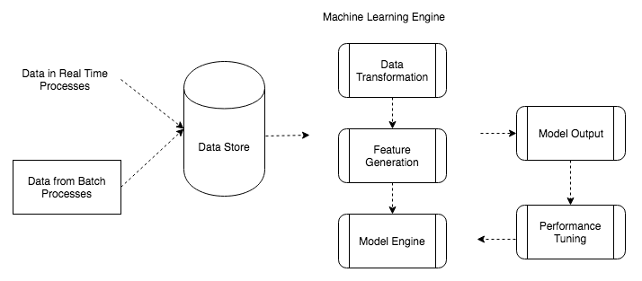
System Architechture

Slide 19
Modules
Data Collection
Data Preprocessing
Feature Engineering
Training the model
Validation
User Interface
Admin Interface

Slide 20
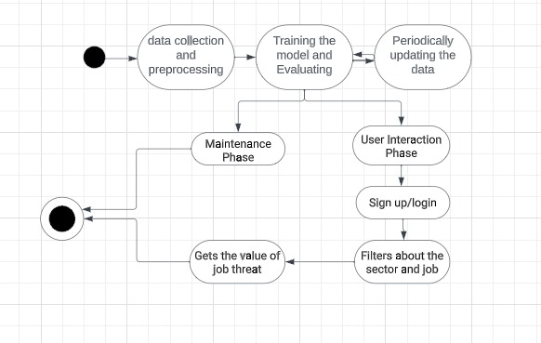
UML DIAGRAM

Slide 21
Status of the Work

Slide 22
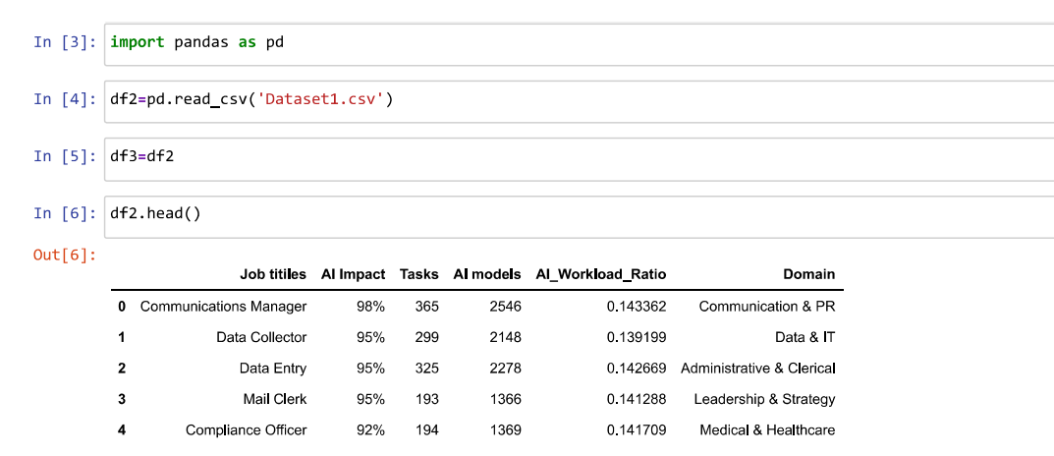
Implementation
Reading the dataset

Slide 23
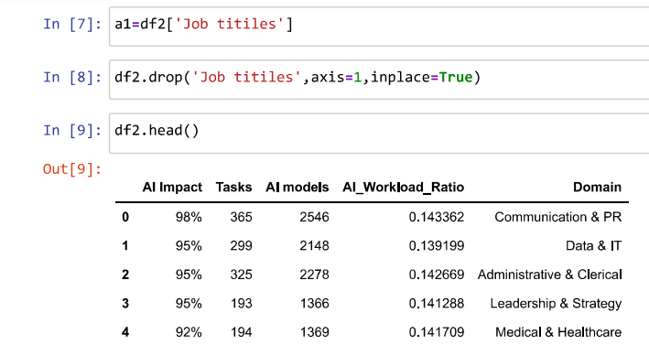
Implementation
Removing unnecessary columns

Slide 24
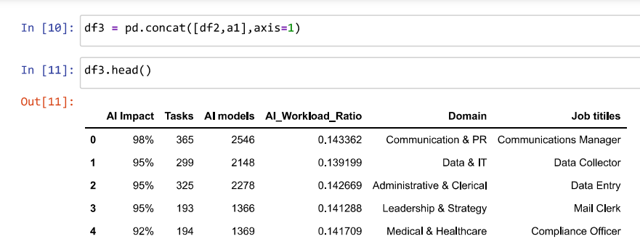
Implementation
Concatenating df2,a1 into a dataframe

Slide 25
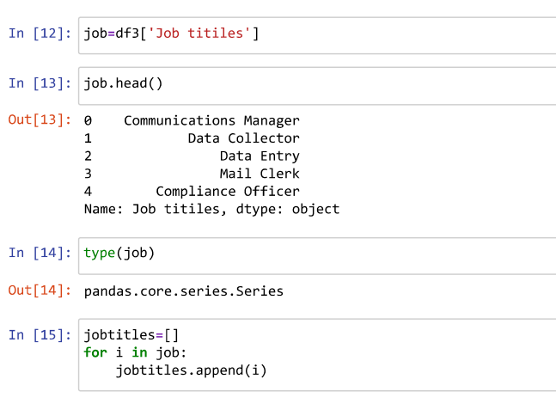
Implementation
Dataframe for titles , display, type

Slide 26
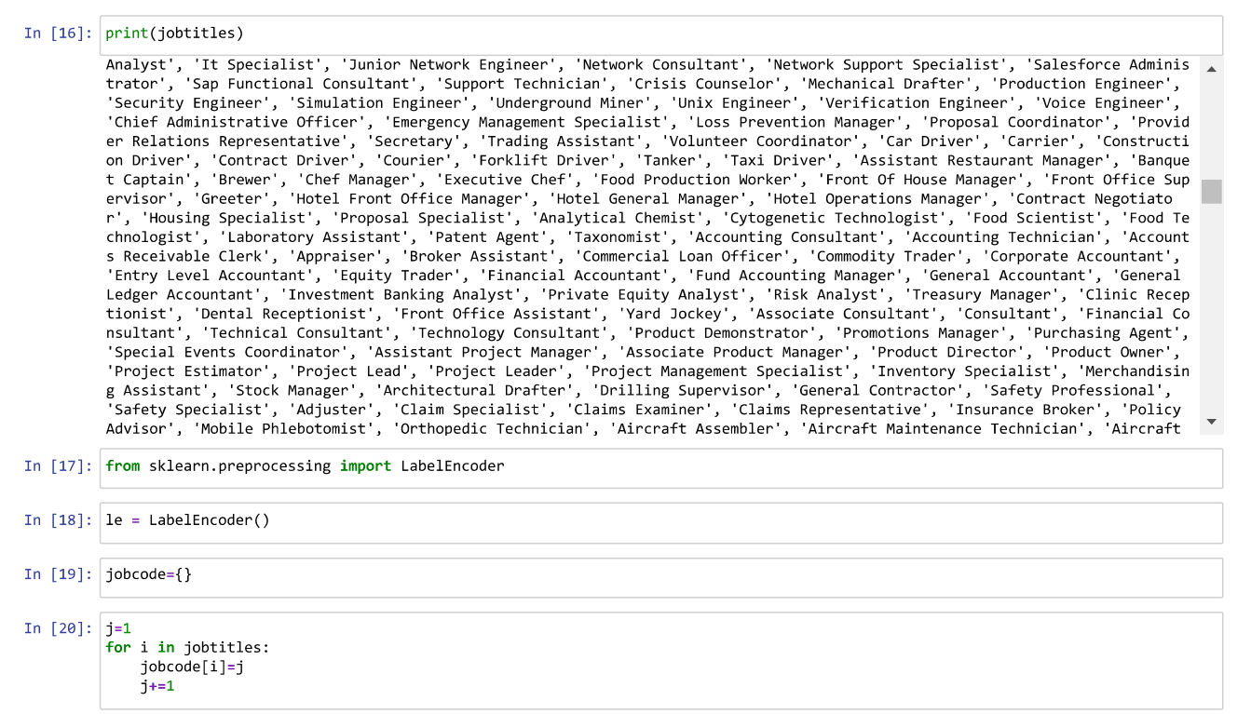
Implementation
Encoding the textual data

Slide 27
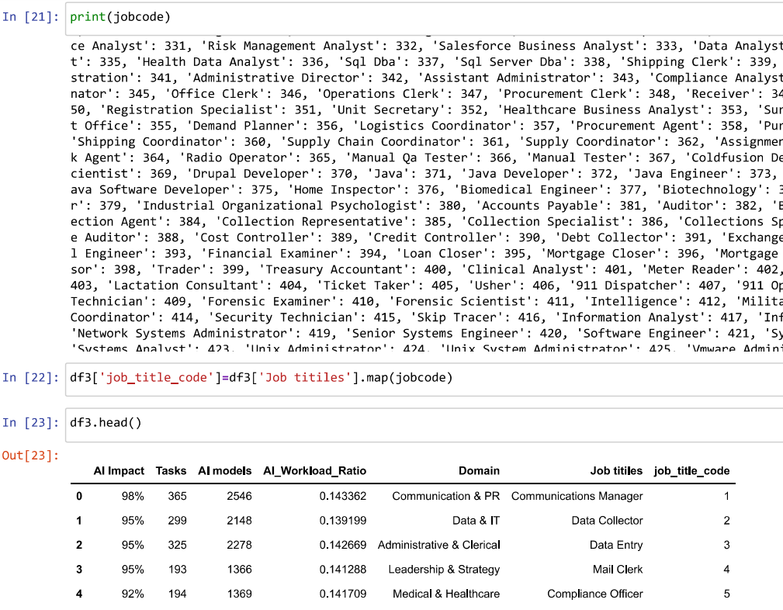
Implementation
Mapping the jobcode

Slide 28
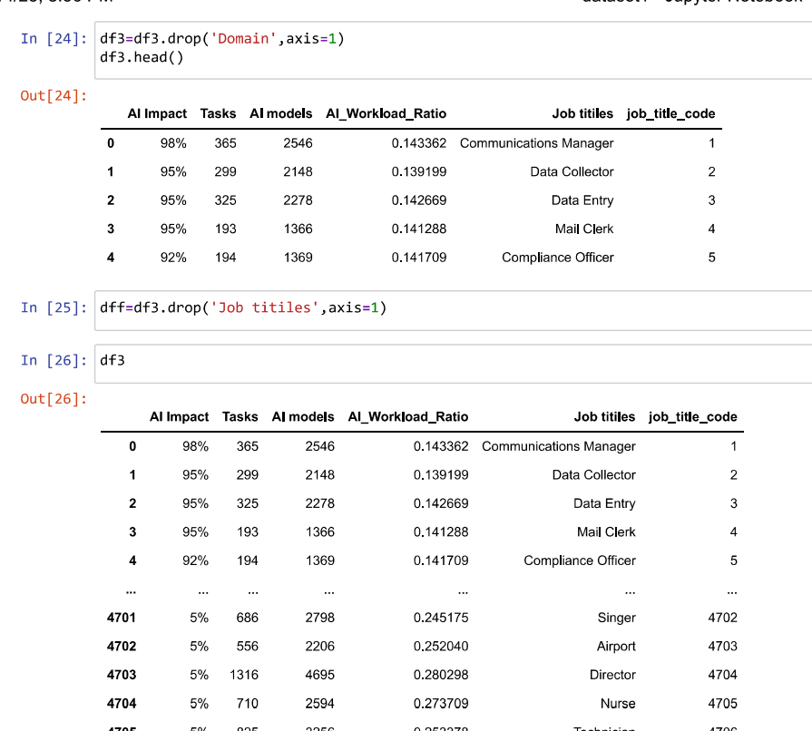
Implementation
Dropping the job titles

Slide 29
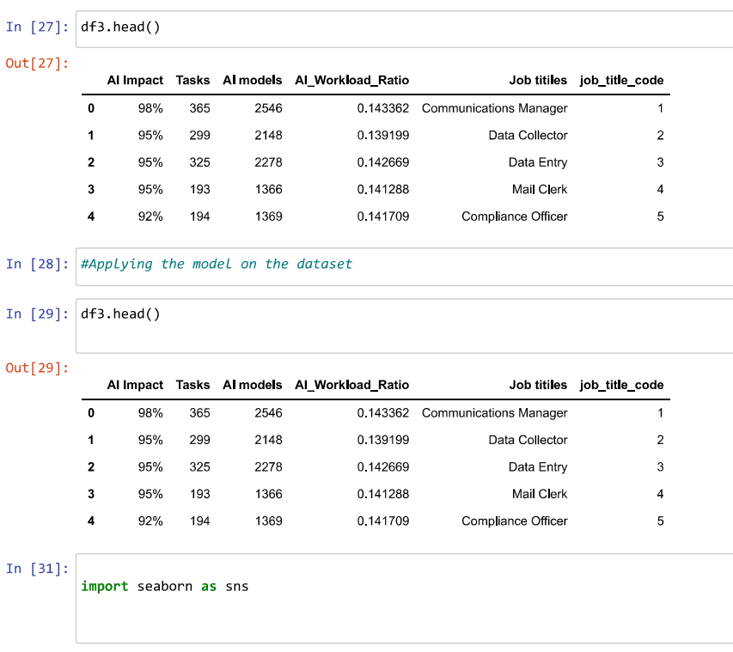
Implementation
Displaying df3

Slide 30
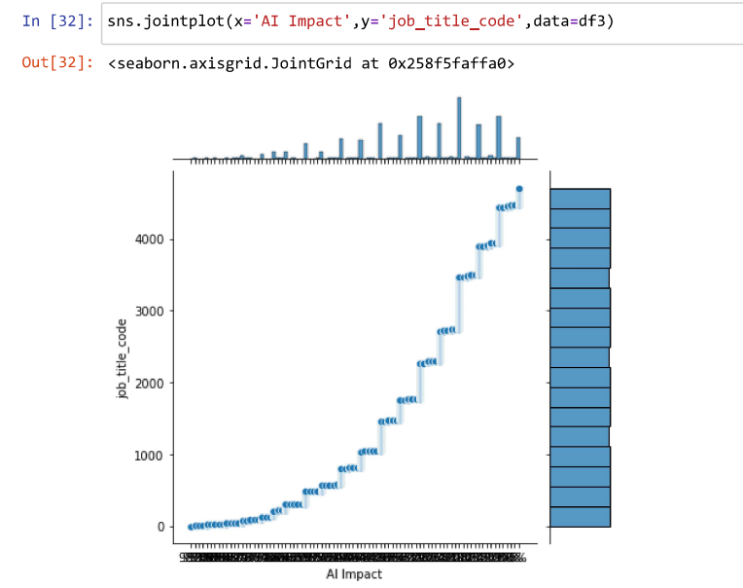
Implementation
Data Visualiation

Slide 31
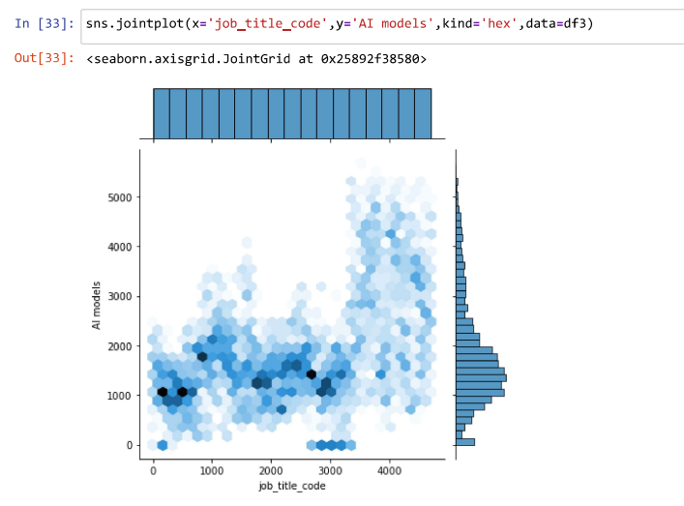
Implementation
Data Visualiation

Slide 32
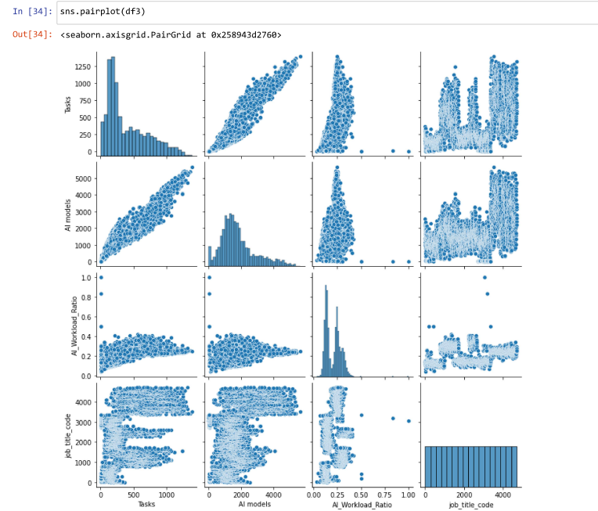
Implementation
Data Visualiation

Slide 33
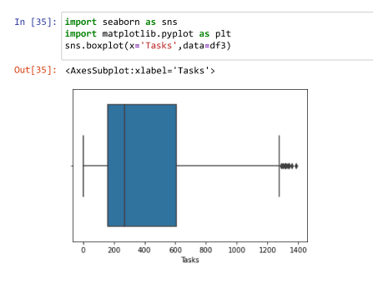
Implementation
Data Visualiation

Slide 34
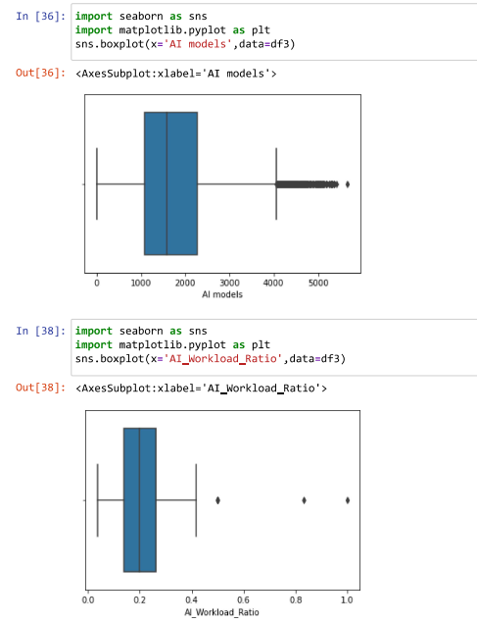
Implementation
Data Visualiation

Slide 35
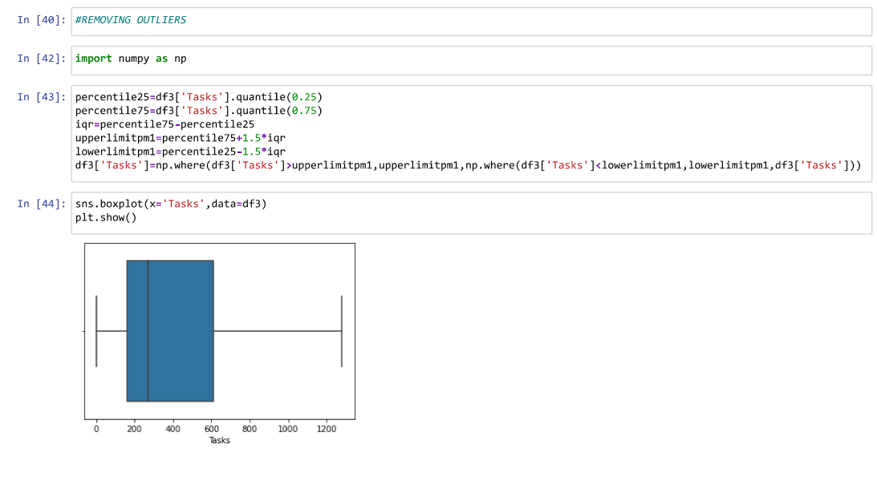
Implementation
Remove Outliners

Slide 36
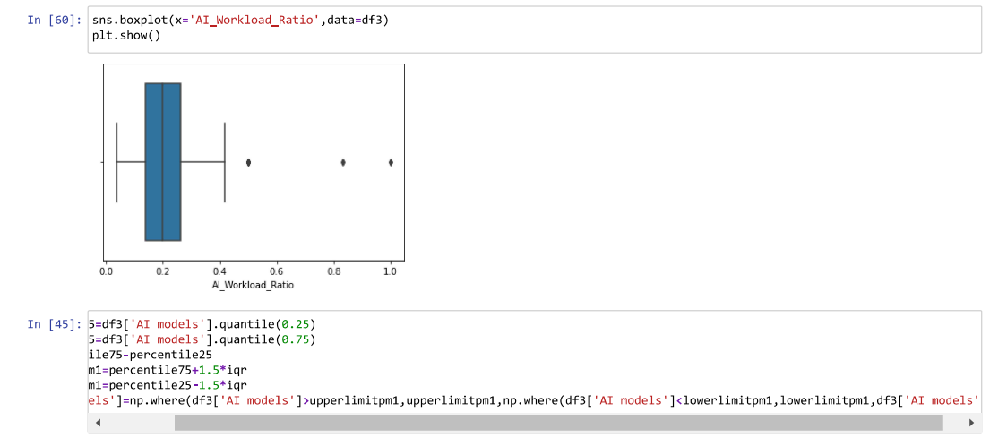
Implementation
Remove Outliners

Slide 37
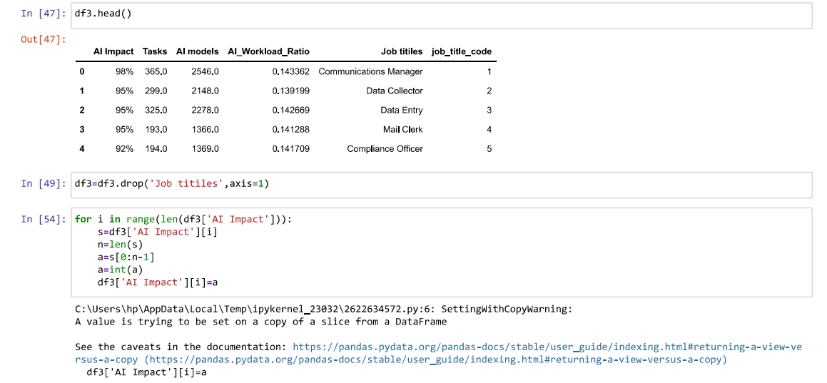
Implementation
Converting AI Impact from String datatype to numerical

Slide 38
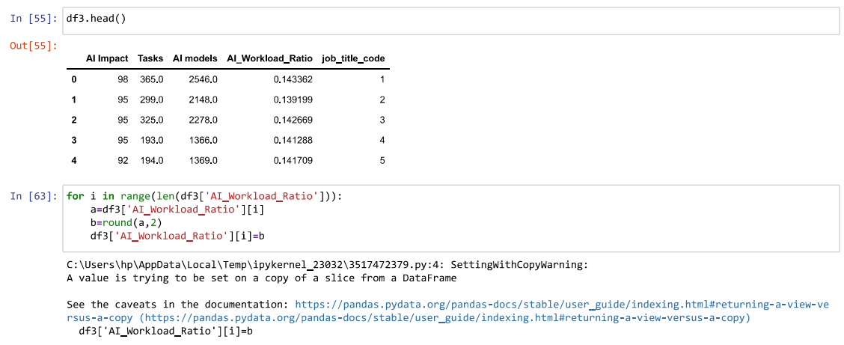
Implementation
Rounding off the AI_Workload_Ratio

Slide 39
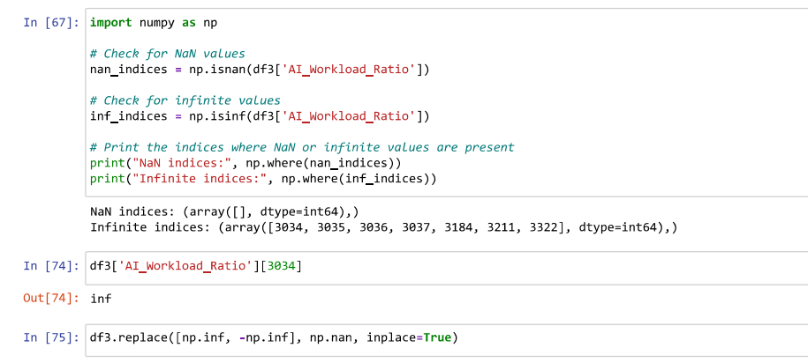
Implementation
Replacing null values with nan’s

Slide 40
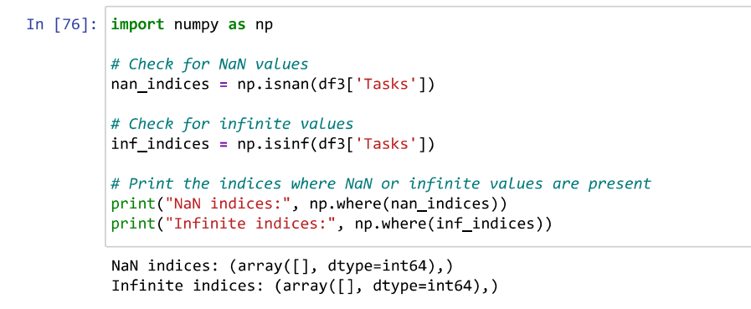
Implementation
Replacing null values with nan’s

Slide 41
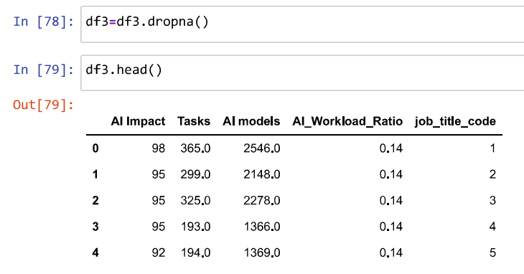
Implementation
Dropping the converted nan values from the dataframe

Slide 42
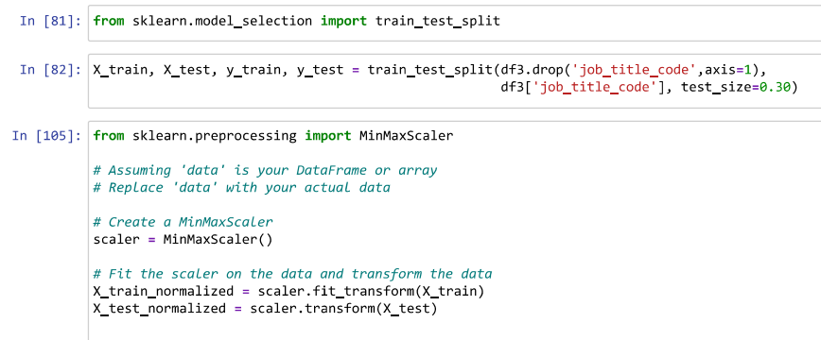
Implementation
Splitting the dataframe

Slide 43
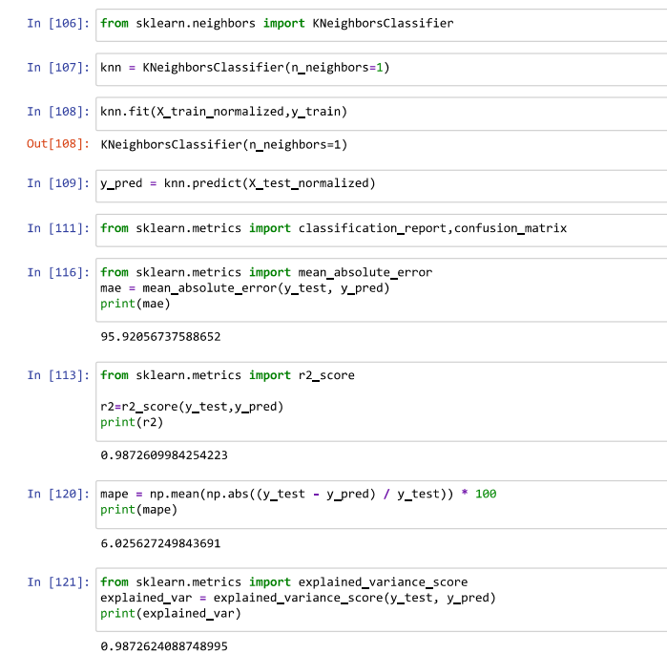
Implementation
Applying the KNN Classifier on the split data

Slide 44
THANK YOU

