Slide 1
01 · THE COORDINATION GAP
One repeated message can become two demands.
Scarce supply moves quickly. Evidence, demand, stock, and custody need different states.
FICTIONAL EXAMPLE
What breaks without coordination
Two messages.
One actual need.
01
Repeated reports
Evidence gets mistaken for demand.
“North hall needs 50 water packs.”
02
Stale supply
Offers get mistaken for confirmed stock.
“Same hall still needs fifty packs.”
03
Unclear fairness
A decision has no inspectable policy.
04
Missing custody
“Delivered” lacks source and recipient confirmation.
If each becomes demand, 60 available packs appear insufficient by 40 more units than reality.

Slide 2
02 · THE TRUSTGRID FLOW
Human judgment at every consequential step.
AI organizes a draft. Coordinators confirm demand and policy. Participants confirm custody.
1
2
3
4
Report
Review
Allocate
Handoff
Original words + corrected structured draft
Link duplicate/conflicting evidence to one need
Compare named policies against current stock
Source → volunteer → recipient events
The safety boundary
TrustGrid does not verify truth, dispatch emergency services, diagnose needs, or guarantee assistance. Unknown location and relative time stay unknown until a person confirms them.
AI-EXTRACTED DRAFT
AWAITING REVIEW
PARTICIPANT-CONFIRMED

Slide 3
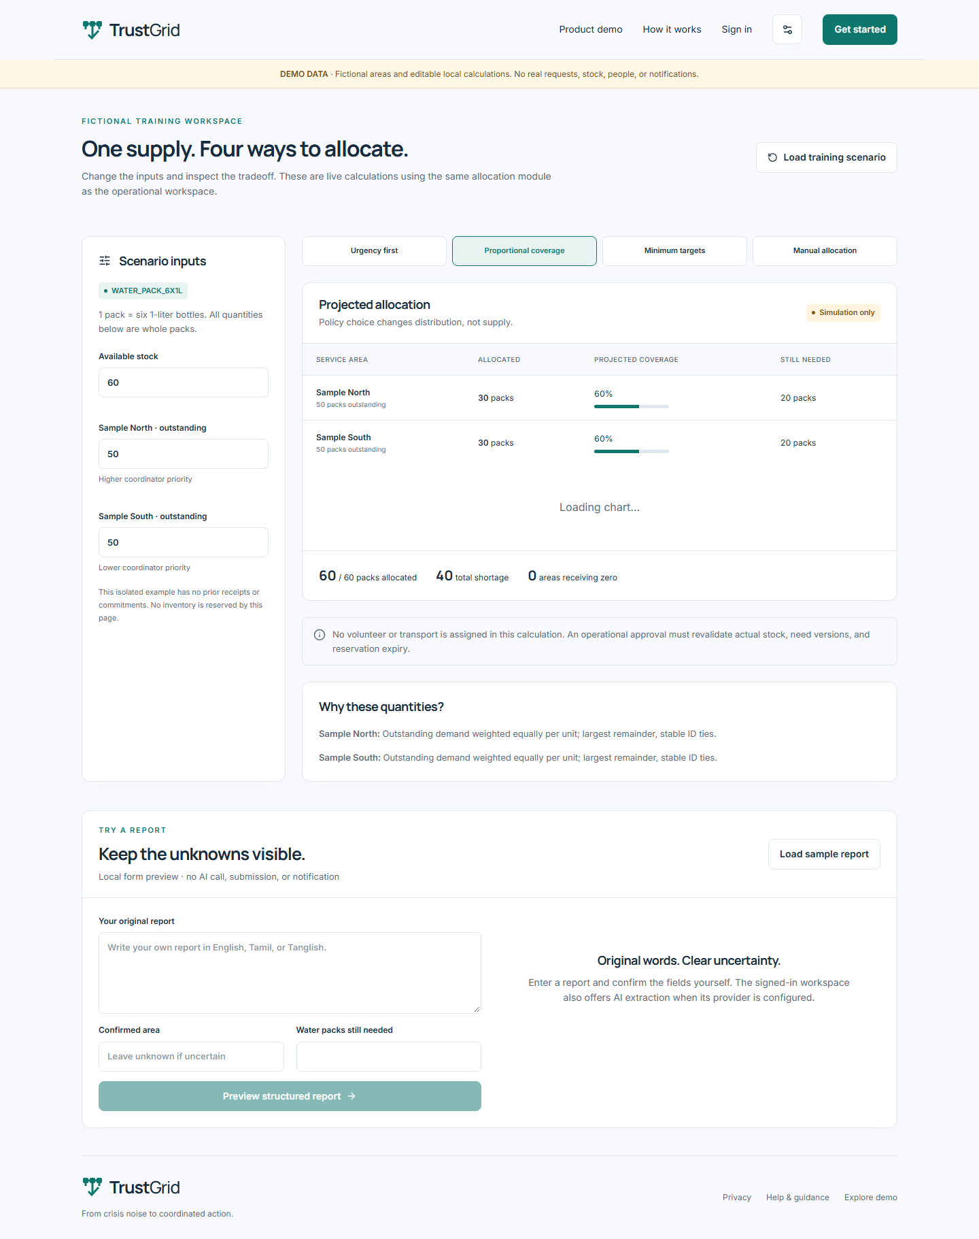
03 · WORKING PRODUCT
Change the inputs. Inspect the tradeoff.
The deployed demo runs the same deterministic allocation module used by the operational workspace.
60 packs
one fixed supply
Equal / proportional
30 / 30
Urgency first
50 / 10
Minimum targets
40 / 20
Also live
Editable report example preserves unknown address and ambiguous “tomorrow morning.”
ACTUAL DEPLOYMENT SCREENSHOT

Slide 4
04 · TECHNOLOGY THAT PROVES THE CLAIM
Each layer answers a different trust question.
One Next.js application; PostgreSQL owns authorization and accounting invariants.
AI extraction
Schema + source snippets
RLS + org keys
Scoped reads and references
Proves what the draft came from — not that it is true.
Proves one organization cannot rely on a client-supplied scope.
Row locks + ledger
Atomic reservation and custody
Realtime + receipts
Authorized refetch and actors
Proves the same physical units cannot be committed twice.
Proves who recorded each state and when.
Next.js 16 · Supabase Auth / PostgreSQL / Storage / Realtime · Google GenAI · Vitest / PGlite / Playwright

Slide 5
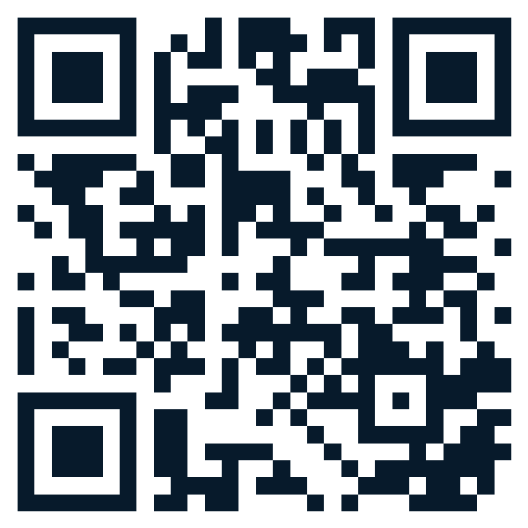
05 · DEMONSTRATED TODAY
Auditable coordination, with honest limits.
The public product is live; account-owner OAuth setup unlocks the authenticated judging flow.
26
8
9 / 9
4
TRY THE LIVE DEMO
domain tests
database integration tests
live browser checks
verified SQL migrations
What works now
✓
Multilingual draft + structured fallback
trustgrid-gamma.vercel.app
✓
Explainable duplicate review and allocation policies
Repository: local Git ready; GitHub authorization pending.
✓
Transactional inventory, volunteer, custody, and audit model
Self-reported data, connectivity, participant collusion, and review capacity remain real constraints.
TEAM · OWNER TO FILL
Limits

