Slide 1

STATE-WISE FARMERS BENEFITTED FROM MICRO IRRIGATION
Project No: DT8
Members of the Team:
Reg No | Name
CB.EN.U4CSE21309 | Darneshwar S
CB.EN.U4CSE21344 | Vignesh P G
CB.EN.U4CSE21349 | Keerthana S
CB.EN.U4CSE21370 | Yashwanthram K A

Slide 2
Objective
Collect data from India for farmers benefited from micro irrigation.
Analyze the data collected to provide a report.
This provides a platform for comparison .
In this WEB-APP (RESPONSIVE UI) Farmer will be able to login with their registered ID.
Enter if they are benefited from the micro-irrigation their location and other details .
State admins can also view all the details with their own ID and verify/Edit the entered details.
A Fully-Functional Website.
Stores Data Entered and Retrieves Entered Data.

Slide 3
Modules
Interface creation for master table management
Issuing of unique ID’s to Admins .
Maintaining details.
Comparison of the details
Preparing summary.
Report generation.

Slide 4
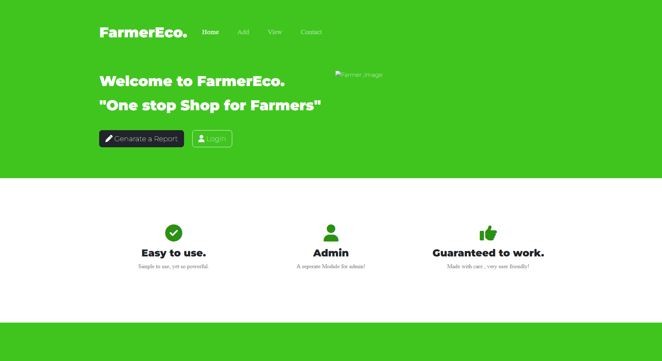
Implementation
Front End UI Design
Back End DB Design
Bootstrap
SQL

Slide 5
Entities Identified and its attributes
Admin:
Admin_id
name
state_name.
2. Farmer:
Farmer_id
Name
Location: land_loc,home_loc
contact_details.
3. Crop:
Crop_id
Name
4.Land:
Area type
Land_id
Area(in sq)
5.Irrigation:
Total Irrigated area
Total unirrigated area

Slide 6
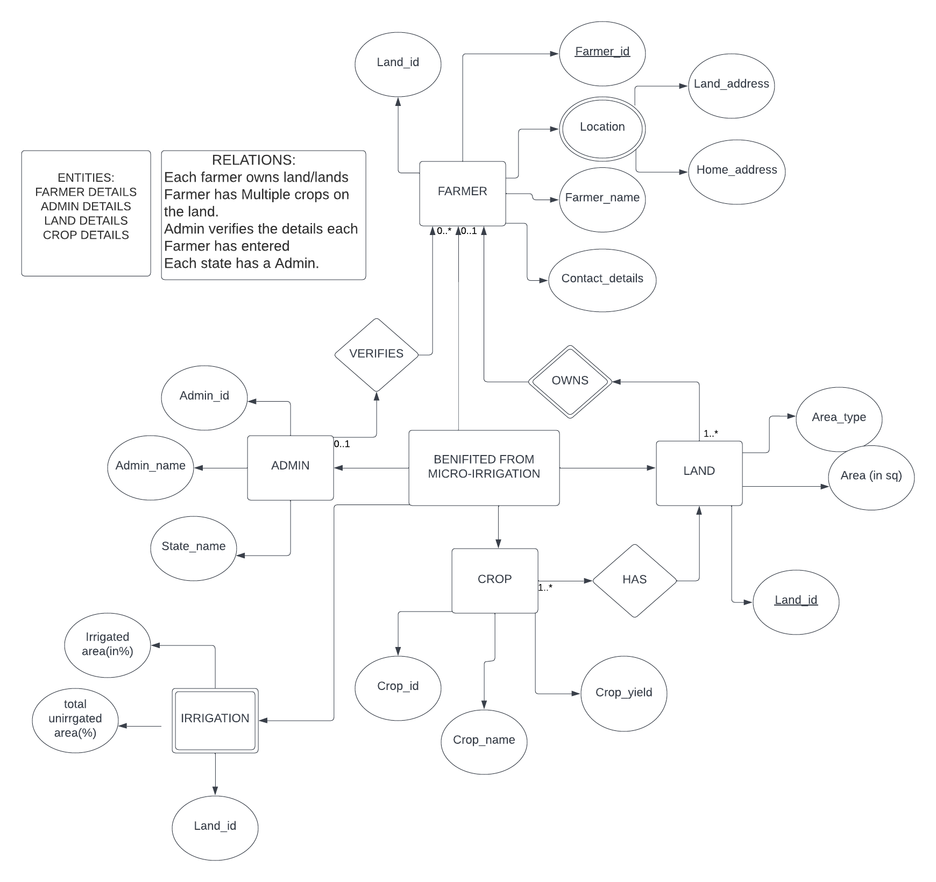
ER Diagram

Slide 7
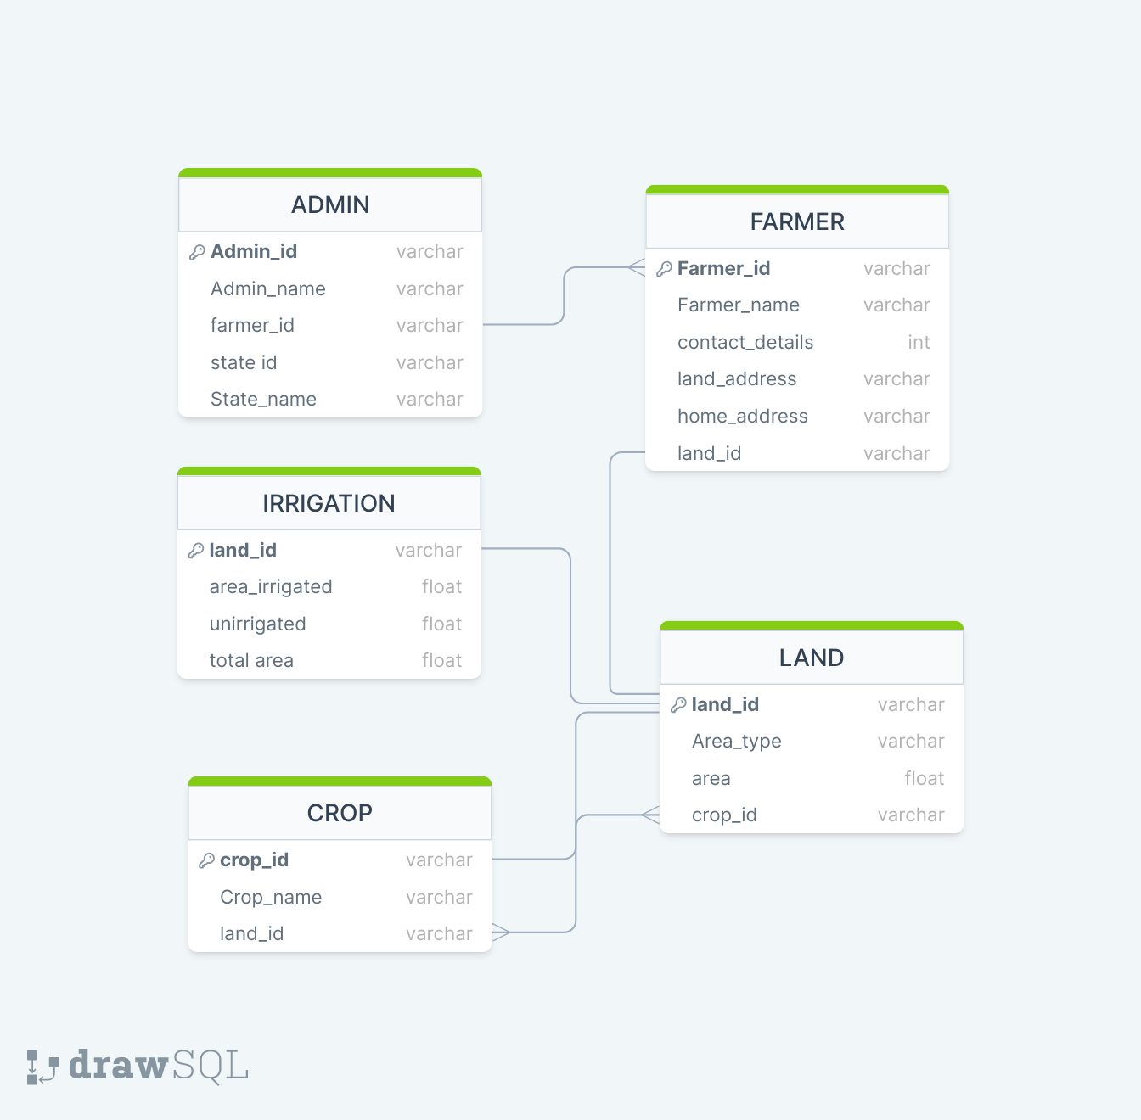
Schema

Slide 8
Thank You

