Slide 1
Sentiment Analysis
Rimpy Bishnoi
Professor, JBIET
Yashwanth Reddy
13671A1237
IT Department

Slide 2
Contents
Slide Contents | Slide Number
What is sentiment analysis ? | 3
Motivation | 4
Abstract | 5
Existing System | 6
Proposed System | 7
Requirements | 8
Design | 13
Implementation | 16
Testing | 19
Result | 21
Conclusion | 22
IT Department

Slide 3

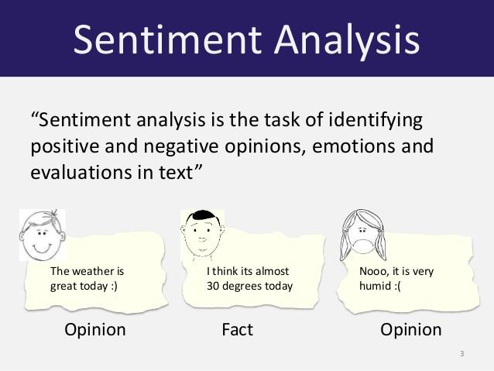
What is sentiment analysis ?
Tweets
Reviews
Anything

Slide 4
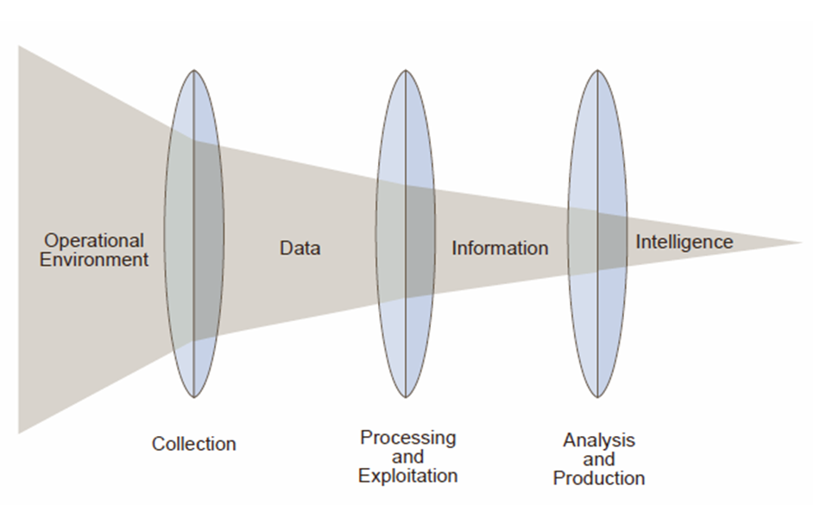
Motivation
Consumer Information
Politics
IT Department

Slide 5
Abstract
E-commerce growth
NLP
Sentiment Analysis
The number of customer reviews that a product receives grows rapidly.
Enabling computers to derive meaning from human or natural language input.
Computationally identifying and categorizing opinions expressed in a piece of text.
IT Department

Slide 6
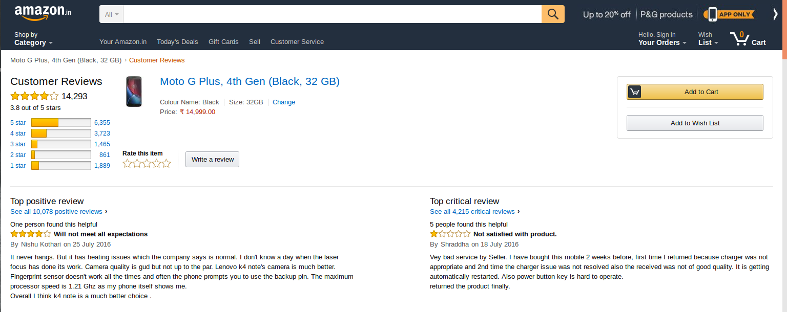
Existing System
IT Department

Slide 7
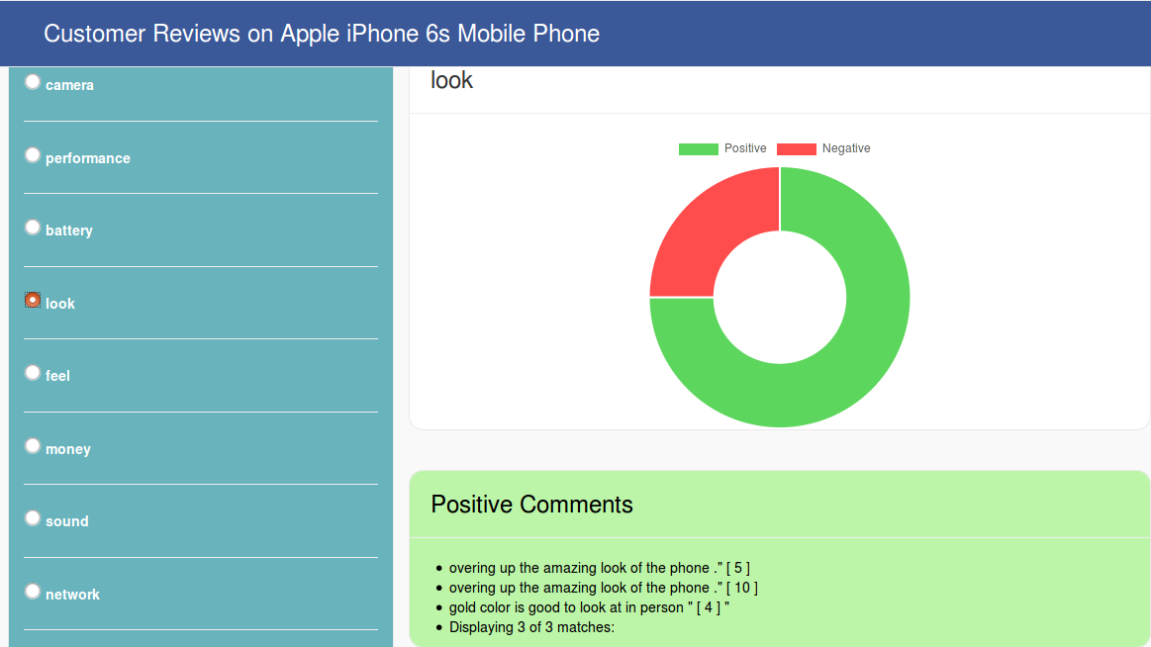
Proposed System
IT Department

Slide 8
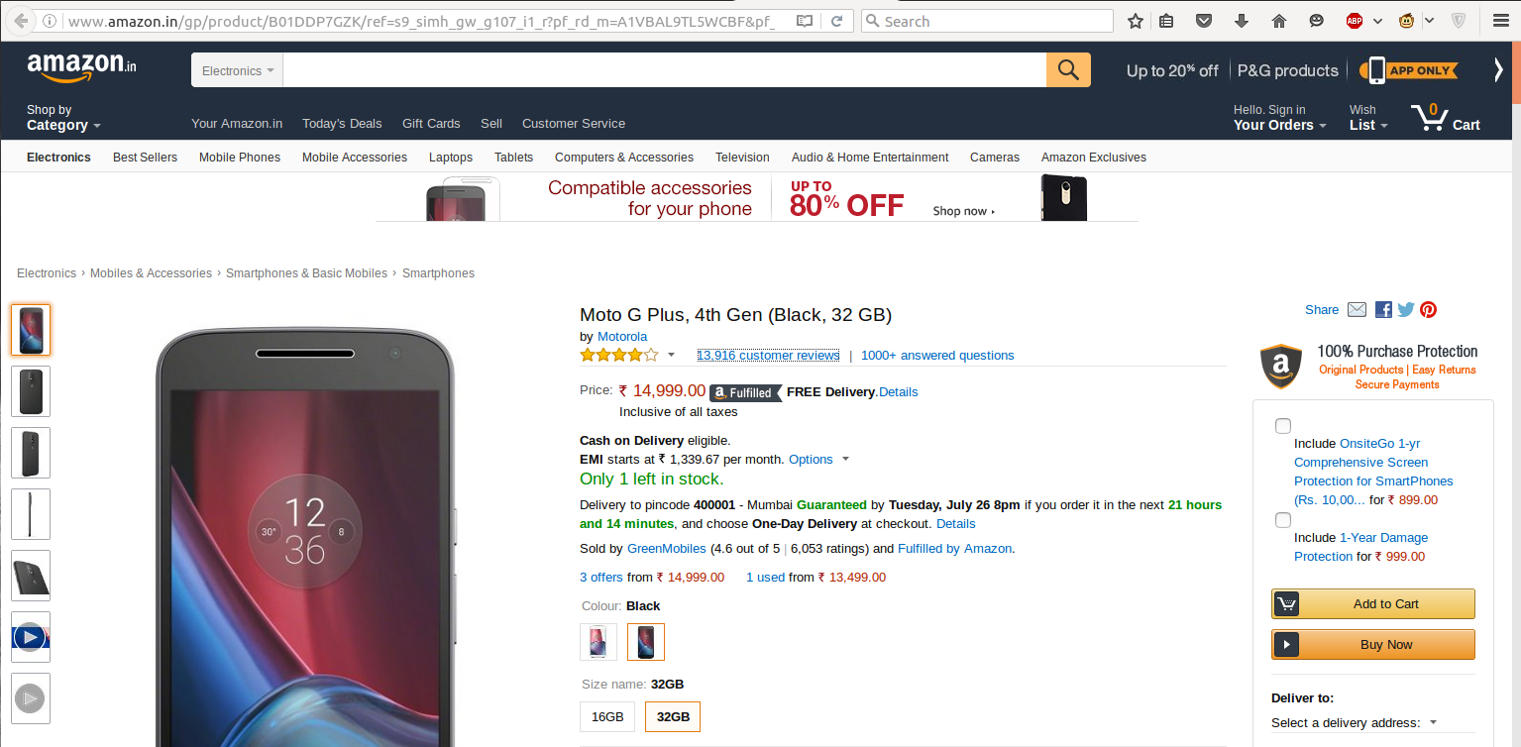
Functional Requirements
Url of product
The user need to enter Url of product to analyse the comments of the product.
IT Department

Slide 9
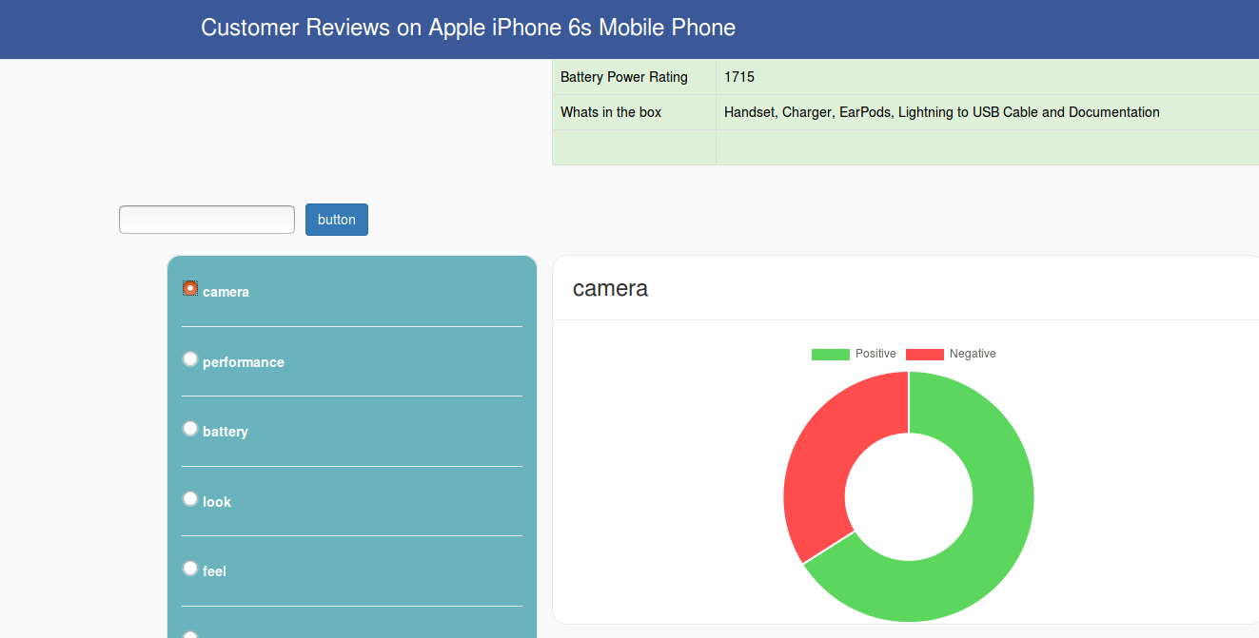
Functional Requirements
Specification
The user need to enter specific feature of the product to analyse the comments of the product.
IT Department

Slide 10
Non-Functional Requirements
Performance requirements
Requires a high speed internet connection at least (1 Mbps).
Response time
Analysis is performed in less than 1 second (0.2 – 0.7 secs).
IT Department

Slide 11
Software Requirements
Web Designing
HTML
CSS
Javascript
Django (Web Framework)
Data Scraping
1. R Programming
Data Analysis
1. Python
Libraries
1. Natural Language Tool Kit
IT Department

Slide 12
Hardware Requirements
Any Dual core Processer
Access to Internet
IT Department

Slide 13
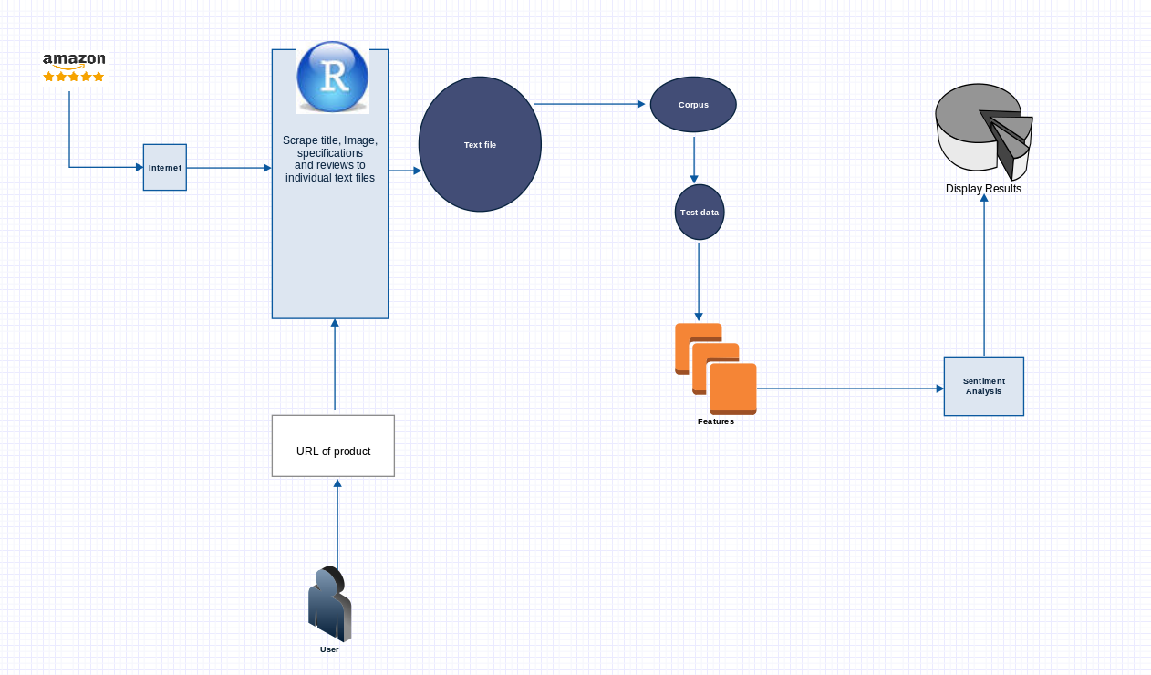
Architecture
IT Department

Slide 14
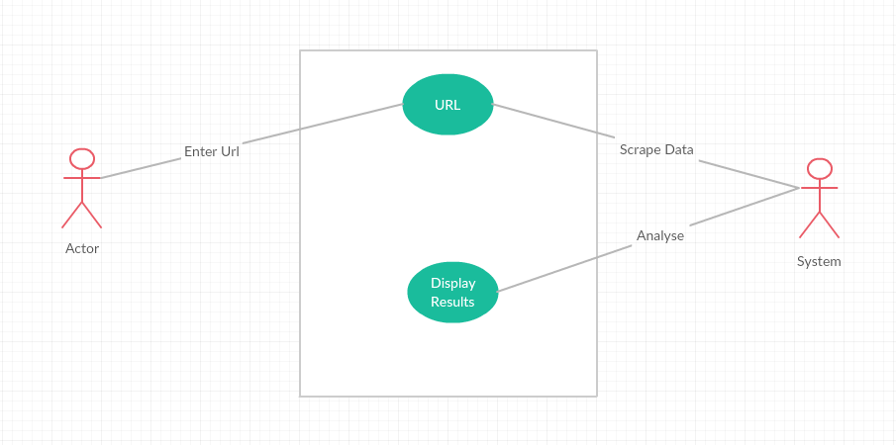
Use case diagram
IT Department

Slide 15
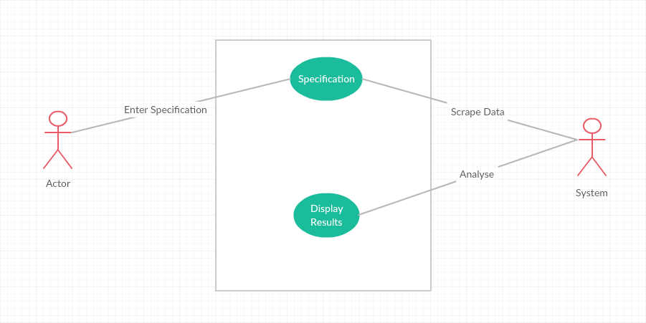
Use case diagram
IT Department

Slide 16
Modules
Module One
Module Two
Scraping
ANALYSIS
01
50%
50%
02
IT Department

Slide 17
Modules
Open the Url
Find the target data
Extract data
Finish

Slide 18
Read Data
Sentiment Analysis
Display Data
FINISH

Slide 19
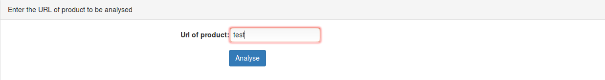
Testing
Url Field
It accepts only URLs
IT Department

Slide 20
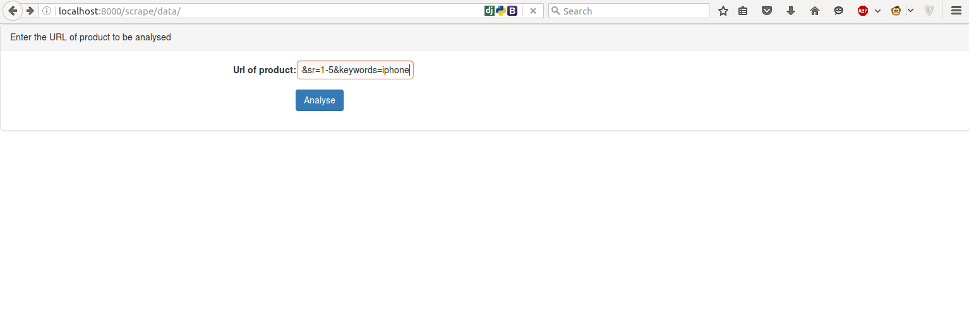
Screen shots
Main page
IT Department

Slide 21
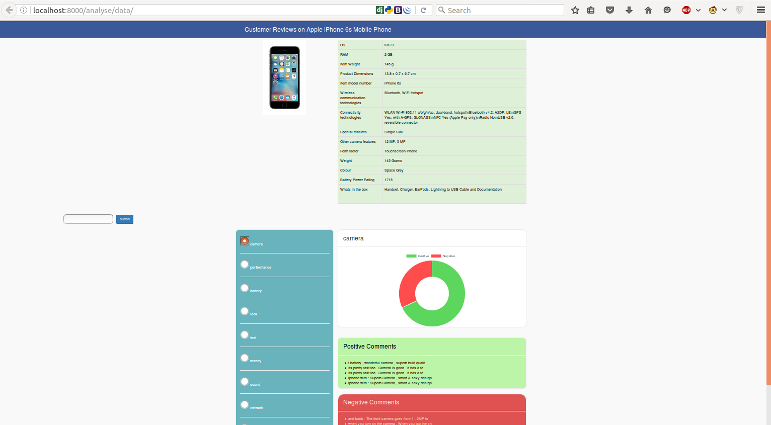
Screen Shots
Results
IT Department

Slide 22
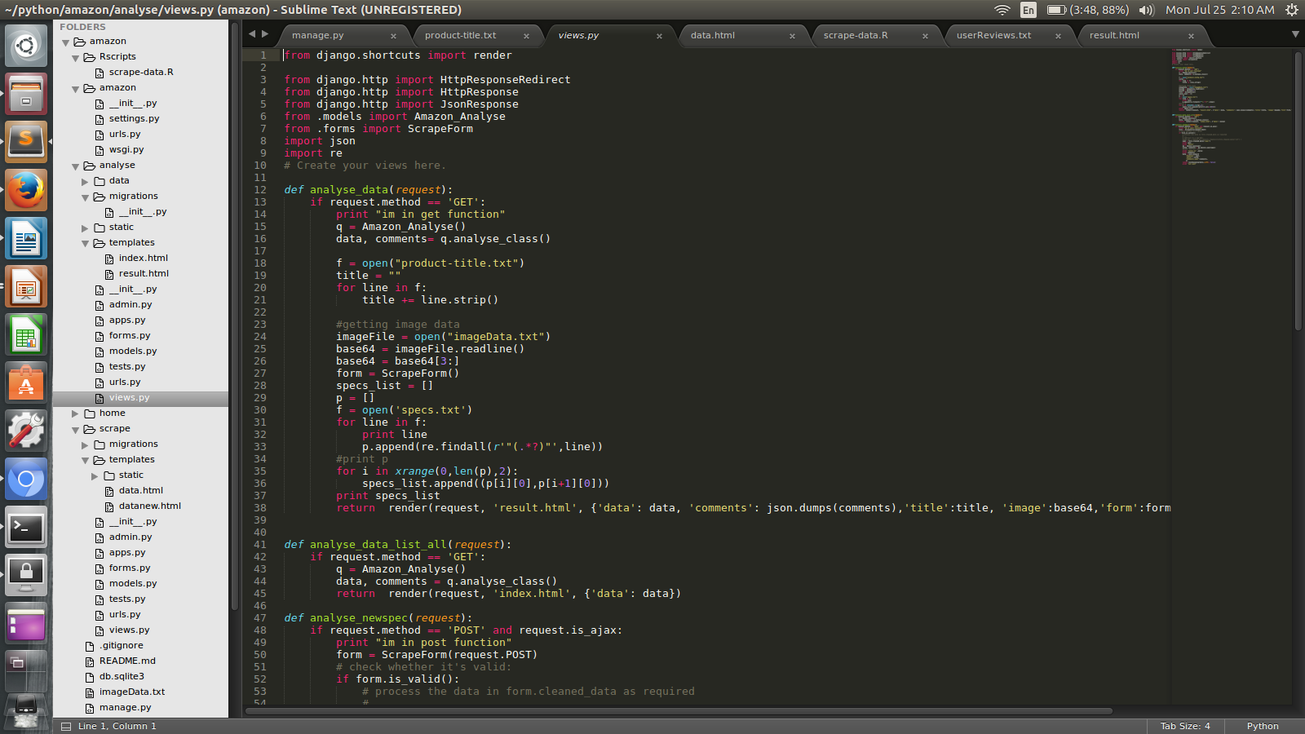
Code
IT Department

Slide 23
Conclusion
Summarizing product reviews based on sentiment analysis & natural language processing methods.
The objective is to provide a
feature-based summary of a large number of customer reviews of a product sold online.
C
Conclusion
IT Department

