Slide 1
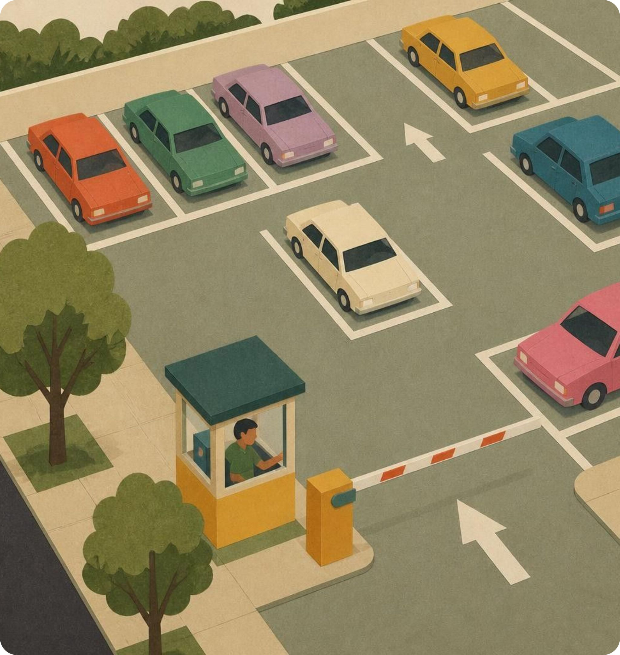
Smart Parking System
SMART PARKING
SLOT COUNTER
Less searching. Less traffic. Smarter parking.
Arduino • IR Sensors • LCD Display
Notes:
Introduce the project: Smart Parking Slot Counter, an automated embedded system using Arduino, IR sensors, and an LCD display to reduce driver search times and vehicle congestion.

Slide 2
The Problem
Wasted time
Drivers circle the lot looking for space.
10
Unnecessary movement
minutes spent searching
Extra vehicle movement adds congestion.
for one empty slot
Daily average urban parking delay per vehicle
Poor management
No clear view of how full the parking area is.
Notes:
Highlight the problem: drivers waste an average of 10 minutes searching for a single parking spot, leading to wasted time, avoidable congestion, and lack of lot visibility.

Slide 3
Our Solution
Count available parking spaces automatically and display the number of empty slots at the entrance.
1
2
3
IR Sensors
Arduino
LCD Display
Detect whether a vehicle occupies a slot
Processes the sensor data
Shows available spaces at the entrance
Notes:
Explain the architecture: infrared sensors at each slot or gate detect presence, an Arduino microcontroller computes real-time vacancy, and an entrance LCD instantly communicates slot availability.

Slide 4
How It Looks
20 Total slots
LCD AT ENTRANCE
SLOTS AVAILABLE
15 Occupied
5
5 Available
Live electronic gate sign readout
20 − 15 = 5
Notes:
Display the lot status: in a 20-slot parking area with 15 occupied spaces, the system calculates 20 minus 15, instantly showing 5 available spaces on the entrance LCD.

Slide 5




Benefits & Applications
Benefits
Where it can be used
Reduces time spent searching
Minimizes unnecessary vehicle movement
Improves parking management
Affordable and easy to understand
Built with basic electronics and programming
Colleges
Shopping malls
Hospitals
Office buildings
Notes:
Present the system benefits alongside its real-world environments: educational campuses, commercial retail centres, healthcare facilities, and office complexes.

Slide 6



Future Scope
Automatic entry
Mobile application
Real-time availability
barriers
Gate opens only when space is free
Check parking from your phone
Live updates on open slots
Notes:
Outline future improvements: physical boom barriers triggered automatically by vacancy counts, mobile applications for remote reservation, and IoT-driven real-time updates.

Slide 7
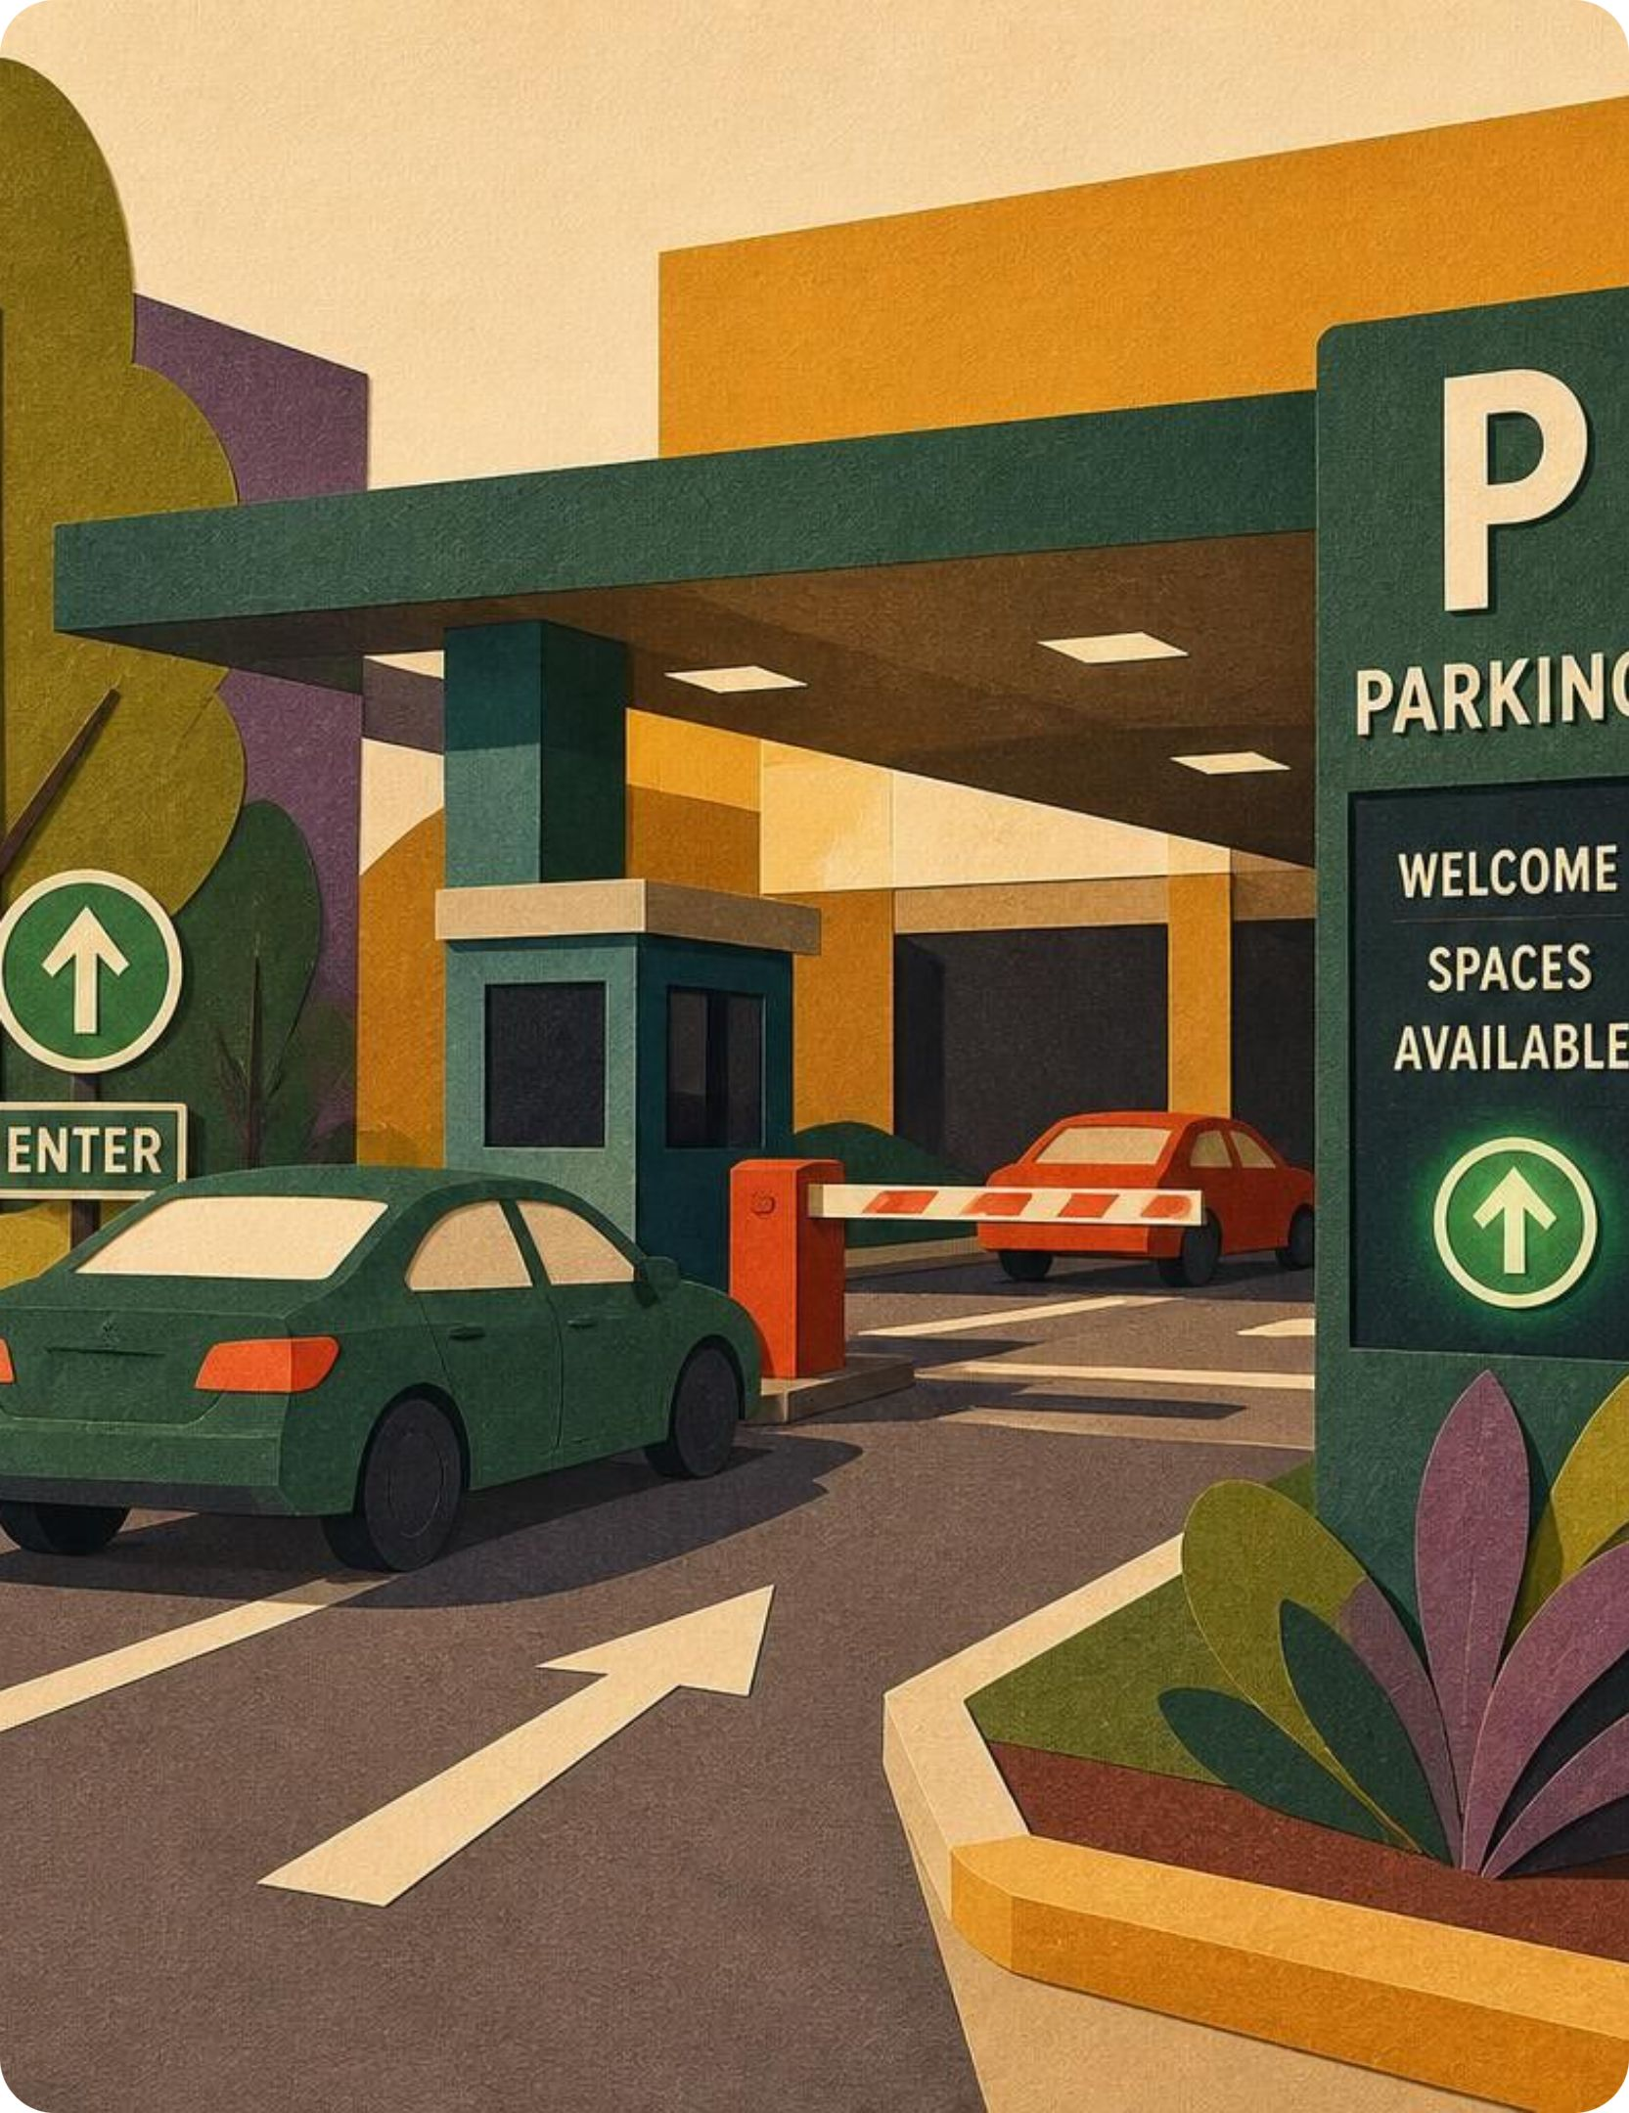
Our Vision
Less searching,
less traffic,
smarter parking.
Thank you!
Notes:
Conclude the presentation: reiterate our core vision of less searching, less traffic, and smarter parking, and open the floor for questions from the audience.

