Slide 1

Department of Collegiate and Technical Education
Computer Science and Engineering
AI and ML( 5th Semester)
WEEK-V
DATA PREPROCESSING
SESSION-1
Computer Science & Engineering – 20CS54I

Slide 2
Session-1 –Outline
Data Preprocessing
  Importance of data preprocessing
Data cleaning
  Assess Data quality
  Data anomalies
  Detect missing values with pandas dataframe functions: .info() and .isna()
  Diagnose type of missing values with visual and statistical methods
Approaches to deal with missing values
Keep the missing value as is
Remove data objects with missing values
  Remove the attributes with missing values
Estimate and impute missing values

Slide 3
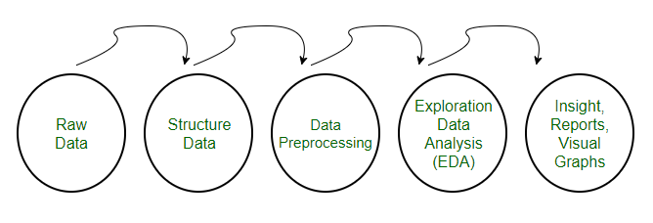
DATA PREPROCESSING And
Definition
Why do we need Data Preprocessing?

Slide 4
DATA CLEANING
Assess Data quality -Four metrics
Completeness
Validity
Timeliness
Consistency

Slide 5
DATA ANOMALIES
An anomaly is something that differs from a norm: a deviation, an exception. Some examples are:
sudden burst or decrease in activity
error in the text;
sudden rapid drop or increase in temperature.
Common reasons for outliers are:
data preprocessing errors
noise
fraud
attacks

Slide 6
Detect missing values with pandas dataframe functions: .info() and .isna()
Pandas DataFrame info() Method
Syntax
dataframe.info(verbose,buf,max_cols,memory_usage,show_counts,null_counts)
Return Value
None. The info() method does not return any value, it prints the information.
import pandas as pd
df = pd.read_csv('data.csv')
df.info()

Slide 7
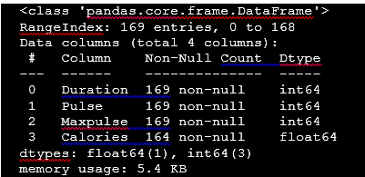
Detect missing values with pandas dataframe functions: .info() and .isna()

Slide 8
Detect missing values with pandas dataframe functions: .info() and .isna()
Pandas DataFrame isna() Method
Syntax: DataFrame.isna()
Returns : Mask of bool values for each element in DataFrame that indicates whether an element is not an NA value
import pandas as pd
# Creating the dataframe
df = pd.read_csv("nba.csv")
#Print dataframe
df
# detect the missing values
Df.isna()

Slide 9
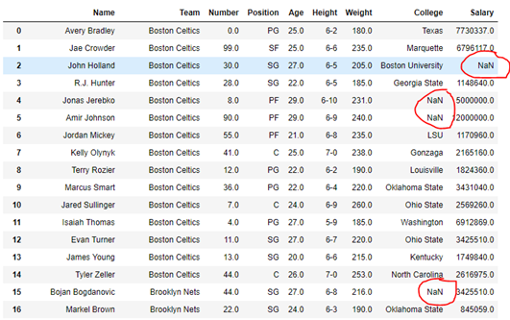
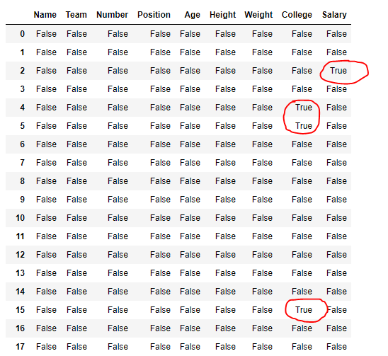
Detect missing values with pandas dataframe functions: .info() and .isna()

Slide 10
Approaches to deal with missing values
Keep the missing value as is
Remove data objects with missing values (Deleting the entire row)
Remove the attributes with missing values (Deleting the entire column)
Estimate and impute missing values

Slide 11
Approaches to deal with missing values
Estimate and impute missing values
Replacing with Arbitrary Value
#Replace the missing value with '0' using 'fiilna' method
train_df['Dependents'] = train_df['Dependents'].fillna(0)
train_df[‘Dependents'].isnull().sum()

Slide 12
Approaches to deal with missing values
Estimate and impute missing values
Replacing with mean
#Replace the missing values for numerical columns with mean
train_df['LoanAmount'] = train_df['LoanAmount'].fillna(train_df['LoanAmount'].mean())
train_df['Credit_History'] = train_df[‘Credit_History'].fillna(train_df['Credit_History'].mean())

Slide 13
Approaches to deal with missing values
Estimate and impute missing values
Replacing with median
#Replace the missing values for categorical columns with mode
train_df['Gender'] = train_df['Gender'].fillna(train_df['Gender'].mode()[0])
train_df['Married'] = train_df['Married'].fillna(train_df['Married'].mode()[0])
train_df['Self_Employed'] = train_df[‘Self_Employed'].fillna(train_df['Self_Employed'].mode()[0])
train_df.isnull().sum()

Slide 14
Approaches to deal with missing values
Estimate and impute missing values
Replacing with median
train_df['Loan_Amount_Term']= train_df['Loan_Amount_Term'].fillna(train_df['Loan_Amount_Term'].median())

Slide 15
Approaches to deal with missing values
Replacing with previous value – Forward fill
import pandas as pd
import numpy as np
test = pd.Series(range(6))
test.loc[2:4] = np.nan
Replacing with previous value – Backward fill
# Backward-Fill
test.fillna(method=‘bfill')

