Slide 1

Microservices Architecture

Slide 2
Microservice Architecture Big Picture
Service Registry
Github
User
API Gateway
/users/
Hystrix
Dashboard
Config Server
Department
/departments/
User
Zipkin
Server

Slide 3
Procedure
Create Microservice – Department & User
Create Service Registry
Create API Gateway
Create Hystrix Dashboard
Create Config Server & Github Repository
Create Zipkin Server

Slide 4
Microservice
Microservices is a variant of the service-oriented architecture (SOA) architectural style that structures an application as a collection of loosely coupled services.
Each running in its own process and communicating with lightweight mechanisms, often an HTTP resource API.

Slide 5
Service Registry
Clients of a service use either Client-side discovery or Server-side discovery to determine the location of a service instance to which to send requests.
Service instances are registered with the service registry on startup and deregistered on shutdown.

Slide 6
API Gateway
API Gateway is a server that is the single-entry point into the system
API gateway availability requires a load balancer that can provide flexibility to cope with rapid changes in microservices, such as versioning and dynamically shifting scale.

Slide 7
Hystrix Dashboard
A Hystrix system provides such data as a stream of JSON documents via HTTP. The Hystrix Dashboard can visualize the data in a web interface. The dashboard presents all Circuit Breakers along with the number of requests and their state (open/closed)

Slide 8
Config Server
Central configuration server provides configurations (properties) to each micro service connected
With the Config Server you have a central place to manage external properties for applications across all environments.” Basically, a config server allows you to externally store variables your application will need to run in all environments, regardless of lifecycle, and update them in one, centralized place.

Slide 9
Zipkin Server
Zipkin is very efficient tool for distributed tracing in microservices ecosystem.
It helps gather timing data needed to troubleshoot latency problems in service architectures

Slide 10
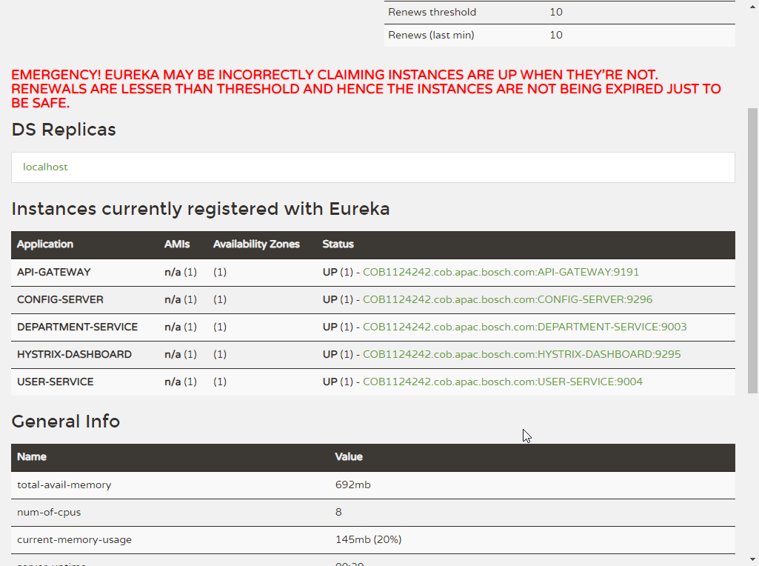
Server Instance in Eureka

Slide 11
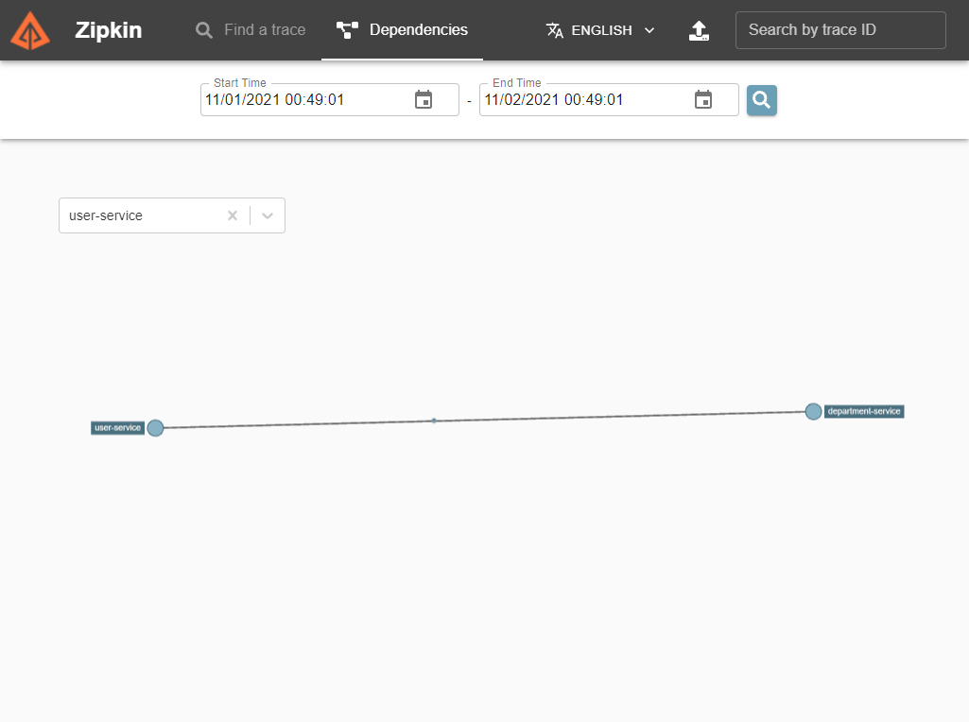
Zipkin Server

Slide 12
Change Port of Tomcat
https://www.java67.com/2019/07/spring-boot-3-ways-to-change-port-of-tomcat.html

