Slide 1
Sales Forecasting for Corporación Favorita
Time Series and Retail Analytics By Yasida Wanigatunga Software Engineer @ Jahan.ai

Slide 2

Introduction
Problem:
Predicting sales for perishable goods is challenging due to fluctuating demand.
Corporación Favorita (Ecuador’s largest grocery retailer) seeks accurate forecasts to reduce waste and improve inventory management.
Objective:
Build a machine learning model to predict daily sales across multiple stores and product categories.
Key factors: Historical sales, promotions, holidays, oil prices, and store/item metadata.

Slide 3

Data Preprocessing
Filled missing onpromotion values with False and converted to Boolean.
Cleaned unit_sales:
Removed 7,795 negative values (returns).
Removed 11M+ outliers using IQR method.
Merged store/item metadata (city, store type, perishability).
Filtered data from 2016 onward for relevancy and memory efficiency.

Slide 4
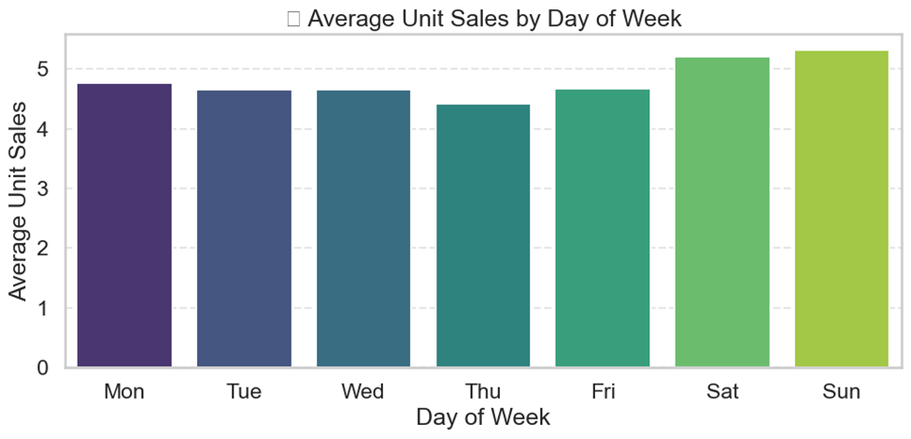
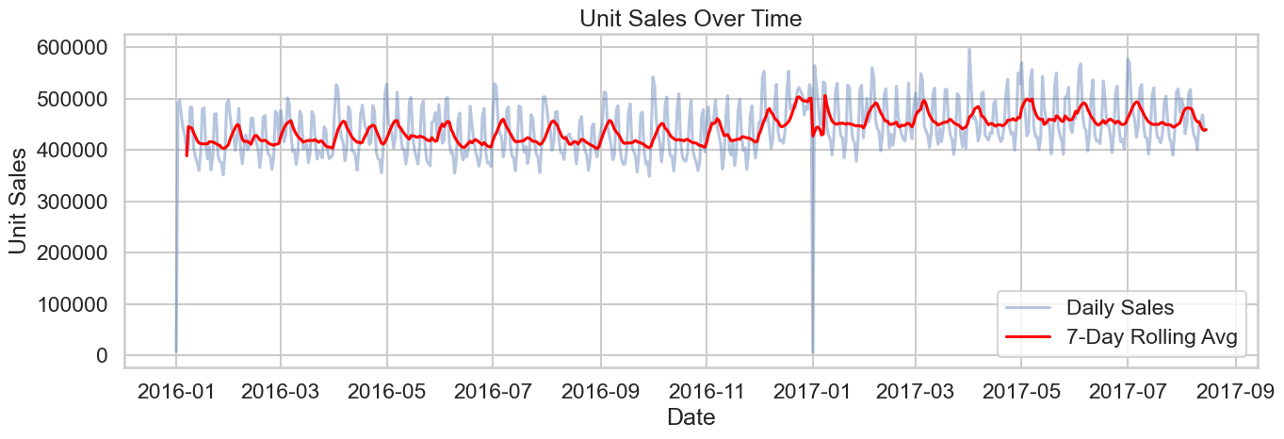
Temporal Trends
Daily Sales Trends & Seasonality
Weekly Seasonality: Sales show a clear 7-day cycle, peaking on weekends and dipping midweek.
Holiday Effects:
Sharp dip on New Year's Day (2017-01-01).
Immediate rebound on 2017-01-02, likely due to pent-up demand.
Rolling Average (7-day) smooths fluctuations, revealing stable overall trend from 2016–2017.
Late 2017 shows increased volatility, possibly due to marketing campaigns or events
Key Insights: ✔ Weekly seasonality dominates sales (ACF peaks at 7-day lags). ✔ Holidays disrupt sales, but demand rebounds immediately after (e.g., Jan 2 spike). ✔ No long-term trend, but late 2017 saw higher variability.

Slide 5
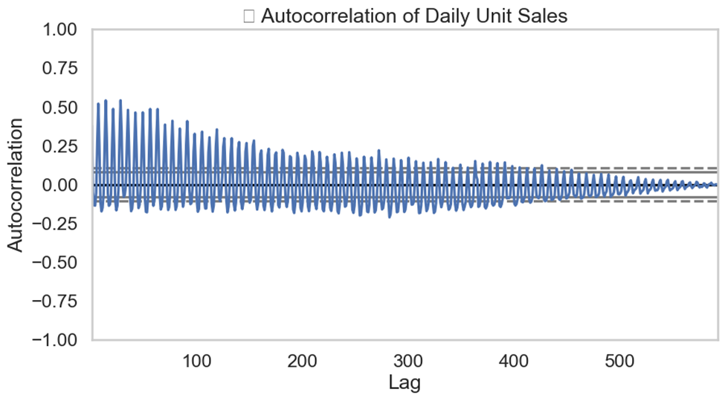
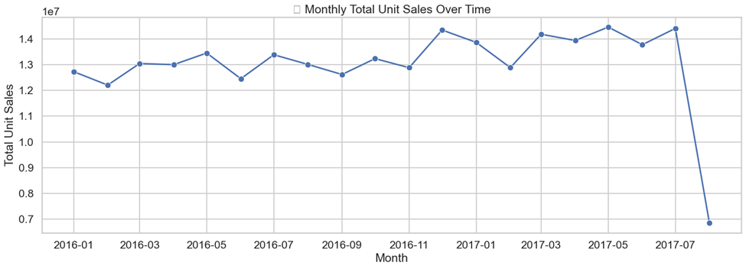
Temporal Trends
Monthly & Autocorrelation Patterns
Autocorrelation plot shows strong positive spikes at lags 7, 14, 21, etc. → confirms weekly structure. Oscillating decay confirms seasonal persistence
Peaks in December (holidays) and June (mid-year events).
ADF p-value = 0.009 → Sales series is stationary, suitable for time series models.
Key Insights: ✔ Recurring monthly cycles align with holidays/paydays. ✔ Sales today depend heavily on last week’s sales (lag-7 correlation). ✔ ADF Test (p=0.009): Data is stationary → Ideal for time-series models.

Slide 6
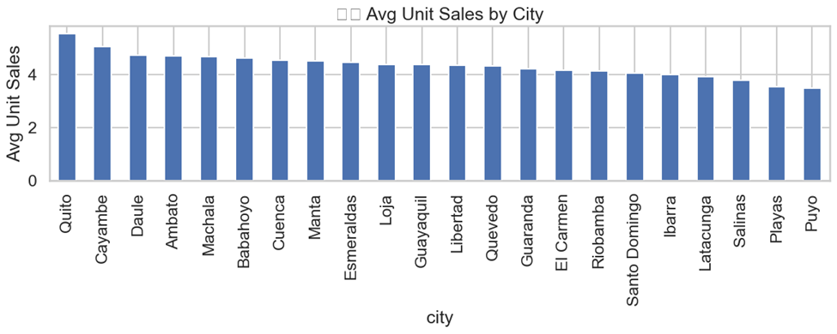
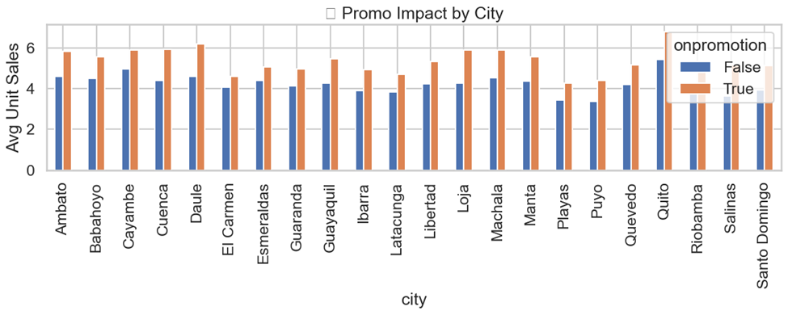
Spatial Sales Patterns
Regional Sales Variation:
Quito has the highest average unit sales, followed by Cayambe and Daule.
Cities like Puyo and Ambato show the lowest sales.
Indicates significant regional demand differences.
Promotional Impact by City:
Promotions lead to a ~1.2 unit sales increase on average.
Babahoyo and Daule show strong uplift from promotions.
Guayaquil and Ambato see smaller changes — highlighting region-specific promotion effectiveness.

Slide 7
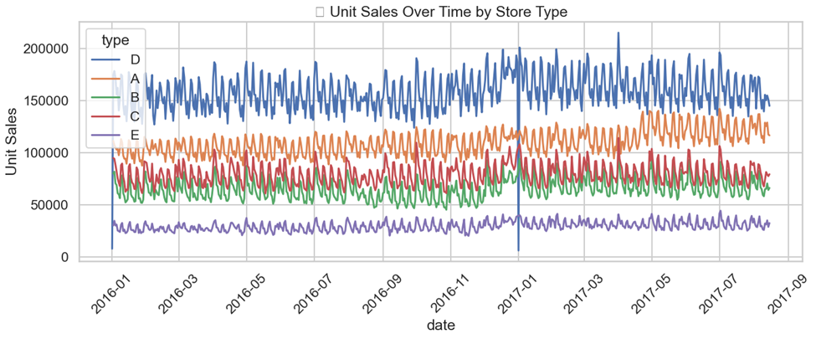
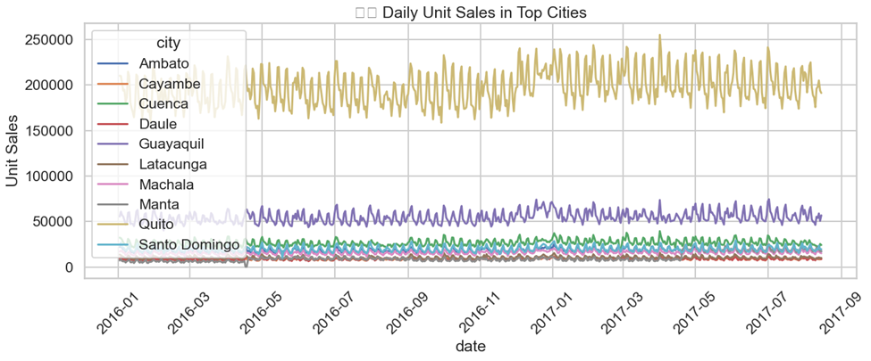
Spatial-Temporal Sales Dynamics
City-Level Trends Over Time:
Quito consistently leads in daily unit sales, with clear weekly seasonality.
Guayaquil follows with moderate but stable trends.
Smaller cities have lower and more variable sales.
Store Type Performance Over Time:
Store Type D leads consistently, followed by Type A.
Types B, C, and E show lower performance, often overlapping.
All types show similar weekly patterns, but magnitude varies.

Slide 8
Feature Engineering: Building Predictive Power
Feature Type | Key Features | Purpose | EDA Insight
Temporal | is_month_start, is_month_end | Capture payday surges & month-end clearance | Monthly peaks in Dec/Jun
 | sales_lag_7 | Model weekly seasonality (7-day autocorrelation) | Strong ACF at 7-day lags
 | day_sin, day_cos | Encode cyclical day-of-week patterns (smooth transitions) | Weekend sales spikes
Promotion | promo_uplift | Measure product-specific promotion sensitivity | Promos boost sales +1.2 units on average
 | promo_x_perishable | Highlight stronger promo effects for perishables | Perishables need urgency
 | promo_strength (city-level) | Quantify regional promo effectiveness | Babahoyo/Daule respond best
Spatial | city_avg_sales | Normalize sales by city demand baseline | Quito sales 3–5× higher
 | sales_ratio_vs_city | Compare item performance to city average | Small cities volatile
Target Transform | log_unit_sales | Reduce skewness from outliers and stabilize variance | IQR-filtered 11M outliers

Slide 9
Model Building
📊 Data Splitting
- Train: 60%, Test: 20%, Validation: 20%
🤖 Models Used
- Ridge Regression - LightGBM Regressor
📈 Evaluation Metrics
LightGBM: - Test → MSE: 0.2692, RMSE: 0.5189, MAE: 0.4218, R²: 0.3873 - Validation → MSE: 0.2668, RMSE: 0.5165, MAE: 0.4188, R²: 0.3933 Ridge Regression: - Test RMSE (log): 0.5292 - Validation RMSE (log): 0.5263
📝 Key Insights
- LightGBM outperformed Ridge on both test and validation sets. - Ridge was evaluated on log scale, so direct comparison may differ.

