Slide 1
PREDICT & RETAIN
Data-Driven HR Employee Attrition & Workforce Analytics
Comprehensive Exploratory Analysis, Inferential Validation & Interactive Decision Support
Domain: Foundations of Data Science | October 2026

Slide 2
PREDICT & RETAIN — HR WORKFORCE ANALYTICS
Problem Statement: The Hidden Cost of Talent Turnover
Operational Disruption
• Voluntary departures cause project bottlenecks and loss of institutional capability.
• Replacement expenses typically range between 50% and 200% of annual salary per role.
• Increased workload on remaining personnel elevates attrition risk across teams.
Core Business Dilemmas
• Which operating units and job functions suffer disproportional turnover rates?
• Does compensation explain attrition, or do acute workplace stressors dominate?
• What empirical impact does mandatory overtime have on employee retention?
• Can early-tenure vulnerability be identified in the first 24 months?
The Data Science Shift
• Transition from reactive exit interviews to evidence-based workforce analytics.
• Rigorous statistical validation (Chi-square, Welch's t-test) of operational hypotheses.
• Deploying interactive decision intelligence for proactive HR intervention.

Slide 3
PREDICT & RETAIN — HR WORKFORCE ANALYTICS
Project Objectives & Analytical Framework
Objective 1: Quantify Attrition Risk
Measure baseline and segmented turnover rates across Research & Development, Sales, and Human Resources divisions, as well as 9 distinct organizational job roles.
Objective 2: Compensation Architecture Analysis
Evaluate income distributions, median/mean disparities, and statistical significance tests between departing ($4,787) and retained ($6,833) personnel cohorts.
Objective 3: Workplace Stress & Commute Evaluation
Analyze the observational relationships between mandatory overtime status (30.5% vs 10.4%), commute distance (>20 km vs 0-5 km), and employee turnover.
Objective 4: Interactive Dashboard & Decision Support
Deliver a dynamic Streamlit application with live KPI metrics, multi-criteria filtering (Department, Role, Overtime, Travel), and actionable HR guidance.

Slide 4
PREDICT & RETAIN — HR WORKFORCE ANALYTICS
Dataset Overview: IBM HR Analytics Benchmark
1,470
Total Employee Records
35
Initial Workforce Variables
16.12%
Baseline Attrition Rate
100%
Data Completeness (0 Nulls)
Dataset Characteristics & Analytical Fields
Target Variable: Attrition ('Yes' = 237, 'No' = 1,233). Baseline turnover is exactly 16.12%.
Demographics & Experience: Age (18-60), Education, EducationField, TotalWorkingYears, YearsAtCompany (0-40).
Organizational Structure: Department (R&D: 961, Sales: 446, HR: 63), JobRole (9 distinct titles), JobLevel (1-5).
Compensation & Performance: MonthlyIncome ($1,009 to $19,999), PercentSalaryHike, PerformanceRating, StockOptionLevel.
Workplace Stress & Surveys: OverTime ('Yes': 416, 'No': 1,054), DistanceFromHome (1-29 km), JobSatisfaction (1-4), WorkLifeBalance (1-4).

Slide 5
PREDICT & RETAIN — HR WORKFORCE ANALYTICS
Data Cleaning & Feature Engineering Pipeline
Rigorous Data Cleaning Protocol
✔ Zero Missing Values: Confirmed complete 1,470 x 35 records with no null imputations required.
✔ Zero Duplicate Rows: Confirmed unique employee identifiers.
✔ Constant Column Audit: Identified uninformative administrative constants (EmployeeCount=1, Over18='Y', StandardHours=80).
✔ Categorical Validation: Verified standardized label encoding across departments, roles, and travel tiers.
✔ Outlier Preservation: Preserved legitimate high incomes ($20k) and senior tenures (40 yrs) to reflect genuine workforce hierarchy.
Feature Engineering Implementations
⚡ Attrition_Num: Created binary target mapping (Yes -> 1, No -> 0) enabling mathematical aggregation and correlation.
⚡ TenureRatio: Ratio of company longevity relative to chronological age (YearsAtCompany / Age) with safe denominator safeguards.
⚡ TenureGroup: Segmented career longevity into 0-2 yrs (probation), 3-5 yrs, 6-10 yrs, and 11+ yrs (veteran).
⚡ DistanceBand: Segmented commute distance into 0-5 km, 6-10 km, 11-20 km, and 21+ km.
⚡ Final Dataset Validation: Successfully generated and verified data/final_dataset.csv (1,470 rows x 39 columns).

Slide 6
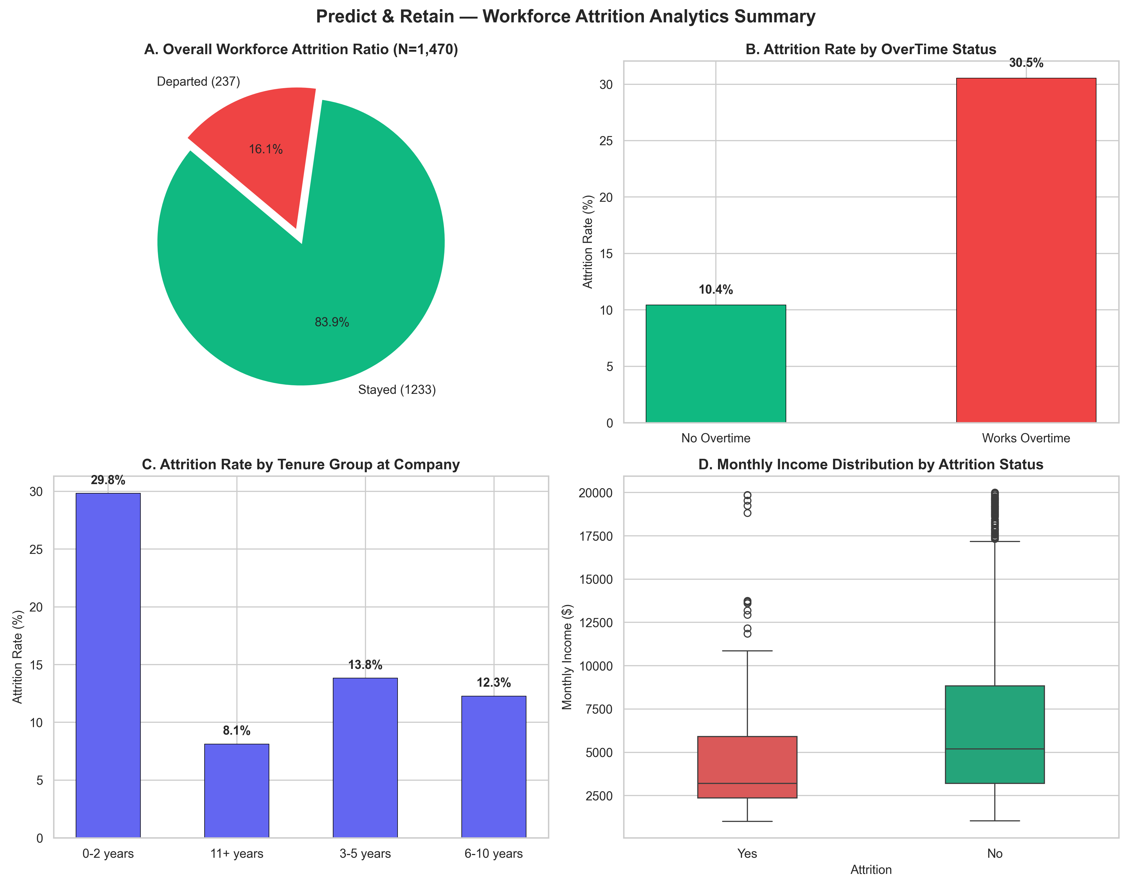
PREDICT & RETAIN — HR WORKFORCE ANALYTICS
Exploratory Data Analysis: Workforce Summary
Key Workforce Observations
• Overall Workforce Distribution: 83.88% of employees remain retained (1,233 staff) against a 16.12% attrition baseline (237 staff).
• Departmental Differences: Sales exhibits an observed attrition rate of 20.63%, Human Resources 19.05%, and Research & Development 13.84%.
• Role Variation: Highest observed attrition occurs in Sales Representatives (39.76%), Laboratory Technicians (23.94%), and Human Resources (23.08%).
• Lowest Turnover Roles: Research Directors (2.50%) and Managers (4.90%) exhibit the lowest observed attrition rates.

Slide 7
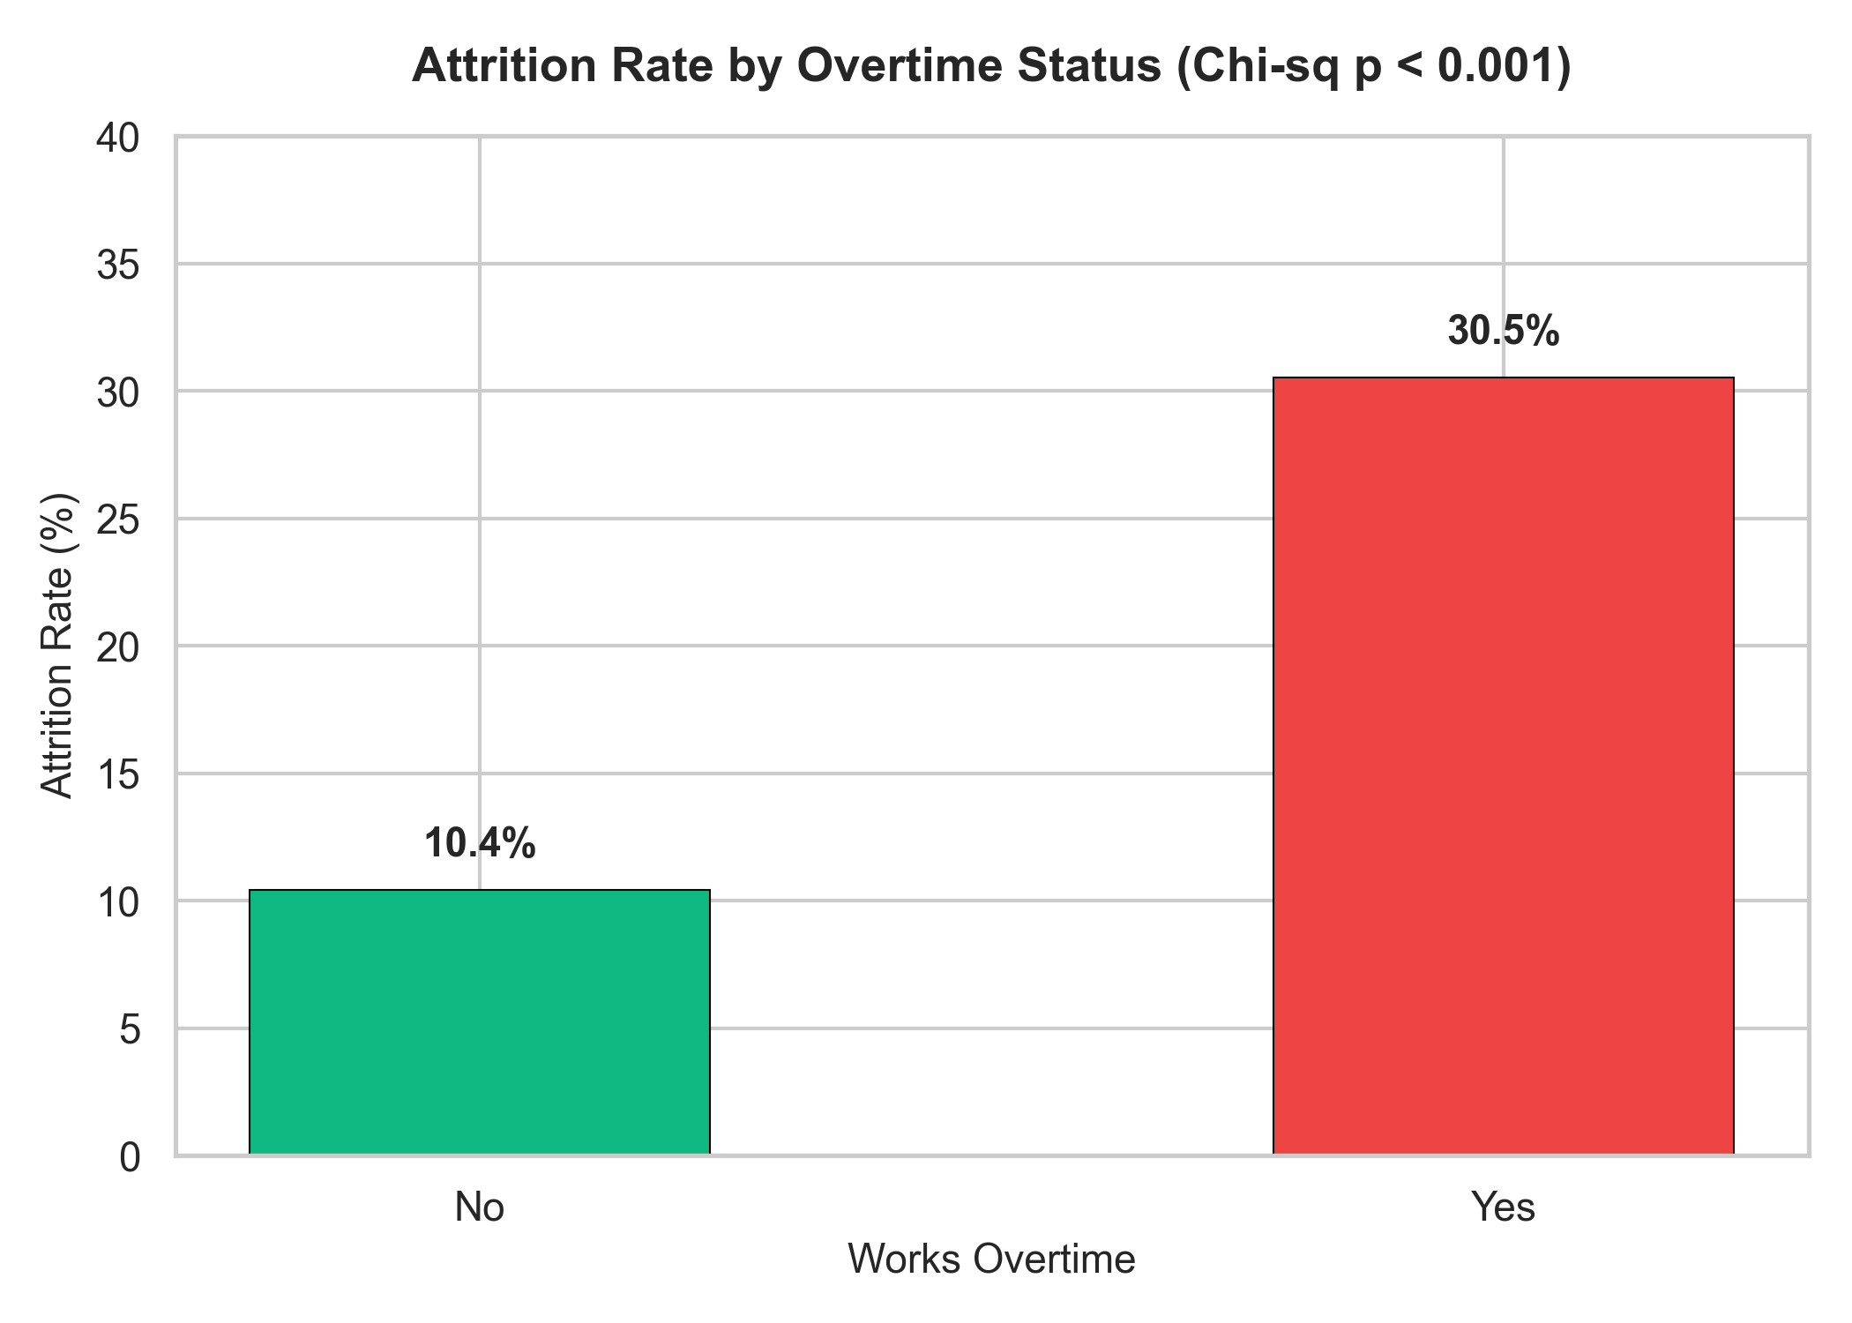
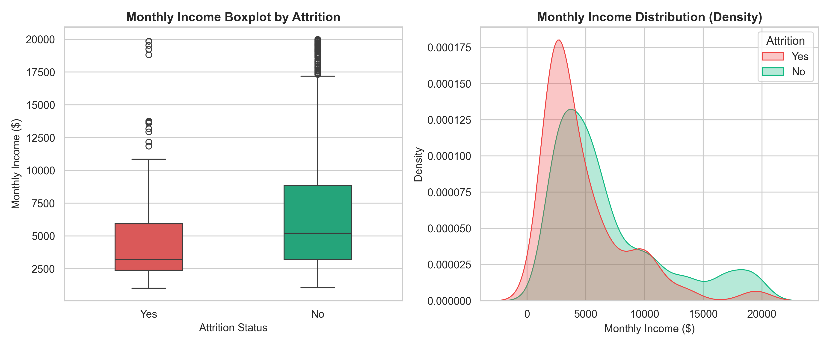
PREDICT & RETAIN — HR WORKFORCE ANALYTICS
Critical Drivers: Overtime Burden & Compensation Gap
Statistical Hypothesis Testing Results:
• Overtime Association: Attrition is 30.53% for overtime staff vs 10.44% without overtime (Chi2 = 87.5643, p = 8.16e-21). Statistically highly significant.
• Compensation Gap: Retained personnel earn mean $6,832.74 (median $5,204) vs $4,787.09 (median $3,202) for departed staff (gap: $2,045.65, Welch t = -7.4826, p = 4.43e-13).
• Note: Project spec reference salaries were ~$11,330 vs ~$9,592. Actual calculated values from dataset are $6,833 vs $4,787 (p < 0.001); direction is identical.

Slide 8
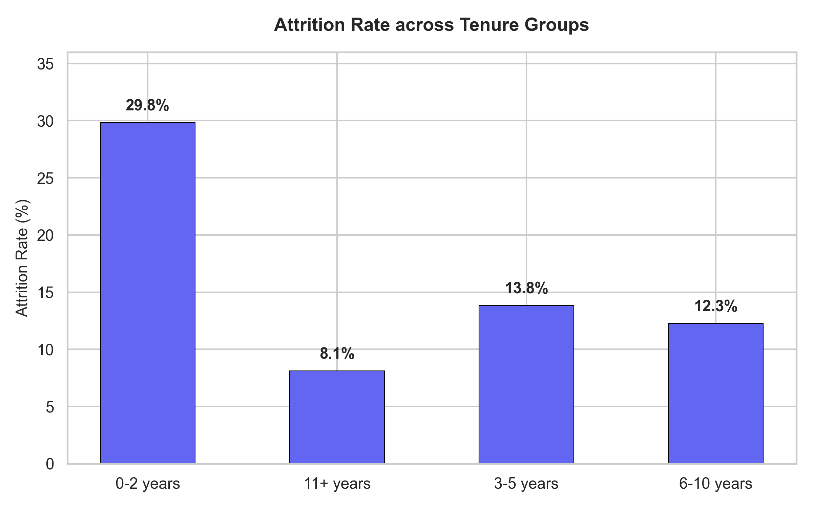
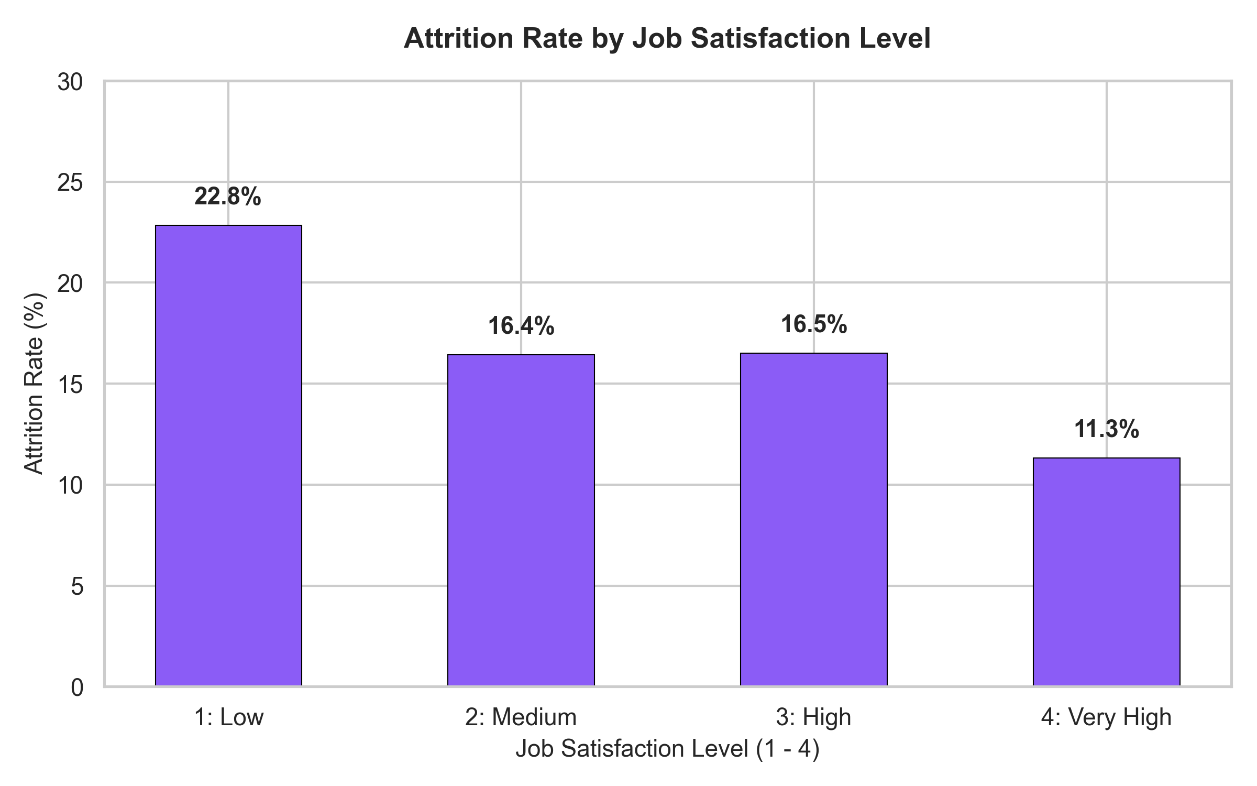
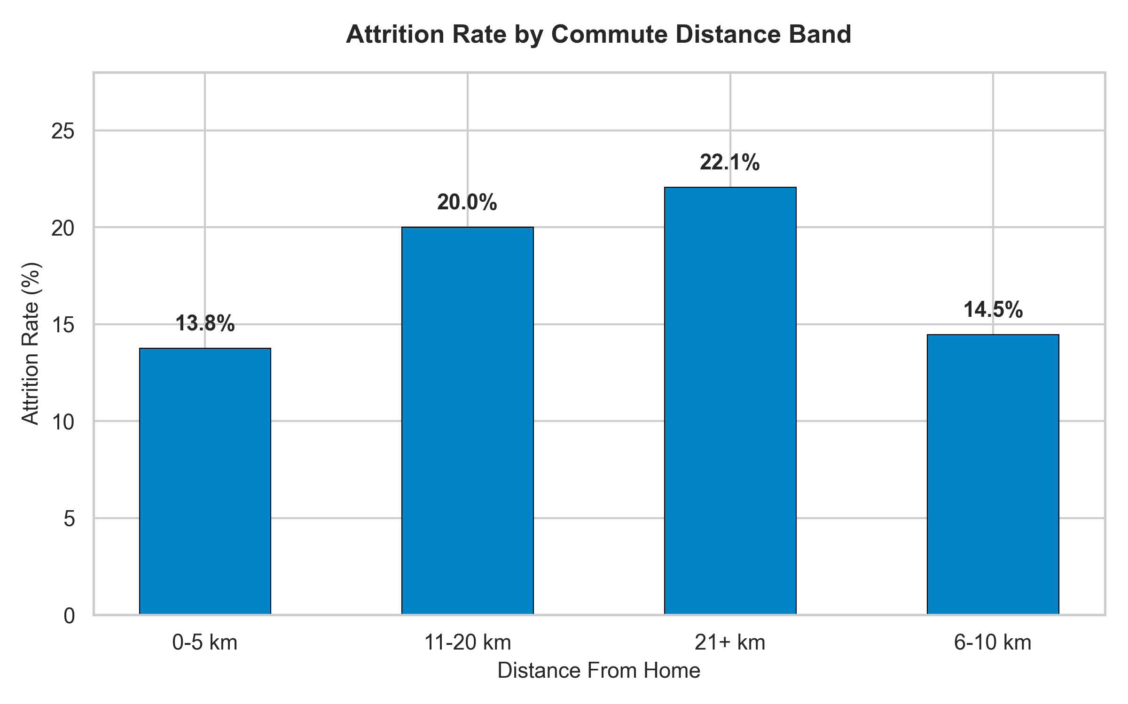
PREDICT & RETAIN — HR WORKFORCE ANALYTICS
Workplace Dynamics: Tenure, Sentiment & Commute
Key Observational Insights:
1. Early Tenure Window: Employees in years 0–2 exhibit 29.82% attrition, which drops sharply to 13.82% in years 3–5 and 8.13% beyond 11 years.
2. Sentiment Compounding: Low job satisfaction produces 22.84% attrition (vs 11.33% at level 4). Combined with poor work-life balance, attrition exceeds 40%.
3. Commute Distance Friction: Commuters traveling >20 km exhibit 22.06% attrition compared to 13.77% for staff residing within 5 km.

Slide 9
PREDICT & RETAIN — HR WORKFORCE ANALYTICS
Interactive Streamlit Dashboard Architecture
Production Dashboard Capabilities
✔ Dynamic KPI Metrics Ribbon: Total Employees, Departed Count, Live Attrition Rate (color-coded vs 16.1% baseline), and Average Monthly Income.
✔ Multi-Dimensional Sidebar Filters: Dynamic cascading dropdowns for Department, Job Role, Overtime Status, and Business Travel.
✔ Zero-Row Safe Execution: Gracefully handles narrow query combinations without breaking or throwing runtime errors.
✔ Execution Command: streamlit run dashboard/app.py
Structured Exploration Modules
• Section A: Workforce Overview: Interactive donut composition, department comparisons, and sorted job role turnover charts.
• Section B: Compensation & Tenure: Income distribution boxplots, density histograms, tenure bands, and TenureRatio boxplots.
• Section C: Workplace & Satisfaction: Overtime rate comparisons, survey score breakdowns, and satisfaction × work-life interaction heatmaps.
• Section D: Commute Analysis: Distance distribution histograms and distance band turnover evaluations.
• Section E: Key Insights & Evidence: Dynamically calculated metric summaries and evidence-based HR recommendations.

Slide 10
PREDICT & RETAIN — HR WORKFORCE ANALYTICS
Summary of Key Analytical Findings
1. Overtime Disparity
Employees working overtime exhibit a 30.53% attrition rate vs 10.44% for non-overtime peers (+20.09 percentage points, Chi2 = 87.56, p < 0.001).
2. Compensation Gap
Retained staff average $6,832.74 monthly earnings vs $4,787.09 for departed personnel ($2,045.65 gap, Welch t = -7.48, p < 0.001).
3. The 0–2 Year Vulnerability
Nearly 30% of employees with under 2 years of tenure exit the firm (29.82%), stabilizing to 13.82% in years 3–5 and 8.13% after 11 years.
4. Role Disparity
Observed attrition rates are highest in Sales Representatives (39.76%), Laboratory Technicians (23.94%), and Human Resources (23.08%).
5. Sentiment Interaction
Employees reporting low job satisfaction AND poor work-life balance experience peak attrition rates exceeding 40%.
6. Commute Distance
Commuting beyond 20 km elevates observed attrition to 22.06% compared to 13.77% for staff living within 5 km.

Slide 11
PREDICT & RETAIN — HR WORKFORCE ANALYTICS
Strategic HR Action Plan: Evidence-Based Retention
1. Overtime Governance & Workload Audits
Establish workload monitoring protocols for staff with recurring OverTime status. Rebalance department headcounts to mitigate prolonged overtime exposure.
2. Competitive Compensation Calibration
Conduct market median salary benchmarking specifically for roles exhibiting elevated turnover (Laboratory Technicians: $3,237/mo, Sales Representatives: $2,626/mo).
3. Structured 0–24 Month Retention Program
Implement 30-60-90-180 day structured milestone reviews and assign experienced mentors to all new hires to navigate the critical early-tenure window.
4. Flexible & Hybrid Commute Accommodations
Provide 2–3 days weekly remote flexibility or transit subsidies for personnel residing >15–20 km away to alleviate commute friction.
5. Transparent Career Pathways
Establish explicit advancement criteria and quarterly skills training to support retention in roles with higher observed turnover.

Slide 12
PREDICT & RETAIN — HR WORKFORCE ANALYTICS
Conclusion & Future Scope
Concluding Summary
✔ Predict & Retain demonstrates that employee attrition is strongly patterned by measurable workplace conditions.
✔ Overtime status, compensation disparities, and the initial 24-month tenure window represent the highest leverage points for retention intervention.
✔ Proactive workforce analytics replaces subjective guesswork with statistically validated talent strategies.
✔ The complete end-to-end framework—from cleaning and EDA to the interactive dashboard—equips leadership with decision intelligence.
Future Research & Expansion
🚀 Longitudinal Survival Analysis: Ingest time-series employee logs to estimate time-to-attrition survival probabilities using Cox Proportional Hazards.
🚀 Predictive Machine Learning: Develop calibrated classifier ensembles (XGBoost, Random Forest) with SHAP explainability for individual flight-risk scores.
🚀 NLP Sentiment Analysis: Analyze open-text exit interview feedback and anonymous internal pulse surveys to capture cultural nuances.
🚀 Enterprise HRIS Integration: Connect live API endpoints to HR platforms (Workday, SAP SuccessFactors) for real-time automated monitoring.

