Slide 1

Class - 05
Hasan Mahmud Rhidoy
Software Development Engineer, BRAC IT

Slide 2
Python Data Type : Introduction
Variables can hold values, and every value has a data-type.
Python is a dynamically typed language; hence we do not need to define the type of the variable while declaring it.
The interpreter implicitly binds the value with its type.

Slide 3
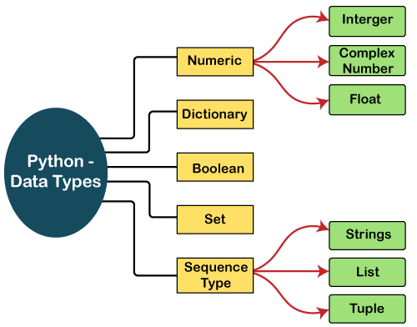
Standard data types

Slide 4
Python Data Type : Standard Data type
Numbers: Number stores numeric values. The integer, float, and complex values belong to a Python Numbers data-type.
Python supports three types of numeric data.
Int - Integer value can be any length such as integers 10, 2, 29, -20, -150 etc.
Float - Float is used to store floating-point numbers like 1.9, 9.902, 15.2, etc.
Complex - A complex number contains an ordered pair, i.e., x + iy where x and y denote the real and imaginary parts, respectively.

Slide 5
Python Data Type : Standard Data type
Sequence Type
String : The string can be defined as the sequence of characters represented in the quotation marks. In Python, we can use single, double, or triple quotes to define a string.
List: Python Lists are similar to arrays. However, the list can contain data of different types. The items stored in the list are separated with a comma (,) and enclosed within square brackets [].
Tuple: A tuple is similar to the list in many ways. The items of the tuple are separated with a comma (,) and enclosed in parentheses (). A tuple is a read-only data structure as we can't modify the size and value of the items of a tuple.

Slide 6
Python Data Type : Standard Data type
Dictionary
Dictionary is an unordered set of a key-value pair of items.
Key can hold any primitive data type, whereas value is an arbitrary Python object.
The items in the dictionary are separated with the comma (,) and enclosed in the curly braces {}.
Boolean
Boolean type provides two built-in values, True and False.
These values are used to determine the given statement true or false.
Set
Python Set is the unordered collection of the data type.
It is iterable, mutable(can modify after creation), and has unique elements.
The set is created by using a built-in function set(), or a sequence of elements is passed in the curly braces and separated by the comma.

Slide 7
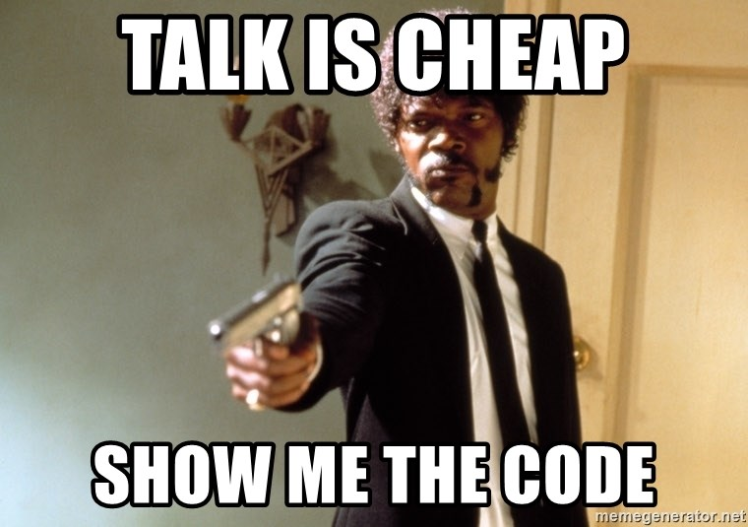
Python Data Type : Type Check
Python enables us to check the type of the variable used in the program.
Python provides us the type() function, which returns the type of the variable passed.

Slide 8
Python Keywords : Introduction
Python keywords are unique words reserved with defined meanings.
False | await | else | import | pass
None | break | except | in | raise
True | class | finally | is | return
and | continue | for | lambda | try
as | def | from | nonlocal | while
assert | del | global | not | with
async | elif | if | or | yield

Slide 9
Python TypeCasting

Slide 10


