Slide 1
Project Title: An efficient deep learning framework for the recognition of house numbers in street view imagery.
Group Information
Group 19
Section: 01
NAME | STUDENT ID | Department
Md. Yasin Arafat Tamim | 20301029 | CSE
Md.Tariqul Islam | 20301044 | CSE
Nabiha Tasnim Orchi | 20301148 | CSE
Mohammad Tajwar Chowdhury | 20301080 | CSE
Zohayer Bin Osman | 20301362 | CSE

Slide 2
Introduction
House number recognition in street view imagery is a critical task with wide-ranging applications in location-based services and urban infrastructure management. This research paper presents an efficient deep learning framework designed to address the challenges of accurately recognizing house numbers from street view images.
For this paper, we look into some models that are widely used, like- Convolutional Neural Networks (CNNs), Recurrent Neural Networks (RNNs), and Multi-layer Perceptrons (MLPs). To enhance efficiency, the paper introduces novel optimization techniques, such as model compression and quantization.

Slide 3
Research Objective
Develop a highly effective deep learning model
Address the challenge of recognizing digits
Create a system that can extract and interpret the numbers
Employing strategies to improve training efficiency

Slide 4
WHY WE CHOOSE THAT TOPIC
The idea for the research on "An Efficient Deep Learning Framework for the Recognition of House Numbers in Street View Imagery" was inspired by a real-life problem observed in the neighborhood. This recurring problem highlighted the need for an accurate and automated solution to recognize house numbers from street view images.
To tackle this issue, we chose to explore deep learning and create a specialized framework for accurately recognizing house numbers from street view images. The broader motivation behind this work was to improve location-based services and optimize the delivery process (like- mailing, parcel, letters etc.) for enhanced efficiency and customer satisfaction.

Slide 5
RESEARCH BACKGROUND
Possible models for our topic:
(i) Convolutional Neural Networks (CNNs)
(ii) Recurrent Neural Networks (RNNs)
(iii) Multi-layer Perceptrons (MLPs)
Possible Datasets
(i) SVHN (Street View House Numbers) Dataset: The SVHN dataset is one of the most widely used datasets for this task. It contains over 600,000 color images of house numbers collected from Google Street View. The dataset includes real-world challenges like varying image quality, occlusions, and multiple digits in a single image.
(ii) MNIST + House Numbers: Combining the MNIST dataset (a popular dataset for handwritten digit recognition) with house numbers datasets can create a hybrid dataset that covers a broader range of digit styles.

Slide 6
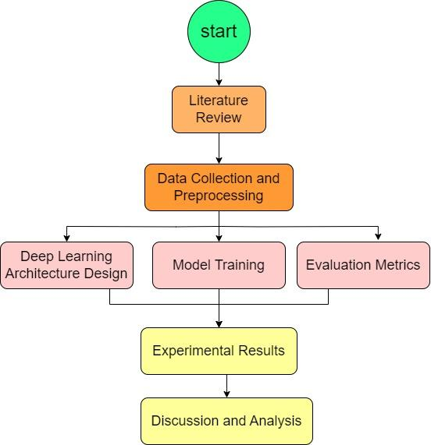
Future Work Plan
Conduct an in-depth review of relevant literature and research papers on image recognition, deep learning models, and applications related to house number recognition.
Preprocess the data: Resize, augment, and clean the dataset to ensure its suitability for training deep learning models.
Choose the appropriate deep learning architecture Implement the chosen architecture using a deep learning framework.
Train the deep learning model using the prepared dataset and the selected architecture.
Define evaluation metrics to assess the performance of the deep learning framework.
Discuss the strengths and weaknesses of our deep learning framework.

Slide 7
CONCLUSION
Our research presents a cutting-edge deep learning framework that addresses the crucial challenge of house number recognition in street view imagery. By leveraging a variety of widely-used models and innovative optimization techniques, our approach achieves remarkable efficiency without compromising accuracy. The incorporation of diverse datasets further enhances the framework's adaptability, showcasing its potential for diverse applications in location-based services and urban infrastructure management. This advancement holds significant promise in improving the accuracy, efficiency, and convenience of various services that rely on precise house number identification, benefiting communities on a global scale.

Slide 8
Thank you

