Slide 1
JAMHURIYA UNIVERSITY OF SCIENCE AND TECHNOLOGY (JUST)
Faculty of Computer & Information Technology
PRE-PANEL PRESENTATION
BAREAI
Automatic Classification of Crime-Related Text Reports Using NLP
BAREAI — Bare AI Crime Intelligence Platform
Yaasiin Mohamuud Abdullaahi | Naima Abdiaziz Said • Nasteha Mohamuud Mohamed | Najma Muhidiin Mohamed
August 2026

Slide 2
Asalka Mowduuca (Background)
BAREAI
Dembiyada maalin walba way dhacaan — warbixinnadu waxay ku yimaadaan qoraal.
NLP wuxuu kombiyuutarka u suurtageliyaa inuu fahmo luqadda dadka.
Machine Learning wuxuu bartaa qaabka qoraallada dembiga iyo kuwa aan dembiga ahayn.
Soomaaliya: qoraallo isku dhafan (Soomaali + Ingiriisi) — gacanta ma dabooli karto.
Hadaf: Nidaam casri ah oo ka caawiya hay'adaha amniga kala saarid degdeg ah.
2

Slide 3
Dhibaatada (Problem Statement)
BAREAI
Kala saarid GACANTA ah → gaabis, khaladaad, qaalin.
Tusaale: 500 qoraal/maalin × 2 daq = 16+ saacadood kala saarid.
Nidaamyo jira: Ingiriisi kaliya, keyword filter, ma jiro workflow.
GAP: Ma jiro platform Soomaali + ML + monitoring + cases.
Su'aasha cilmi-baarista: Sidee loo dhiso nidaam NLP ah oo ku habboon Soomaaliya?
3

Slide 4
Ujeeddooyinka (Objectives)
BAREAI
Ujeeddo Guud
Ujeeddooyin Gaar ah
In la dhiso framework otomaatig ah oo ML + NLP ku kala saara warbixinnada dembiga.
Yareynta ku tiirsanaanta gacanta
Uruurinta & diyaarinta xogta
Soo saarista features sax ah
Dhisidda nidaam NLP otomaatig ah
4

Slide 5
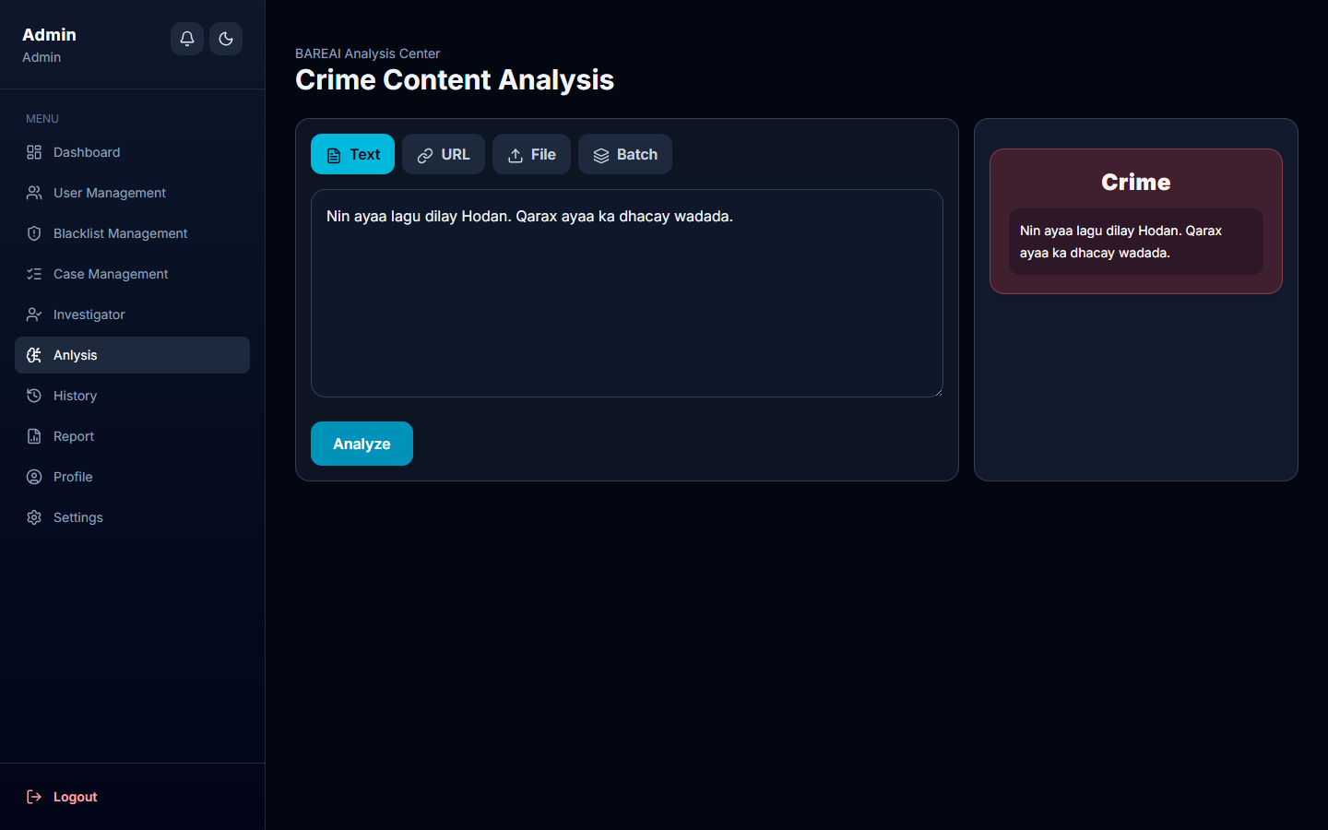
Xalka: BAREAI
BAREAI
Platform web ah oo dhammaystiran — ma aha kaliya model.
Kala saarid: Crime vs Not-crime + confidence score.
Input: Text • URL • File (PDF/DOCX) • Batch.
Hybrid: ML + ereyo Soomaali + goobo + blacklist.
Facebook monitoring + Cases + Notifications + Reports.
5

Slide 6
Qaab-dhismeedka Nidaamka (Architecture)
BAREAI
PRESENTATION LAYER
React 19 + Vite | Port 5173 Dashboard • Analysis • Cases • Reports
APPLICATION LAYER
Node.js + Express 5 | Port 5000 Auth • API • Facebook Monitor • Blacklist
AI SERVICE
Python Flask | Port 5001 crime_model.pkl • vectorizer.pkl
DATA LAYER
MongoDB — crime_detection_system Users • Analyses • Cases • Notifications
JWT + bcrypt + RBAC | REST API | 3-tier + AI microservice
6

Slide 7
Habka Cilmi-baarista (Methodology)
BAREAI
Dataset: dataset.csv.csv — crime / not crime labels.
Preprocessing: nadiifin → TF-IDF → train/test 80/20.
Models: SVM • Random Forest • BERT (isbarbardhig).
Metrics: Accuracy, Precision, Recall, F1, AUC-ROC.
Kan ugu fiican → Flask /predict endpoint.
7

Slide 8
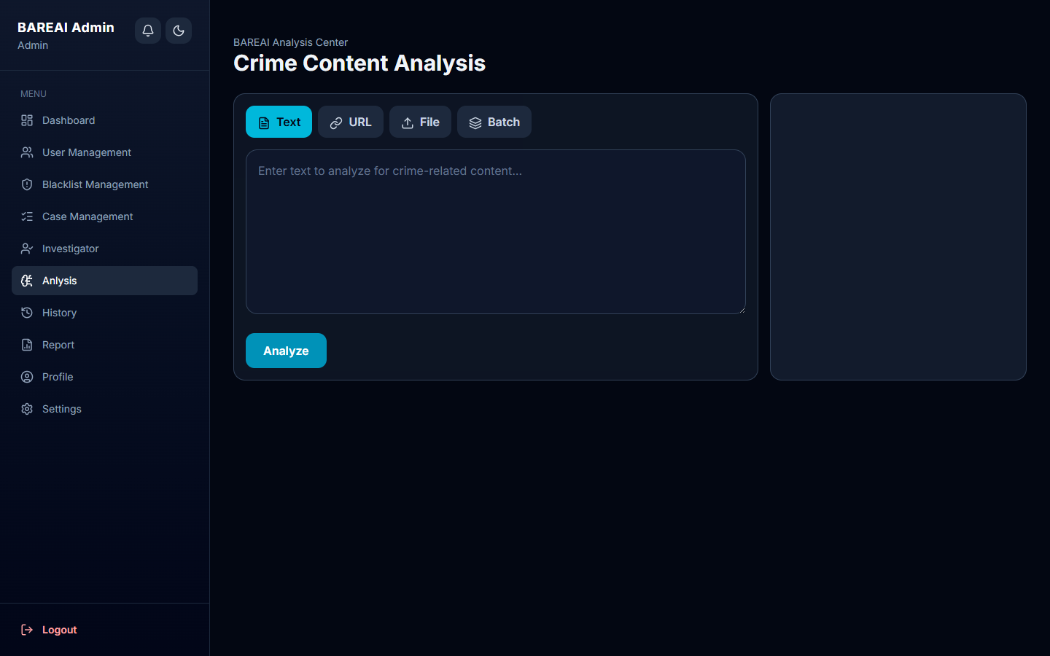
Astaamaha Muhiimka ah (Key Features)
BAREAI
Analysis Center — 4 nooc oo input ah.
Dashboard — KPIs, trends, top keywords.
Blacklist — pages, persons, keywords, websites.
Notifications — digniino degdeg ah.
Case Management — investigator + verdict.
PDF Reports — weekly, monthly, individual.
8

Slide 9
Natiijooyinka & Tijaabada
BAREAI
Model & Performance
Testing
SVM, RF, BERT — isbarbardhig
Jawaabta AI: < 3 ilbiriqsi
End-to-end: < 30 ilbiriqsi
Keyword fallback haddii AI dhaco
20 test cases — dhammaan PASS ✓
Integration: Frontend→Backend→AI
Security: JWT, bcrypt, RBAC
Ka dhakhso badan kala saarid gacanta
9

Slide 10
Gabagabo & Mustaqbal (Conclusion)
BAREAI
BAREAI wuxuu xallinayaa kala saarid gacanta iyadoo la adeegsanayo NLP + ML.
Decision-support tool — bini'aadamku go'aanka ugu dambeeya wuu qaataa.
Mustaqbal: Multi-class crime types, dataset Soomaali ballaaran.
Afri-BERTa fine-tuning, mobile app, Netlify deploy.
10

Slide 11
Mahadsanid!
Su'aalo?
BAREAI — Bare AI Crime Intelligence Platform

