Slide 1
Software Project Lab-01
Project Name: Finding the Solution of Linear Equation System
Presented by:
Mohammed Yasin
Roll: 1406
Supervised by:
Professor Dr. Md. Shariful Islam

Slide 2
Project Details and Motivation:
The project will take a linear system as an augmented matrix. Then it will solve the system in the following three methods:
Ordinary Least Square Method
Kaczmarz Method
Co-ordinate Descent Method

Slide 3
Project Details and Motivation:
The project will take a linear system as an augmented matrix. Then it will solve the system in the following three methods:
Ordinary Least Square Method
Kaczmarz Method
Co-ordinate Descent Method
The motive of the project is to solve the system of linear equations using the above mentioned methods and compare the solutions between the methods.

Slide 4
Overview
Tasks that I have already completed of my project:
Taking matrix as an input
Calculating addition and multiplication of two matrices
Calculating transpose of a matrix
Calculating Euclidean Norm of a matrix
Calculating dot product of two vectors
Finding the eigenvalues of a matrix using Jacobian method
Finding the eigenvectors of a square matrix using Jacobian method
Finding the SVD of square matrix
Solving a normal linear equation system using Kaczmarz method

Slide 5
Addition of two matrices
Two matrices can be added if there dimensions are same
The elements with same index are to be added

Slide 6
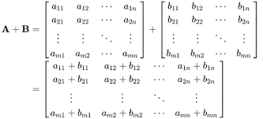
Addition of two matrices
Two matrices can be added if there dimensions are same
The elements with same index are to be added

Slide 7
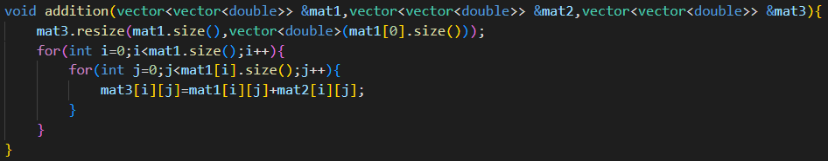
Addition of two matrices
Two matrices can be added if there dimensions are same
The elements with same index are to be added
Code for matrix addition:

Slide 8
Multiplication of two matrices
Two matrices can be multiplied if the number of columns of the first matrix and the number of rows of the second matrix are same
The dimension of the result matrix will be (number of rows of the first matrix) x (number of columns of the second matrix)

Slide 9
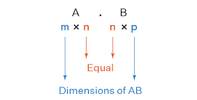
Multiplication of two matrices
Two matrices can be multiplied if the number of columns of the first matrix and the number of rows of the second matrix are same
The dimension of the result matrix will be (number of rows of the first matrix) x (number of columns of the second matrix)

Slide 10
Multiplication of two matrices
Two matrices can be multiplied if the number of columns of the first matrix and the number of rows of the second matrix are same
The dimension of the result matrix will be (number of rows of the first matrix) x (number of columns of the second matrix)
Each element of the result matrix will be the dot product of each rows and each columns

Slide 11
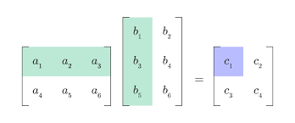
Multiplication of two matrices
Two matrices can be multiplied if the number of columns of the first matrix and the number of rows of the second matrix are same
The dimension of the result matrix will be (number of rows of the first matrix) x (number of columns of the second matrix)
Each element of the result matrix will be the dot product of each rows and each columns

Slide 12
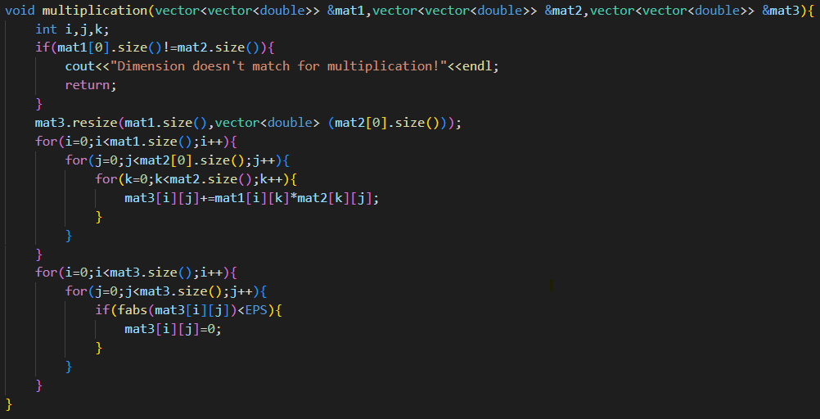
Code for matrix multiplication:

Slide 13
Transpose of a matrix
Transpose of a matrix turns the rows of the matrix into its columns and the columns of a matrix into its rows

Slide 14
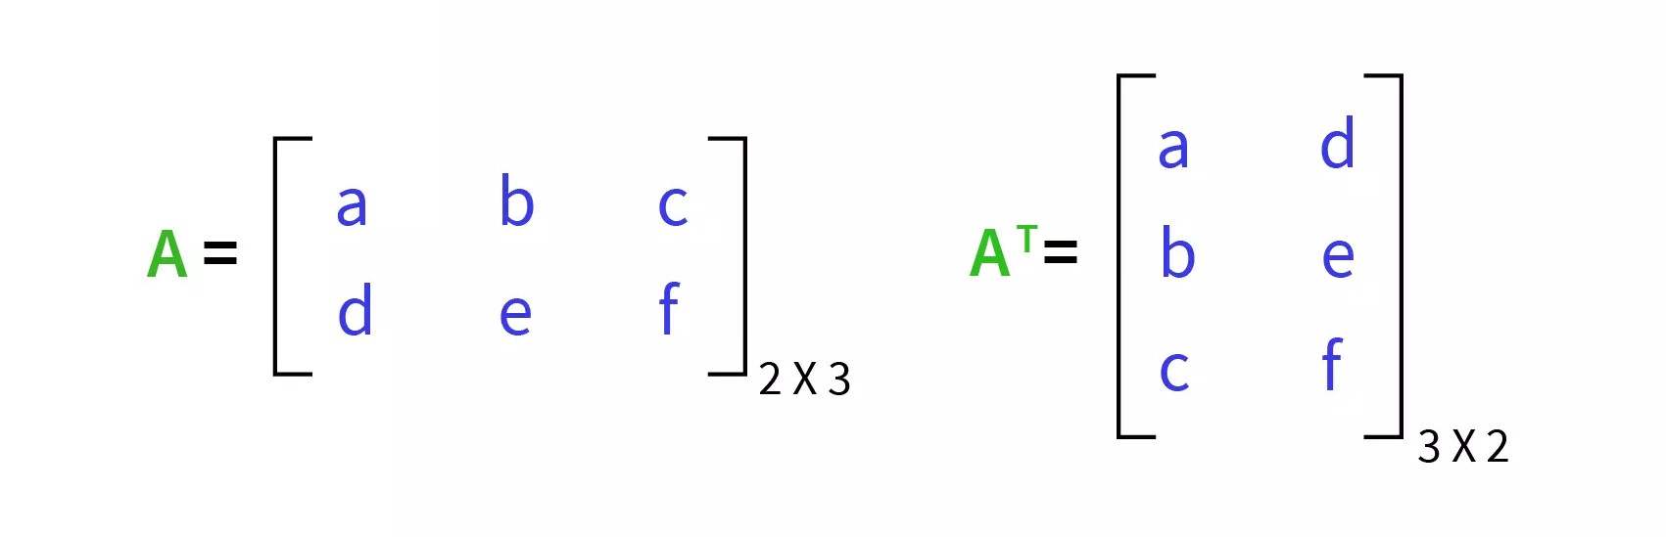
Transpose of a matrix
Transpose of a matrix turns the rows of the matrix into its columns and the columns of a matrix into its rows

Slide 15
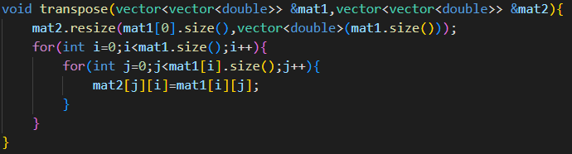
Transpose of a matrix
Transpose of a matrix turns the rows of the matrix into its columns and the columns of a matrix into its rows
Code for transpose of a matrix:

Slide 16
Matrix Norm
One of the matrix norms is Euclidean Norm
Euclidean Norm is the square root of the sum of square of every elements of a vector (a row or a column matrix)

Slide 17
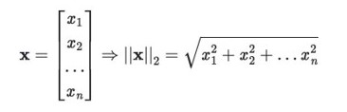
Matrix Norm
One of the matrix norms is Euclidean Norm
Euclidean Norm is the square root of the sum of square of every elements of a vector (a row or a column matrix)

Slide 18
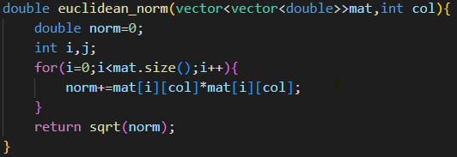
Matrix Norm
One of the matrix norms is Euclidean Norm
Euclidean Norm is the square root of the sum of square of every elements of a vector (a row or a column matrix)
Code for Euclidean Norm:

Slide 19
Dot product of matrix
Vectors are row or column matrices
Dot product of two vectors is the sum of the product of the elements of two vectors with same index

Slide 20
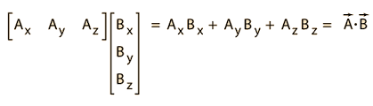
Dot product of matrix
Vectors are row or column matrices
Dot product of two vectors is the sum of the product of the elements of two vectors with same index

Slide 21
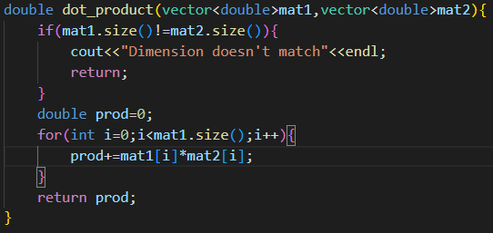
Dot product of matrix
Vectors are row or column matrices
Dot product of two vectors is the sum of the product of the elements of two vectors with same index
Code for dot product:

Slide 22
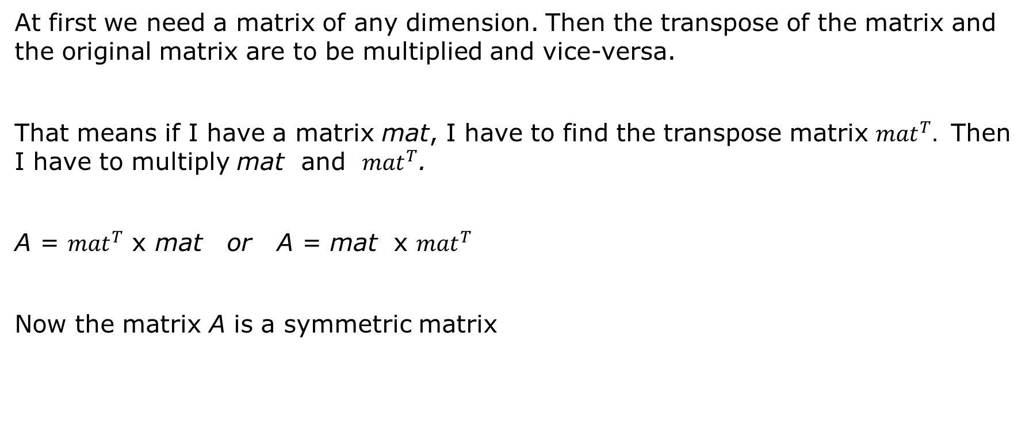
Finding the Eigenvalues
At first we need a matrix of any dimension. Then the transpose of the matrix and the original matrix are to be multiplied and vice-versa.
That means if I have a matrix mat, I have to find the transpose matrix ${mat}^{T}.$ Then I have to multiply mat and ${mat}^{T}$.
A = ${mat}^{T}$ x mat or A = mat x ${mat}^{T}$
Now the matrix A is a symmetric matrix

Slide 23
Finding the Eigenvalues (continued)
Algorithm to find the eigenvalues and eigenvectors of the matrix A matrix using the Jacobian method:
Initialize an identity matrix P of size n x n.
Find the index (p, q) of the maximum off diagonal value in the matrix A.

Slide 24

Finding the Eigenvalues (continued)
Algorithm to find the eigenvalues and eigenvectors of the matrix A matrix using the Jacobian method:
Initialize an identity matrix P of size n x n.
Find the index (p, q) of the maximum off diagonal value in the matrix A.
θ = $\frac{1}{2}$ $\tan^{−1}\left(\frac{2 A\left[p\right]\left[q\right]}{A\left[p\right]\left[p\right]−A\left[q\right]\left[q\right]}\right).$

Slide 25
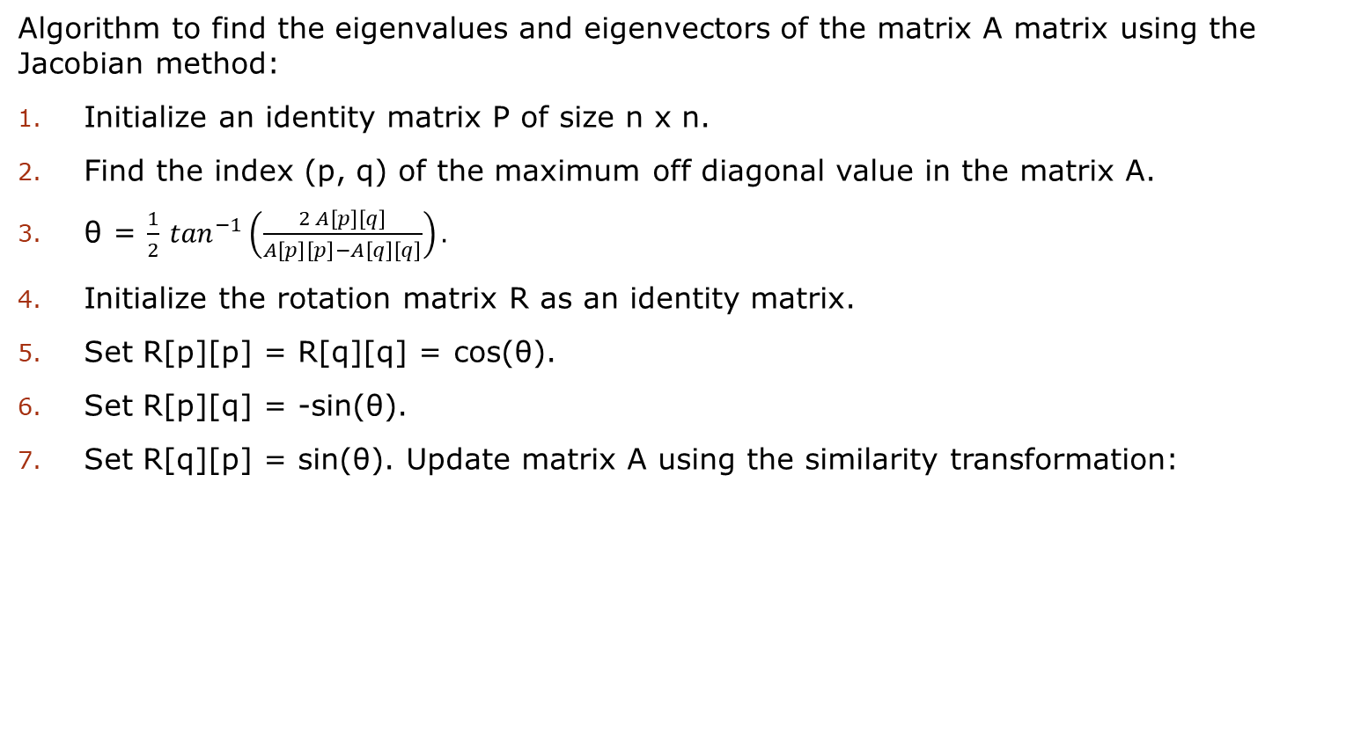
Finding the Eigenvalues (continued)
Algorithm to find the eigenvalues and eigenvectors of the matrix A matrix using the Jacobian method:
Initialize an identity matrix P of size n x n.
Find the index (p, q) of the maximum off diagonal value in the matrix A.
θ = $\frac{1}{2}$ $\tan^{−1}\left(\frac{2 A\left[p\right]\left[q\right]}{A\left[p\right]\left[p\right]−A\left[q\right]\left[q\right]}\right).$
Initialize the rotation matrix R as an identity matrix.
Set R[p][p] = R[q][q] = cos(θ).
Set R[p][q] = -sin(θ).
Set R[q][p] = sin(θ). Update matrix A using the similarity transformation:

Slide 26
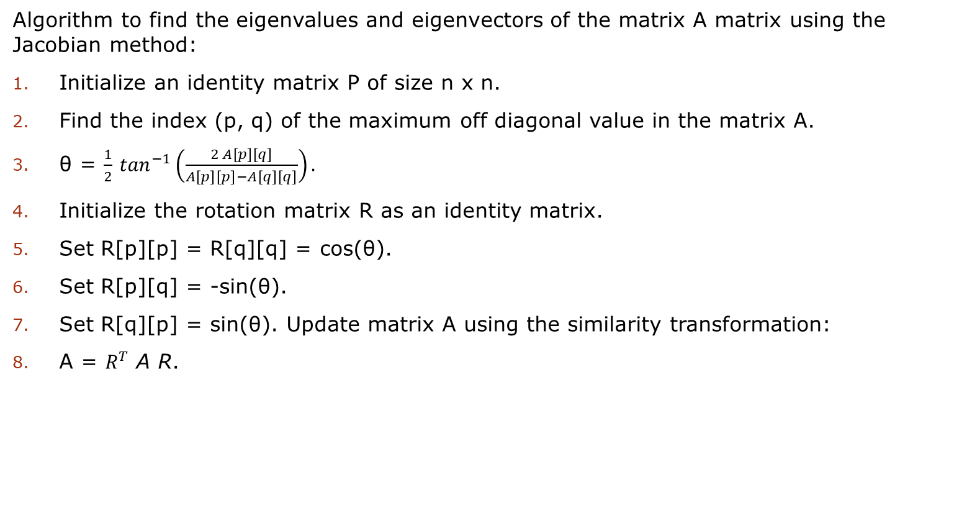
Finding the Eigenvalues
Finding the Eigenvalues (continued)
Algorithm to find the eigenvalues and eigenvectors of the matrix A matrix using the Jacobian method:
Initialize an identity matrix P of size n x n.
Find the index (p, q) of the maximum off diagonal value in the matrix A.
θ = $\frac{1}{2}$ $\tan^{−1}\left(\frac{2 A\left[p\right]\left[q\right]}{A\left[p\right]\left[p\right]−A\left[q\right]\left[q\right]}\right).$
Initialize the rotation matrix R as an identity matrix.
Set R[p][p] = R[q][q] = cos(θ).
Set R[p][q] = -sin(θ).
Set R[q][p] = sin(θ). Update matrix A using the similarity transformation:
A = $R^{T}$ A R.

Slide 27
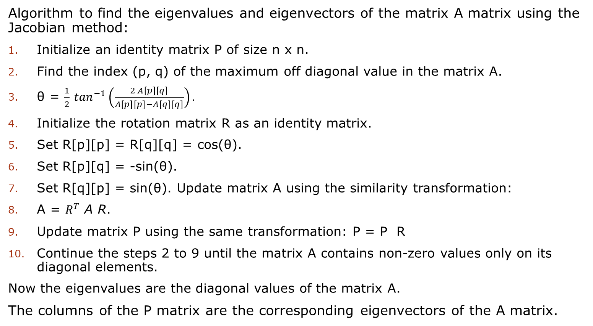
Finding the Eigenvalues
Finding the Eigenvalues (continued)
Algorithm to find the eigenvalues and eigenvectors of the matrix A matrix using the Jacobian method:
Initialize an identity matrix P of size n x n.
Find the index (p, q) of the maximum off diagonal value in the matrix A.
θ = $\frac{1}{2}$ $\tan^{−1}\left(\frac{2 A\left[p\right]\left[q\right]}{A\left[p\right]\left[p\right]−A\left[q\right]\left[q\right]}\right).$
Initialize the rotation matrix R as an identity matrix.
Set R[p][p] = R[q][q] = cos(θ).
Set R[p][q] = -sin(θ).
Set R[q][p] = sin(θ). Update matrix A using the similarity transformation:
A = $R^{T}$ A R.
Update matrix P using the same transformation: P = P R
Continue the steps 2 to 9 until the matrix A contains non-zero values only on its diagonal elements.
Now the eigenvalues are the diagonal values of the matrix A.
The columns of the P matrix are the corresponding eigenvectors of the A matrix.

Slide 28
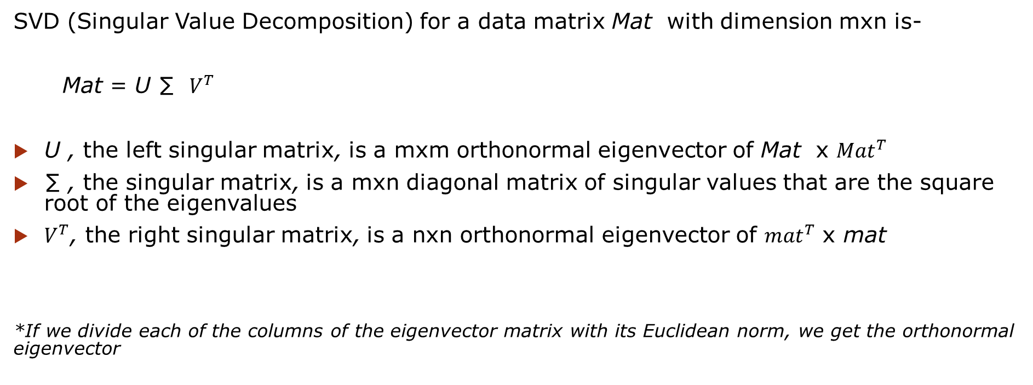
SVD
SVD (Singular Value Decomposition) for a data matrix Mat with dimension mxn is-
Mat = U ∑ $V^{T}$
U , the left singular matrix, is a mxm orthonormal eigenvector of Mat x ${Mat}^{T}$
∑ , the singular matrix, is a mxn diagonal matrix of singular values that are the square root of the eigenvalues
$V^{T}$, the right singular matrix, is a nxn orthonormal eigenvector of ${mat}^{T}$ x mat
*If we divide each of the columns of the eigenvector matrix with its Euclidean norm, we get the orthonormal eigenvector

Slide 29

SVD (continued)
U = [ $U_{1}$ $U_{2} U_{3}$……. $U_{m} ]$

Slide 30

SVD (continued)
U = [ $U_{1}$ $U_{2} U_{3}$……. $U_{m} ]$
∑ = $\begin{matrix}λ_{1} & 0 & 0 \\ 0 & λ_{2} & 0 \\ 0 & 0 & λ_{n}\end{matrix}$

Slide 31

SVD (continued)
U = [ $U_{1}$ $U_{2} U_{3}$……. $U_{m} ]$
∑ = $\begin{matrix}λ_{1} & 0 & 0 \\ 0 & λ_{2} & 0 \\ 0 & 0 & λ_{n}\end{matrix}$
$V^{T}$ = ${\text{[ }V_{1} V_{2} V_{3} \text{……. }V_{n} ] }^{T}$
*Each of the $U_{i}$ and $V_{i}$ are column of the matrix

Slide 32
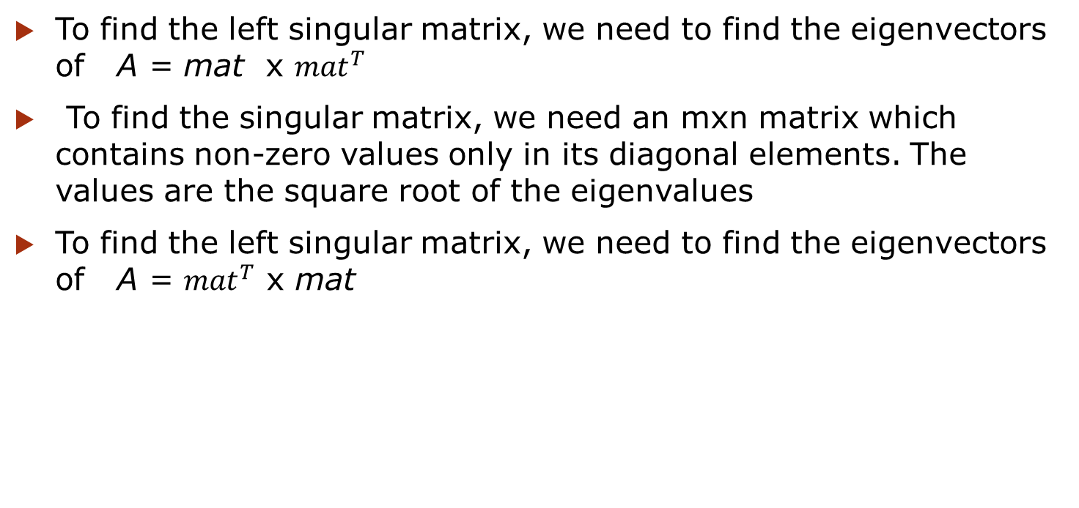
Finding SVD
To find the left singular matrix, we need to find the eigenvectors of A = mat x ${mat}^{T}$
To find the singular matrix, we need an mxn matrix which contains non-zero values only in its diagonal elements. The values are the square root of the eigenvalues
To find the left singular matrix, we need to find the eigenvectors of A = ${mat}^{T}$ x mat

Slide 33
Kaczmarz Method
Kaczmarz method is an iterative method to solve linear equation systems.

Slide 34
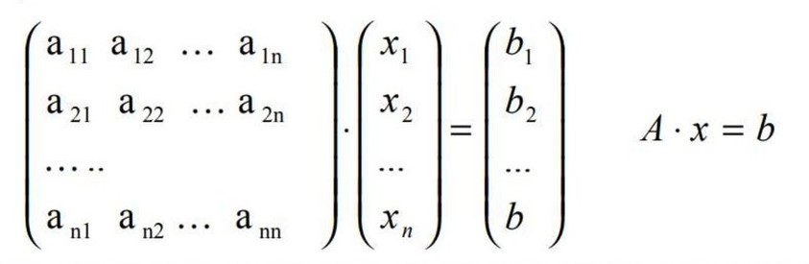
Kaczmarz Method
Kaczmarz method is an iterative method to solve linear equation systems.

Slide 35
Kaczmarz Method
Kaczmarz method is an iterative method to solve linear equation systems.
Initially a solution is guessed. Then in each iteration, using the solution in the last iteration, we head closer to the accurate solution.

Slide 36
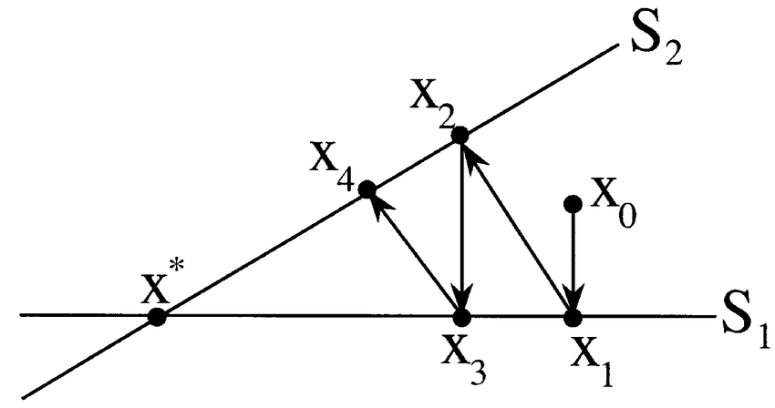
Kaczmarz Method
Kaczmarz method is an iterative method to solve linear equation systems.
Initially a solution is guessed. Then in each iteration, using the solution in the last iteration, we head closer to the accurate solution.

Slide 37

Solution using Kaczmarz Method
For a linear equation system Ax=b the Kaczmarz methos follows:
The initial guess of the solution is $x^{0}$

Slide 38

Solution using Kaczmarz Method
For a linear equation system Ax=b the Kaczmarz methos follows:
The initial guess of the solution is $x^{0}$
After ${(k+1)}^{th}$iteration, the solution is –
$x^{k+1}$ = $x^{k}+ \frac{b_{i} − <a_{i} , x^{k}>}{{||a_{i}||}^{2}}$ $\overline{a_{i}}$

Slide 39
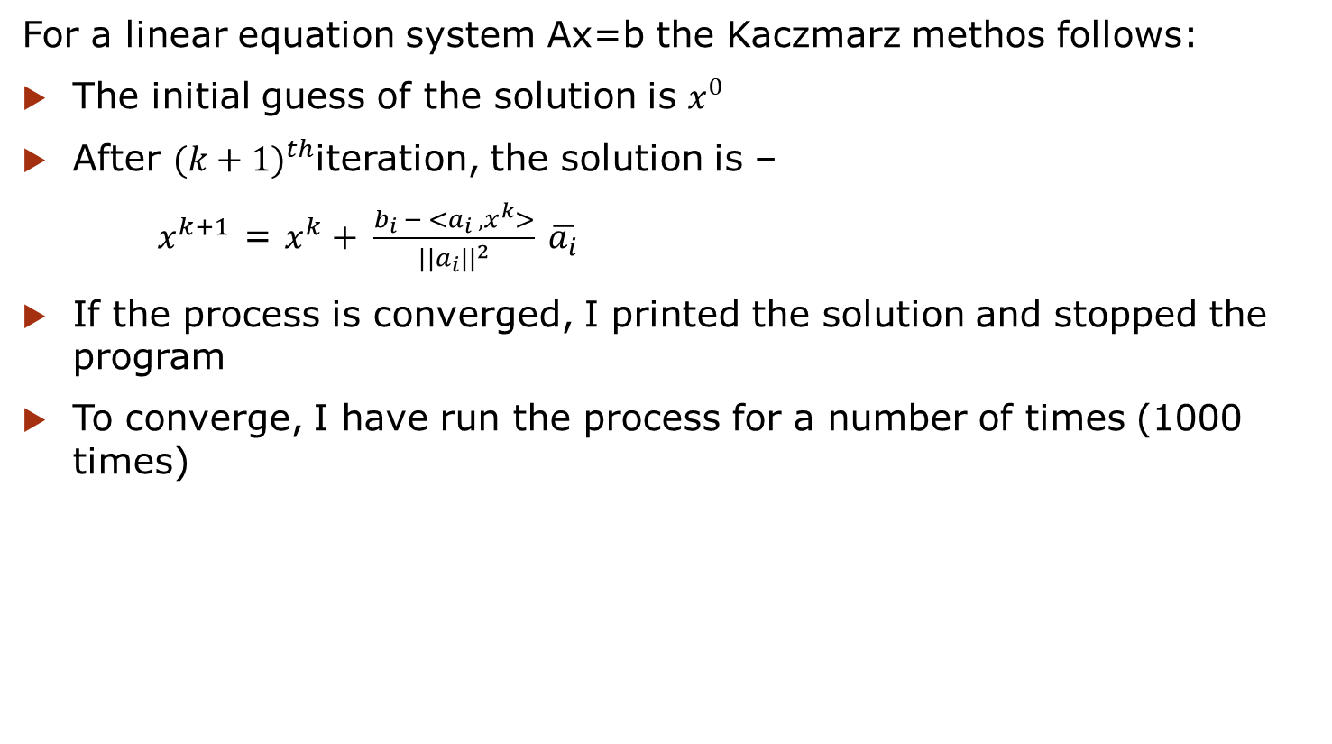
Solution using Kaczmarz Method
For a linear equation system Ax=b the Kaczmarz methos follows:
The initial guess of the solution is $x^{0}$
After ${(k+1)}^{th}$iteration, the solution is –
$x^{k+1}$ = $x^{k}+ \frac{b_{i} − <a_{i} , x^{k}>}{{||a_{i}||}^{2}}$ $\overline{a_{i}}$
If the process is converged, I printed the solution and stopped the program
To converge, I have run the process for a number of times (1000 times)

Slide 40
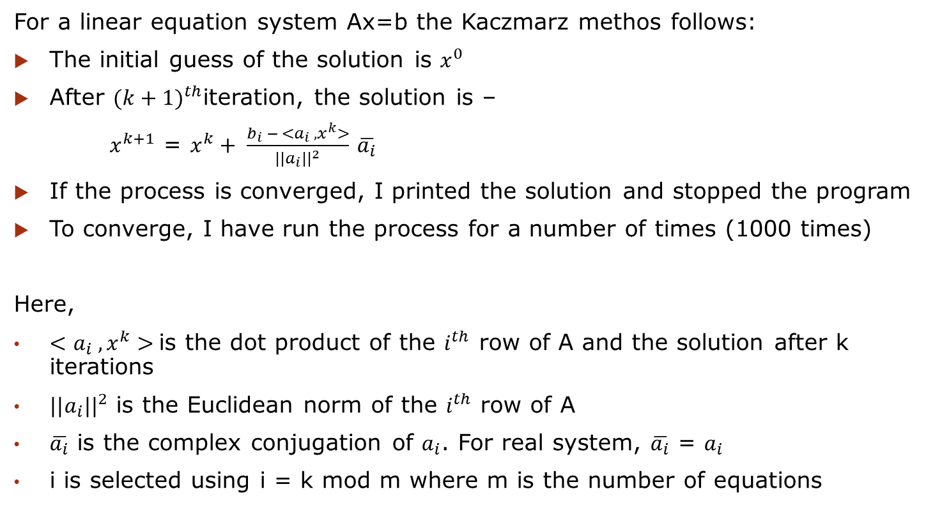
Solution using Kaczmarz Method
For a linear equation system Ax=b the Kaczmarz methos follows:
The initial guess of the solution is $x^{0}$
After ${(k+1)}^{th}$iteration, the solution is –
$x^{k+1}$ = $x^{k}+ \frac{b_{i} − <a_{i} , x^{k}>}{{||a_{i}||}^{2}}$ $\overline{a_{i}}$
If the process is converged, I printed the solution and stopped the program
To converge, I have run the process for a number of times (1000 times)
Here,
$<a_{i} , x^{k}>$is the dot product of the $i^{th}$ row of A and the solution after k iterations
${||a_{i}||}^{2}$ is the Euclidean norm of the $i^{th}$ row of A
$\overline{a_{i}}$ is the complex conjugation of $a_{i}$. For real system, $\overline{a_{i}}$ = $a_{i}$
i is selected using i = k mod m where m is the number of equations

Slide 41
Overview (again)
Tasks that will be done in the next step-
Finding SVD for every type of matrix
Using SVD, finding the pseudo inverse of a matrix
Using pseudo inverse of a matrix, solving the linear equation systems in Ordinary Least Square method
Solving any linear equation system using Kaczmarz method
Solving linear equation systems using Co-ordinate Descent method

Slide 42
Challenges Faced
Handling 2D vector
Converting mathematical notations into code
Finding eigenvalues and eigenvectors
Defining the dimensions of the matrices in the process of finding SVD
Handling a large code sequentially

Slide 43
Thank You

