Slide 1
PROJECT NAME
“Pet Application”
Mr.Yasin Tamboli.
Mr.Shubham Pasale.
Mr.Rushikesh Salunkhe.
Ms.Krutika Jagatap.
Ms.Vaishali Jadhav.
Ms.Snehal Shendage.
Ms.Rupali Yadav.

Slide 2

Project Introduction .
Problem Statement.
Objective.
Software and hardware requirement.

Slide 3
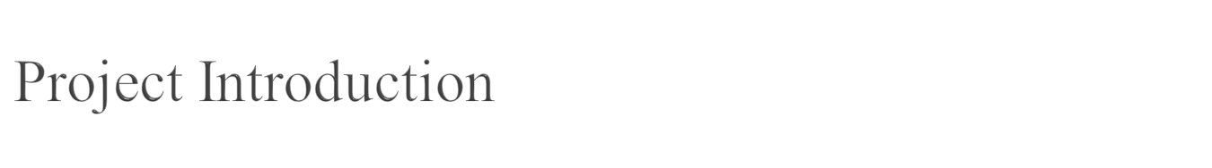
In this project we are going to create application. It is a platform independent application, so this application can access anywhere in the system.

Slide 4
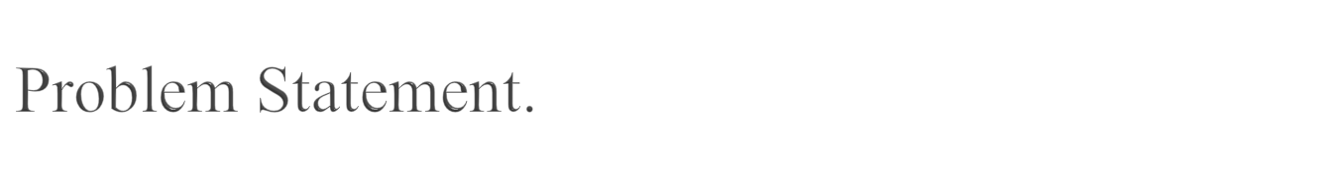
Design a application that would easily connect people looking for a new pet with the right companion for them.

Slide 5
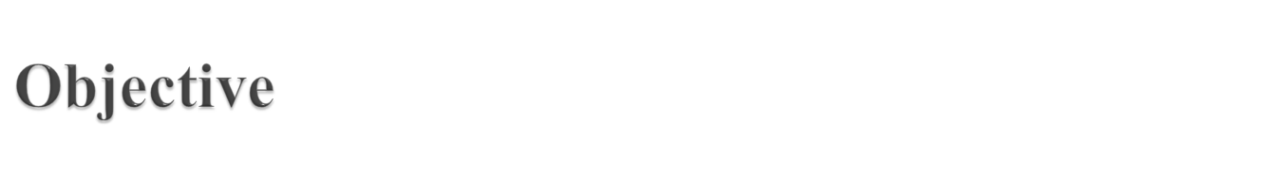
To provide a quick response with accurate information as and whenever required.

Slide 6
Start
Flowchart
Register
no
con
yes
Login
no
con
yes
Display pet’s
no
yes
con
Operation perform
Stop
yes
con

Slide 7
Data Flow Diagram
Database
Pet application
Insert data
data information
User
View the data

Slide 8
Class Diagram-
User
Register
Login
username :String
Password : String
Email : String
Mobile : String
Username : String
Password :String
Create()
Login()
pet
Petid: int
Petname:String
Pet food :String
Pet price : double
Insert data()
Update data()
Get data()
Delete data()

Slide 9
Sequence Diagram
user
System
Request for login
CheckUser name & password
Checked
Successfully login
Get response
Insert/Upload data
Insert /updated successfully
View data
Managed
Successfully manage the data
Request for logout
Successfully logout
Fig. sequence diagram for user

Slide 10

Register
login
Dao
user
Daoimpl
pet
cfg
client

Slide 11
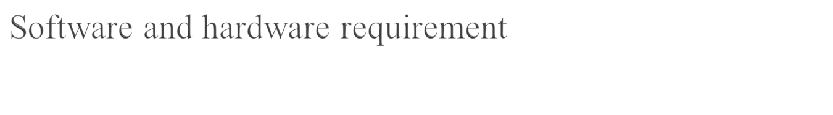
Hardware requirement:
Processor – compatible
Memory – 2GB
Software requirement:
Operating System – Windows
Language - Java runtime version-1.8.0
Platform –java EE IDE.

Slide 12
Debug-
What is Debugging ?
Why Debugging ?
How ?

Slide 13
THANK YOU.

