Slide 1

Anime Recommendation App “Discover your next favorite anime!”
By: Yasin Kone and Chidi Dike

Slide 2


Application Scenario and Problem Statement
"Overwhelmed by too many options? This app filters anime by genre, popularity, and more!”
With 10,000+ anime titles available across 50+ genres, viewers like me face:
Choice Paralysis: Spending more time browsing than watching.
Mismatched Recommendations: Generic suggestions ("Because you watched Naruto...") that ignore significant preferences.
Hidden Gems: High-quality anime get buried under popular titles.
Why It Matters: 73% of anime fans abandon platforms due to poor recommendations (2023 Anime Industry Report).
Purpose: Helps users to find anime tailored to their taste.

Slide 3
The Prototype
Film Recommendation app
Main, survey, logic, and mapping
TMDB
HBox
Cluttered
Complex mapping
Logic algorithm
We were going to use 1s and 0s for the logic
It was sometimes confusing figuring out which fields to use from the API response for example, knowing where to find the genre names or popularity scores in the JSON data
Since API data can change or break unexpectedly, I realized I’d need error handling and backup logic in case the API call failed or returned incomplete data.

Slide 4
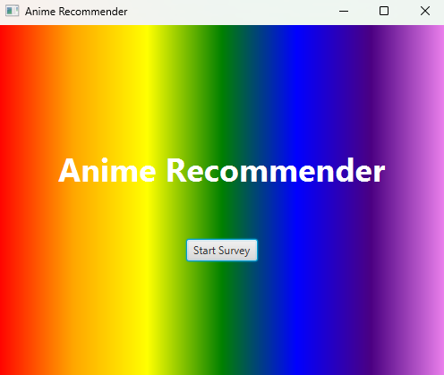
Features Overview
Genre-based filtering
Movie vs. TV show toggle
Popular and Highly Rated picks
Multi-genre recommendations (e.g., Action + Fantasy)
Minimalist design for quick decisions

Slide 5
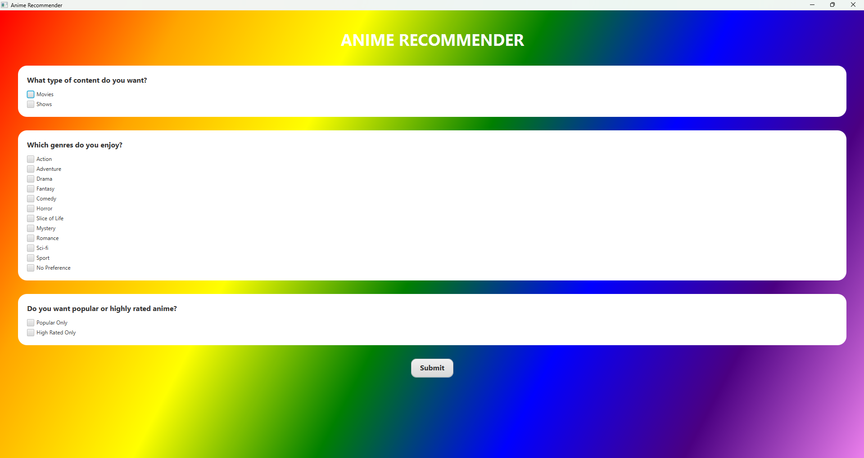
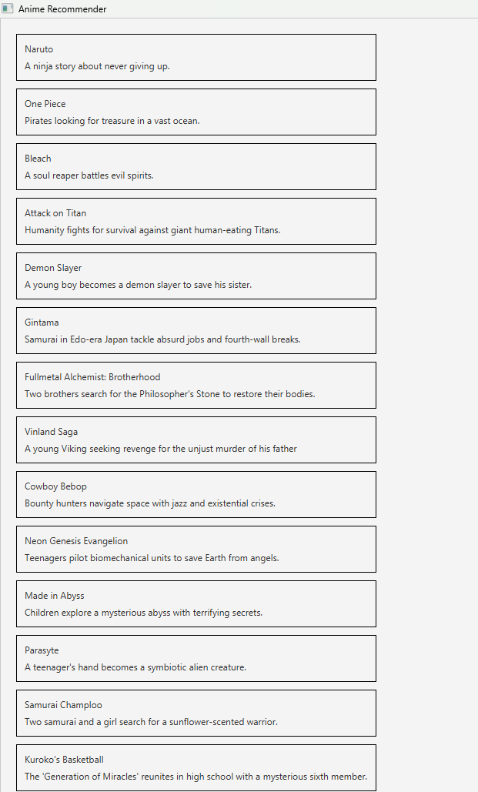
How It Works
Genre-Based Recommendations
Choose from 12+ genres like Action, Fantasy, Romance, or Sports
Mix and match to find niche combos (e.g., Horror-Comedy or Sci-Fi Mystery)
Example: Select "Fantasy + Adventure" → Get Hunter x Hunter or Made in Abyss
Tailored to Your Preferences
Filter by movies (like Your Name) or TV shows (like Attack on Titan)
Toggle between:
Popular picks (Fan favorites)
Highly-rated (Critically acclaimed)
One-Click Results
Hit "Submit" to get a curated list instantly
No overwhelming choices—just the best matches for your taste

Slide 6

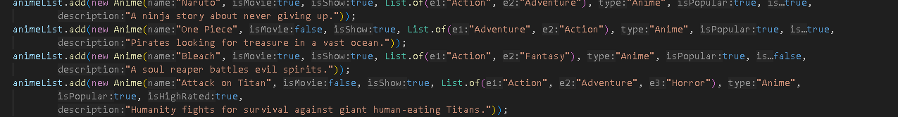
Challenge Driven Implementations
We used Vbox to avoid overlapping
We hardcoded all the shows in an array list
CheckBox = true
We were going to use 1s and 0s
Multiple methods because we tripped up with classes

Slide 7
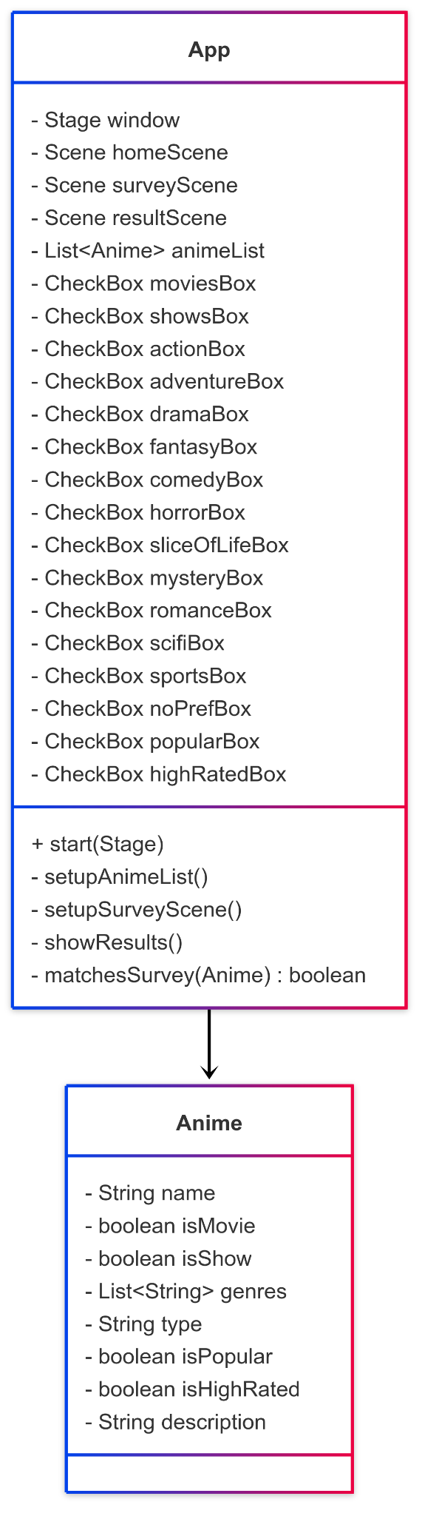
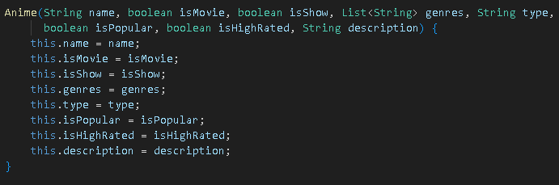
How It Works From Start To Finish
The application initializes the data of the films and starts by loading the main page
The main page has a title and has a button called start survey for you to press
The action assigned to that button is to set the scene to the survey which changes the page
Then you take a survey and depending on the survey You get recommended a variety of shows and/or movies
On the page with the show recommendations there is another button to take you back to the main page

Slide 8
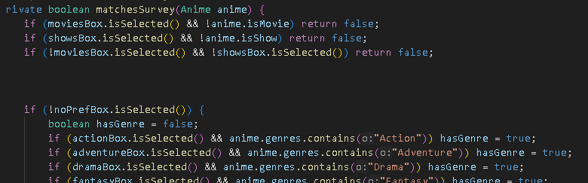
The Logic
Every show has its own values
When you check a box you set it to true
It shows animes that have some of the items you selected if not all
What disqualifies one from being shown is if you haven't checked out any of the boxes it fills because those values will be set to negative

Slide 9


What We Learned
And
Challenges
Managing workflow is very important
how to use APIs
Design a gui to our liking
Scene management
Problem solving
Getting specific results from the API
Bugs
Small screw ups
https://youtu.be/GmNqddF4fB0

