Slide 1
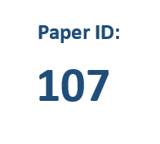

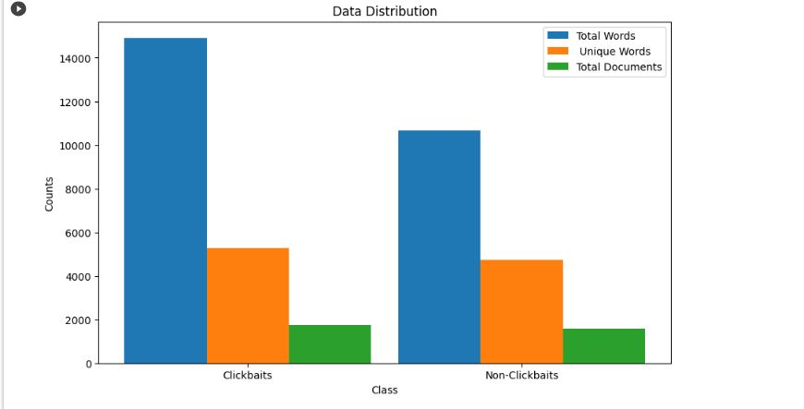
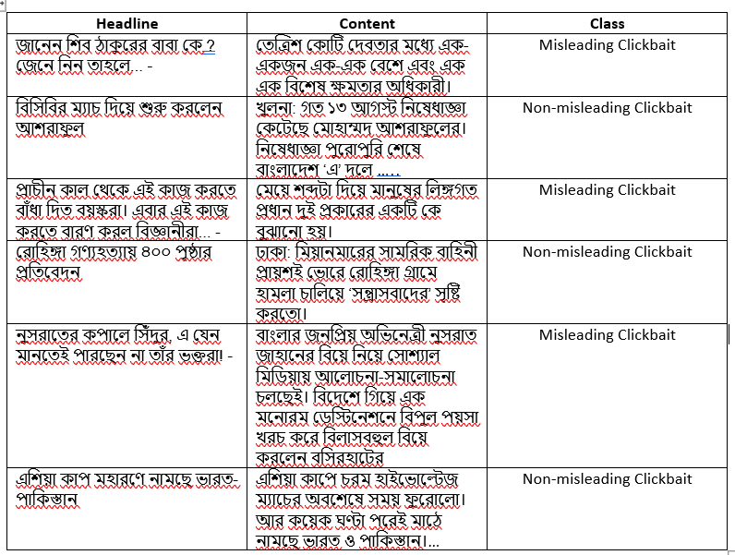
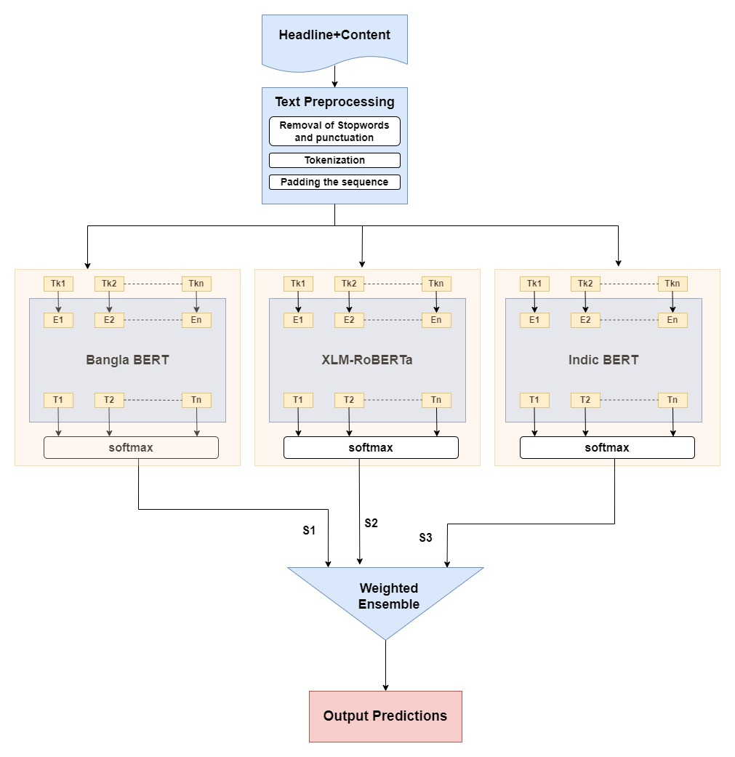
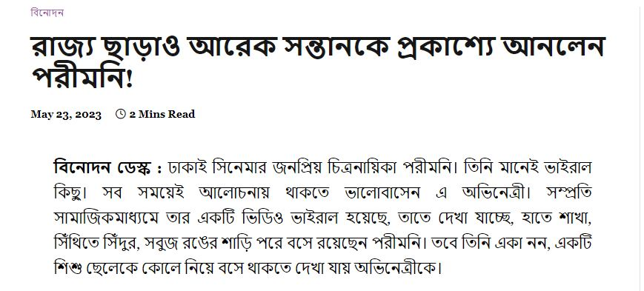
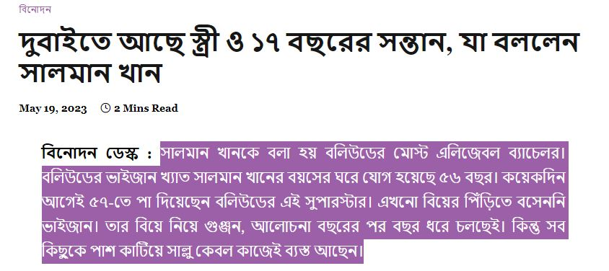
Bangla Misleading Clickbait Detection Using Ensemble Learning Approach
Yasin Arfat, Sharmistha Chanda Tista
Department of Computer Science & Engineering
Chittagong University of Engineering and Technology, Chattogram-4349, Bangladesh
Email-u1704109@student.cuet.ac.bd, tista_chanda@cuet.ac.bd
RESEARCH HIGHLIGHTS
DATA & METHODS
Model
Precision
Recall
F1 Score
Accuracy
Developed a specialized dataset for Bangla misleading clickbait detection
Compared the effectiveness of different machine learning, Deep learning, and transformer models
Highlight the process of ensembling transformer models to improve misleading clickbait detection accuracy
Conducted comprehensive performance evaluation of the developed models, including accuracy, precision, recall, and F1-score metrics
Data: Developed a corpus with 3350 data among them 1750 are misleading clickbait and 1600 are non-misleading clickbait.
Methodology: Our proposed model is average weighted ensemble of XLM-RoBERTa, Indi BERT and Bangla BERT.
Naïve Bayes
91.65%
89.82%
90.73%
91.74%
LSTM
98.25%
98.74%
98.50%
92.98%
Bangla-BERT
94.46%
94.46%
94.46%
95.52%
Table II: Best Performing Models
Model
Precision
Recall
F1 Score
Accuracy
Indic Bert[3]
89.72%
94.63%
Random Forest[1]
93.74%
86.73%
93.50%
Figure 2:Histogram of dataset
Figure 3: Sample Dataset
84.85%
85.78%
87.06%
RESEARCH OBJECTIVES
Proposed Model
94.83%
95.16%
94.99%
96%
Table III: Comparison of Proposed and Existing Models
Developing a detection system to create a misleading clickbait-free environment for a healthy online experience
Assemble a varied collection of Bangla news headlines from a variety of sources with annotations indicating whether or not each headline is misleading
Misleading Clickbait detection tech raises moral issues due to potential biases and for that policies must ensure fair findings
Using ensemble learning among best-performing models
CONCLUSIONS
Addressing the growing importance of detecting misleading clickbait in Bangla news headlines, we utilized ensemble learning techniques to develop a model aimed at improving information integrity
A transformer-based framework is implemented to detect misleading clickbait from a news headline
A dataset with misleading clickbait and non-misleading clickbait headlines with content is developed
Achieved the highest accuracy of 96% with the proposed model which is an ensemble of(XLM-RoBERTa+Bangla BERT+Indic BERT) in our corpus
Future Improvements:
-> More data to be added in the data corpus
-> Bangla English mixing clickbait headlines
might be in consideration
Figure 4: Proposed Framework
INTRODUCTION
RESULTS
The emergence of internet-based news portals has become
prevalent, presenting both positive and negative aspects and
clickbait is an associated term with online news portals
Clickbait refers to articles with content whose primary purpose is to attract and encourage visitors to click on a link to a particular webpage[1]
Clickbaits can be categorized into misleading and non-misleading types and detecting misleading clickbait headlines is crucial due to their deceptive nature
Natural language processing(NLP) techniques can aid in extracting attributes from clickbait headlines, enabling the use of classifiers to categorize phrases accurately
The complexity of detecting clickbait lies in its varied forms and manipulation tactics, which often exploit human emotions and decision-making processes, as highlighted in a study by Potthast et al.(2016)[2]
Motivation:
-> Promoting a misleading clickbait-free environment for
a healthier online experience
-> The spreading of misinformation over online news
media can be reduced
-> Detecting clickbait aligns with the principles of ethical
journalism
Feature-Extractor | Classifiers | Precision | Recall | F1 Score | Acc.
LR
90.42%
89.82%
90.52%
91.14%
Tf-Idf
Naïve Bayes
91.40%
89.38%
90.38%
91.44%
REFERENCES
Random Forest
82.98%
87.39%
85.13%
86.27%
[1] D. S. Sisodia, ‘Ensemble learning approach for clickbait detection using article headline features.,’ Informing Sci. Int. J. an Emerg. Transdiscipl.,vol. 22, pp. 31–44, (2019)
[2] M. Potthast, S. Köpsel, B. Stein and M. Hagen, ‘Clickbait detection,’in European conference on information retrieval, Springer, (2016),pp. 810–817 .
[3] M. Mahtab, M. Haque and M. Hasan, ‘Banglabait: Using transformers,neural networks & statistical classifiers to detect clickbaits in new bangla clickbait dataset,’ Ph.D. dissertation,Brac University, (2022).
SVM
91.65%
89.82%
90.73%
91.74%
LR
88.53%
90.49%
89.50%
90.45%
Bag of Words
Naïve Bayes
91.65%
89.82%
90.73%
91.74%
Random Forest
84.85%
86.73%
85.78%
87.06%
SVM
89.93%
90.93%
90.43%
91.34%
Word2Vec
CNN
68.3%
79.74%
73.58%
74.16%
BiLSTM
65.07%
86.78%
74.76%
73.56%
Word2Vec
(pretrained)
CNN
98.19%
98.81%
98.50%
92.83%
LSTM
98.25%
98.74%
98.50%
92.98%
BiLSTM
97.73%
97.31%
97.52%
89.99%
FastText
CNN
91.06%
91.69%
91.37%
92.53%
ACKNOWLEDGEMENTS or CONTACT
BiLSTM
86.30%
93.77%
89.88%
90.89%
Glove
CNN
83.22%
85.81%
84.49%
86.41%
I would first like to express my gratitude to Almighty Allah for giving me the fortitude, drive, perseverance, and stamina to do this assignment. Additionally, I want to thank each one of my instructors. Last but not least, I want to thank my seniors and everyone who has helped me.
LSTM
84.07%
58.47%
68.97%
77.31%
BiLSTM
85.71%
8.3%
15.14%
59.85%
XLM- RoBERTa
82.59%
98.67%
89.92%
90.05%
Indic BERT
93.74%
89.72%
93.50%
94.63%
Figure 1: Examples of misleading clickbait
Bangla-BERT
94.46%
94.46%
94.46%
95.52%
Table I: Results of Machine Learning, Deep Learning and Transformer Models
6th International Conference on Electrical Engineering and Information & Communication Technology (ICEEICT)
Contact:+8801627202290

