Slide 1
Bangla ClickBait Detection using Ensemble Learning Approach
Presented By
Yasin Arfat
ID: 1704109
Dept. of CSE, CUET
Supervised By
Sharmistha Chanda Tista
Assistant Professor
Dept. of CSE, CUET

Slide 2
Contents
Introduction
Motivation
Challenges
Objective
Contributions
Related Work
Dataset Development
Methodology
Results
Conclusion

Slide 3
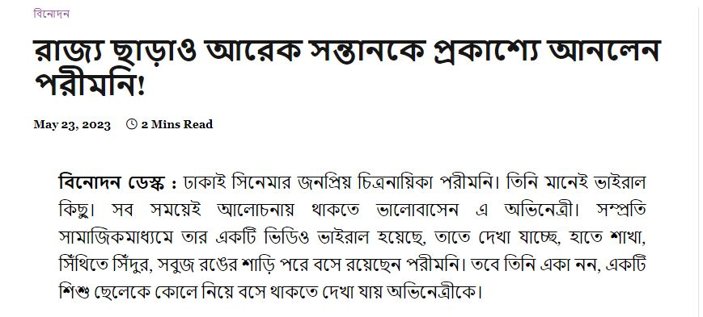
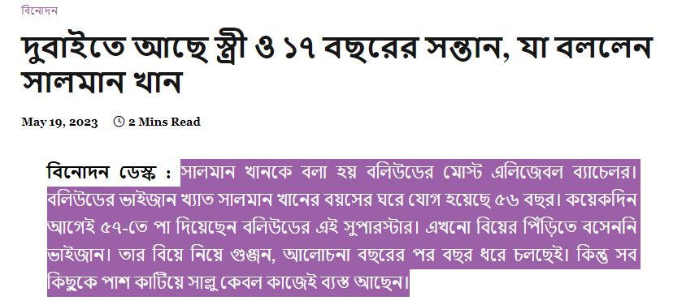
Introduction
Clickbait refers to articles with content whose primary purpose is to attract and encourage visitors to click on a link to a particular webpage[3]
Contains luring headlines to click on it
Figure 1:Examples of clickbaits

Slide 4
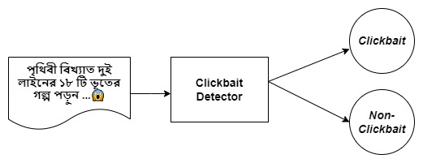
Introduction(Cont.)
Clickbait Detection:
Developing a system that detect the misleading title from those
article headlines
Figure 2:Simple framework overview

Slide 5
Motivation
    Promoting a clickbait-free environment for a healthier online experience
    Spreading of misinformation over online news media can be reduced
    Detecting clickbait aligns with the principles of ethical journalism
    A few work in tackling increasing amount of clickbait in Bengali online news portal

Slide 6
Challenges
Shortage of Bangla clickbait resources
Difficult to identify confusing headlines that are clickbait or not
Shortage of necessary tools such as GPU, high ram to train models

Slide 7
Objective
Developing clickbait detection system to create a clickbait-free environment for a healthy online experience

Slide 8
Related Work and Limitations
1. Martin Potthast, Sebastian Kopsel, Benno Stein and Matthias Hagen et al proposed “Clickbait Detection” [2] it has:
Used tweeter as a platform for detecting clickbaits
Used machine learning approaches
Limitations:
Focused on only English tweets not on news headlines and not in Bengali language
Compared only with machine learning models

Slide 9
Related Work(Cont.)
2. Motahar Mahtab, Monirul Haque and Mehedi Hasan et al proposed “Banglabait:Using Transformers, Neural Networks & Statistical Classifier to detect clickbaits in New Bangla Clickbait” [1]
Used different neural network model and transformer model
Limitations:
Comparative analysis between models and not used ensemble learning approach

Slide 10
Related Work(Cont.)
3. Sisodia et al.(2018) proposed “Ensemble Learning Approach for Clickbait Detection using Article Headline Features [3] has:
Applied ensemble techniques bagging, boosting and Random forest
Limitations:
Used ensemble of machine learning models
Used only English news article headlines
Used ensemble techniques of bagging, boosting and Random forest

Slide 11
Contributions
    Development of Bangla clickbait dataset containing 3350 news headline with their contents
    Analyzed the performances of various deep learning, machine learning & transformer models on the developed dataset
    Ensemble of transformer models(XLM-RoBERTa+Bangla BERT+Indic BERT)

Slide 12
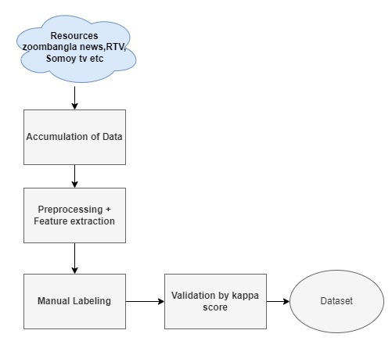
Dataset Development
Figure 3: Process of dataset development
Data sources: zoombangla news, RTV, Somoytv, Priyobangla news

Slide 13
Dataset Development(Cont.)
Data Annotation:
  Checked by three undergraduate students
  Initial Label through majority voting
  Using Cohen’s Kappa coefficient to evaluate quality of data
        Table 1: Kappa coefficient measurement
Class names | Kappa Score
Clickbaits | 0.95
Non-Clickbaits | 0.97

Slide 14
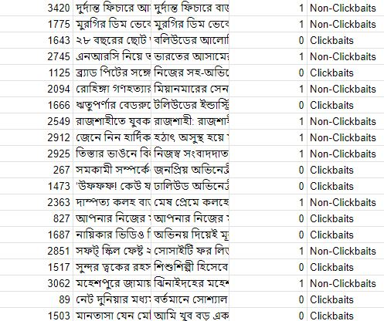
Dataset Description
Total data : 3350
  Clickbaits: 1750
  Non-Clickbaits: 1600
Figure 4:Sample of Bangla Clickbait dataset

Slide 15

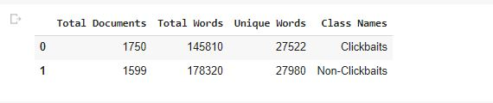
Dataset Description(Cont.)
Figure 5: Text summary of Headlines
Figure 6: Text summary of Contents

Slide 16
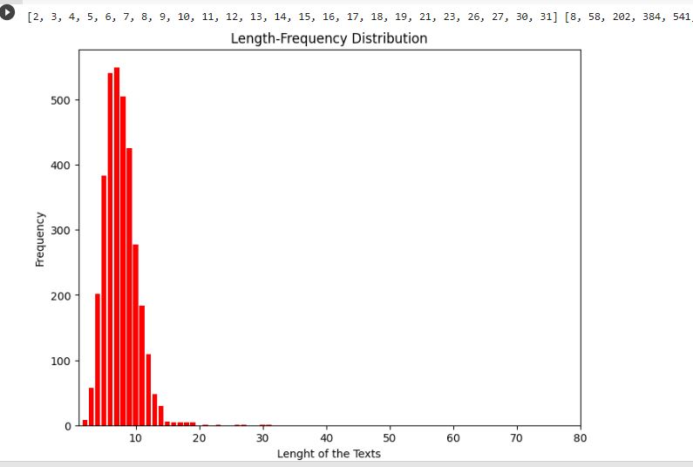
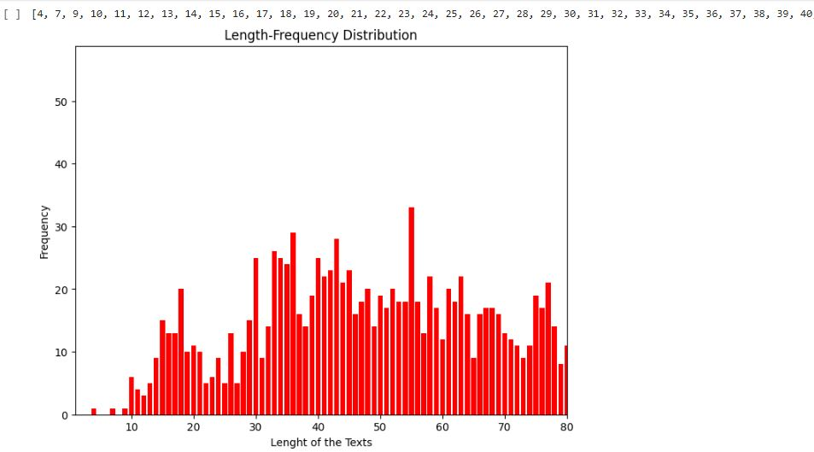
Dataset Description(Cont.)
Maximum length of text is 851
(a)Headlines
(b)Contents
Figure 7: Length frequency distribution table

Slide 17
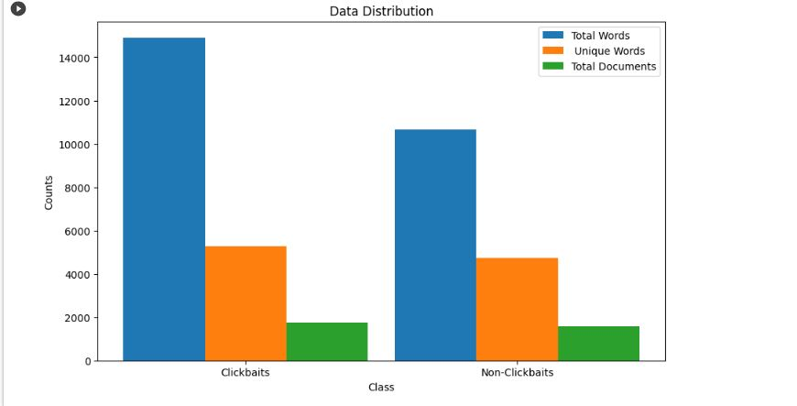
Dataset Description(Cont.)
Total Documents:3350
Figure 8: Data Statistics

Slide 18
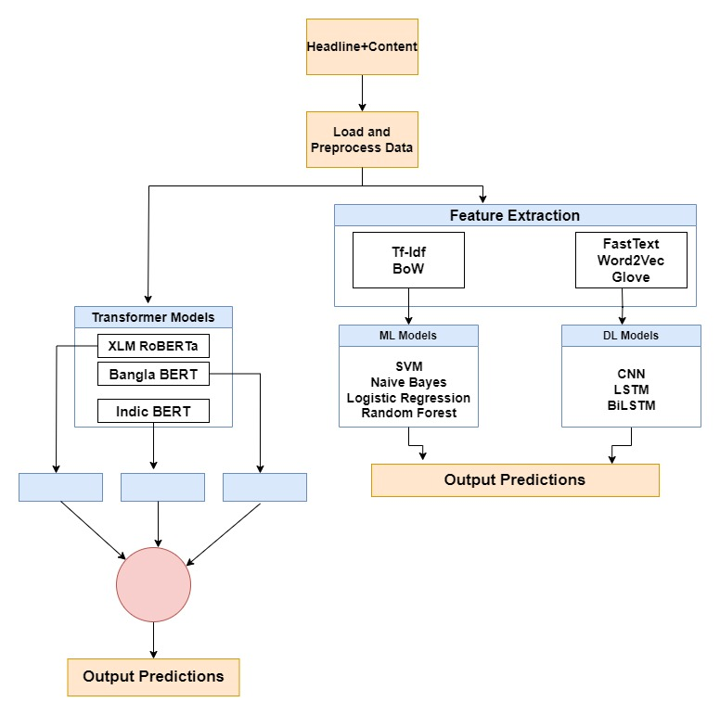
Methodology
Figure 9:Abstract Overview of Framework

Slide 19
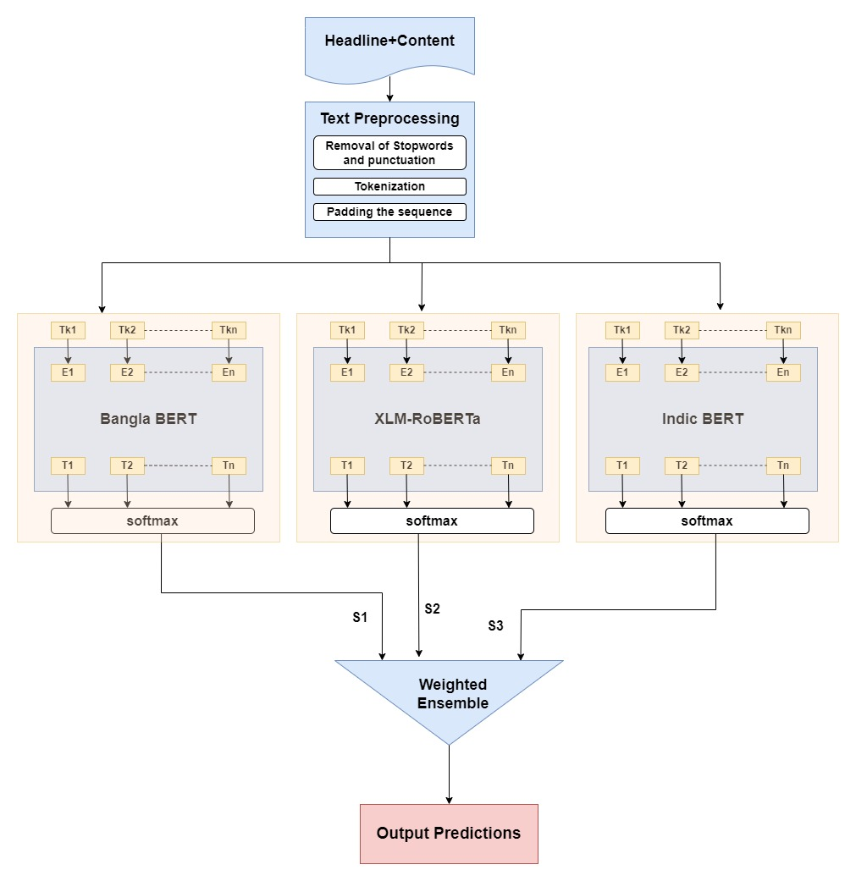
Methodology(Cont.)
Figure 10:Architecture of Proposed methodology

Slide 20
Data Preprocessing
Punctuation, stopwords and unusual symbols are removed
By tokenization text are transformed into vectors
By padding the sequence equal length vectors are achieved

Slide 21
Feature Extraction
Feature Extraction of texts
Pretrained Word2Vec, Glove and FastText are used in Deep Learning models
Used Tf-Idf and Bag of Words for using in Machine Learning models
For Word2Vec,Glove,FastText used a window size of
5 and dimension is set to 100
For Tf-idf used window size is uni-gram and dimension is equal to the total number of unique words in the corpus

Slide 22
Performance Analysis
Analyzed 3 Deep Learning and 4 Machine Learning models
Analyzed three Transformer models and ensembled three models which are XLM-RoBERTa,Indic BERT and Bangla BERT
Softmax activation function used in final dense layer for prediction
In transformer model self attention mechanism is used

Slide 23
Results (ML Models)
Feature Extraction | Classifiers | Precision | Recall | F1 Score | Accuracy
Tf-Idf | Logistic Regression | 90.42% | 89.82% | 90.02% | 91.14%
 | Naïve Bayes | 91.40% | 89.38% | 90.38% | 91.44%
 | Random Forest | 82.98% | 87.39% | 85.13% | 86.27%
 | SVM | 91.65% | 89.82% | 90.73% | 91.74%
Bag Of Words | Logistic Regression | 88.53% | 90.49% | 89.50% | 90.45%
 | Naïve Bayes | 91.65% | 89.82% | 90.73% | 91.74%
 | Random Forest | 84.85% | 86.73% | 85.70% | 87.06%
 | SVM | 89.93% | 90.93% | 90.43% | 91.34%
Table 2:Performance summary of ML models

Slide 24
Results (DL models)
Feature Extraction | Classifiers | Precision | Recall | F1 Score | Accuracy
Word2Vec (Pretrained) | CNN | 68.3% | 79.7% | 73.58% | 74.16%
 | BiLSTM | 65.07% | 86.7% | 74.76% | 73.56%
Word2Vec | CNN | 98.19% | 98.8`% | 98.50% | 92.83%
 | LSTM | 98.25% | 98.2% | 98.74% | 92.98%
 | BiLSTM | 97.73% | 97.3% | 97.52 | 89.99%
FastText | CNN | 91.06% | 91.7% | 91.37% | 92.53%
 | BiLSTM | 86.30% | 93.7% | 89.88% | 90.89%
Glove | CNN | 83.22% | 85.8% | 84.49% | 86.41%
 | LSTM | 84.07% | 58.4% | 68.97% | 77.31%
 | BiLSTM | 85.71% | 8.3% | 15.41% | 59.85%
Table 3:Performance summary of DL models

Slide 25
Results (Transformer Models)
Classifiers | Precision | Recall | F1 Score | Accuracy
XLM-RoBERTa | 82.59% | 98.67% | 89.92% | 90.05%
Indic BERT | 97.74% | 89.72% | 93.50% | 94.63%
Bangla BERT | 94.46% | 94.46% | 94.46% | 95.22%
Table 4:Performance summary of Transformer models

Slide 26
Result (Summary)
Models Summary:
Models | Precision | Recall | F1 Score | Accuracy
Naïve Bayes | 91.65% | 89.82% | 90.73% | 91.74%
LSTM | 98.25% | 98.74% | 98.50% | 92.98%
Bangla BERT | 94.46% | 94.46% | 94.46% | 95.22%
Ensemble(XLM-RoBERTA+Indic BERT+Bangla BERT) | 94.83% | 95.16% | 94.99% | 96%
Table 5:Model Summary

Slide 27
Performance Comparison
Author | Model | Accuracy | Precision | Recall | F1
Mahtab et al. 2022[1] | Indic BERT | 94.63% | 93.74% | 89.72% | 93.50%
Sisodia et al. 2018[2] | Random Forest | 87.06% | 84.85% | 86.73% | 85.70%
Proposed Model | XLM-RoBERTa+Indic BERT+Bangla BERT | 96% | 94.83% | 95.16% | 94.99%
Table 6: Performance Comparison with previous works

Slide 28
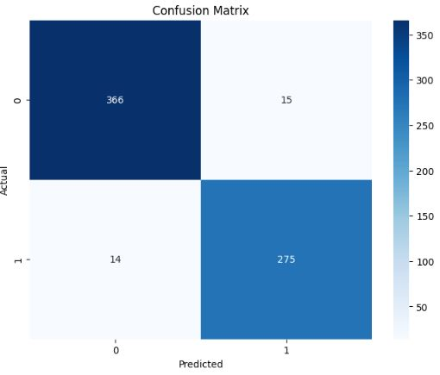
Error Analysis
Confusion Matrix of Proposed Method:
Figure 11:Confusion Matrix

Slide 29
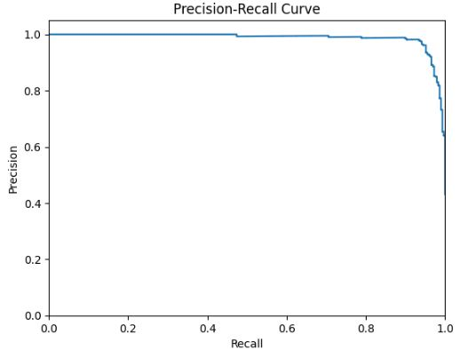
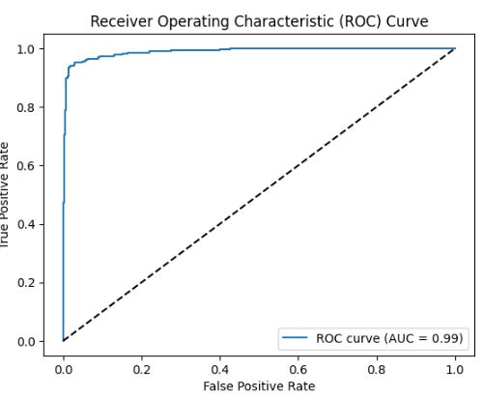
Error Analysis(Cont.)
Precision Recall curve and ROC Curve of Proposed Method:
(a)Precision Recall Curve
(b)ROC Curve

Slide 30
Future Improvements
More datas to be added in data corpus
Ensemble with more models can be implemented
Bangla English mixing clickbait headlines might be in consideration

Slide 31
Conclusion
Transformer based framework is implemented to detect clickbait from news headline
A dataset with clickbait and non-clickbait headlines with content is developed
Achieved highest accuracy of 96% with proposed model which is ensemble of(XLM-RoBERTa+Bangla BERT+Indic BERT) in our corpus.

Slide 32
References
[1] M. Mahtab, M. Haque and M. Hasan, ‘Banglabait: Using transformers,neural
networks & statistical classifiers to detect clickbaits in new bangla clickbait dataset,’
Ph.D. dissertation,Brac University, (2022).
[2] M. Potthast, S. Köpsel, B. Stein and M. Hagen, ‘Clickbait detection,’in European
conference on information retrieval, Springer, (2016),pp. 810–817 .
[3] D. S. Sisodia, ‘Ensemble learning approach for clickbait detection using article
headline features.,’ Informing Sci. Int. J. an Emerg. Transdiscipl.,vol. 22, pp. 31–44,
(2019)

Slide 33
Thank you

