Slide 1
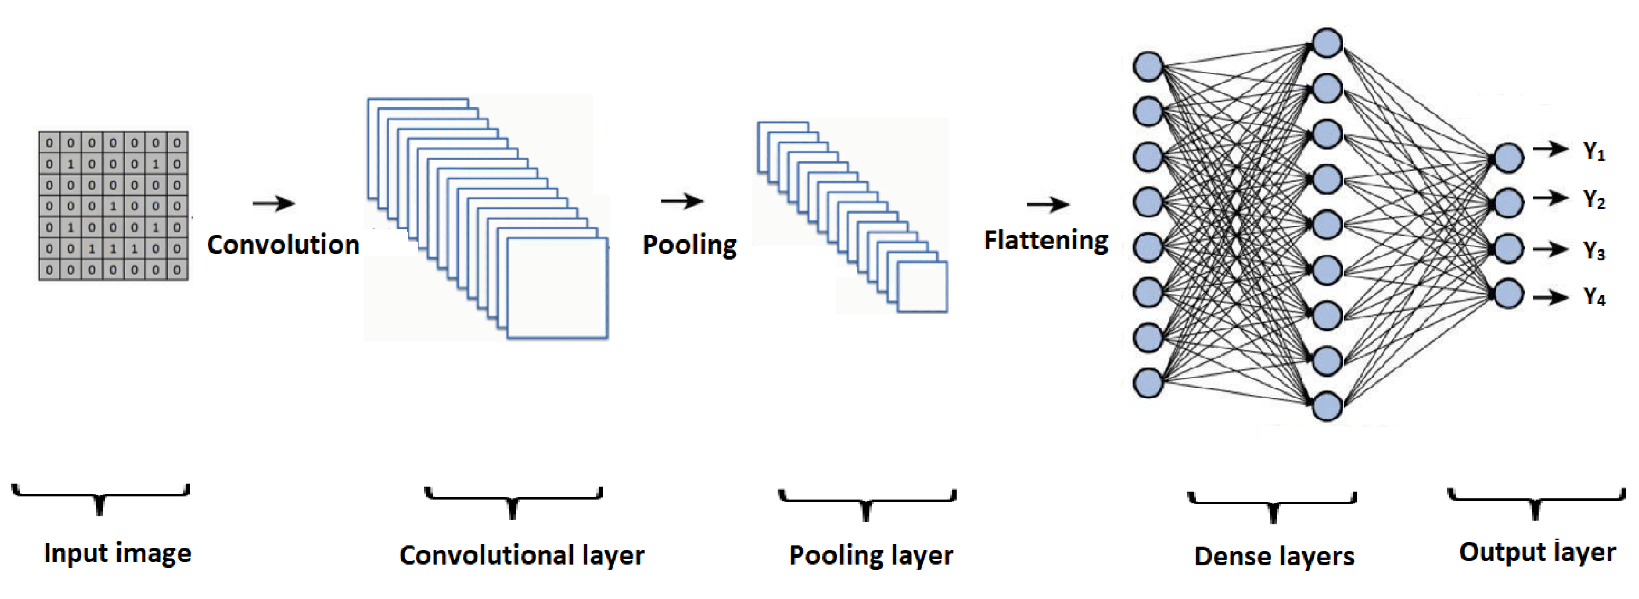
Handwritten English Alphabet
Recognition with Convolutional Neural Network
Yasin Vəliyev

Slide 2
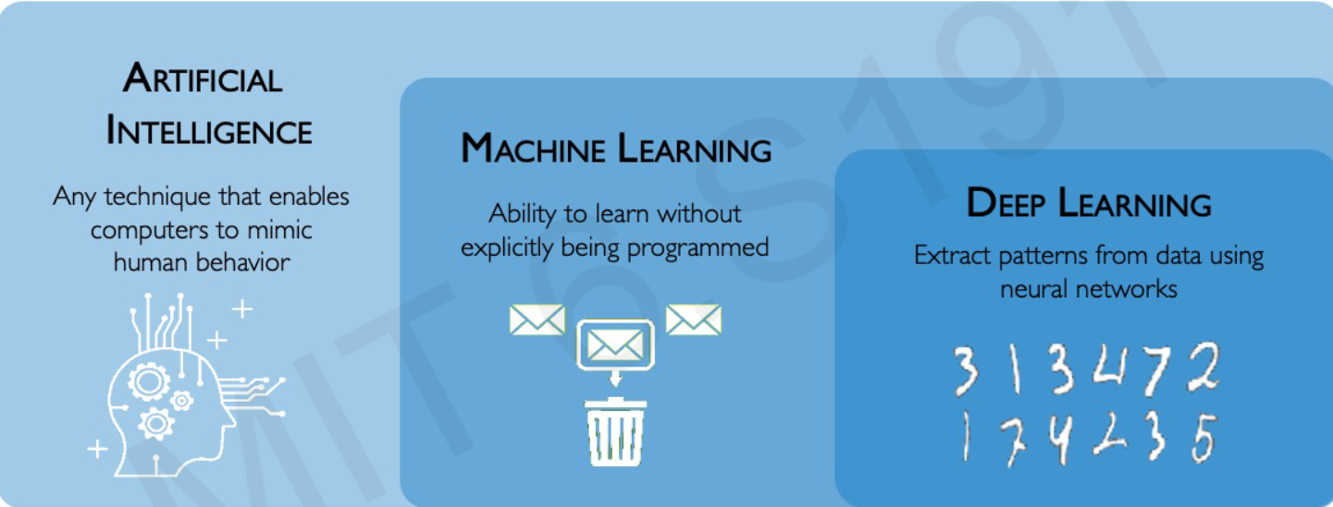
What Is Deep Learning
Teaching computers how to learn a task directly from raw data

Slide 3
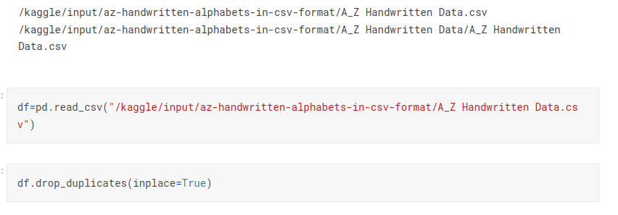
Data source, Data Cleaning

Slide 4
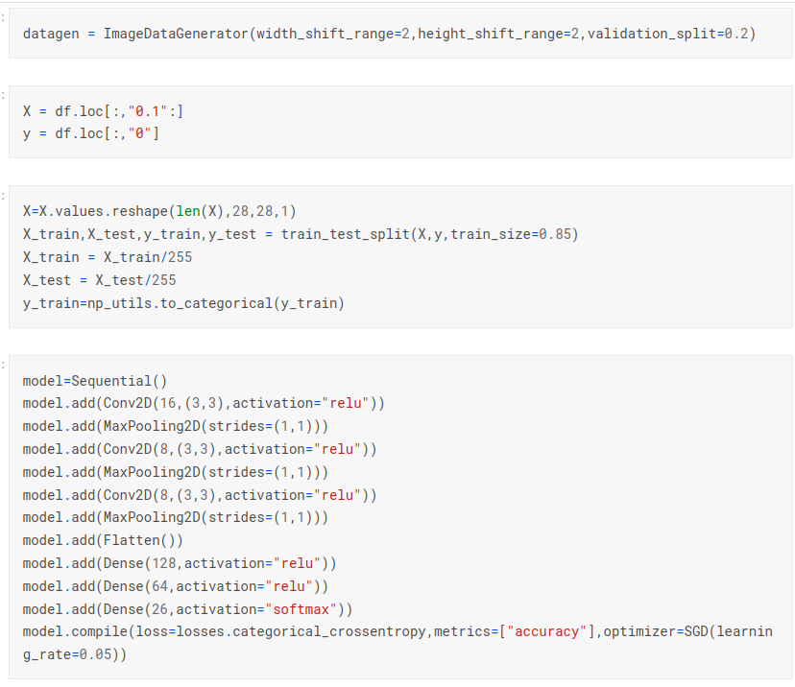
Modelling

Slide 5
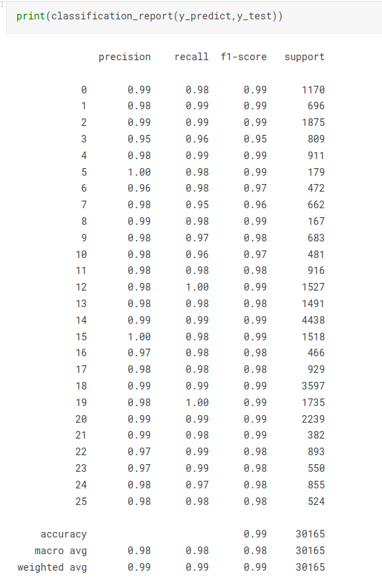
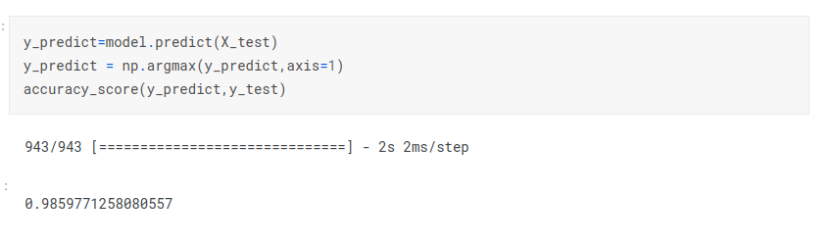
Results

