Slide 1
Predicting Appliance
Energy Use in a
Low-Energy House
Kahathota Liyanage Yasindu Janiya Weerasinghe
Matriculation: 557466 | Course: Machine Learning / Artificial Intelligence
Notes:
Welcome. This presentation covers my Machine Learning final project on predicting appliance energy consumption in a low-energy house in Belgium.

Slide 2
The Objective & The Problem
Goal: Predict short-term (10-min interval) appliance energy consumption using indoor/outdoor weather and time-of-day data.
The Core Problem
Appliance energy spikes are sudden, extreme, and non-constant — they follow no simple linear pattern.
The Hypothesis
Standard linear mathematics will fail. Advanced non-linear and ensemble machine learning techniques are required.
19,735
29
10-min
4.5 mo
Observations
Features
Intervals
Duration
Notes:
The dataset comes from a low-energy house in Belgium, collected by Candanedo et al. (2017). The target variable is total appliance energy consumption per 10-minute interval.

Slide 3
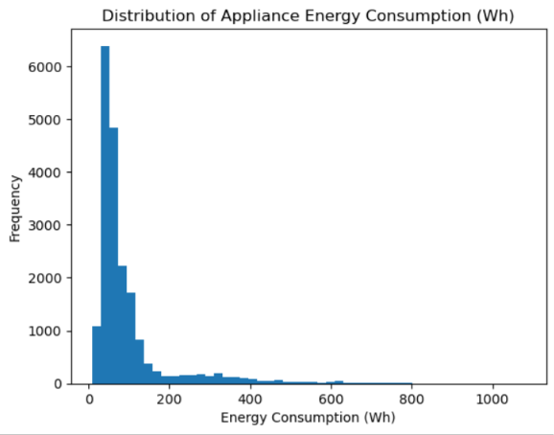
What the Data Tells Us: EDA Findings
1
Right-Skewed Target
INSERT HISTOGRAM HERE
From your notebook:
plt.savefig('histogram.png')
Then insert via:
Insert → Pictures
Mean: 97.7 Wh, Max: 1,080 Wh. Most readings are low-energy baseline periods, punctuated by rare extreme spikes — confirming standard linear models will fail.
2
Weak Linear Correlations
Individual weather features show very low linear correlation with the target. Energy use is driven by complex combinations of factors, not any single variable.
3
Multicollinearity Detected
Severe multicollinearity among temperature and humidity sensors (T1–T9, RH_1–RH_9). Handled by retaining all features and relying on tree-based models which handle this natively.
Notes:
EDA confirmed the hypothesis: the target is right-skewed (most readings low, rare extreme spikes). Linear correlations are weak. Multicollinearity exists among sensors but is handled by tree-based models. REMINDER: Insert histogram.png from your notebook into the right placeholder before presenting.

Slide 4
Data Preprocessing & Feature Engineering
Feature Engineering
Extracted 'hour' and 'day_of_week' from raw timestamp to proxy human occupancy patterns — the primary driver of energy spikes.
Outlier Handling (IQR)
~11% of target values flagged as statistical outliers. Intentionally kept — these represent legitimate high-energy events (cooking, laundry), not sensor errors.
StandardScaler
Mathematically mandatory for SVR (distance-based model). Fit ONLY on X_train, then transform() applied to X_test separately to prevent data leakage.
Stratified Train/Test Split (80/20)
Used pd.qcut to bin continuous target into quartiles, enabling stratified splitting. Ensures proportionate distribution of extreme spikes across both sets.
Notes:
Key point about scaling: scaler.fit_transform() on X_train only, then scaler.transform() on X_test — this is critical for preventing data leakage. If asked why outliers were kept: these are legitimate energy events, removing them would mean the model never learns to handle high-consumption periods.

Slide 5
The Modeling Strategy
Why Non-Linear Outperforms Linear:
Appliances operate on threshold logic (e.g., HVAC activates strictly below a temperature threshold).
Linear models cannot capture step-functions; non-linear models partition the feature space to map these discontinuous triggers.
Models Deployed:
Baseline
Nonlinear #1
Nonlinear #2
Ensemble
Linear Regression
Decision Tree
SVR (RBF Kernel)
Random Forest
Lower bound — proves nonlinearity is required
Threshold-based splits (if temp < 20°C...)
Geometric mapping to high-dimensional space
Variance reduction via Bagging (75 trees)
Notes:
Why Decision Tree: captures threshold-based rules — perfect for HVAC and occupancy-driven triggers. Why Random Forest over single Decision Tree: averaging 75 trees reduces variance and prevents overfitting. Why SVR: maps data to high-dimensional space using RBF kernel to capture complex nonlinear relationships. GridSearchCV used for Decision Tree (small grid), RandomizedSearchCV for SVR and RF (large search space).

Slide 6
Final Results: Model Comparison
🏆 Random Forest Ensemble — Test R²: 0.5305 (3× baseline) | MAE: 33.07 Wh | RMSE: 70.05 Wh
Model | CV R² | Train R² | Test R² | MAE (Wh) | RMSE (Wh)
Linear Regression | 0.1624 | 0.1675 | 0.1696 | 53.16 | 93.17
Decision Tree | 0.2721 | 0.5143 | 0.3336 | 41.30 | 83.47
SVR | 0.2213 | 0.2618 | 0.2353 | 36.89 | 89.41
Random Forest ★ | 0.4800 | 0.9135 | 0.5305 | 33.07 | 70.05
Notes:
Key numbers to remember: - Linear Regression Test R²: 0.1696 (baseline — only 17% explained) - Random Forest Test R²: 0.5305 (tripled — 53% explained) - Random Forest MAE: 33.07 Wh vs baseline 53.16 Wh - Train R² for Linear Regression is shown as — because cross_val_score was used (not a direct train fit)

Slide 7
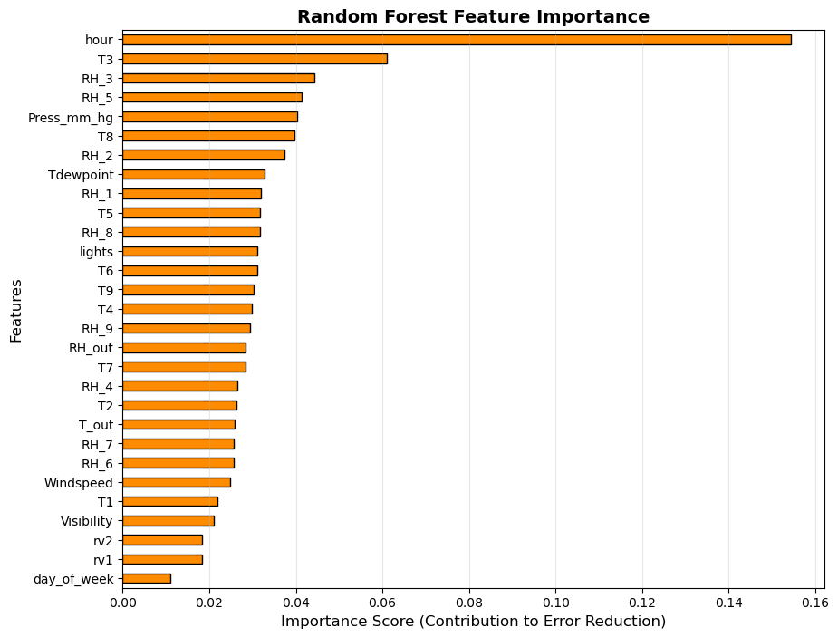
What Actually Drives Energy? (Feature Importance)
Hour dominates everything
Score ~0.16 — daily routines (cooking, waking, sleeping) drive consumption far more than any other factor.
Indoor climate zones (T3, RH_3, RH_5)
Activity-proxy rooms (kitchen/laundry area) register next-highest importance.
Surprising: day_of_week ranks last
A 6 PM energy spike occurs equally on Tuesday or Saturday — time of day matters far more than day of week.
Notes:
Feature importance extracted from RandomForestRegressor using .feature_importances_ attribute on best_estimator_. Hour at ~0.16 importance is roughly 3x more important than the next feature (T3 at ~0.06). This directly proves the Step 0 hypothesis that daily occupancy routines are the primary energy driver. dday_of_week ranking last is counterintuitive but makes sense: if someone cooks at 7pm, they cook at 7pm regardless of the day.

Slide 8
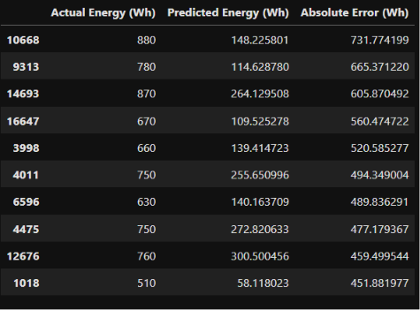
Error Analysis: Top 10 Largest Prediction Errors
Systematic Under-Prediction
Every major error shows the same pattern: actual energy 500–880 Wh, model predicts only 58–300 Wh.
Why does this happen?
Ensemble averaging suppresses extremes. The final prediction is the mean of 75 trees — extreme spikes get averaged away.
What would fix it?
IoT occupancy sensors — knowing 3 people are home and the washing machine is running would directly predict spikes.
Notes:
This slide shows the Top 10 largest absolute prediction errors. Key observation: every single error involves actual energy > 500 Wh. The model systematically under-predicts because Random Forest averages 75 trees — extreme values get pulled toward the mean. If asked about the residual plot: the residual plot showed a fan-shape (heteroscedasticity) — residuals expand as predicted energy increases, confirming this same pattern visually.

Slide 9
Conclusions & Future Improvements
R² improved from 0.1696 → 0.5305 (3×) and MAE reduced from 53.16 → 33.07 Wh by moving from Linear Regression to Random Forest ensemble — confirming that nonlinear modeling is essential for this dataset.
Strict Time-Series Split
Replace random CV with chronological splitting — train on months 1–3, test on months 4–4.5. Properly simulates real-world forecasting and eliminates temporal data leakage.
Gradient Boosting (XGBoost)
Sequential tree building targets each tree at correcting the previous tree's errors. This focused approach could specifically reduce the extreme-spike under-predictions.
IoT Sensor Integration
Add explicit room occupancy counters and smart-plug appliance monitors. This directly provides the missing human behavior context that causes 90%+ of the model's worst errors.
Candanedo et al. (2017). Energy and Buildings, 145, 13–25. https://doi.org/10.1016/j.enbuild.2017.03.040
Notes:
Key takeaway: Linear Regression (17% explained variance) vs Random Forest (53% explained variance) — threefold improvement proves the nonlinear hypothesis. If asked what you'd do differently: Time-series split first (most rigorous fix), then Gradient Boosting for spike prediction, then IoT sensors for fundamentally better data. AI Usage: Claude (Anthropic) was used for conceptual explanations only. All code and analysis produced independently.

