Slide 1



TECHNICAL ASSIGNMENT — SE INTERNSHIP
Weekly Report Generator
& Team Dashboard
A full-stack system for structured weekly reporting and team-wide, role-based analytics.
React + Tailwind
Node.js / Express
PostgreSQL

Slide 2


Objective & Scope
Build a multi-user system where team members log structured weekly reports and managers analyze them across the whole team.
Role-based access
Fixed report schema
Manager dashboard
Team Member vs Manager/Admin, enforced server-side on every route.
Same fields, same order, for every user — reports stay comparable.
Filters by member, project, date range; compliance & workload insights.
2
Weekly Report Generator & Team Dashboard

Slide 3
System Architecture Overview
React SPA
(Vite + Tailwind)
Express REST API
PostgreSQL
(Sequelize)
Personal report page · Team dashboard
REST / JSON (JWT bearer)
JWT auth · RBAC middleware · Controllers
Sequelize ORM
users · projects · weekly reports
1. User authenticates → server issues a signed JWT containing user id + role.
2. Every request carries the JWT; "protect" middleware verifies it, "requireRole" gates manager-only routes.
3. Members' report queries are always scoped to req.user.id at the controller level — never trusted from the client.
4. Dashboard endpoints run SQL GROUP BY / SUM / COUNT queries directly over the reports table for real-time metrics.
3
Weekly Report Generator & Team Dashboard

Slide 4
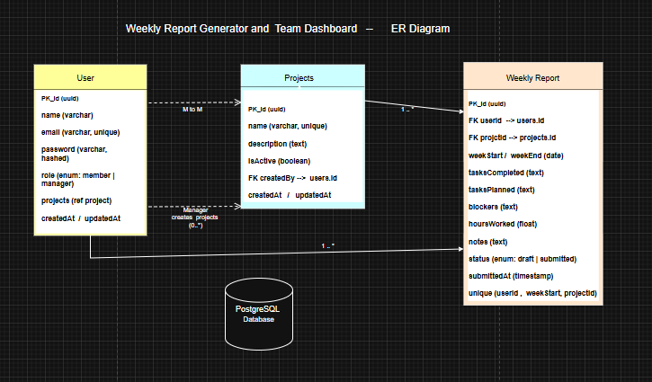
Database Design
Entity-Relationship Diagram — PostgreSQL tables
4
Weekly Report Generator & Team Dashboard

Slide 5


Frontend Structure
Clear separation between the personal report page and the team dashboard
My Reports (Team Member)
Team Dashboard (Manager)
ReportForm — fixed, shared schema
ReportCard — history grouped by week
Create / edit / submit / save draft
SummaryCard — compliance, blockers, headcount
TasksTrendChart / SubmissionStatusChart / WorkloadChart
Filterable report table (member, project, date range)
Weekly Report Generator & Team Dashboard

Slide 6

API Design & Role-Based Access Control
Endpoint | Access | Purpose
POST /api/auth/register, /login | Public | Account creation & JWT issuance
GET/POST /api/reports | Member (own) / Manager (all, filtered) | Create & list weekly reports
PUT/DELETE /api/reports/:id | Manager only | Edit or remove a report
GET/POST/PUT/DELETE /api/projects | Read: any user · Write: Manager | Manage project/category list
GET /api/dashboard/* | Manager only | Summary, trend, workload, activity aggregations
Request
protect (verify JWT)
requireRole('manager') if needed
Controller (scoped query)
Response
Weekly Report Generator & Team Dashboard

Slide 7

Dashboard & Visual Insights
Recharts on the frontend; SQL GROUP BY queries on the backend
Total reports submitted:
This week's count vs. team sizeSubmission compliance rate:
Submitted ÷ total membersOpen blockers across the team:
Reports with a non-empty blockers fieldRecent activity feed:
Latest submissions, newest first
Weekly Report Generator & Team Dashboard

Slide 8

Challenges & How They Were Solved
Keeping report fields identical for every user
Enforced once in the Sequelize model definition and again in a single shared ReportForm component — no per-user customization surface exists in the UI or API.
Preventing members from viewing/editing others' reports
Ownership check happens in the controller (report.user === req.user.id), not just hidden in the frontend — verified with role-based route tests.
Computing dashboard metrics efficiently
Used SQL GROUP BY / SUM / COUNT queries (via Sequelize) directly on the reports table instead of pulling all rows into Node and computing in memory.
Defining 'late' vs 'pending' submissions
A member is 'late' only once the selected week's Sunday has passed and they still haven't submitted — computed server-side per request.
8
Weekly Report Generator & Team Dashboard

Slide 9
Possible Future Improvements
1
Build the AI Chat Assistant described earlier (Q&A + auto-generated team summaries)
2
Email/Slack reminders for pending or late weekly reports
3
Refresh-token rotation instead of long-lived JWTs, plus rate limiting on auth routes
4
Automated tests (Jest/Supertest) covering role-based access boundaries
5
Exportable PDF/CSV weekly summaries for managers and stakeholders
9
Weekly Report Generator & Team Dashboard

Slide 10



Thank You
Submission includes:
Repository link - GitHub repository
https://github.com/YasinthaWanasundara/weekly-report-system
One Drive Link - Demo video
https://drive.google.com/file/d/14eOlULZIIMW2Imp8Nxtsi4Pgt9oEuQbo/view?usp=sharing
ER diagram Link
https://drive.google.com/file/d/1xogQvXjWYVdseQjRzj485qtiLWx23kTl/view?usp=sharing
https://tinyurl.com/3tfucmxy
Presentation Link
https://docs.google.com/presentation/d/18cRkAIfj8Ec4Jplj7lTexhhIY264SNo-/edit?usp=sharing&ouid=118075605909374359343&rtpof=true&sd=true
10
Weekly Report Generator & Team Dashboard

