Slide 1

RANDOM FOREST
Regression
Medical Insurance Cost Prediction
Team Members
Abdulrahman Bajunaid · Mansour Alhenaki · Yasir Aladwani
Instructor: Khulud Alshammari | Teaching Assistant: Abdullah Alharbi
Machine Learning Mini Project · Scikit-learn · Kaggle Dataset

Slide 2
01
Algorithm
Explanation
Understanding how Random Forest Regression works under the hood

Slide 3
What is Random Forest?
Definition
Random Forest is an ensemble learning algorithm that builds a large number of decision trees during training and outputs the mean prediction of all individual trees for regression tasks. It was first proposed by Leo Breiman in 2001 and builds on two powerful ideas:
Bagging (Bootstrap Aggregating) — each tree is trained on a random sample of the data drawn with replacement, meaning roughly 63% of training records appear in each tree's sample, while the remaining 37% (out-of-bag data) can be used for internal validation without a separate test set.
Feature Randomness — at every node split, each tree is allowed to consider only a randomly chosen subset of m features rather than all available features. This forces the trees to learn different aspects of the data, making them diverse and complementary to one another.
By combining hundreds of such diverse trees and averaging their outputs, Random Forest achieves far greater accuracy and robustness than any single decision tree could ever achieve alone. The key insight is that averaging diverse models cancels out individual errors — the noise is random, but the signal is consistent.

Slide 4
The Core Mechanism — Ensemble Learning & Bagging
ENSEMBLE LEARNING
BOOTSTRAP AGGREGATING (BAGGING)
The word 'ensemble' comes from music — many instruments playing together produce a richer sound than any single instrument alone. In machine learning, an ensemble combines many weak learners (models that are only slightly better than random guessing) into one powerful, stable predictor.
Random Forest applies this idea using decision trees as its base learners. A single decision tree tends to overfit — it memorises training data perfectly but fails on new examples. When you average hundreds of slightly different trees, overfitting cancels out while the true underlying pattern is preserved.
This is the bias-variance tradeoff in practice: individual trees have low bias but high variance. Averaging reduces variance without increasing bias, which is exactly what produces strong generalisation.
Bagging creates diversity among trees by training each one on a different random sample of the original dataset. This sampling is performed with replacement — the same row can appear multiple times within a single sample.
For a dataset of n rows, each bootstrap sample also contains n rows. About 63% of original rows appear at least once; the rest form the out-of-bag (OOB) sample, which provides a free internal validation set — no separate validation split needed.
Because each tree sees a different slice of the data, they will make different individual errors. When their predictions are averaged, those errors tend to cancel out, leaving a final prediction much closer to the true value than any single tree could achieve.

Slide 5
Feature Randomness — Making Trees Truly Independent
Why Feature Randomness?
m = p/3
Features at each split
(regression default)
Even with bagging, if there is one very strong predictor, almost every tree will choose that feature for its root split — making all trees look similar, or correlated. Averaging correlated models provides little benefit.
Random Forest solves this with an extra layer of randomness: at every single node split, only a random subset of m features is considered. For regression, m is typically p/3, where p is the total number of features.
This forces some trees to build themselves around weaker predictors, giving them a chance to discover subtle secondary patterns. The result is a genuinely diverse forest where each tree is learning something different from its peers.
In our insurance dataset with 6 features, this means some trees may rely primarily on age and BMI — even though smoker dominates — and those trees contribute valuable nuance to the final averaged prediction, especially for edge cases.
n_estimators = 200
Trees trained in this project
OOB Score
Free validation from ~37%
of data unseen per tree
max_depth = None
Fully grown trees — high
individual variance by design

Slide 6
How Random Forest Works — Step by Step
Bootstrap Sampling
1
For each of the 200 trees, draw a random sample (with replacement) of n=1,337 rows. ~63% of rows appear; the rest become the OOB set used for free internal validation during training.
Grow Each Decision Tree
2
Build a full unpruned tree on each bootstrap sample. At every node, consider only a random subset of m features for the best split. Each tree perfectly memorises its own sample — high variance by design.
Generate Predictions
3
Pass a new data point down every tree in the forest. Each tree independently returns a numeric insurance cost estimate based on the path the record takes through its learned branches and leaf values.
Average the Outputs
4
The final prediction is the arithmetic mean of all 200 tree predictions. Averaging smooths out individual tree errors — the random noise cancels, the consistent signal strengthens. Result: R² = 0.884.

Slide 7
When to Use · Advantages · Limitations
WHEN TO USE
ADVANTAGES
LIMITATIONS
Dataset has many features with complex, non-linear interactions
You suspect interactions between variables (e.g. smoker × BMI)
Outliers or noise are present in the data
High prediction accuracy matters more than model interpretability
You need built-in, reliable feature importance estimates
Very high accuracy — consistently outperforms single models on tabular data
Highly resistant to overfitting due to the averaging effect
Handles mixed data types (numeric + categorical) gracefully
Provides reliable feature importance rankings
Minimal hyperparameter tuning needed — works well out of the box
Robust to outliers — no single noisy point can dominate
Difficult to interpret — a 'black box' compared to linear models
Slow prediction in production with 200+ trees
High memory usage for storing many fully grown trees
Poor extrapolation beyond the range of training data
Biased toward features with many unique values
Slower to train than simpler models on very large datasets

Slide 8
02
Dataset
Overview
Medical Cost Personal Dataset — 1,337 records, 6 features, 1 target

Slide 9
Dataset Structure & Features
1,337
6
expenses
0
Rows (after dedup)
Input Features
Target Variable
Missing Values
Feature | Type | Description | Range / Values
age | Numeric | Primary policyholder age in years | 18 – 64
sex | Categorical | Biological sex of the insured | male / female
bmi | Numeric | Body Mass Index (weight / height²) | 16.0 – 53.1
children | Numeric | Number of dependents on the policy | 0 – 5
smoker | Categorical | Whether the individual smokes tobacco | yes / no
region | Categorical | US residential region (4 zones) | NE / NW / SE / SW
expenses | Numeric (TARGET) | Annual medical insurance billed (USD) | $1,122 – $63,770

Slide 10
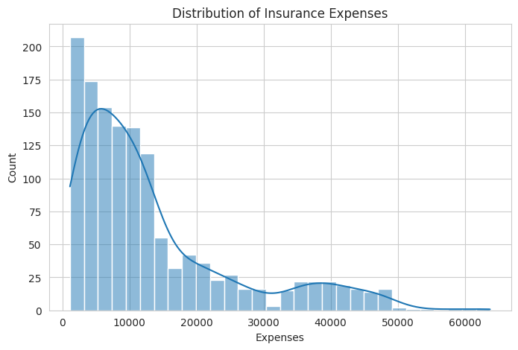
EDA 1 — Distribution of Insurance Expenses
The distribution is strongly right-skewed. Most policyholders pay $1k–$15k/year, while a second cluster around $30k–$50k reveals a distinct high-cost subgroup — almost certainly driven by smokers.

Slide 11
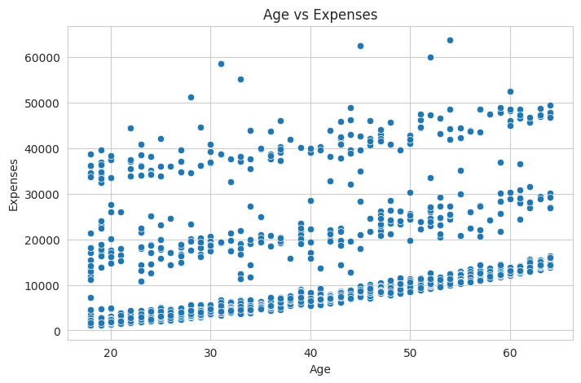
EDA 2 — Does Age Affect Insurance Expenses?
A clear positive relationship exists between age and medical expenses. The three distinct horizontal cost bands suggest another variable (smoking status) creates parallel subgroups that each rise with age independently.

Slide 12
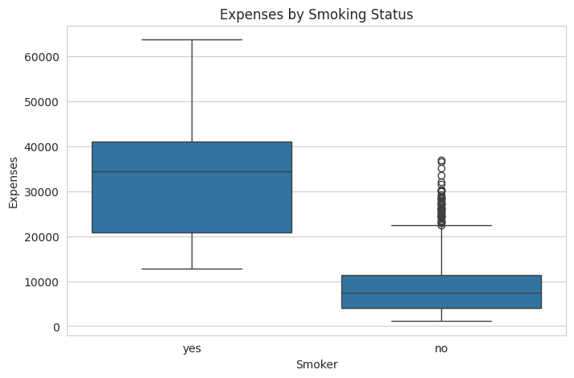
EDA 3 — Do Smokers Pay Higher Insurance Expenses?
Smokers cost 3.8× more than non-smokers on average. Smoking status is the single strongest predictor in the dataset (correlation = 0.79 with expenses).
$32,050 Avg — Smokers
$8,441 Avg — Non-Smokers

Slide 13
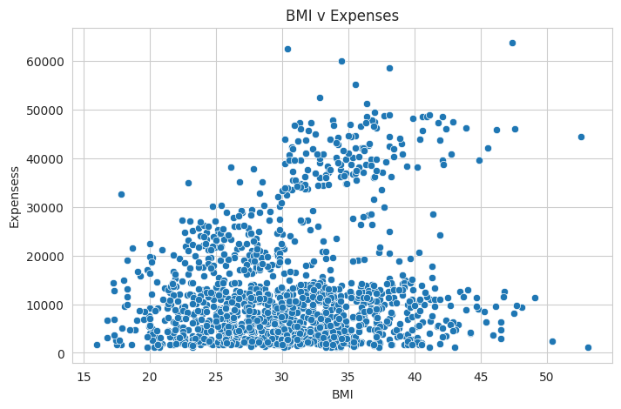
EDA 4 — Does BMI Affect Insurance Expenses?
Higher BMI is associated with increased expenses, but the relationship is not linear. The cloud of high-cost points above BMI=30 suggests an interaction with smoking — obese smokers represent the highest-cost group.

Slide 14
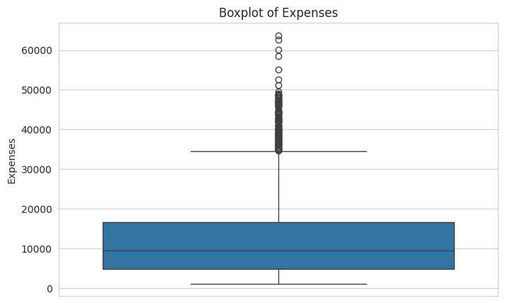
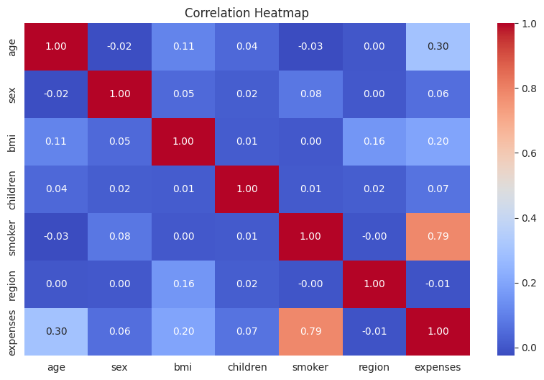
EDA 5 & 6 — Outliers & Correlation Heatmap
139 outliers identified in expenses — all retained as they represent genuine high-cost patients. | Smoker (0.79) → Age (0.30) → BMI (0.20) are the top 3 correlated features with expenses.

Slide 15
Data Preprocessing Pipeline
1 Duplicate Removal
2 No Missing Values
1 duplicate row was found and removed. Final dataset: 1,337 rows. All remaining rows are unique and valid records.
Zero null values across all 7 columns. No imputation was required — the dataset was completely clean from the start.
3 Label Encoding
4 No Feature Scaling
sex, smoker, and region were label-encoded using sklearn's LabelEncoder. The encoded df_encoded copy preserves the original for EDA.
Random Forest is a tree-based, non-distance method. Feature scaling (standardisation / normalisation) is not required and was not applied.
5 Train / Test Split
6 Model Configuration
80% training (1,069 rows) and 20% testing (268 rows). random_state=42 ensures the split is reproducible across all runs.
RandomForestRegressor with n_estimators=200 and random_state=42. All other parameters use sklearn defaults (max_depth=None, max_features='sqrt').

Slide 16
03
Model
Results
Training configuration, evaluation metrics, and feature importance

Slide 17
Model Training — Configuration & Code
Hyperparameter Configuration
Python Implementation
from sklearn.ensemble import RandomForestRegressor
from sklearn.model_selection import train_test_split
from sklearn.metrics import (
mean_absolute_error, mean_squared_error, r2_score)
X_train, X_test, y_train, y_test =
train_test_split(X, y, test_size=0.2,
random_state=42)
rf_model = RandomForestRegressor(
n_estimators=200,
random_state=42
)
rf_model.fit(X_train, y_train)
y_pred_rf = rf_model.predict(X_test)
n_estimators
200
Trees in the forest
max_depth
None
Fully grown — no pruning
max_features
'sqrt'
Features per split
random_state
42
Reproducibility seed
n_jobs
default
Single core (default)
test_size
0.20
20% held-out test set
random_state
42
Split seed

Slide 18
Model Evaluation — Performance Metrics
MAE
RMSE
R²
n
$2,545
$4,618
0.884
200
Mean Absolute Error
Root Mean Sq. Error
R-Squared Score
Trees (n_estimators)
On average the model's prediction deviates from actual expenses by $2,545. Given a target range of $1,122–$63,770, this is a precise result.
RMSE penalises large errors more heavily. The $4,618 value reflects a small number of high-cost outliers where the model slightly underestimates.
The model explains 88.4% of the variance in insurance expenses — a strong result showing the model has captured the key cost drivers effectively.
200 decision trees were trained and averaged. More trees reduce prediction variance further, at the cost of additional training and memory.

Slide 19
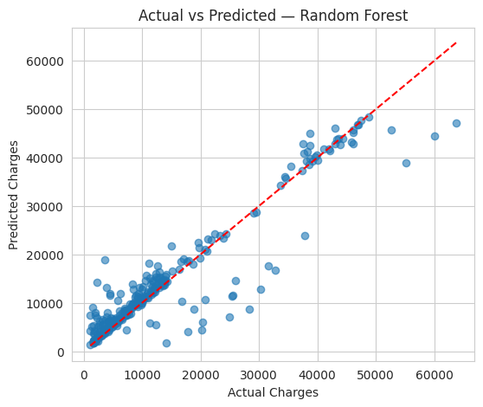
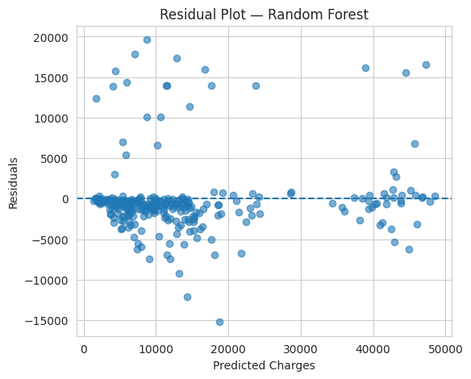
Model Results — Actual vs Predicted & Residuals
Left: Points tightly cluster around the perfect-prediction line (R²=0.884). Right: Residuals are centred on zero with no systematic pattern — confirming no significant model bias.

Slide 20
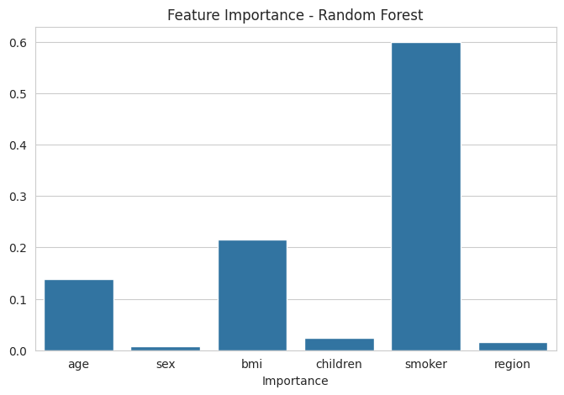
Feature Importance — What Drives Insurance Cost?
smoker — 59.9%
Smoking status is the dominant predictor, accounting for nearly 60% of the model's predictive power. This mirrors its 0.79 correlation with expenses — the largest of any feature.
bmi — 21.5%
BMI is the second most important feature. Its effect is amplified for smokers (high BMI + smoking = dramatically higher costs), a non-linear interaction only tree-based models can capture.
age — 13.8%
Older policyholders consistently incur higher expenses. Age contributes a steady, linear-style increase visible in the three rising cost bands in the EDA scatter plot.
children — 2.4%
Having more dependents adds a small but measurable cost. The effect is consistent and modest — children's routine healthcare is far less expensive than adult chronic conditions.
sex (0.8%) and region (1.7%) have negligible impact — demographic and geographic factors matter far less than lifestyle choices.

Slide 21
Key Insights & Takeaways
Lifestyle Factors Dominate Cost
Non-Linear Relationships Are Critical
Smoking (60%) and BMI (21%) together account for over 80% of the model's predictive power. Insurance pricing is primarily driven by modifiable lifestyle choices — not fixed demographics like sex or region.
A linear regression model on this same dataset achieves only R²≈0.80 vs Random Forest's 0.884. The gap confirms that smoker × BMI interactions are non-linear and can only be captured by an ensemble tree method.
Model Accuracy Is Practically Useful
Actionable Public Health Insight
MAE of $2,545 on a target spanning $1k–$64k means predictions are tight enough to be used in actuarial pricing models. The residual plot confirms no systematic under- or over-prediction across the cost range.
The feature importance ranking directly validates the need for wellness programs targeting smoking cessation and weight management. Addressing these two factors alone would have the greatest actuarial impact on reducing insurance costs.

Slide 22
Thank You
Any Questions?
0.884
$2,545
$4,618
200
R² Score
MAE
RMSE
Trees
Abdulrahman Bajunaid · Mansour Alhenaki · Yasir Aladwani
Instructor: Khulud Alshammari | TA: Abdullah Alharbi

