Slide 1

CSE 3118
(Microprocessors and Microcontroller Lab)
Mr. Unstoppable
- A Smart Vacuum Cleaner Robot
Presented by:
Aurprita Mahmood 20200104035
Khaled Hasan 20200104037
Yasir Arafah Prince 20200104042
Sumaiya Shejin 20200104043

Slide 2
LET’S GET STARTED!!
Our Targets
We are going to know about our objectives about our project
Social values
We are going to know about the backend motivation for building this project
What do we need to make our project alive?
We are going to know what materials do we need for our project
How the machine works?
We are going to know the working mechanism of our project
What is the cost?
We are going to know our estimated budget for our project
Final Summary
We are going to have a final overview of our project

Slide 3
Our Targets
Cleaned surface
Easy to use
Smart robot
Reducing human effort
Automation
Easy to afford

Slide 4
Social Values
People now can relax and don’t need to worry about dirt
Maintaining hygiene
Low maintenance
1
3
5
2
4
Saving time & labor
Customized size & shape

Slide 5
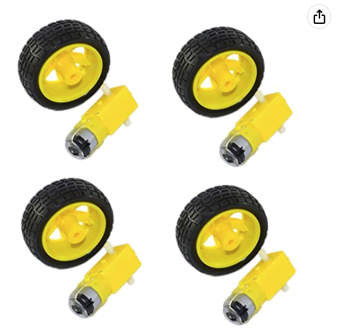
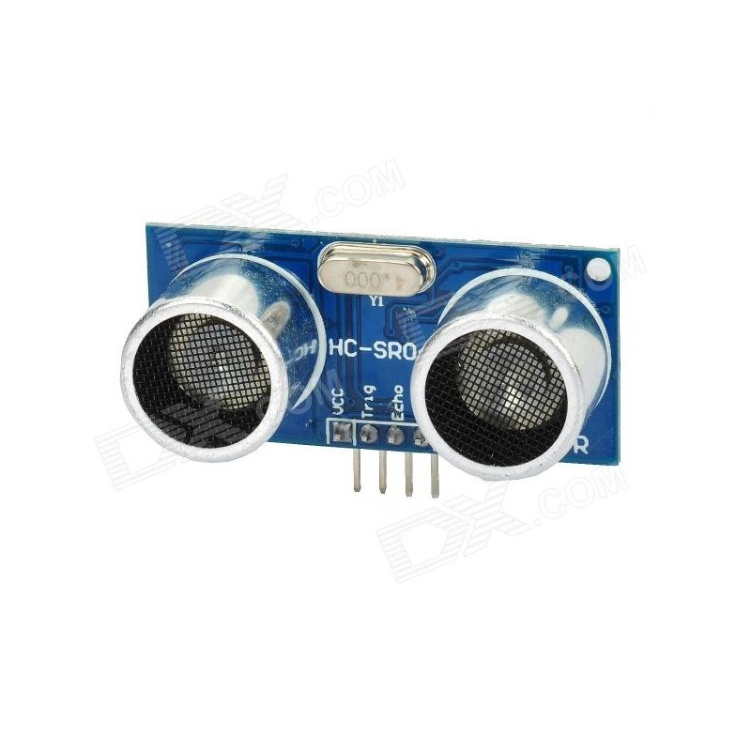
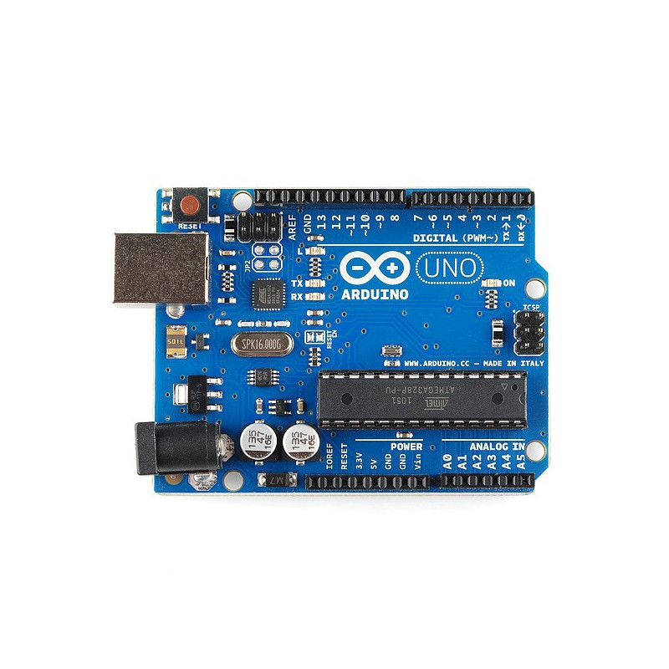
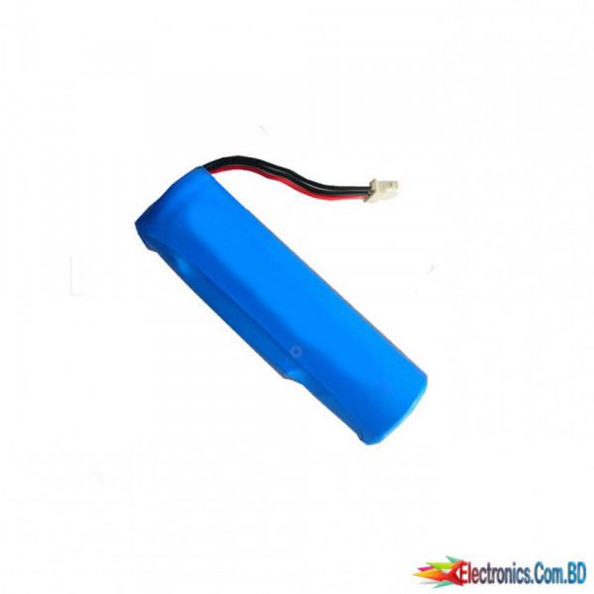
What do we need to make our project alive?
Geer Motor & Wheels
Ultrasonic Sensor
Arduino UNO
Lithium ion Battery

Slide 6
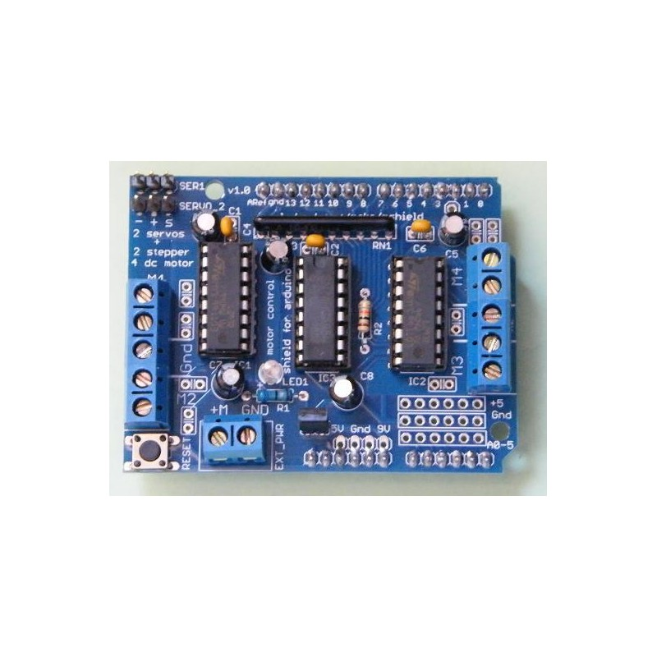
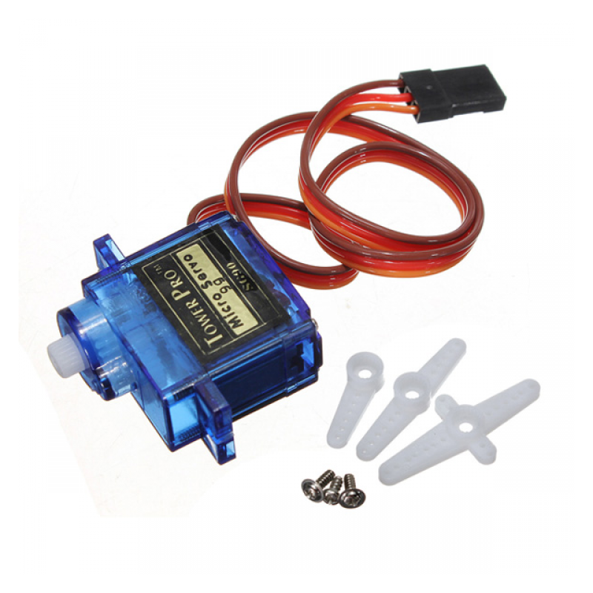
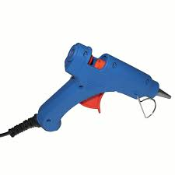
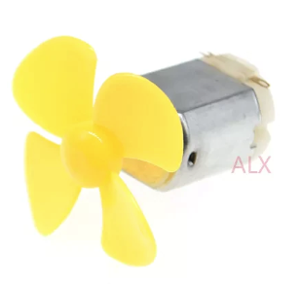
What do we need to make our project alive?
Arduino Motor Shield
Servo Motor
Glue Gun and Glue sticks
6 v motor and fan

Slide 7
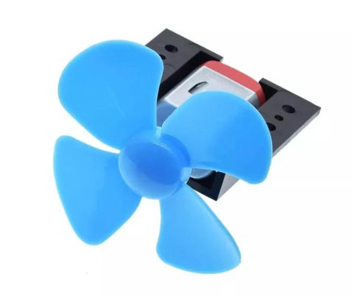

How the machine works?
Low pressure Area
1. Suction
Dirt debris
High pressure Area
Suction tube

Slide 8
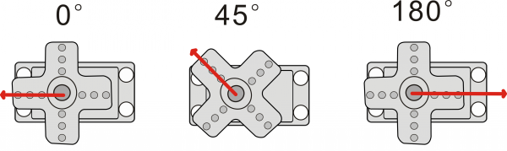
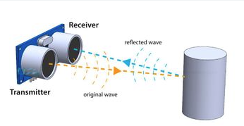
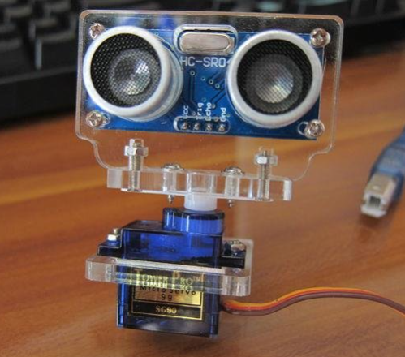
How the machine works?
2. Sensors
Servo motor rotation
Ultrasonic sensor
Combining the power of servo motor with ultra sonic sensor

Slide 9
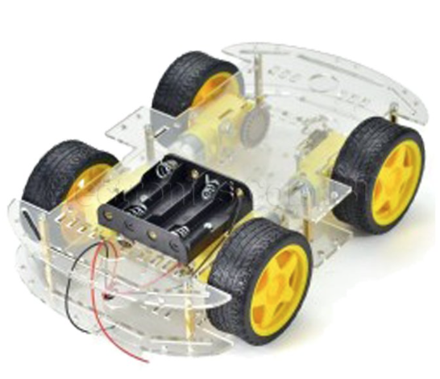
How the machine works?
3. Motors & Wheels
Allowing the robot to move easily without any distractions

Slide 10
What is the cost?
Components | Quantity | Price(BDT)
1. Gear motor & wheels | 4 | 130x4 = 520
2. Arduino UNO | 1 | 1050
3. Lithium ion battery | 2 | 93x2 = 186
4. Arduino motor shield | 1 | 210
5. Servo motor | 1 | 100
6. Ultrasonic sensor | 1 | 95
7. 6v motor & Propeller | 1 | 200
8. Glue gun & glue sticks | 1 | 195
9. DPDT switch | 1 | 25
Total |  | 2581

Slide 11
Final Summary
As remaining cleaned is an important part of hygiene, there is a gap where we always can’t take a look at our floor and unable to keep it clean all the time. This vacuum cleaner can be a great thing to cover up that gap. So we all should have vacuum cleaner in our household.

Slide 12
THANK YOU!!

