Slide 1

From BigDog to BigDawg Transitioning an HPC Cluster for Sustainability

Slide 2
Topic: From BigDog to BigDawg Transitioning an HPC Cluster for Sustainability
CSE 449
Name: Sheikh Yasir Hossain Katib
ID: 20301013
Section: 01
Course Instructor: Annajiat Alim Rasel

Slide 3

Introduction
Welcome to the presentation on Transitioning an HPC Cluster for Sustainability: Unleashing the Potential from BigDog to BigDawg. This presentation will explore the strategies and beneﬁts of transitioning to a more sustainable high-performance computing (HPC) cluster. We will discuss to improve cluster administration and performance, OpenHPC, SLURM, and Dell hardware were adopted throughout this shift.

Slide 4


Understanding HPC Clusters
HPC clusters are powerhouses of computing, enabling high-speed processing of complex scientific and engineering problems. These clusters consist of multiple interconnected computers working together to solve computationally intensive tasks. However, traditional HPC clusters often consume significant energy and have environmental impacts. It is crucial to explore sustainable approaches to minimize the ecological footprint of these systems

Slide 5

The Need for Sustainability
As the demand for computational resources continues to grow, it is essential to address the sustainability challenges of HPC clusters. High energy consumption, carbon emissions, and waste generation pose signiﬁcant concerns. Transitioning to a more sustainable model can lead to reduced operational costs, improved energy efﬁciency, and a smaller carbon footprint. It also aligns with the global efforts towards a greener future.

Slide 6


Beneﬁts of Transitioning
Cost Savings through Reduced Energy Consumption
Improved Resource Utilization
Higher Performance per Watt
Enhanced Institution Reputation
Attraction of Research Collaborations
Contribution to a Cleaner Environment

Slide 7

Strategies for Transition
Hardware Upgrades for Energy Efficiency
Implementation of Power Management Techniques
Optimization of Workload Scheduling Algorithms
Adoption of Renewable Energy Sources
Promotion of Green Computing Practices
These strategies collectively contribute to achieving sustainability goals while ensuring high-performance computing capabilities

Slide 8

Case Study: BigDog to BigDawg
Let's explore a real-world case study of transitioning an HPC cluster from BigDog to BigDawg. This project involved upgrading hardware components, implementing energy- efﬁcient cooling systems, optimizing job scheduling algorithms, and integrating renewable energy sources. The successful transition resulted in substantial energy savings, improved performance, and reduced environmental impact.

Slide 9
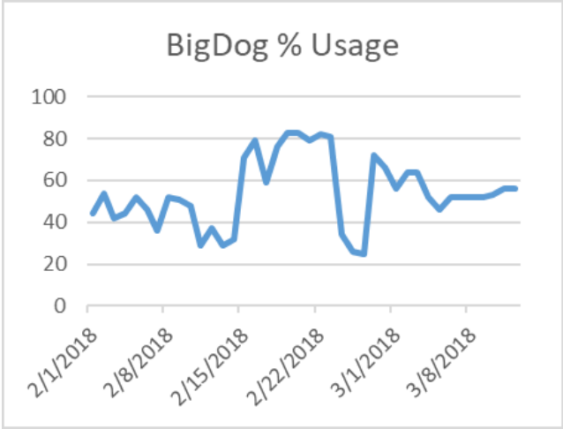
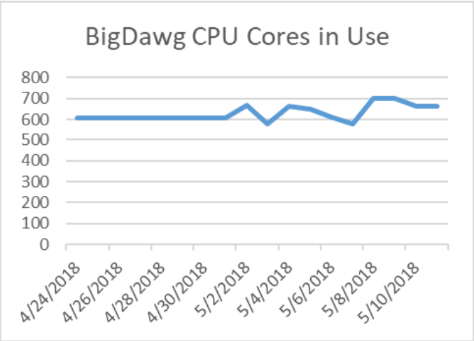

Slide 10

Challenges and Mitigation
Challenges:
Initial Investment Costs
Compatibility Issues with Legacy Software
Resistance to Change
Mitigation Strategies:
Careful Planning
Stakeholder Engagement
Leveraging Available Funding Opportunities
Highlighting Long-term Benefits of Sustainability

Slide 11
Future Plans
In the future, the paper outlines the replacement of old compute nodes and software updates to keep the cluster technologically current and sustainable. It emphasizes a cost-effective approach, green computing practices, optimizing GPU usage, expanding user training, and ensuring the cluster remains aligned with evolving research needs. These plans reflect a commitment to long-term cluster viability and enhanced support for the research community.

Slide 12
Conclusion
Transitioning an HPC cluster for sustainability is a vital step towards a greener and more efﬁcient future. By embracing energy-efﬁcient technologies, optimizing resource utilization, and adopting sustainable practices, organizations can unlock the full potential of their HPC clusters while reducing environmental impact. Let's work together to unleash the power of BigDawg and create a more sustainable computing ecosystem.The transfer integrated GPU resources for Deep Learning smoothly, after some initial issues with software administration. Because of the smooth transfer made feasible by the dual-cluster approach, which also fulfilled the overall schedule, researcher usability increased and the cluster was raised to XSEDE Level 3.

Slide 13
Thank You!

