Slide 1
A Survey On Cloud-Based Distributed Computing System Frameworks

Slide 2
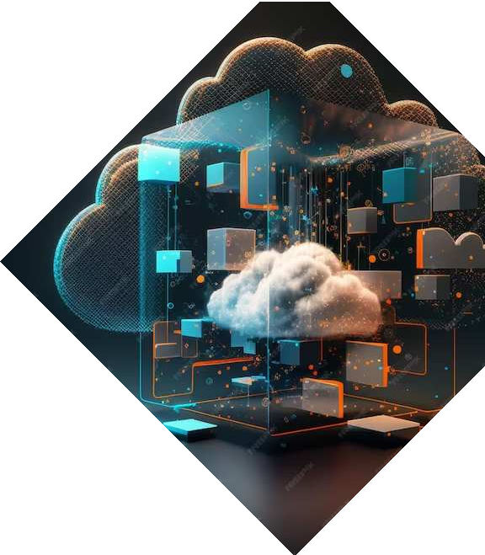
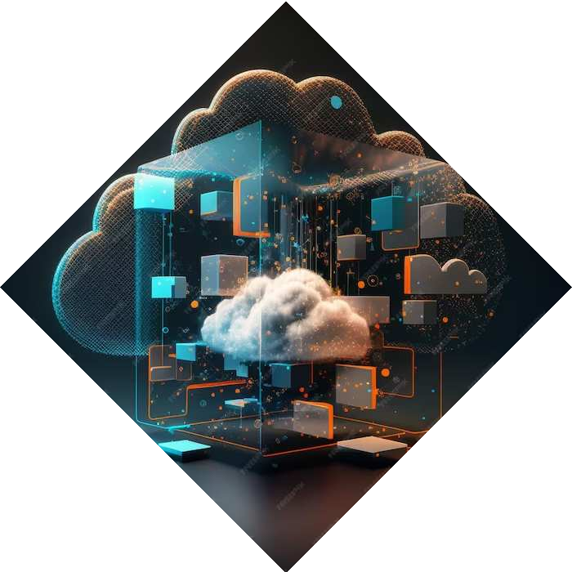
CSE449
Name: Sheikh Yasir Hossain
ID: 20301013
Section: 01
Course Instructor: Annajiat Alim Rasel

Slide 3
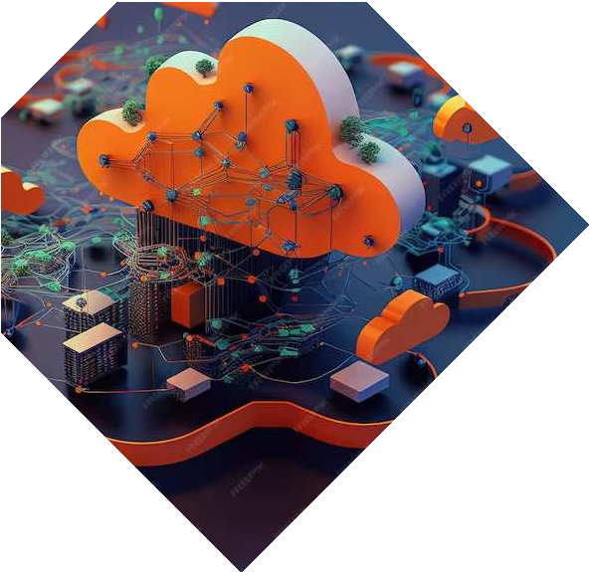

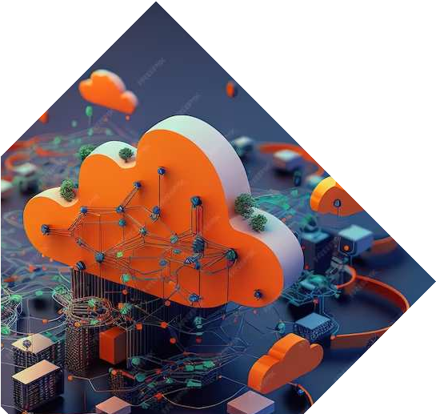
Introduction
This presentation provides a comprehensive survey of
We will explore the key concepts, challenges, and current trends in this rapidly evolving field. Here as we delve into the intricate world of distributed computing.
.

Slide 4
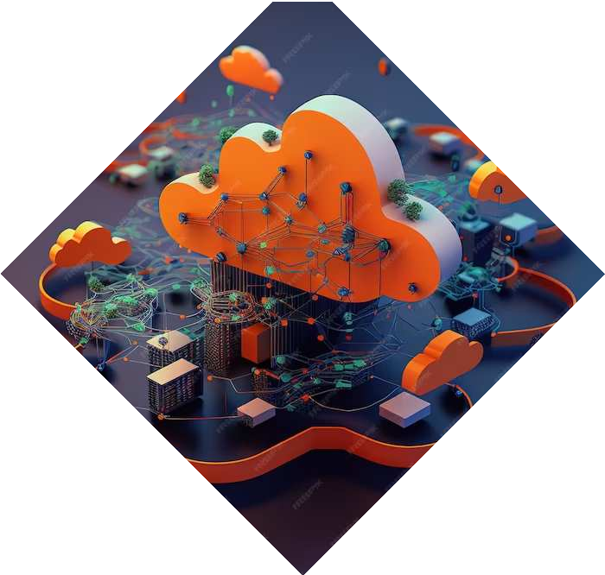
Cloud Computing Fundamentals
Understanding the foundations of cloud computing is crucial for comprehending distributed computing frameworks. This slide will cover the essential components and characteristics of cloud computing, including scalability, elasticity, and resource pooling.

Slide 5
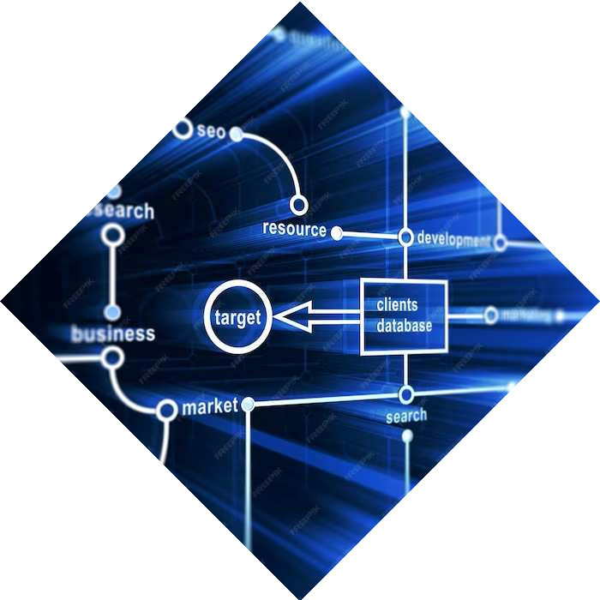
Distributed Computing
Frameworks
Explore the diverse range of
distributed computing frameworks, from Apache Hadoop to Spark and
beyond. We will delve into the unique features, advantages, and use cases of each framework, shedding light on their role in modern computing
ecosystems

Slide 6
Advantages and Disadvantages of Distributing Computing
Advantages:
Scalability
Fault Tolerance
High Performance
Resource Utilization
Flexibility
Data Security
Disadvantages:
Complexity
Coordination Overhead
Data Management
Communication Delays
Cost
Security Challenges

Slide 7
Proposed Frameworks and Approaches
Frameworks for Distributed Computing in the Cloud:
Flint Framework
Portfolio-Driven Resource Management
Elasecutor
SplitServe
Zero-Copy Buffer Management for Spark
Approaches for Cost
Optimization:
Spot-Check Approach
D-Space4Cloud
Bricklayer Framework
OptiSpot Algorithm
Spotagres - Parallel Data Processing Engines (PDEs)

Slide 8
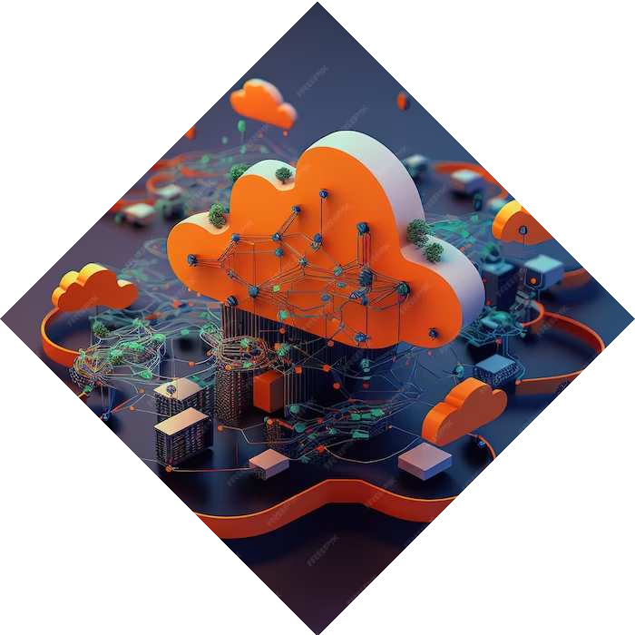
Challenges and Solutions
Challenges:
Resource Management Complexity
Data Processing Inaccuracy
Fault Tolerance in Distributed Systems
Solutions:
Dynamic Resource Allocation
Data Processing Optimization
Fault-Tolerance Mechanisms

Slide 9

Current Trends and Future Outlook
Stay ahead of the curve with insights into the latest trends shaping cloud- based distributed computing. From edge computing to serverless architectures, we will examine the cutting-edge developments and offer a glimpse into the future of distributed computing.

Slide 10
Conclusion
As we conclude this survey, it is evident that cloud-based distributed computing system frameworks play a pivotal role in modern IT infrastructures. Embracing the complexities and harnessing the potential of these frameworks is crucial for organizations striving for innovation and efficiency.

Slide 11
Thanks!

